Slide 1
Fetal membranes
Fetal membrane
Chorion
Amnion
Yolk sac
Allantois
Umbilical cord

Slide 2
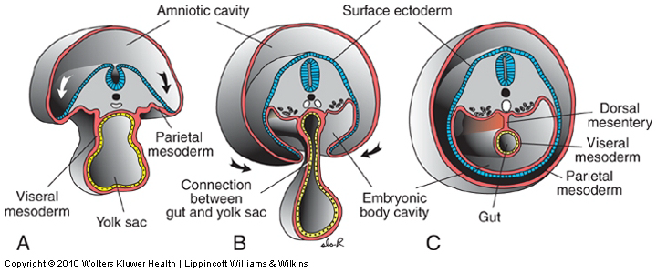
Yolk sac：it is a membranous sac attached to the embryo, convey nourishment to the embryo (e.g. in birds), in humans, Incorporate into the endoderm of embryo as a primordial gut and the primordial germ cells appear in the endodermal lining of the wall of the yolk sac in the 3rd week

Slide 3
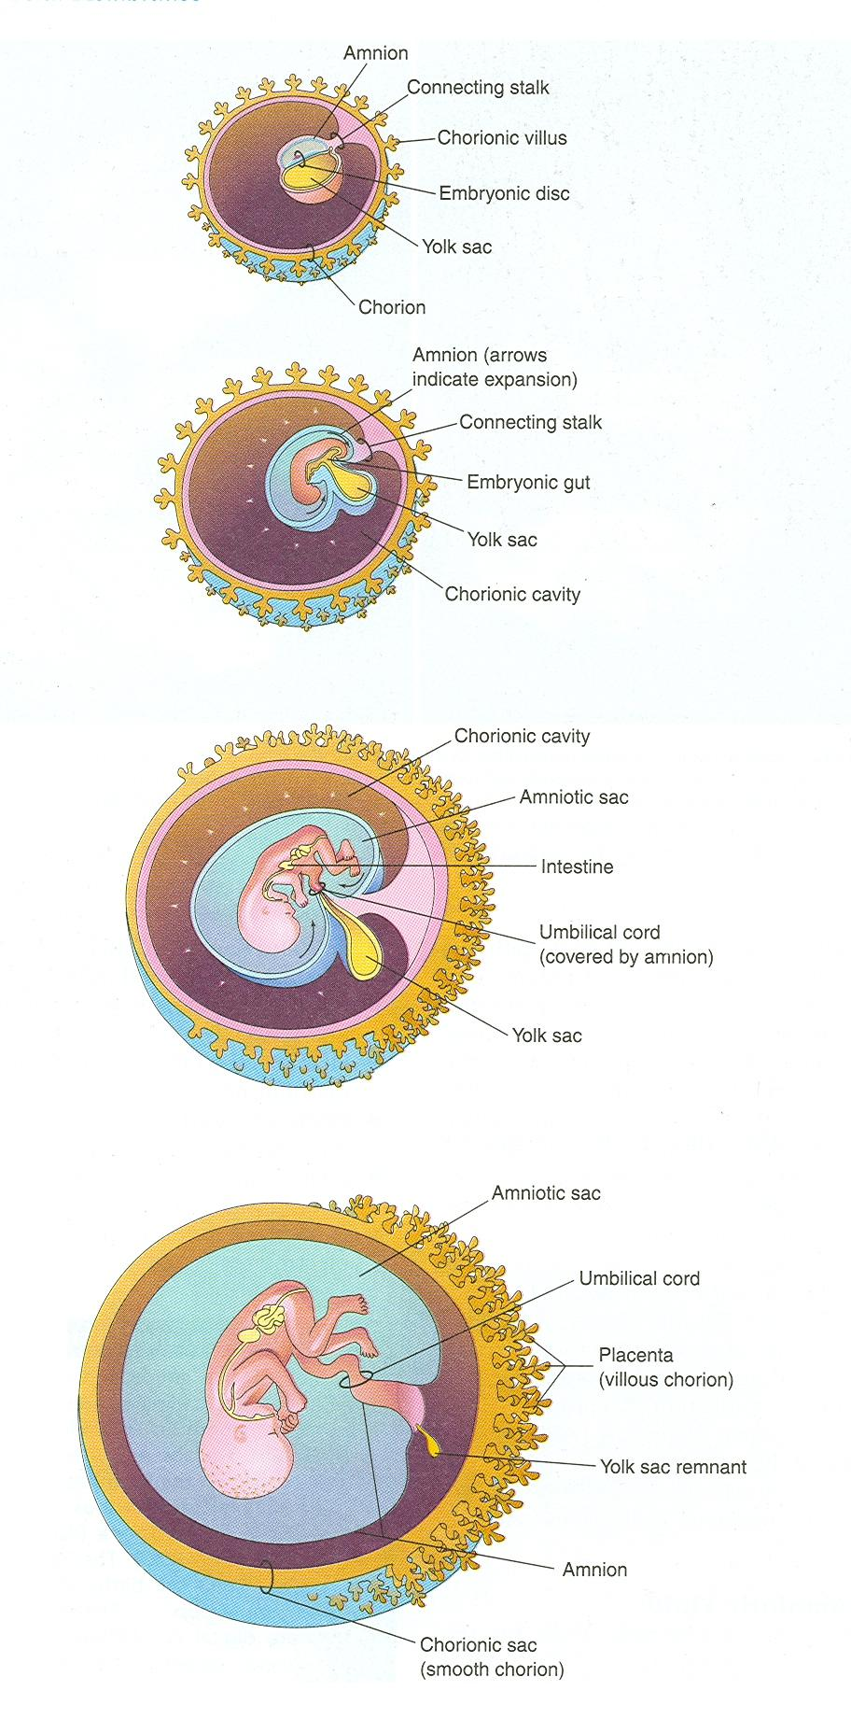
It is large at 32 days (at early development)
by 10th week, regresses to 0.5 cm as a remnant structure which is connected to the midgut by a narrow yolk stalk
at 20 weeks becomes very small, usually not visible thereafter.

Slide 4
Abnormalities:
Sometimes it persists throughout the pregnancy but of no significance
In about 2% of adults the proximal intra-abdominal part of yolk stalk persists as an ileal diverticulum or Meckel diverticulum
① Meckel’s diverticulum
② Umbilical fistula

Slide 5
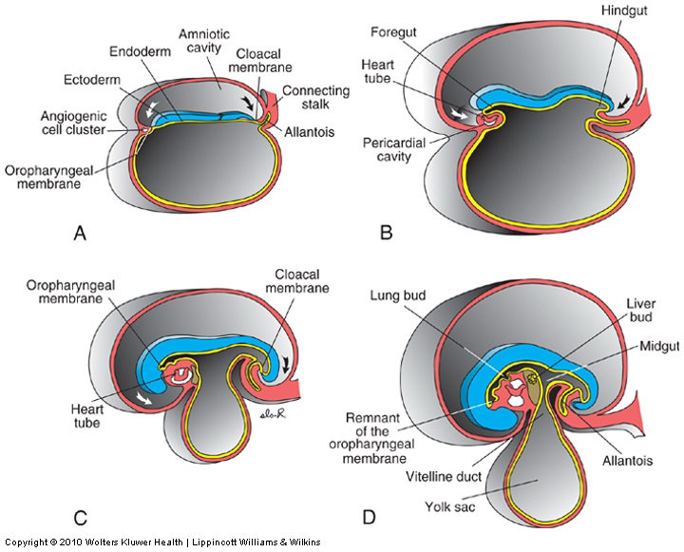
allantois, an extra-embryonic membrane of reptiles, birds, and mammals arising as a pouch, or sac, from the hindgut
In the 3rd week it appears as a tubular diverticulum from the caudal wall of yolk sac that extends into the connecting stalk
During the 2nd month, the extraembryonic part of the allantois degenerates

Slide 6
Functions of Allantois
Blood formation occurs in the wall during the 3rd to 5th week
Its blood vessels persist as the umbilical vein and arteries
Becomes Urachus and after birth is transformed into
median umbilical ligament
extends from the apex of the bladder to the umbilicus

Slide 7
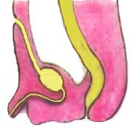
Abnormality:
Urachal fistula

Slide 8
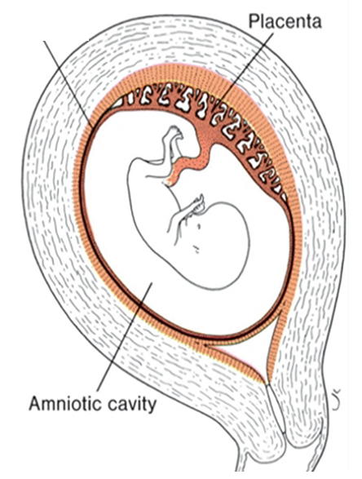
Amniotic Fluid
The amniotic cavity is filled with a clear, watery fluid is produced in part by amniotic cells but is derived primarily from maternal blood
The amount of fluid increases from approximately 30 ml at 10 weeks of gestation to 450 ml at 20 weeks to 800 to 1000 ml at 37 weeks
serves as a protective cushion. The fluid
1- prevents adherence of the embryo to the amnion
2-allows for fetal movements
The volume of amniotic fluid is replaced every 3 hours
From the beginning of the fifth month, the fetus swallows its own amniotic fluid and it is estimated that it drinks about 400 ml a day, about half of the total amount
Fetal urine is added daily to the amniotic fluid in the fifth month but this urine is mostly water, since the placenta is functioning as an exchange for metabolic wastes

Slide 9
During childbirth, the amnio-chorionic membrane forms
a hydrostatic wedge that helps to dilate the cervical canal.

Slide 10
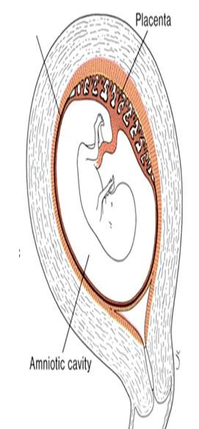
1-Hydramnios or polyhydramnios is the term used to describe an excess of amniotic
fluid (1500–2000 ml)
Primary causes of hydramnios include idiopathic causes (35%)
maternal diabetes (25%)
congenital malformations
including central nervous system disorders (e.g., anencephaly) and
Gastrointestinal defects
(atresias, e.g., esophageal)
that prevent the infant from swallowing the fluid
2-Oligohydramnios refers to a decreased
amount (less than 400 ml)
Oligohydramnios is a rare occurrence that may result from renal agenesis
Premature rupture of the amnion,
the most common cause of preterm labor
occurs in 10% of pregnancies

Slide 11
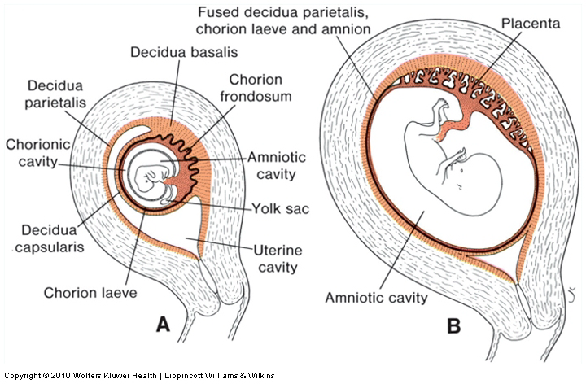
With growth of the
chorionic vesicle
the decidua capsularis becomes stretched and degenerates
Subsequently
the chorion laeve comes into contact with the uterine wall (decidua parietalis) on the opposite side of the uterus and the two fuse obliterating
the uterine lumen.
Similarly, fusion of the amnion and chorion
to form the amniochorionic membrane obliterates the chorionic cavity
It is this membrane that ruptures during labor
(breaking of the water).

Slide 12
Umbilical cord

Slide 13
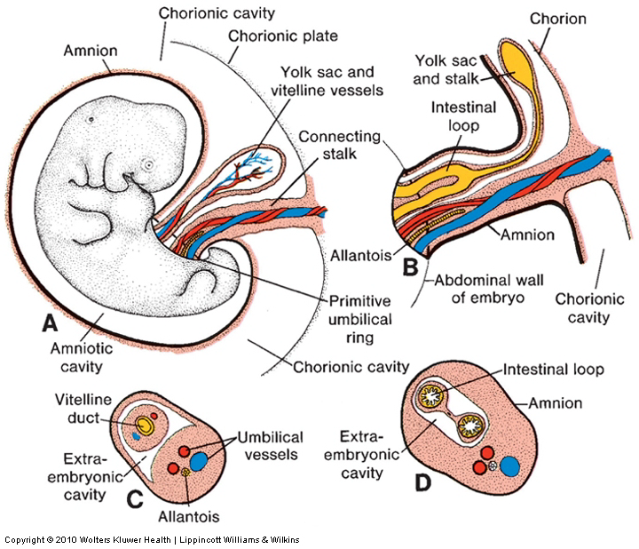
At the fifth week
of development, the following structures pass through the primitive umbilical ring
(1) The connecting stalk, containing the allantois and the umbilical vessels, consisting of two arteries and one vein
(2) The yolk stalk (vitelline duct), accompanied by the vitelline vessels
(3) The canal connecting the intraembryonic and extraembryonic cavities

Slide 14
During further development,
the amniotic cavity enlarges rapidly at the expense of
the chorionic cavity
As a result the amnion begins to envelop
the connecting and yolk sac stalks, crowding them together
and giving rise to
the primitive umbilical cord

Slide 15
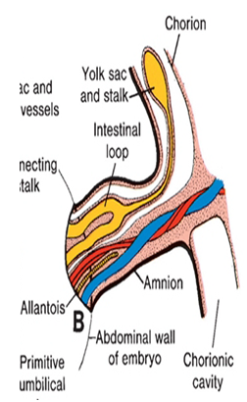
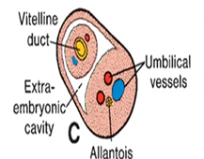
The abdominal cavity is temporarily too small for the rapidly developing
intestinal loops and some of them are pushed into the extraembryonic space
in the umbilical cord. These extruding intestinal loops form a physiological umbilical hernia
At approximately the end of the third month
the loops are withdrawn into the body of the embryo and the cavity in the cord is obliterated.
When the allantois and the vitelline duct and
its vessels are also obliterated, all that remains in the cord are the umbilical vessels surrounded by the jelly of Wharton.

Slide 16
Summary of the Umbilical cord：
Covered with amniotic membrane
Contains
1umbilical vein
2 umbilical arteries
degenerated yolk sac and allantois
connects fetus with placenta
Length 50 cm
Abnormality: ＞80 cm (long), An extremely long cord may encircle the neck of the fetus, usually without increased risk
＜35 cm (short) may cause difficulties during delivery
by pulling the placenta from its attachment in the
uterus

Slide 17
Umbilical vessels are longer than the cord, so twisting and bending of the vessels are common
They frequently form loops, producing false knots, that are of no significance
In about 1% of pregnancies, true knots form in the cord and cause fetal death

