Slide 1
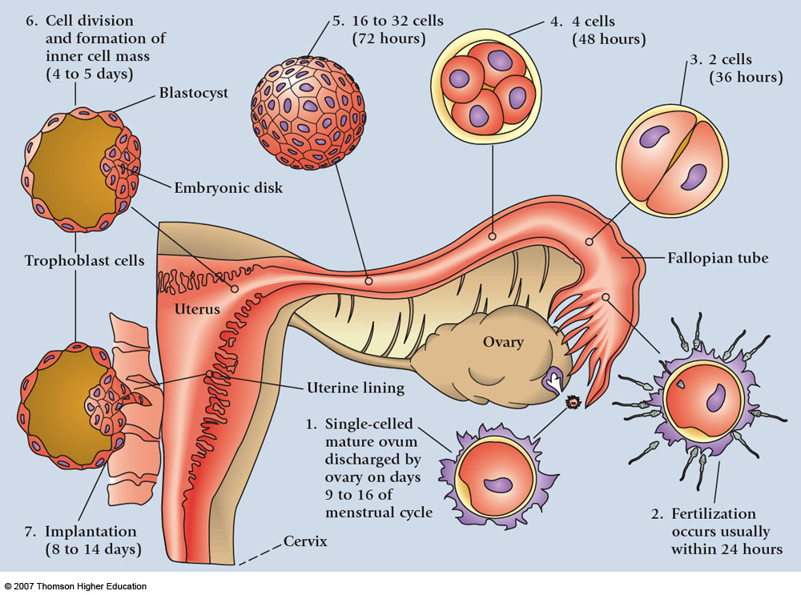

Slide 2
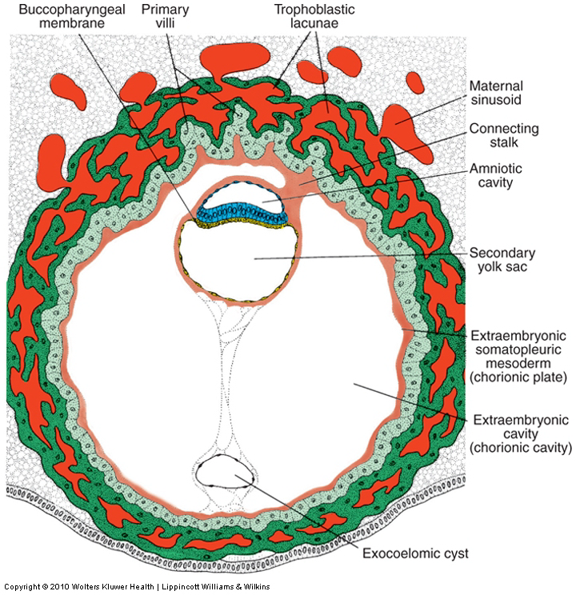
The extraembryonic mesoderm lining the inside of the cytotrophoblast is then known as
THE CHORIONIC PLATE
The only place where extraembryonic mesoderm traverses the chorionic cavity is in
THE CONNECTING STALK
With development of blood vessels, the stalk becomes THE UMBILICAL CORD

Slide 3
THIRD WEEK
OF DEVELOPMENT

Slide 4
It is not birth, marriage or death, but gastrulation,
which is truly the most important time in your life
Lewis Wolpert (1986)

Slide 6
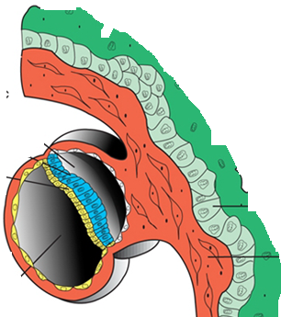
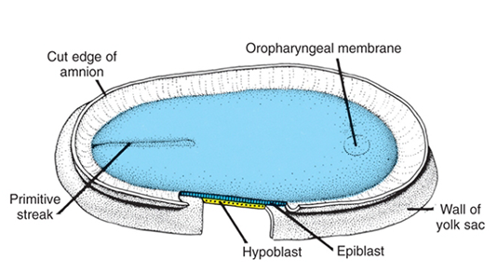
When viewed from above, through the amniotic cavity, the epiblast appears as an oval disc

Slide 7
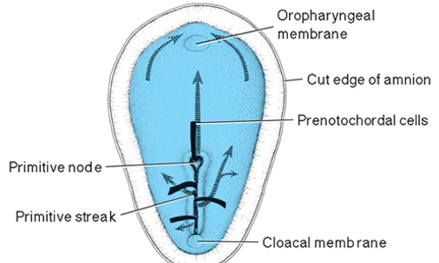
The BUCCOPHARYNGEAL MEMBRANE marks the future mouth which is situated in the midline at the cranial end
The CLOACAL MEMBRANE marks the future anus which is situated in the midline at caudal end.

Slide 8
The cells of the EPIBLAST are capable of
proliferation and migration
These two features of the epiblast will lead to:
The cells of the epiblast start to proliferate forming
a swilling called PRIMITIVE NODE

Slide 9
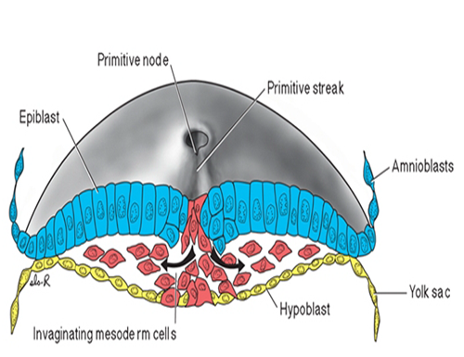
As the primitive node elongates THE PRIMITIVE STREAK appears
Cells of the epiblast migrate toward the primitive streak .
The cells of the primitive streak ingress in the epiblast making a pore in the middle
Upon arrival in the region of the streak, they detach from the epiblast, and slip beneath it.
This inward movement is known as invagination.

Slide 10
Once the cells have invaginated, some displace the hypoblast, creating the embryonic ENDODERM
Other cells come to lie between the epiblast and newly created endoderm to form MESODERM
Cells remaining in the epiblast then form ECTODERM.
Thus, THE EPIBLAST, through the process of gastrulation,
is the source of all of the germ layers.
cells in these layers will give rise to all of the tissues and organs in the embryo.

Slide 11
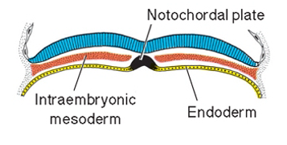
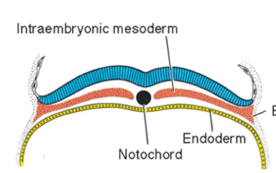
A swelling appears on the upper surface of the hypoblast called
NOTOCHORD
Because of the presence of the notochord in the middle of the trilaminar disc ,
the migrating cells from the epiblast will fill only the paraxial region
(the area around
the axis)

Slide 12
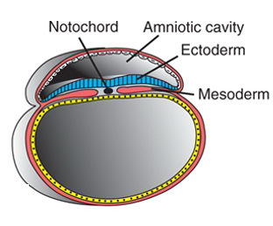
The most characteristic event occurring during the third week of gestation
is
GASTRULATION, the process that establishes all three germ layers in the embryo
ENDODERM
1-ECTODERM
2-MESODERM
3-ENDODERM

Slide 13
Derivatives of the ectodermal
germ layer

Slide 14
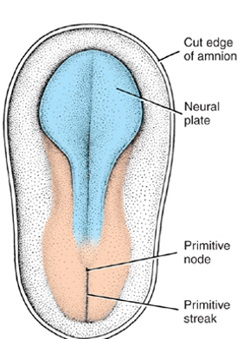
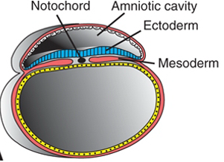
Development of the neural tube
At the middle of the epiblast another swelling called
1- neural plate appears
The neural plate replaces the receding primitive streak and closes the pore formed before

Slide 15
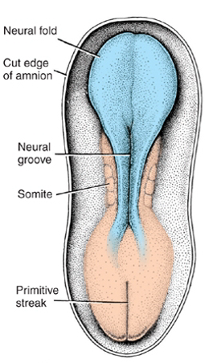
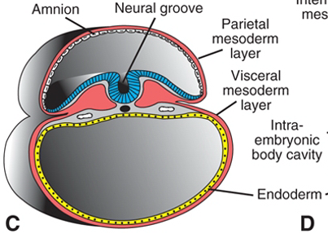
2-Neural groove

Slide 16
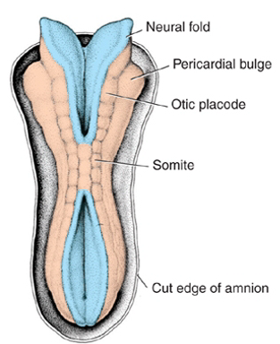
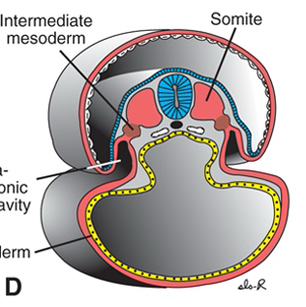
3-Neural tube

Slide 17
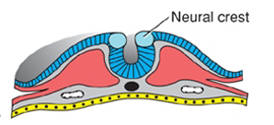
Parts of the neural tube
1-neural crest
2-alar plate
3-basal plate
alar plate
basal plate

Slide 18
The nervous system is formed from the ectoderm
(the neural tube)
The neural crest gives rise to the ganglia
The alar plate gives rise to the sensory part of the nervous system
The basal plate gives rise to the motor part of the nervous system

Slide 19
Neural Crest Derivatives
1-Connective tissue and bones of the face and skull
2-Cranial nerve ganglia
3-C cells of the thyroid gland
4-Conotruncal septum in the heart
5-Odontoblasts
6-Dermis in face and neck
7-Spinal (dorsal root) ganglia
8-Sympathetic chain and preaortic ganglia
9-Parasympathetic ganglia of the gastrointestinal tract
10-Adrenal medulla
11-Schwann cells
12-Glial cells
13-Arachnoid and pia mater (leptomeninges)
14-Melanocytes

Slide 20
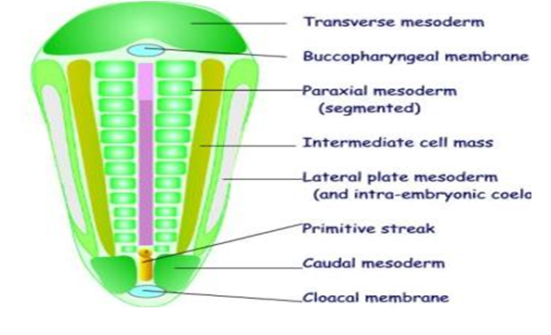
The notochord
gives rise to the
Nucleus pulpous
Of the intervertebral disk

Slide 21
MAJOR EVENTS OF THE SECOND WEEK OF DEVELOPMENT
A-Completion of implantation of the blastocyst
B-Production of a bilaminar embryonic disc
C-FORMATION OF EXTRAEMBRYONIC STRUCTURES:
1-AMNIOTIC CAVITY
2-AMNION
3-YOLK SAC
4-CHORIONIC SAC
5- CONNECTING STALK
D-APPEARANCE OF PRIMARY CHORIONIC VILLI
E-APPEARANCE OF THE PRECHORDAL PLATE

Slide 22
MAJOR EVENTS OF THE THIRD WEEK
Development of
THE PRIMITIVE STREAK
Development of
THE NOTOCHORD
Formation of
THE TRILAMINAR GERM DISC
Beginning of formation
OF NEURAL TUBE

