Slide 1
ECG Interpretation
Fatima Ryalat, MD
Research and Teaching Assistant
Physiology Department

Slide 2
We diagnose PATIENTS not ECG
Always stick to your own methodology analyzing ECG so as not to miss anything.

Slide 3
Methodology Check for: ID, date, time Rhythm Rate Axis Waves, intervals, segments

Slide 4
Normal ECG

Slide 5
Normal Sinus Rhythm: Regular R-R intervals ( card method). every QRS complex is preceded by a P wave. Normal P-R intervals

Slide 6
Heart Rate If the heart rate is regular (equal distances between Rs) : HR= 300/ no. Of large squares within R-R interval or HR= 1500/ no. Of small squares within R-R interval

Slide 7
Normal Heart Rate 60- 100 bpm if < 60 : sinus Bradycardia if >100 :sinus Tachycardia

Slide 8
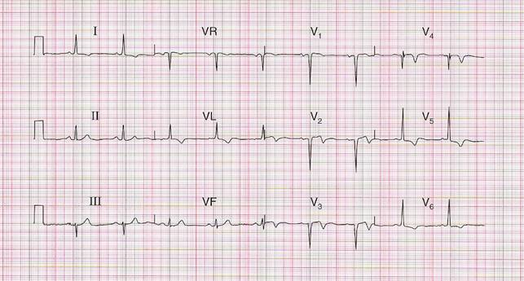
Normal Axis

Slide 9
Normal Axis We look at limb leads only. if leads (I and II) +ve, then normal cardiac axis. RULE OF THUMBS

Slide 10
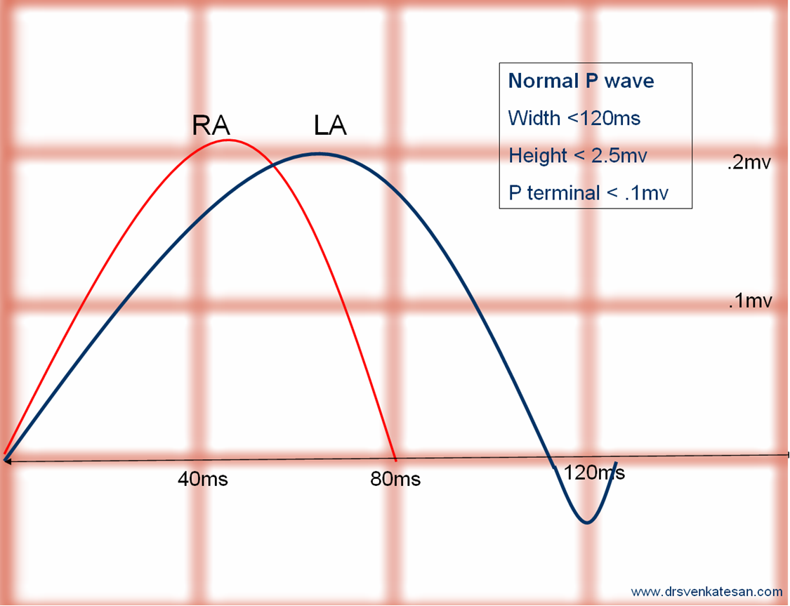
Normal P wave

Slide 11
Normal P-R interval 3- 5 ss (120- 200 ms) Normal QRS complex <3 ss (120 ms)

Slide 12
Normal QT interval QT c= QT /sq root (R-R) <=0.44 s or < 50% of R-R interval

Slide 13
Normal ST segment isoelectric ( in comparison to the T –P segment) T wave Normally inverted in aVR ,V1, v2 +/- v3, III.

Slide 14
Abnormalities in ECG

Slide 15
How to calculate Heart Rate in irregular rhythm? Count the Rs in 30 large squares then multiply by 10

Slide 16
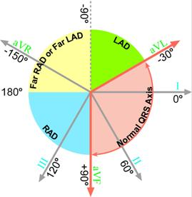
Axis deviation

Slide 17
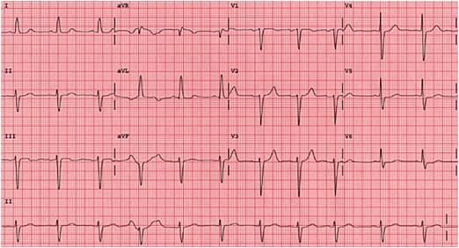
LAD

Slide 18
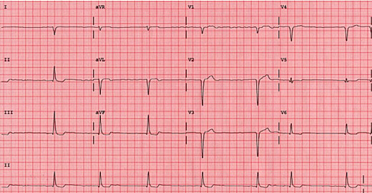
RAD

Slide 19
P wave
Present
Normal Morphology
Abnormal Morphology
Abscent

Slide 20
P wave

Slide 21
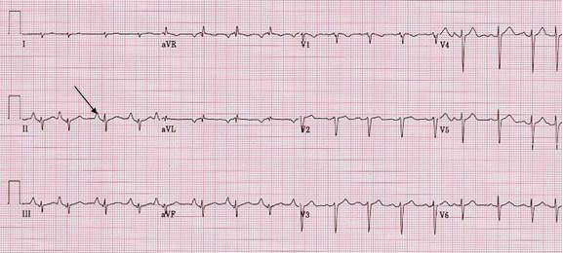
P Pulmonale Peaked P wave in RA hypertrophy

Slide 22
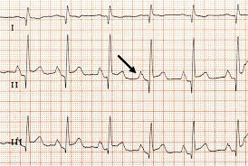
P Mitrale Bifid P wave in LA hypertrophy

Slide 23
P-R INTERVAL
Normal
120 – 200 ms ( 3-5 ss)
Prolonged
Shortened
< 3 ss
WPW
> 5 ss
Heart Block

Slide 24
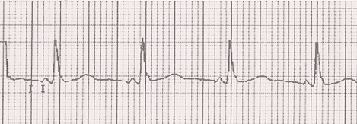

Slide 25
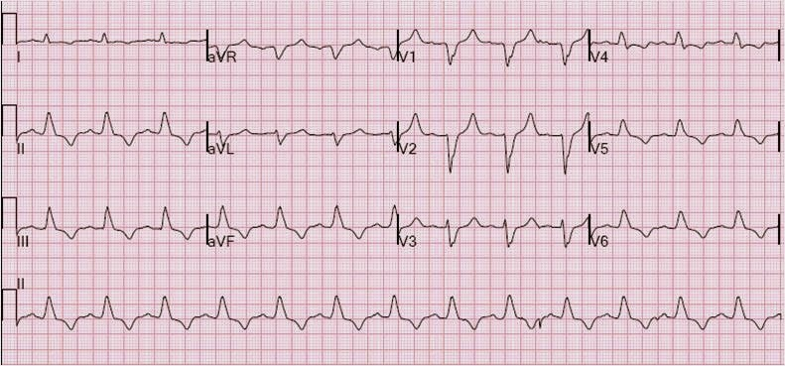
wide QRS( >3 ss) = ventricular abnormality

Slide 26
ST segment
Iso electric
(normal)
Elevated
(MI or Pericarditis)
Depressed
(Ischemia)

Slide 28
NL T wave
Inverted
Hyper acute
(MI)
Peaked
(hyperkalemia)
Flat
(hypokalemia)

Slide 29
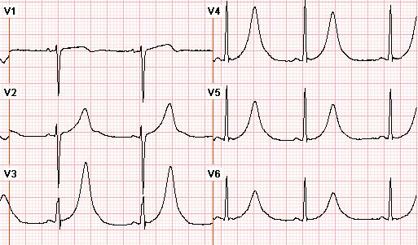

Slide 30
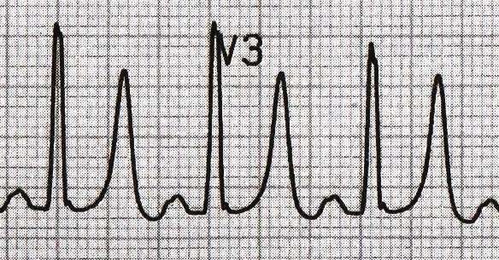

Slide 31
Abnormal Rhythm

Slide 32
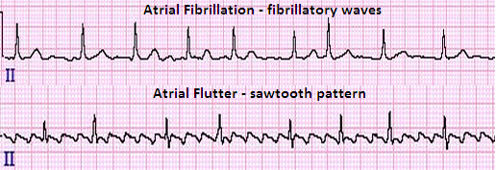
Atrial Rhythm

Slide 33
Ventricular Rhythm Ventricular Tachycardia and Ventricular Fibrillation

Slide 34
Atrioventricular Rhythms (Conduction Blocks) Heart Block( 3 degrees) Bundle Branch Block

Slide 35
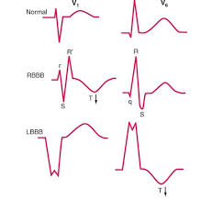
LBBB

Slide 36
RBBB

Slide 37
GOOD LUCK

