Slide 1
The second week

Slide 2
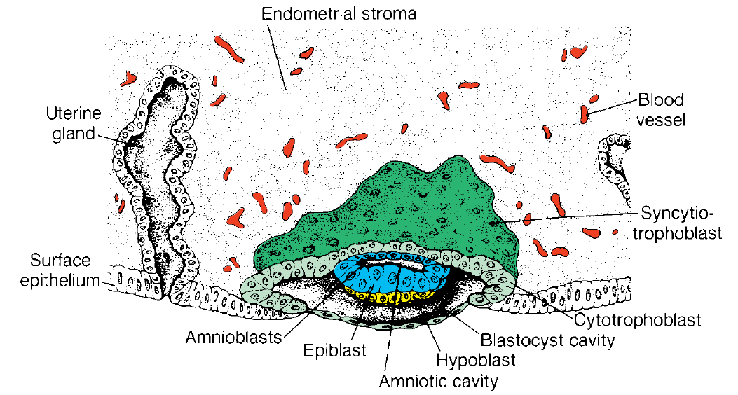
Day 8
At the eighth day of development, the blastocyst is partially embedded in the endometrial stroma.
In the area over the embryoblast, the trophoblast has differentiated into two layers:
(a) an inner layer of mononucleated cells, the cytotrophoblast,
(b) an outer multinucleated zone without distinct cell boundaries, the syncytiotrophoblast
Mitotic figures are found in the cytotrophoblast but not in the syncytiotrophoblast.
Thus, cells in the cytotrophoblast divide and migrate into the syncytiotrophoblast, where they fuse and lose their individual cell membranes.

Slide 3
Cells of the inner cell mass or embryoblast also differentiate into two layers:
a) a layer of small cuboidal cells adjacent to the blastocyst cavity, known as the hypoblast layer,
(b) a layer of high columnar cells adjacent to the amniotic cavity, the epiblast layer
Together, the layers form a flat disc.
At the same time, a small cavity appears within the epiblast. This cavity enlarges to become the amniotic cavity.
Epiblast cells adjacent to the cytotrophoblast are called amnioblasts; together with the rest of the epiblast, they line the amniotic cavity
The endometrial stroma adjacent to the implantation site is edematous and highly vascular. The large, tortuous glands secrete abundant glycogen and mucus.

Slide 4
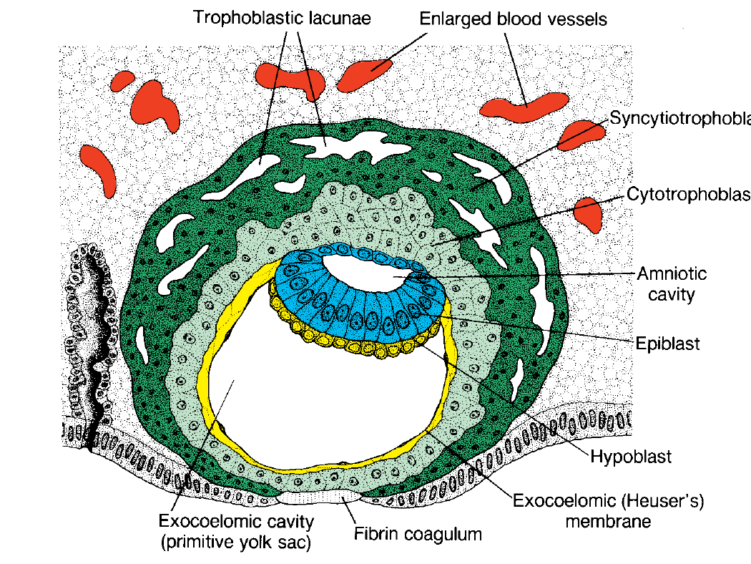
Day 9
The blastocyst is more deeply embedded in the endometrium, and the penetration defect in the surface epithelium is closed by a fibrin coagulum
The trophoblast shows considerable progress in development, particularly at the embryonic pole, where vacuoles appear in the syncytium.
When these vacuoles fuse, they form large lacunae, and this phase of trophoblast development is thus known as the lacunar stage
At the abembryonic pole, meanwhile, flattened cells probably originating from the hypoblast form a thin membrane, the exocoelomic (Heuser’s) membrane, that lines the inner surface of the cytotrophoblast
This membrane, together with the hypoblast, forms the lining of the exocoelomic cavity, or primitive yolk sac.

Slide 5
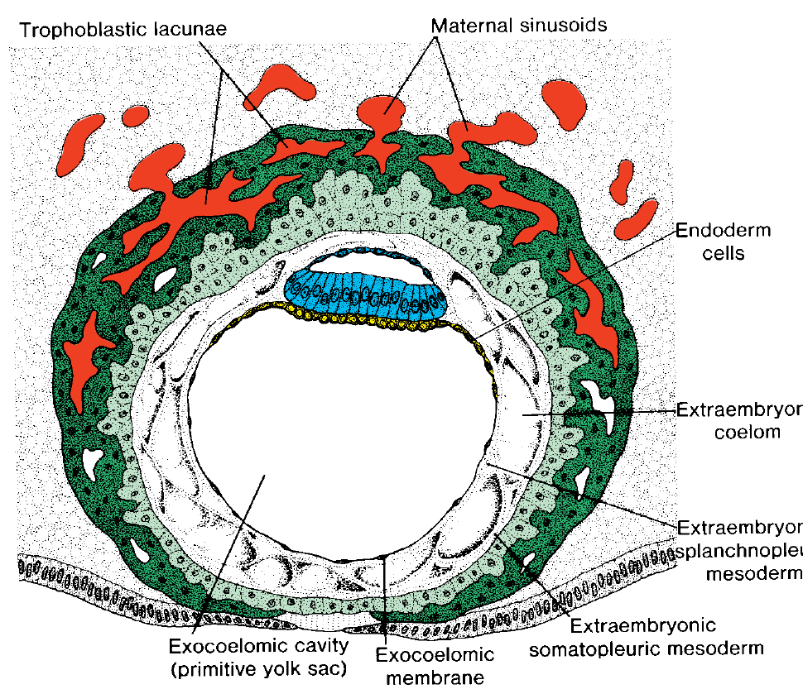
Days 11 and 12
By the 11th to 12th day of development, the blastocyst is completely embedded in the endometrial stroma
and the surface epithelium almost entirely covers the original defect in the uterin wall
The blastocyst now produces a slight protrusion into the lumen of the uterus.
The trophoblast is characterized by lacunar spaces in the syncytium that form an intercommunicating network.
This network is particularly evident at the embryonic pole; at the abembryonic pole, the trophoblast still consists mainly of cytotrophoblastic cells

Slide 6
Concurrently, cells of the syncytiotrophoblast penetrate deeper into the stroma and erode the endothelial lining of the maternal capillaries.
These capillaries, which are congested and dilated, are known as sinusoids.
The syncytial lacunae become continuous with the sinusoids and maternal blood enters the lacunar system
As the trophoblast continues to erode more and more sinusoids, maternal blood begins to flow through the trophoblastic system, establishing the uteroplacental circulation.

Slide 7
In the meantime, a new population of cells appears between the inner surface of the cytotrophoblast and the outer surface of the exocoelomic cavity.
These cells, derived from yolk sac cells, form a fine, loose connective tissue, the extraembryonic mesoderm, which eventually fills all of the space between the trophoblast externally and the amnion and exocoelomic membrane internally
Soon, large cavities develop in the extraembryonic mesoderm, and when these become confluent, they form a new space known as the extraembryonic coelom, or chorionic cavity
This space surrounds the primitive yolk sac and amniotic cavity except where the germ disc is connected to the trophoblast by the connecting stalk

Slide 8
The extraembryonic mesoderm lining the cytotrophoblast and amnion is called the extraembryonic somatopleuric mesoderm
the lining covering the yolk sac is known as the extraembryonic splanchnopleuric mesoderm
Growth of the bilaminar disc is relatively slowcompared with that of the trophoblast
the disc remains very small (0.1–0.2 mm).
Cells of the endometrium, meanwhile, become polyhedral and loaded with glycogen and lipids; intercellular spaces are filled with extravasate, and the tissue is edematous.
These changes, known as the decidua reaction, at first are confined to the area immediately surrounding the implantation site but soon occur throughout the endometrium.

Slide 9
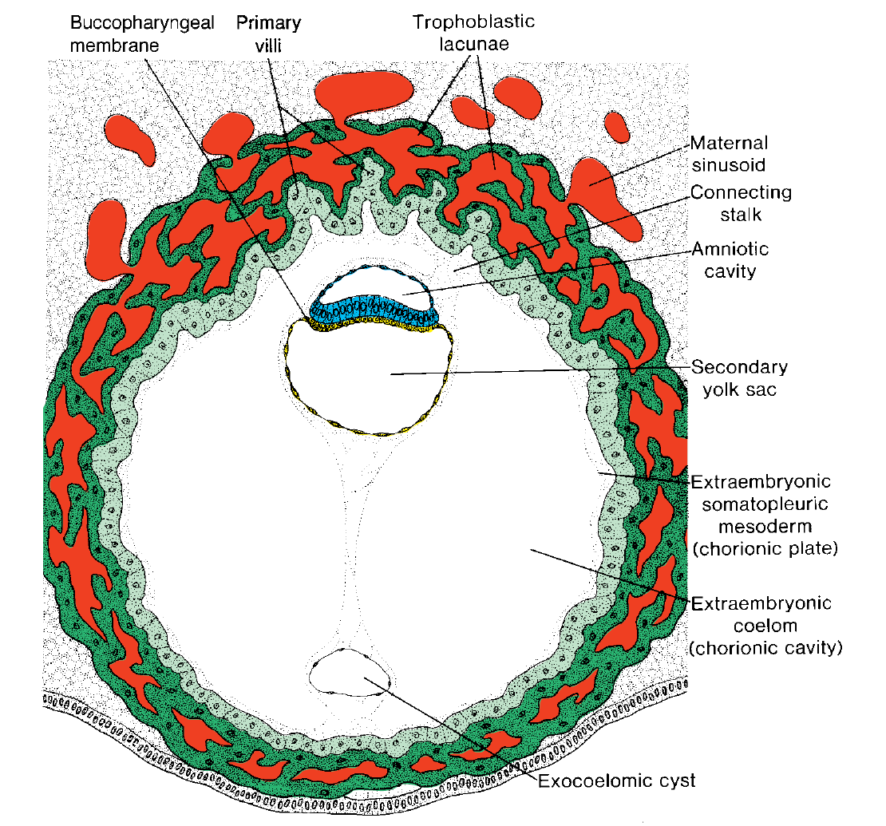
Day 13
By the 13th day of development, the surface defect in the endometrium has usually healed.
Occasionally, however, bleeding occurs at the implantation site as a result of increased blood flow into the lacunar spaces.
Because this bleeding occurs near the 28th day of the menstrual cycle, it may be confused with normal menstrual bleeding and, therefore, cause inaccuracy in determining the expected delivery date.
The trophoblast is characterized by villous structures.
Cells of the cytotrophoblast proliferate locally and penetrate into the syncytiotrophoblast, forming cellular columns surrounded by syncytium
Cellular columns with the syncytial covering are known as primary villi

Slide 10
In the meantime, the hypoblast produces additional cells that migrate along the inside of the exocoelomic membrane
These cells proliferate and gradually form a new cavity within the exocoelomic cavity.
This new cavity is known as the secondary yolk sac or definitive yolk sac
This yolk sac is much smaller than the original exocoelomic cavity, or primitive yolk sac
During its formation, large portions of the exocoelomic cavity are pinched off. These portions are represented by exocoelomic cysts, which are often found in the extraembryonic coelom or chorionic cavity

Slide 11
Meanwhile, the extraembryonic coelom expands and forms a large cavity, the chorionic cavity.
The extraembryonic mesoderm lining the inside of the cytotrophoblast is then known as the chorionic plate.
The only place where extraembryonic mesoderm traverses the chorionic cavity is in the connecting stalk
With development of blood vessels, the stalk becomes the umbilical cord.

Slide 12
pregnancy testing
The syncytiotrophoblast is responsible for hormone production including human chorionic gonadotropin (hCG).
By the end of the second week, quantities of this hormone are sufficient to be detected by radioimmunoassays, which serve as the basis for pregnancy testing.

Slide 13
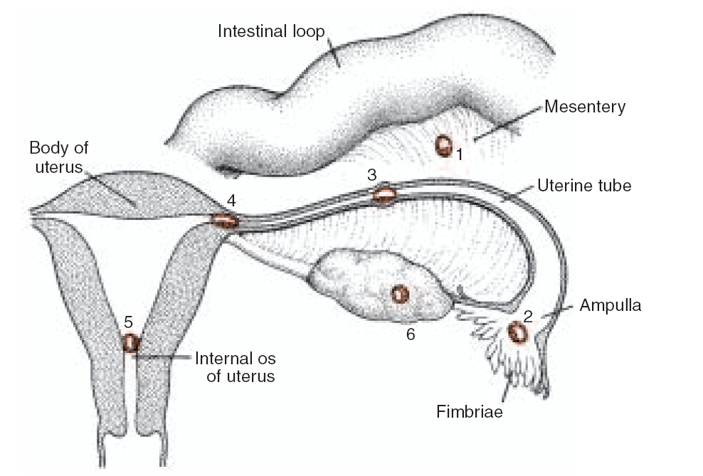
Abnormal Implantation
Abnormal implantation sites sometimes occur even within the uterus.
Occasionally the blastocyst implants close to the internal opening os (opening) of the cervix.
the placenta bridges the opening (placenta previa) and causes severe, even life-threatening bleeding in the second part of pregnancy and during delivery.
Occasionally, implantation takes place outside the uterus, resulting in extrauterine pregnancy, or ectopic pregnancy.
Ectopic pregnancies may occur at any place in the abdominal cavity, ovary, or uterine tube
However, 95% of ectopic pregnancies occur in the uterine tube, and most of these are in the ampulla

Slide 14
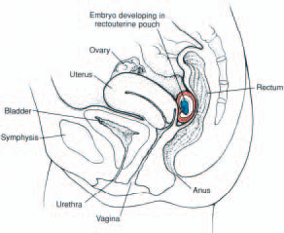
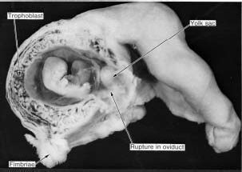
In the abdominal cavity, the blastocyst most frequently attaches itself to the peritoneal lining of the rectouterine cavity, or Douglas’ pouch
Sometimes the blastocyst develops in the ovary proper, causing a primary ovarian pregnancy.
In most ectopic pregnancies, the embryo dies about the second month of gestation, causing severe hemorrhaging and abdominal pain in the mother.

Slide 15
hydatidiformmole
Abnormal blastocysts are common.
It is likely that most abnormal blastocysts would not have produced any sign of pregnancy because their trophoblast was so inferior that the corpus luteum could not have persisted.
In some cases, however, the trophoblast develops and forms placental membranes, although little or no embryonic tissue is present.
Such a condition is known as a hydatidiformmole. Moles secrete high levels of hCG and may produce benign or malignant (invasive mole, choriocarcinoma) tumors

Slide 16
Chromosomal abnormalities

Slide 17
Chromosomal abnormalities
may be numerical or structural,
It is estimated that 50% of conceptions end in spontaneous abortion and that 50% of these abortuses have major chromosomal abnormalities.
thus approximately 25% of conceptuses have a major chromosomal defect
The most common chromosomal abnormalities in abortuses are 45,X (Turner syndrome), triploidy, and trisomy 16
Chromosomal abnormalities account for 7% of major birth defects

Slide 18
Numerical Abnormalities
Normal somatic cells are diploid, or 2n;
normal gametes are haploid, or n
Euploid refers to any exact multiple of n, e.g., diploid or triploid
Aneuploid refers to any chromosome number that is not euploid;
it is usually applied when an extra chromosome is present (trisomy) or when one is missing (monosomy)
Abnormalities in chromosome number may originate during meiotic or mitotic divisions.

Slide 19
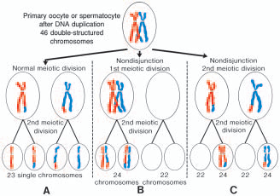
Nondisjunction
In meiosis, two members of a pair of homologous chromosomes normally separate during the first meiotic division
Sometimes, however, separation does not occur (nondisjunction), and both members of a pair move into one cell
As a result of nondisjunction of the chromosomes, one cell receives 24 chromosomes, and the other receives 22 instead of the normal 23.
When, at fertilization, a gamete having 23 chromosomes fuses with a gamete having 24 or 22 chromosomes, the result is an individual with either 47 chromosomes (trisomy) or 45 chromosomes (monosomy).
Nondisjunction may involve the autosomes or sex chromosomes
In women, the incidence of chromosomal abnormalities, including nondisjunction, increases with age, especially at 35 years and older.
Occasionally nondisjunction occurs during mitosis (mitotic nondisjunction) in an embryonic cell during the earliest cell divisions.
Such conditions produce mosaicism, with some cells having an abnormal chromosome number and others being normal

Slide 20
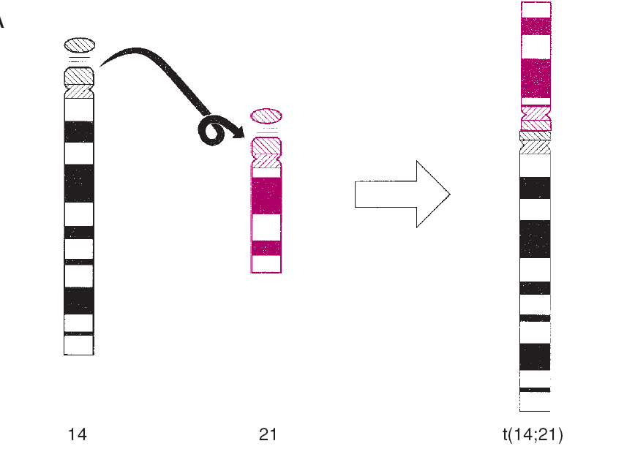
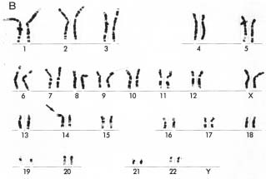
Translocations
Sometimes chromosomes break, and pieces of one chromosome attach to another.
Such translocations may be balanced, in which case breakage and reunion occur between two chromosomes but no critical genetic material is lost and individuals are normal;
or they may be unbalanced, in which case part of one chromosome is lost and an altered phenotype is produced.
For example, unbalanced translocations between the long arms of chromosomes 14 and 21 during meiosis I or II produce gametes with an extra copy of chromosome 21, one of the causes of Down syndrome

Slide 21
Numerical abnormalities

Slide 22
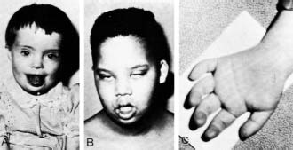
TRISOMY 21 (DOWN SYNDROME)
May happen during meiosis or mitosis
Caused by disjunction of chromosome 21
Monosomic cells (2n-1) aneuploid dies rapidly while children with trisomic cells (2n+1) have the characteristic syndrome
which is characterized by a flat, broad face, oblique palpebral fissures, epicanthus, and furrowed lower lip.
Another characteristic of Down syndrome is a broad hand with single transverse or simian crease.
Many children with Down syndrome are mentally retarded and have congenital heart abnormalities.

Slide 23
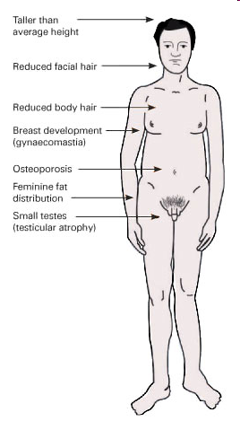
KLINEFELTER SYNDROME
The clinical features of Klinefelter syndrome, found only in males are sterility, testicular atrophy, and usually gynecomastia.
The cells have 47 chromosomes with a sex chromosomal complement of the XXY type, and a sex chromatin body (Barr body)
Nondisjunction of the XX homologues is the most common causative event

Slide 24
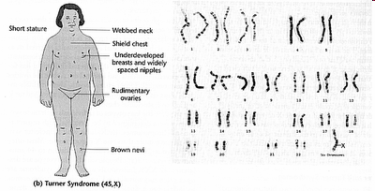
TURNER SYNDROME
Turner syndrome, with a 45,XO karyotype, is the only monosomy compatible with life
characterized by the absence of ovaries (gonadal dysgenesis) and short stature (normal female appearance)
Other common associated abnormalities are webbed neck, lymphedema of the extremities, skeletal deformities, and a broad chest
Approximately 55% of affectedwomen are monosomic for the X and chromatin body negative because of nondisjunction.

Slide 25
TRIPLE X SYNDROME
Karyotype XXX
Patients with triple X syndrome are infertile, with scanty menses and under developed genitals
some degree of mental retardation

Slide 26
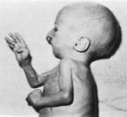
Edwards syndrome
trisomy 18.
prominent occiput,
cleft lip,
Micrognathia (small chin),
low-set ears,
and one or more flexed fingers

Slide 27
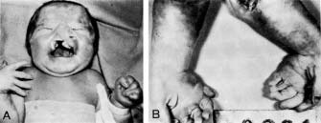
Patau syndrome
trisomy 13.
cleft lip and palate, the sloping forehead, and microphthalmia
The syndrome is commonly accompanied by polydactyly.

Slide 28
Structural abnormalities

Slide 29
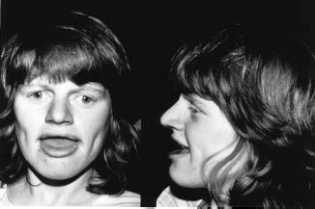
Angelman syndrome
resulting from a microdeletion on maternal chromosome 15
If the defect is inherited on the paternal chromosome, Prader-Willi syndrome occurs
the children are mentally retarded, cannot speak, exhibit poor motor development, and are prone to unprovoked and prolonged periods of laughter

Slide 30
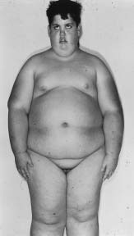
Prader-Willi syndrome
If the defect is inherited on the paternal chromosome 15
affected individuals are characterized by hypotonia, obesity, mental retardation, hypogonadism, and cryptorchidism

Slide 31
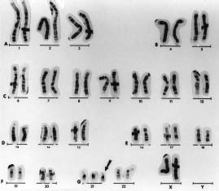
Diagnostic Techniques for Identifying Genetic Abnormalities
Cytogenetic analysis is used to assess chromosome number and integrity.
Chromosomes are stained with Giemsa stain to reveal light and dark banding patterns unique for each chromosome.

Slide 32
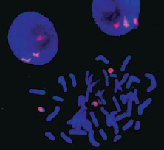
New molecular techniques, such as fluorescence in situ hybridization (FISH), use specific DNA probes
Used to identify genetic material deletions and detect the abnormalities of the genes and the chromosomes.

