Slide 1
DIABETES MELLITUS
Dr Heyam Awad
FRCPath

Slide 2
DM IS A GROUP OF METABOLIC DISORDERS SHARING HYPERGLYCEMIA.
Blood glucose levels normally are maintained in a very narrow range, usually 70 to 120 mg/dL.

Slide 3
Insulin effect
Increase uptake of glucose by striated muscle and adipocytes.
Insulin has anabolic effect on lipid, protein and glycogen.
Insulin reduces production of glucose from liver.

Slide 4
- Diabetes Mellitus is diagnosed by any one of three criteria
1. A random blood glucose concentration of 200 mg/dL or higher, with classical signs and symptoms
2. A fasting glucose concentration of 126 mg/dL or higher on more than one occasion
3. An abnormal oral glucose tolerance test (OGTT), in which the glucose levels is 200 mg/dL or higher 2 hours after a standard carbohydrate load (75 g of glucose).

Slide 5
PREDIABETES
- = impaired glucose tolerance.
- elevated blood sugar that does not reach the criteria for diagnosis of diabetes
-persons with prediabetes have an elevated risk for development of frank diabetes.

Slide 6
Classification of DM
Type 1… absolute insulin deficiency due to destruction of the islets… autoimmune destruction.
Type 2.. Relative insulin deficiency …. Peripheral resistance to insulin and inadequate compensatory response of insulin secretion.
Other rare causes

Slide 7
Other rare causes
1)Genetic defects of beta cell function.
-maturity onset diabetes of the young= MODY due to several mutations.
-insulin gene mutations.
-defects in proinsulin conversion
2)Genetic defects in insulin action.. Insulin receptor mutations.
3)Gestational diabetes

Slide 8
4)exocrine pancreatic defects..chronic pancreatitis, pancreatectomy, neoplasia..etc
5)endocrinpathies.. Acromegaly, cushing syndrome, pheochromocytoma
6)infections.. CMV, coxackievirus B , congenital rubella.
7)drugs.. steroids

Slide 9
TYPE 1 Diabetes :-
- It accounts for 10% of all cases .
- Is an autoimmune disease destructing Pancreatic B cells leading to an absolute deficiency of insulin
- Most commonly develops in childhood, becomes manifest at puberty, and patients depend on exogenous insulin for survival; without insulin they develop complications
- The classic manifestations of the disease occur late in its course, after 90% of the beta cells have been destroyed.
-genetic predisposition.

Slide 10
Pathogenesis:- autoimmune:
a. Defective deletion of self-reactive T cells in the thymus,
defects in the functions of regulatory T cells
Autoantibodies against B cell antigens, including insulin and enzyme glutamic acid decarboxylase, are detected in the blood of 70% to 80% of patients
??? Effects of viral infections.

Slide 11
Type 2 diabetes :
Accounts for 80% to 90% of cases
- Caused by a combination of
a. Peripheral resistance to insulin action and
b. An inadequate compensatory response of insulin

Slide 12
Insulin resistance: :
- Is defined as the failure of target tissues to respond normally to insulin
It leads to decreased uptake of glucose in muscle, reduced glycolysis in the liver.

Slide 13
Obesity and Insulin Resistance :Visceral obesity is common in majority of affected patients and insulin resistance is present even with simple obesity un-accompanied by hyperglycemia, indicating a fundamental abnormality of insulin signaling in states of fatty excess.\
The risk of diabetes increases as the body mass index increases, suggesting a dose-response relationship between body fat and insulin resistance.

Slide 14
Obesity and insulin resistance:
A. Role of excess free fatty acids (FFAs): The level of intracellular triglycerides often is markedly increased in muscle and liver tissues in obese persons because excess circulating FFAs are deposited in these organs
- Intracellular triglycerides are potent inhibitors of insulin signaling and result in an acquired insulin resistance

Slide 15
b. Role of inflammation: mediated by cytokines secreted in response to excess FFAs results in peripheral insulin resistance and beta cell dysfunction
Excess FFAs within macrophages and beta cells can engage the inflammasome, leading to secretion of the IL-1β which mediates secretion of additional cytokines from macrophages, that are released into the circulation and act on the major sites of insulin action to promote insulin resistance
c. Role of adipokines: Adipose tissue release adipokines e;g IL-1β which promote peripheral insulin resistance

Slide 16
Beta cell dysfunction
Inability of beta cells to meet the increased demand on insulin due to peripheral resistance.
Cause: multifactorial and overlap with those related to peripheral resistance.
Examples: -FFAs cause cytokine release from the pancreatic Islets causing inflammatory damage.
-Amylin, is secreted by the β- cells and its abnormal aggregation results in amyloid that replaces the islets.

Slide 17
MORPHOLOGY of DM : Pancreas
a. Reduction in the number and size of islets, most often in type 1 particularly with rapidly advancing disease.
b. Leukocytic infiltration of the islets: seen in both type 1 and type 2 DM although it is more severe in type 1
- In both types inflammation is often absent by the time the disease is clinically evident
c. Amyloid replacement of islets in long-standing type 2 diabetes, appear as deposition of pink, amorphous material beginning in capillaries between cells
d. At advanced stages the islets may undergo fibrosis .

Slide 18
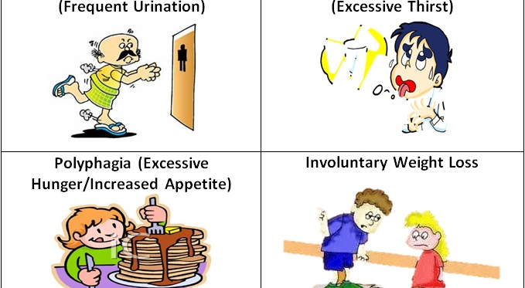
Clinical features of DM

Slide 19
clinical features
a. The hyperglycemia exceeds the renal threshold for reabsorption, and glycosuria induces an osmotic diuresis and polyuria,
b. The obligatory renal water loss combined with the hyperosmolarity tends to deplete intracellular water, triggering the thirst centers of the brain and this generates intense thirst (polydipsia).
c. Deficiency of insulin leads to catabolism of proteins and fats which tends to induce a negative energy balance, which in turn leads to increasing appetite (polyphagia)

Slide 20
COMPLICATIONS OF DM
Blood vesseles: atherosclerosis, hyaline arteriosclerosis, microangiopathy
Nephropathy.. Glumerular lesions, arteriosclerosis, pyelonephritis.
Ocular complications
neuropathy

Slide 21
The pathogenesis of the long-term complications
Formation of advanced glycation end products (AGEs) as a result of nonenzymatic reactions between intracellular
glucose-derived precursors with the amino groups of proteins.
- AGEs bind to a specific receptor expressed on macrophages, endothelium and vascular smooth muscle.
- The effects of the AGE signaling within vessels
a. Release of cytokines and growth factors from intimal macrophages
b. Generation of reactive oxygen species in endothelial cells
c. Increased procoagulant activity on endothelial cells and

Slide 22
II. activation of protein kinase C by de novo synthesis of diacylglycerol (DAG) from glycolytic intermediates
- the effects of this activation include production of proangiogenic molecules such as
A, Vascular endothelial growth factor (VEGF ), implicated in the neovascularization seen in diabetic retinopathy,
B. Transforming growth factor-β, leading to increased deposition of extracellular matrix and basement membrane material.

Slide 23
III. Disturbances in polyol pathways.
- In some tissues that do not require insulin for glucose transport (e.g., nerves, lens, kidneys, blood vessels) hyperglycemia leads to an increase in intracellular glucose that is metabolized by the enzyme aldose reductase to sorbitol, a polyol, and eventually to fructose, in a reaction that uses NADPH as a cofactor. So NADPH is depleted.
- NADPH is required by the enzyme glutathione reductase in a reaction that regenerates reduced glutathione (GSH).
- GSH is important antioxidant and any reduction in GSH increases cellular susceptibility to oxidative stress.
Note- In neurons, persistent hyperglycemia appears to be the major underlying cause of diabetic neuropathy (glucose neurotoxicity).

Slide 24
Morphology and clinical manifesations of complications
1. Diabetic Macrovascular Disease.:
- The hallmark is accelerated atherosclerosis affecting the aorta , large and medium-sized arteries and it is more severe with early onset in diabetics than in nondiabetics
- Myocardial infarction due to Coronary artery athero-sclerosis is the most common cause of death in diabetics and is as common in diabetic women as in diabetic men
- Gangrene of the lower extremities is 100 times more common in diabetics than in the general population ..

Slide 25
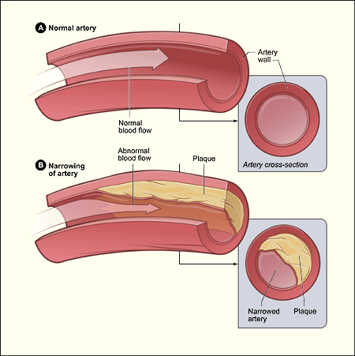

Slide 26
2. Hyaline arteriolosclerosis,
- Is the vascular lesion associated with hypertension
- Is both more prevalent and more severe in diabetics than in nondiabetics, but it is not specific for diabetes and may be seen in elderly persons who do not suffer from either diabetes or hypertension.
- It takes the form of hyaline thickening of the wall of the arterioles, which causes narrowing of the lumen
- In diabetic patients, its severity is related not only to the duration of the disease but also to the presence or absence of hypertension.

Slide 27
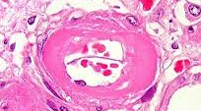
Hyaline arteriolosclerosis

Slide 28
3. Diabetic Microangiopathy. :
Diffuse thickening of basement membranes, is most evident in the capillaries of the skin, skeletal muscle, retina and , renal glomeruli,
It may be seen in renal tubules, nerves, and placenta.
It underlies the development of diabetic nephropathy, retinopathy , and some forms of neuropathy

Slide 29
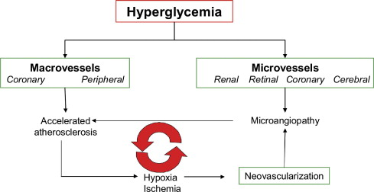

Slide 30
4. Diabetic Nephropathy.:
The kidneys are prime targets of diabetes and renal failure is second only to myocardial infarction as a cause of death from this disease
lesions encountered are:
1. Glomerular lesions
a. Capillary basement membrane thickening :can be detected by electron microscopy within a few years of onset of diabetes without any change in renal function
b. Diffuse mesangial sclerosis,: Consists of a diffuse increase in mesangial matrix and mesangial cell proliferation and it is found in most individuals with disease than 10 years' duration.

Slide 31
- Diffuse mesangial sclerosis also may be seen in association with old age and hypertension
c.Nodular glomerulosclerosis
- Are ball-like deposits of a laminated matrix situated in the periphery of the glomerulus and are PAS-positive
Note: Diffuse and the nodular forms of glomerulosclerosis induce sufficient ischemia to cause kidney scarring
2. Renal atherosclerosis and arteriolosclerosis .

Slide 32
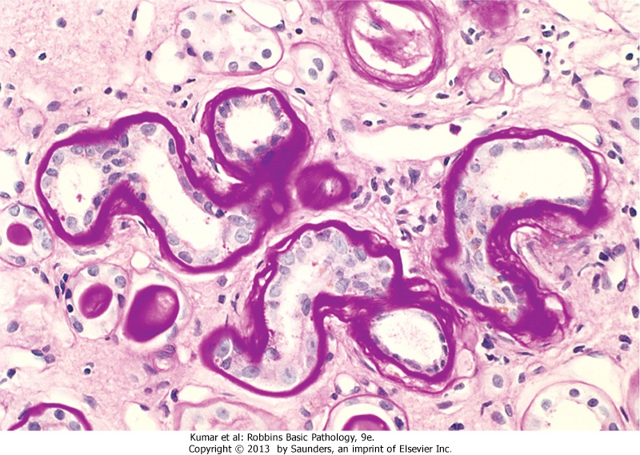
Thickened tubular basement membrane

Slide 33
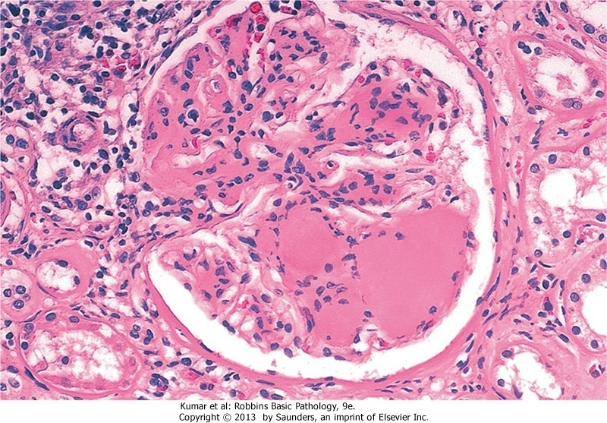
Nodular glomerulosclerosis

Slide 34
. 3. Pyelonephritis,:
Is inflammation that usually begins in the interstitial tissue and involve the tubules and it has both acute and chronic forms

Slide 35
5. Ocular Complications of Diabetes:
- Visual impairment, and blindness, is one of the more
feared consequences of long-standing DM.
Retinopathy, the most common pattern, consists of changes that are considered by many ophthalmologists to be virtually diagnostic of the disease
Note:
- DM currently is the fourth leading cause of acquired blindness in the United States.
About 60% to 80% of patients develop a form of diabetic
retinopathy approximately 15 to 20 years after diagnosis
- diabetic patients also have an increased propensity for glaucoma and cataract formation

Slide 36
Diabetic Neuropathy.:
The most frequent pattern of involvement is that of a peripheral, symmetric neuropathy of the lower extremities affecting motor and sensory nerves
Autonomic neuropathy produces disturbances in bowel and bladder function and sometimes sexual impotence,
C . Mononeuropathy, which may manifest as sudden foot drop or wristdrop or isolated cranial nerve palsies
- The neurologic changes may be the result of microangiopathy and increased permeability of capillaries that supply the nerves, as well as direct axonal damage

Slide 37
Managements of DM
For patients with type 1 diabetes, insulin replacement therapy is the mainstay of treatment, while dietary restrictions and exercise (that improves insulin sensitivity) are the "first line of defense" for type 2 diabetes.
- Most patients with type 2 diabetes will eventually require therapeutic intervention achieved by administration of a number of agents that lower glucose levels

