Slide 1
Mechanisms of action

Slide 2
Signaling networks and regulation
An activation of one pathways leads to expression of its inhibitors.

Slide 3
Crosstalk
The interaction of one signaling pathway with another.
Examples:
cAMP and ERK
Cell adhesion molecules and receptor tyrosine kinases
ERK and PI-3 kinases

Slide 4
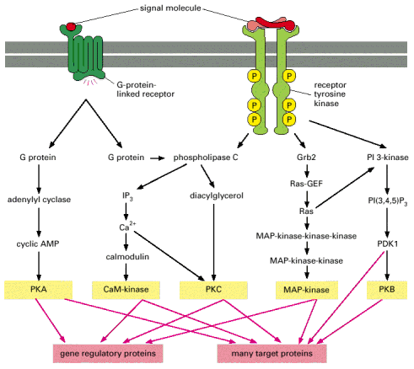

Slide 5
Cell-specific response. Why?
Cells have distinct receptors.
Cells contain a different combination of regulatory proteins that that influence cell behavior.
The final effector (transcription factor) must have access to its DNA-binding site and if the chromatin is packaged tightly, the complex will not be able to bind to the DNA and, hence, activate transcription.

