Slide 1
Omar Obeidat, MD, FACC
Cardiac Emergencies

Slide 2
Cardiac Emergencies
Acute Coronary syndrome
Aortic Dissection
Pulmonary Edema
Pulmonary Embolism
Arrhythmias and sudden cardiac death

Slide 3
Cardiac Emergencies
Chest Pain
SOB
Syncope
Sudden Death
Palpitation

Slide 4
Chest pain Evaluation in the ER
Section 2

Slide 5
Causes of Chest Pain
Cardiac
Aortic
Pulmonary
Esophageal
Musculoskeletal
Abdominal
Skin
Herpes Zoster (Shingles)
Others

Slide 6
History
By far, History, is the most predictive
Do it well, saves time!
Know the classic story for the common complaints
but beware of the pitfalls

Slide 7
OPQRST of Pain Symptoms
Onset
Sudden or gradual?
Anything like this before?
Provocation or palliation
What makes it better/worse?
What was the patient doing at the time?
Quality
What does it feel like (in patient’s own words)?

Slide 8
OPQRST of Pain Symptoms
Radiation
From where to where?
Severity
How bad is it on a scale of 0-10?
Timing
When did it start
How long did it last?
Continuous or intermittent?

Slide 9
6 deadly causes of chest pain
Acute coronary syndromes
Aortic dissection
Pulmonary Embolus “ most commonly presents with dyspnea “
Myo/Pericarditis….Pericardial Tamponade
Mediastinitis “Boerhaave syndrome: Effort rupture of the esophagus”
Tension Pneumothorax

Slide 10
….but luckily some diagnoses are easily recognised:
Myo/pericarditis – mostly has diagnostic History and ECG
Cardiac tamponade: classical exam
Esophageal rupture – classic history
Tension Pneumothorax – classical examination
Leaving three ‘problems’:
Acute Coronary Syndromes
Aortic dissection
Pulmonary Embolus

Slide 11
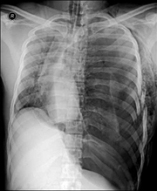
Tension Pneumothorax
Needle decompression
14 gauge angiocath
mid-clavicular line
2nd intercostal space

Slide 12
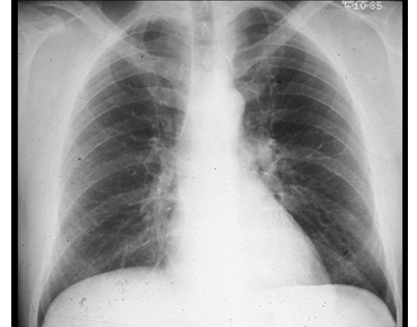
45 year old female, smoker with SOB, what is your diagnosis?!
Oral contraceptives
Recent travel
Family hx
Recent surgery
Hx Cancer

Slide 13
Pulmonary Embolism
Classic triad about 20%:
Pleuritic CP, dyspnea & hemoptysis
Typically some combination of:
Dyspnea, Pleuritic CP, tachypnea, tachycardia
Dyspnea commonest (about 80%)
Pleuritic pain not sensitive or specific:
- 30-40%in one study
Section 3

Slide 14
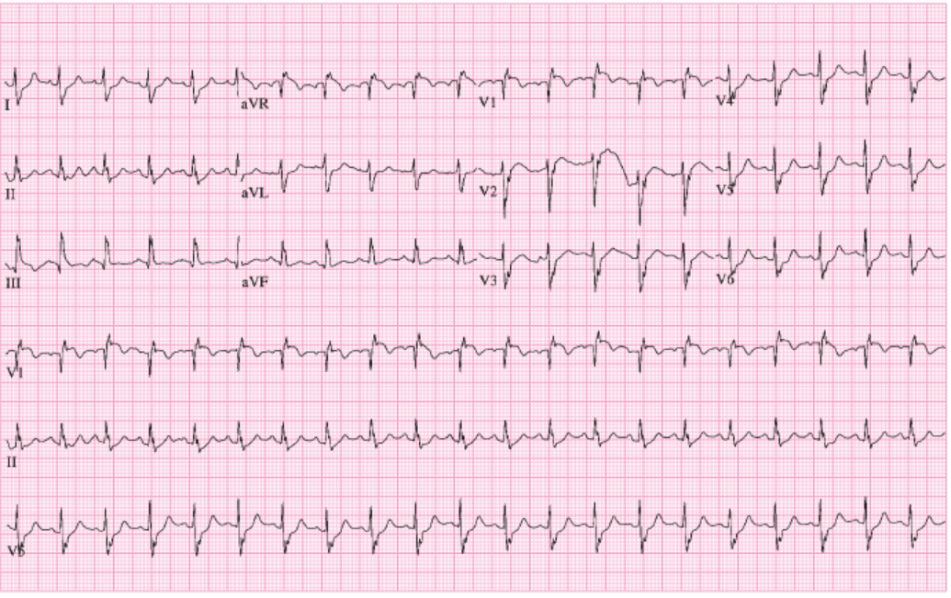
50 year female patient in the ER with acute shortness of breath
S1Q3T3, Right axis

Slide 15
PE - ECG
S1Q3T3 about 12% of PE
Sinus tachycardia is the most common
up to 69%
Anterior T wave inversion(V1-V3)
68% with confirmed PE
ECG doesn’t ‘rule in’ or ‘rule out’

Slide 16
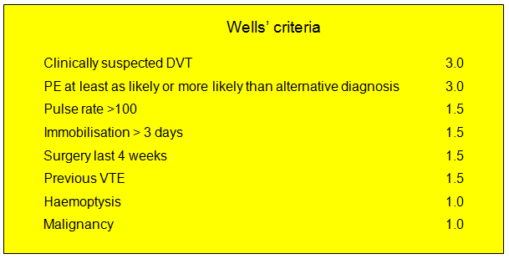
Pulmonary embolism
Traditional Wells: <2 low (10%), 2-6 moderate (25%), >6 high (50%)
Modified Wells: PE likely >4, PE unlikely <=4

Slide 17
Imaging – CT and VQ
CT has high negative predictive value
the test of choice
Alternative diagnosis up to 40%
Better if abnormal CXR (VQ less useful)
Inconclusive rates up to 10%
VQ scanning: impaired renal function

Slide 18
Imaging pregnant patients?!
Advice: investigate as non-pregnant
D-dimer will be positive in pregnancy: not useful
No consistent agreement re VQ vs CT
VQ isotopes renaly excreted, bladder near uterus
CT has contrast as well as radiation
Suggest to try lower limb venous Doppler ultrasound
But only 80% PE have LL DVT

Slide 19
50 year old man with sudden onset chest pain, what is your diagnosis?

Slide 20
Aortic Dissection
Bimodal age distribution
Young with predisposing factors
Collagen vascular disorders such as Marfan’s
Pregnancy (especially third trimester, Pregnancy (50% of dissections in women <40 yrs)
Chest trauma (MVA)
Iatrogenic (cardiac catheterization)
Bicuspid aortic valve (7-14% of cases)
Aortic coarctation
Elderly with chronic hypertension and Atherosclerotic risk factors
Section 4

Slide 21
Aortic Dissection
Clinical presentation
Abrupt tearing chest pain, radiation to back
Maximal intensity at onset
Migrating, dynamic pain pattern, starts in the chest and radiates to the back
Can mimic stroke( up to 30%):
Syncope, decreased LOC, acute paralysis
Can mimic ACS
(up to 8% with inferior STEMI)
Can mimic mesenteric ischemia, kidney stone

Slide 22
Aortic Dissection
Physical exam
Mostly Hypertensive
Asymmetric pulses, asymmetric BP
Discrepancy in systolic BP>20mmHg between left and right arm is suggestive
Up to 30% have neurological findings
Acute aortic regurgitation
Tamponade
Acute Inferior STEMI

Slide 23
Aortic Dissection Classification

Slide 24
Diagnostic Imaging - Aortic Dissection
ECG: not diagnostic
Ischemic changes in 15%
Up to 8% with Type A will have inferior STEMI
Chest x-ray
Widened mediastinum up to 76%
10% have normal CXR
Left pleural effusion

Slide 25
Diagnostic Imaging - Aortic Dissection
CT with contrast
Very sensitive and specific
Now accepted as first-line test
Shows true and false lumen
Intramural hematoma (not seen by traditional angiogram)
Requires dye load and radiation
MRI
TEE (trans-esophageal echo)

Slide 26
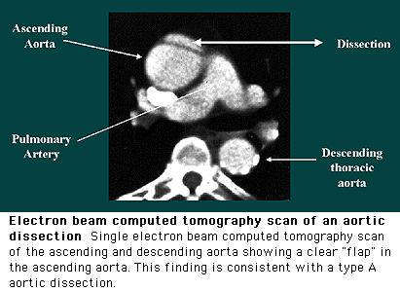
Spiral CT – Aortic Dissection
Sensitivity and Specificity 90 – 100%
Two distinct lumens with a visible intimal flap can be identified

Slide 27
Treatment
Beta blockers, then nitroprusside for both types
Stanford type A:
surgical emergency,
mortality 1-2%/hr early after symptom onset
Stanford B:
1/3 will require surgery for complications

Slide 28
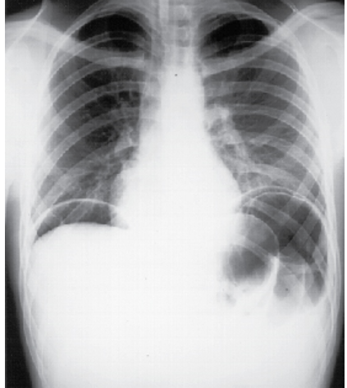
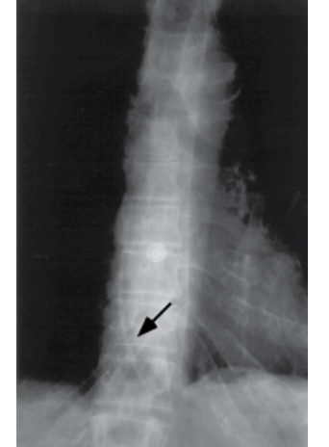
45 year old female with severe chest pain?
History
Forceful
Vomiting
Or EGD

Slide 29
Coronary Artery disease
Stable: chronic stable angina
Unstable: Acute Coronary Syndrome(ACS)
- Unstable Angina(USA)
- Non-STEMI(NSTEMI)
- STEMI

Slide 30
Described Triggers of Acute Plaque Rupture
Exertion
Anger
Mental stress
Cocaine use
Tobacco, marijuana use
Exposure to air pollution
Fever
Specific infection( e.g. influenza)

Slide 31
Locations of Anginal Chest Pain

Slide 32
Clinical Manifestations of Angina
Chest pain or discomfort
Heavy pressure, strange feeling or ache in the chest
Constrictive, squeezing, choking
Indigestion, burning
Types of Angina
Stable Angina
Prinzmetal Angina
Unstable Angina

Slide 33
Stable Angina Pectoris
Chest pain occurs intermittently over a long period with the same pattern of onset, duration, and intensity of symptoms, predictable
Controlled with medications
Pain usually lasts 3 to 5 minutes
Subsides when the precipitating factor is relieved

Slide 34
Prinzmetal’s Angina
Variant Angina
Occurs at rest usually due to spasm of major coronary artery
Spasm may occur in the absence of CAD
Transient ST elevation

Slide 35
Unstable Angina
New onset
Angina at rest
Worsening pattern: more frequent, lasts longer, or occurs with less exertion than previous stable angina
Unpredictable
High risk of MI & death
Duration up to 20 minutes

Slide 36
Angina history pitfalls
Response to analgesia/NTG does not make a diagnosis
Esophageal pain improves with NTG
Typical angina:
Worse with exertion or stress
Relieved by rest
Or Nitroglyceryline
“Atypical” pain
more common in
women,
Diabetics,
Renal failure
Elderly

Slide 37
Angina history pitfalls
By age 85 MAJORITY of AMIs are painless
Anginal ‘equivalents’ include:
Dyspnoea (commonest)
Syncope, weakness, confusion
cold sweats & dizziness

Slide 38
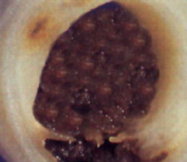
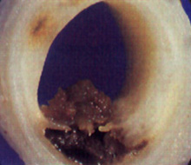
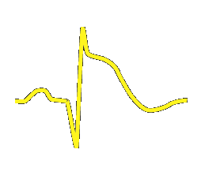
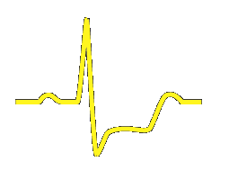
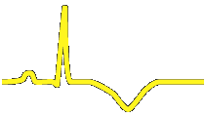
STEMI Non-STEMI/USA
Markers of necrosis: (↑) Markers of necrosis: Normal or (↑)‏‏
Patology: Total oclusive Nonocclusive thrombus

Slide 39
Acute Myocardial Infarction (AMI)
Evidence of myocardial injury or necrosis
Coronary blood flow impairment
Location and size of infarct depends on which coronary artery is blocked
Total occlusion of the coronary artery leads to STEMI
Partial occlusion or on/off occlusion will lead to NSTEMI

Slide 40
Third universal definition of MI released in 2012 by the ESC/ACCF/AHA/WHF
Detection of a rise and/or fall of cardiac biomarker values(preferably cardiac troponin) and with at least one of the following:
- supportive evidence in the form of typical symptoms
- suggestive ECG changes
- imaging evidence of new loss of viable myocardium
- or new regional wall motion abnormality

Slide 41
STEMI:
ST segment elevations ≥1 mm (0.1 mV) in two anatomically contiguous leads
OR ≥2 mm (0.2 mV) in leads V2 and V3 in men >40years, > 2.5mm in men <40yrs, >1.5mm in women
OR new left bundle branch block and presentation consistent with ACS.
OR posterior wall MI: R>S in V1-V2 with ST depression and up-right T waves
If ECG is suspicious but not diagnostic, consult cardiologist early and repeat ECG every 5-10minutes.

Slide 42
STEMI =ALERT
Finding indicates injury and tissue necrosis/ muscle cell death is likely (infarction)
Injury is due to occluded coronary artery
Muscle can still be salvaged if corrective intervention can be taken in timely manner
TIME IS MUSCLE!

Slide 43
STEMI

Slide 44
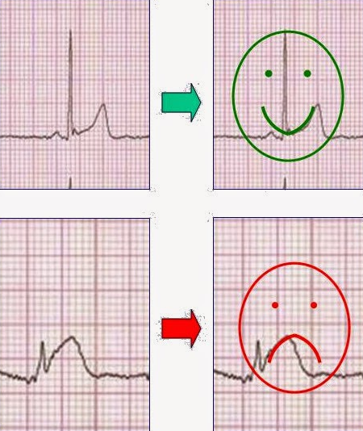
ECG to detect AMI
Concave shape is usually benign: likely pericarditis!
Coved shape usually indicates acute injury

Slide 45
ECG in AMI
ECGs can direct management & treatment of an AMI by;
Identify who needs emergent reperfusion
Specify the infarct-related artery & area of heart muscle
Highlight dysrhythmias/conduction issues
Stat 12 lead ECG within 10 minutes
15 lead ECG for suspected Posterior Wall MI
Right sided leads for inferior MI with hypotension
Repeat ECG every 5 minutes if initial ECG non-diagnostic but clinical suspicion remains high

Slide 46
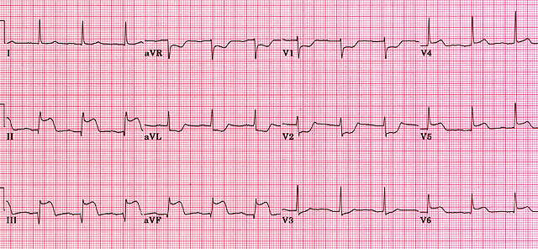
50 year old male patient, DM, smoker with severe CP, what is your diagnosis?
Notes:
Leads II, III and aVF reflect electrocardiogram changes associated with acute infarction of the inferior aspect of the heart. ST elevation, developing Q waves and T wave inversion may all be present depending on the timing of the ECG relative to the onset of myocardial infarction. Most frequently, inferior MI results from occlusion of the right coronary artery. Conduction abnormalities which may alert the physician to patients at risk include second degree AV block and complete heart block together with junctional escape beats. Note that the patient is also suffering from a concurrent posterior wall infarction as eveidenced by ST depression in leads V1 and V2.

Slide 47
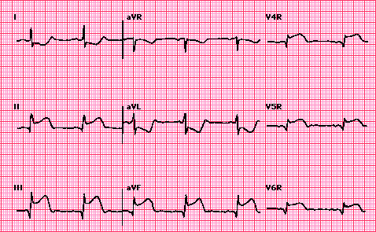
Right sided leads
Notes:
What is this ECG? Answer: right sided ECG. Electrocardiogram shows Q waves and prominent doming ST segment elevation in II, III, and aVF, findings which are characteristic of an acute inferior myocardial infarction. ST elevation in the right precordial leads - V4R, V5R, and V6R - indicates right ventricular involvement as well (arrows). The ST depressions in leads I and aVL represent reciprocal changes.

Slide 48
Acute MI Locator Table
Location | Lead | Reciprocal Changes
Inferior (RCA) | II, III, aVF | I, aVL
Septal (LAD) | V1, V2
Anterior (LAD) | V3, V4 | II, III, aVF
Lateral (Circumflex) | V5, V6, I, aVL | II, III, aVF

Slide 49
What vessel is the culprit?!
LAD

Slide 50
What is your diagnosis?
Infro-Posterior wall MI

Slide 51
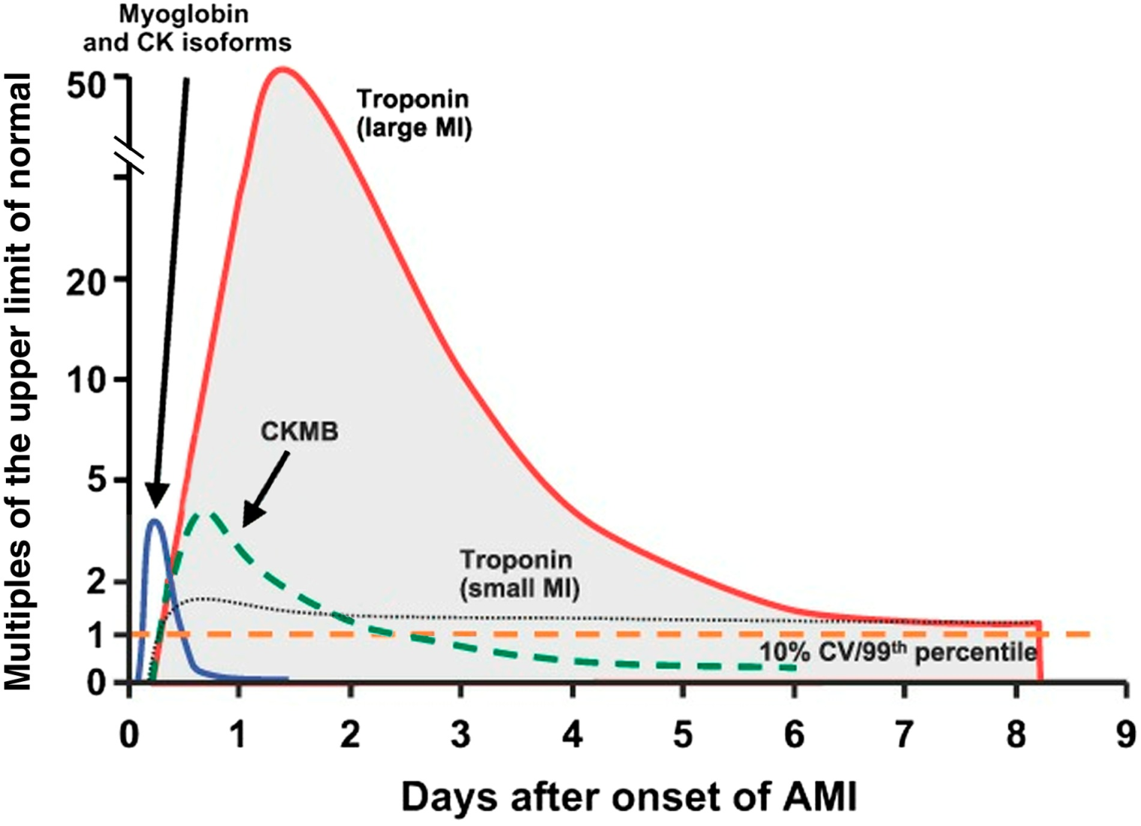
Timing of Release of Various Biomarkers
Shapiro BP, Jaffe AS. Cardiac biomarkers. In: Murphy JG, Lloyd MA, editors. Mayo Clinic Cardiology: Concise Textbook. 3rd ed. Rochester, MN: Mayo Clinic Scientific Press and New York: Informa Healthcare USA, 2007:773–80.
Anderson JL, et al. J Am Coll Cardiol 2007;50:e1–e157, Figure 5.

Slide 52
Treatment Goals
Early recognition
Minimize size of infarction
Reduce myocardial oxygen demand
Decrease patient fear & pain
Salvage ischemic myocardium
Prevent development of dysrhythmias
Improve chances of survival
Take all complaints of chest pain seriously!

Slide 53
Initial Treatment of ACS
Treated initially the same MONA
Morphine (if necessary)
Oxygen
Nitroglycerin – after ECG!
Aspirin
IV-monitor-vital signs-history
12 lead ECG
Treatment fine-tuned as more diagnostic information is obtained

Slide 54
Therapy of AMI
Thrombolysis vs. percutaneous coronary intervention
Outcomes have shown consistent benefit with PCI
Guidelines recommend PCI if FMC to device within 90 minutes
Window of benefit extended over thrombolytics if symptomatic(12-24hours) or if cardiogenic shock

Slide 55
AMI Complications
Arrhythmias with good prognosis
Bradycardia (without hypotension)
2˚ Mobitz type 1 AV block (Wenckebach)
3˚ AV block with inferior MI (resolves)
Narrow QRS complexes
PVCs, PACs
Don’t need to treat PVCs! Look for underlying cause
Early non-sustained V-Tach

Slide 56
Complications
Arrhythmias with poor prognosis
2˚ Mobitz II (progress to 3˚)
3˚ AV block from anterior MI
Persistent sinus tach, SVT, A-fib
New RBBB, bifascicular block (RBBB + hemi-block)
LBBB (large infarct size)
Increased risk of pump failure, mortality
High-grade blocks
seen in anterior MI due to structural loss of
conduction tissue and will need pacemaker

Slide 57
Post MI complications
Cardiogenic Shock
Lateral wall rupture
Septal wall rupture(VSD)
Acute MR
RV infarction
Pericarditis/Dresslers syndrome

Slide 58
Heart Failure
Section 9

Slide 59
HF Definition:
Complex clinical syndrome that results from impairment of ventricular filling or ejection
The cardinal manifestations of HF are:
- dyspnea and fatigue
- fluid retention
- Some patients have mainly exercise intolerance
There is no single diagnostic test for HF
it is largely a clinical diagnosis based on a careful history and physical examination

Slide 60
NYHA classification

Slide 61
HF classification:
Systolic heart failure vs diastolic heart failure
- Heart Failure with reduced ejection fraction(HFrEF) <=40%
- Heart Failure with preserved ejection fraction(HFpEF) >=50%
a. HFpEF, borderline 41-49%
b. HFpEF, improved >40%
Left heart failure vs Right heart failure
The most common cause of right sided failure is left sided failure
Low output vs High output heart failure

Slide 62
Goals of Therapy: outline
1. Identify and treat the underlying cause of excacerbation:
Identify reversible causes
2. Eliminate the acute precipitant
3. Manage HF symptoms
4. Slow progression of LV disease
5. Improve long-term survival
Notes:
-treating underlying cause may be difficult – can require surgical valve or coronary repair, treatement HTN, cessation of alcohol
-modulating the neurohormonal response – to help prevent adverse ventricular remodeling in oder to slow progression of LV dysfunction

Slide 63
Why does my doctor have me on so many pills??
Improve Symptoms
Diuretics (water pills)
digoxin
Improve Survival
Beta blockers
ACE-inhibitors or ARB’s
Aldosterone blocker
Entresto

Slide 64
Hypertensive Emergencies
Section 10

Slide 65
Hypertensive Urgency
Severe hypertension (usually a diastolic blood pressure > 120 mmHg)
None or mild symptoms
There is no proven benefit from rapid reduction in blood pressure in asymptomatic patients
Acute intervention may be harmful
Behavioral modification, initiation of ORAL therapy
Close follow up (e.g. in several days)

Slide 66
Hypertensive Emergency
Severe hypertension (usually DBP>120 mmHg) (SBP>180) with evidence of acute end-organ damage
can be life threatening and requires immediate treatment, usually with parenteral medications in a monitored setting
Goal is to reduce DBP 10-15% or MAP 20-25% within 30-60 minutes, and to 160/100-110 within 2 hours
Measure BP in both arms!

Slide 67
Distribution of hypertensive emergencies
Acute pulmonary edema/CHF 35%
Cerebral infarction(stroke team) 25%
Hypertensive encephalopathy 16%
Acute coronary syndrome 12%
Intracerebral or SA hemorrhage 5%
Eclampsia 5%
Aortic dissection 2%

Slide 68
Hypertensive Emergency
Catecholamine crisis
Pheochromocytoma
MAOI crisis
Cocaine overdose
Treatment in these cases
Alpha plus beta blocker is best
Do not use beta blocker alone (avoid unopposed alpha effect)
Labetalol plus phentolamine (alpha blocker)
Phentolamine (a₁ blocker)
Drug of choice for pheochromocytoma
1-5 mg IV/IM 1-2 hrs preop, repeat as necessary

Slide 69
Hypertensive Emergency Medications
Sodium nitroprusside
Mode of action: arterial and venous dilatation
Onset of action: 1-2 minutes
Half life: 3-4 minutes
Metabolized to thiocyanate (cyanide) therefore do not use for long in renal or pregnant patients
Ideal medication for hypertensive emergencies (rapid onset, potent, short half life)
Can cause reflex tachycardia, therefore use with beta blocker

Slide 70
Hypertensive Emergency Medications
Labetalol
Alpha and beta blocker (primarily beta)
Onset of action: 5-10 minutes
Half life: 5.5 hours
No reflex tachycardia
Contraindicated in bronchospasm, acute CHF,
AV-blocks

Slide 71
Hypertensive Emergency Medications
Nicardipine
Calcium channel blocker
Onset 5-15 min, duration 4-6 hrs
Theoretically reduces cardiac and cerebral ischemia
Nitroglycerin
Vasodilation primarily; arteriolar dilation at high doses
Limited utility with profound hypertension
Onset: immediate
Half life: 4 minutes
Tachyphylaxis
Ideal for cardiac emergencies such as CHF, MI
Side effects: headache and tachycardia

Slide 72
Hypertensive Emergency Medications
Hydralazine
Direct arteriolar vasodilator
Onset: 10 min (IV)
Half life: 2-4 hours
Indicated in pregnancy-related hypertension, pediatric nephritis
Side effects:
reflex tachycardia (limits use in CAD, dissection)
Chronic use associated with “lupus-like” syndrome

Slide 73
Pericardial Emergencies
Section 11

Slide 74
Pericardial Tamponade
Causes
Trauma, uremia, anticoagulation, neoplasm
Clinical signs (Beck’s triad, 1935)
Hypotension, JVD, muffled heart sounds
pulsus paradoxus
ECG
Electrical alternans (beat to beat alteration in the amplitude of the QRS complex), low voltage
ECHO findings
Effusion
RV diastolic collapse (specific for tamponade)

Slide 75
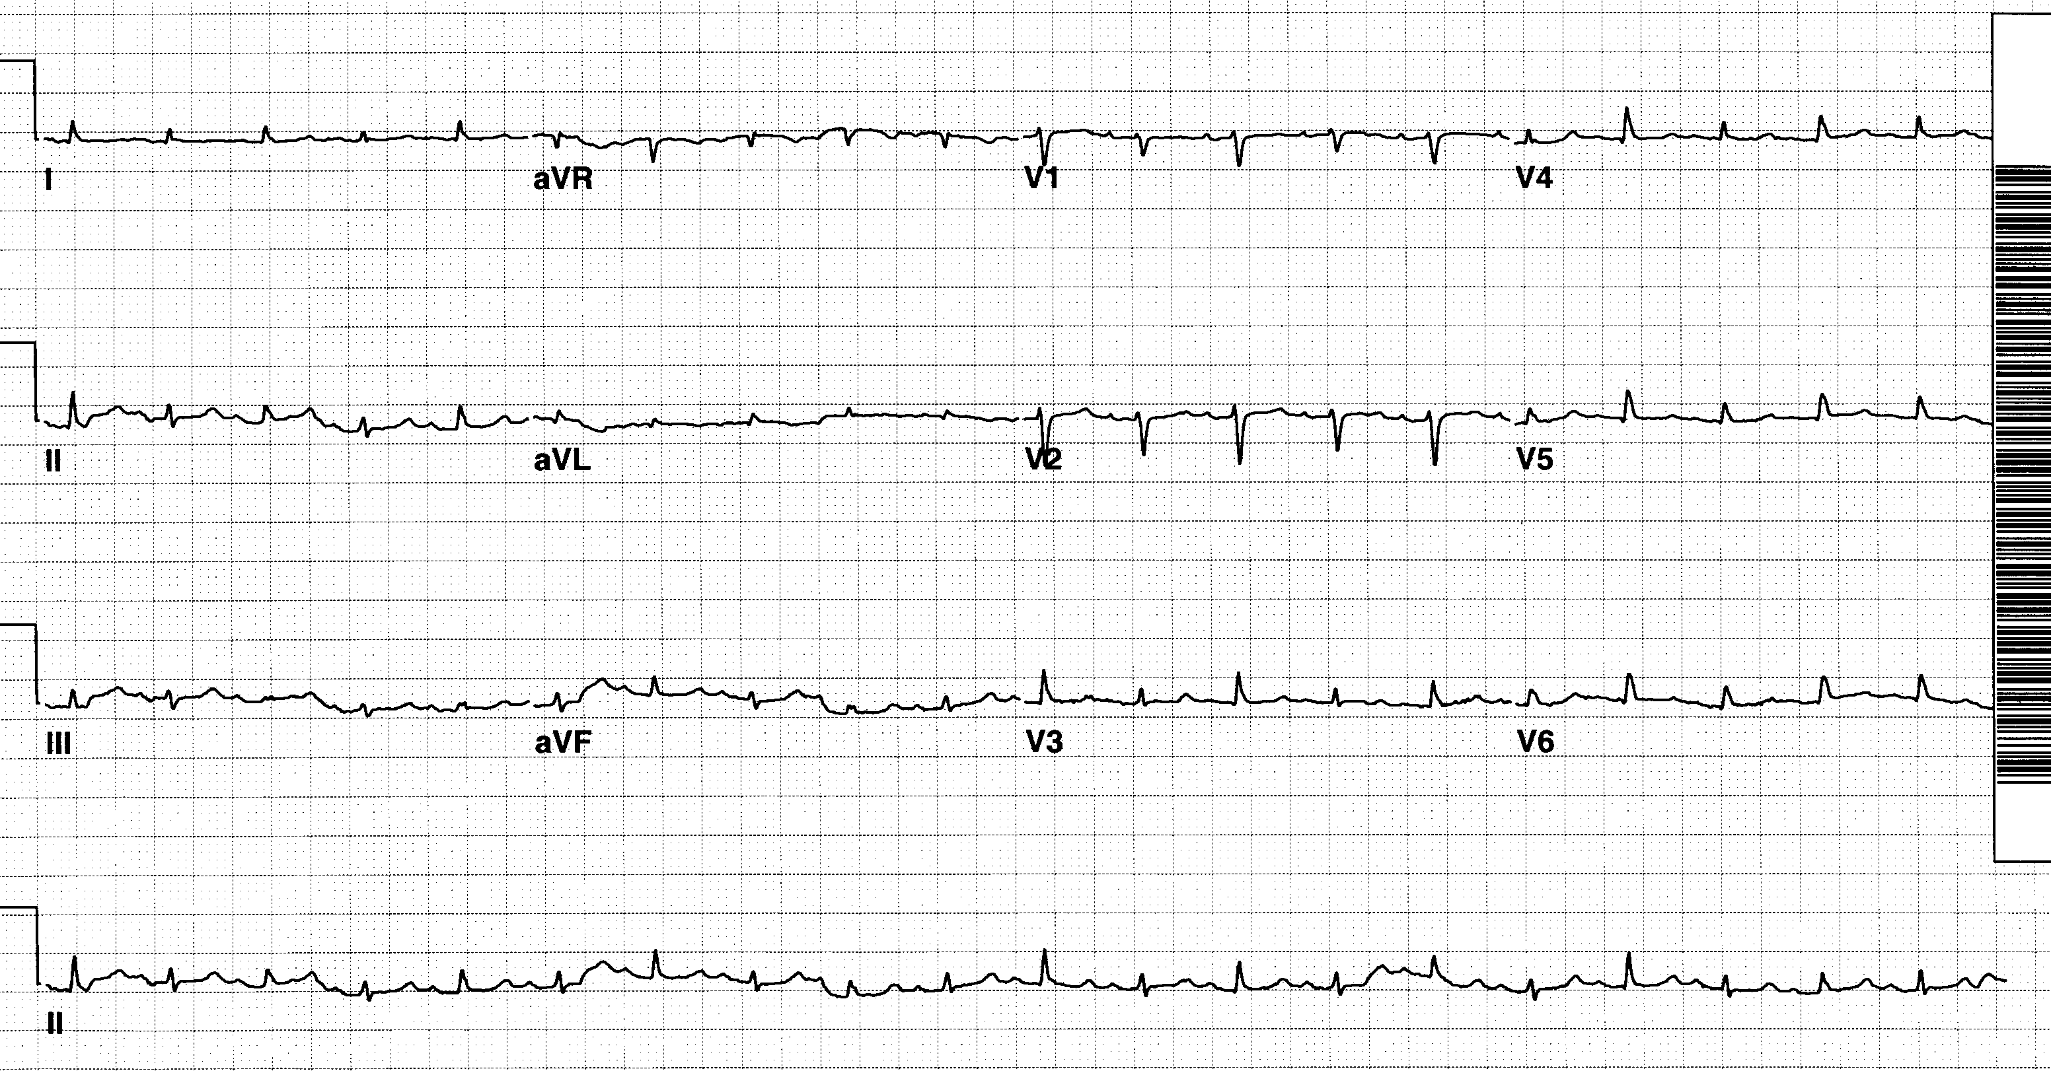
Pericardial Effusion
From ECGs for the Emergency Physician Vol 1 (Mattu, Brady; Blackwell 2003)

Slide 76
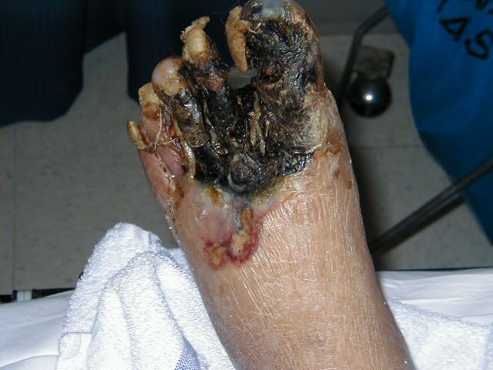
Acute Limb Ischemia
Section 12

Slide 77
Acute Limb Ischemia
Emboli
Usually cardiac
Mural thrombus from MI
A-fib
Endocarditis
Arterial source
Aneurysm
Dissection
Atherosclerotic disease
Paradoxical embolus
From venous emboli through septal defect

Slide 78
Acute Limb Ischemia
Signs of acute ischemia (6 P's)
Pain
Pallor
Paresthesias
Paralysis
Pulselessness (late finding)
Poikilothermia (polar, cold)
Treatment of acute limb ischemia
Vascular consultation!
Heparin bolus & infusion
Embolectomy
Bypass for atherosclerotic disease
Don’t forget to consider aortic
dissection or AAA

Slide 79
Common Murmurs and Timing
Systolic Murmurs
Aortic stenosis
Mitral insufficiency
Mitral valve prolapse
Tricuspid insufficiency
Diastolic Murmurs
Aortic insufficiency
Mitral stenosis
S1 S2 S1

Slide 80
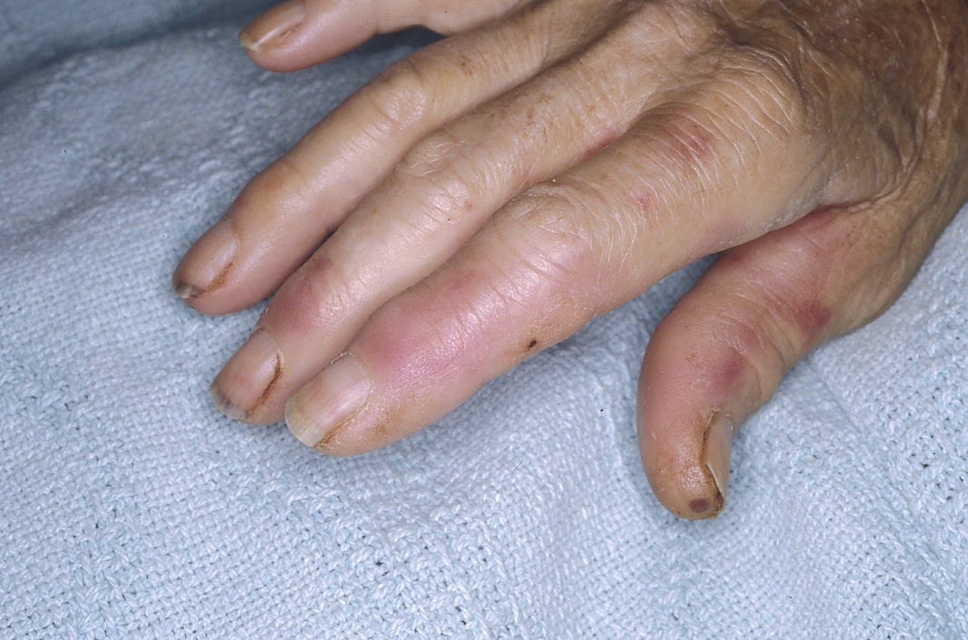
Osler Nodes
80

Slide 81
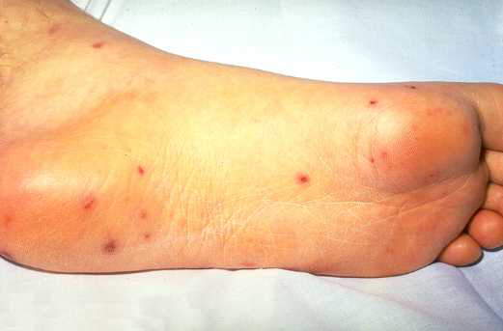
Septic Emboli

Slide 82
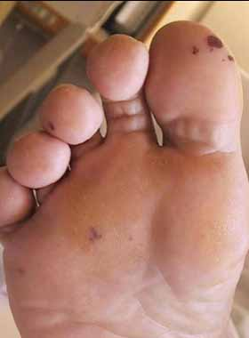
Janeway Lesion
79

Slide 83
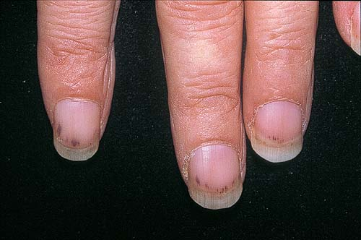
Splinter Hemorrhages
81

Slide 84
Thank You

