Slide 1
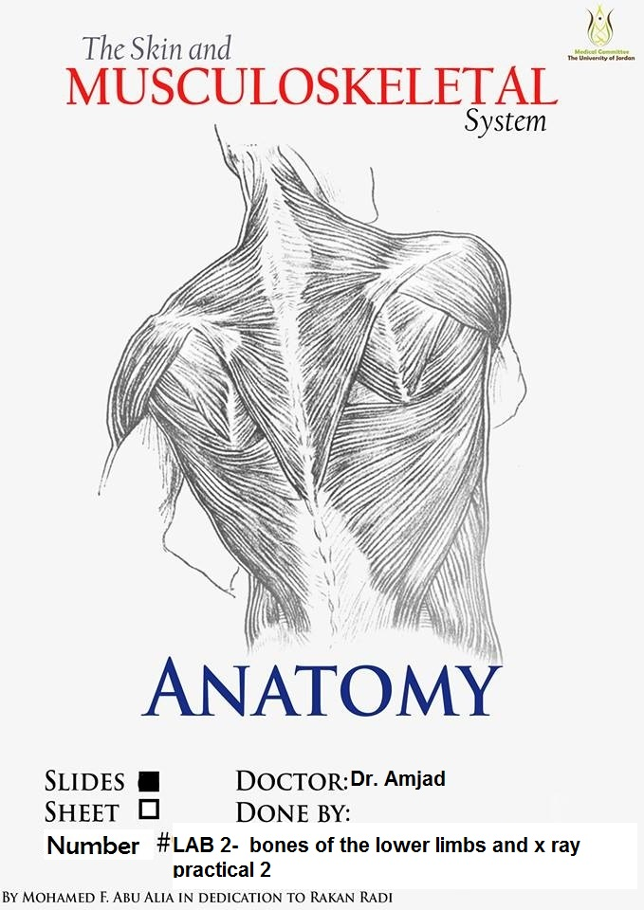

Slide 2
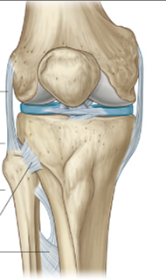
Patella
Triangular sesamoid bone
Contained within patellar ligament

Slide 3
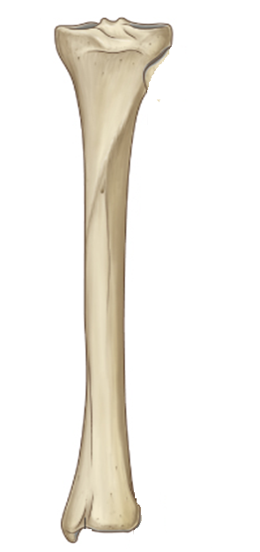
Lateral
condyle
Medial
condyle
Groove for Semimembranosus
Right Tibia
Anterior view
Posterior view
Tuberosity
Of Tibia
Fibular facet
Area for
popliteus muscle
Soleal line
Upper end
Medial surface
Lateral surface
Vertical line
Anterior border
shin tibia
Interosseous
border
Directed
laterally
Posterior surface
The shaft of the tibia is subcutaneous and unprotected anteromedially
throughout its course. It is not surprising that the tibia is the commonest long bone to be fractured .The extensive subcutaneous surface of the tibia makes it an accessible donor site for bone-grafts
Medial border
*
Lower end
Groove for
tibialis posterior
Fibular notch
Medial malleolus
Inferior articular surface
Fibular notch

Slide 4
Styloid process
Head
Articular facet of the head
Neck
2-Anterior surface
provides origin to
the extensor muscles of the leg
Extensor surface
1-Lateral surface
Provides origin to
The muscles in the lateral
compartment of the leg
3-Posterior surface
provides origin to some of
the flexor muscles of the leg
flexor surface
Anterior border
Medial creast
*
Interosseous border
Subcutaneous
triangular area
*
Malleolar fossa, located on the medial surface
of the lateral malleolus
Inferior
Posterior
medial
in position
helps to determine left or right
Lateral malleolus
Right fibula- anterior view

Slide 5
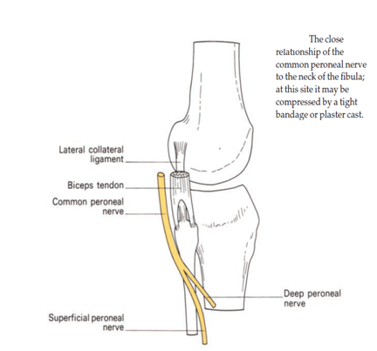
The common peroneal nerve is related to the neck of fibula
The common peroneal nerve in this area is covered by skin and fascia only therefore it is exposed to injuries
Foot drop

Slide 6
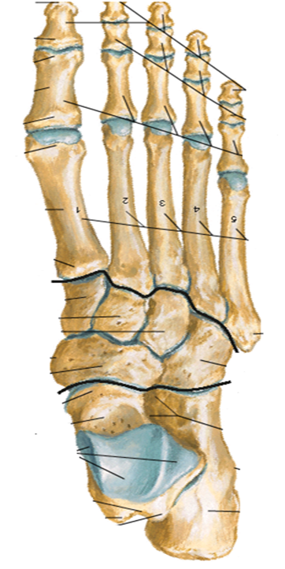
Distal phalanx
First metatarsal
bone
Middle phalanx
Proximal phalanx
Fifth metatarsal
bone
Medial cuneiform bone
Intermediate cuneiform bone
Lateral cuneiform bone
Navicular bone
Cuboid bone
Talus bone
Calcaneus
Bones of the right foot

Slide 7
A)
3-
2-
1-
B)
C)
The sulcus tali and the sulcus calcanei in the articulated foot form a tunnel, the sinus tarsi, which is occupied by the strong interosseous talocalcaneal ligament.

Slide 9
Insertion of peroneus brevis muscle

Slide 13
