Slide 1
Autacoids
Munir Gharaibeh, MD, PhD, MHPE
Faculty of Medicine,
The University of Jordan
August, 2015

Slide 2
Autacoids
Endogenous substances with complex physiologic and pathphysiologic functions; commonly understood to include histamine, serotonin, prostaglandins, and vasoactive peptides.

Slide 3
Histamine
Occurs in plants, animals, venoms, and stinging secretions.
Formed from l-histidine.
Mediator of immediate allergic , and inflammatory reactions.
Plays only a modest role in anaphylaxis.
Gastric acid secretion.
Neurotransmission.

Slide 4
Histamine
Stored in granules in mast cells and basophils, and inactivated. Two types of release:
Immunologic Release:
IgE and antigen interaction causes explosive degranulation and release of histamine, ATP, and other mediators.
Chemical and Mechanical Release:
Drugs like morphine and tubocurarine.

Slide 5
Molecular Actions of Histamine
G Protein Coupled Receptors:
H 1, H2, H3, H4 types, no subfamilies.
Activation of H1 receptors (in endothelium, smooth muscle cells, and nerve endings), elicits inositol triphosphate(IP3).
Activation of H2 receptors(in gastric mucosa, cardiac muscle, and some immune cells), increases cAMP

Slide 7
Pharmacologic Effects of Histamine
Satiety effect
Decrease BP and increase HR.
Constricts bronchial muscle.
Stimulates GI smooth muscle.
Stimulates gastric acid secretion.
Triple Response: intradermal injection causes red spot, edema, and flare response.
Pain sensation.

Slide 8
Histamine Antagonists
Physiologic Antagonists:
Epinehrine
Release Inhibitors:
Cromolyn
Nedocromil
Receptor Antagonists:
H1 antagonists
H2 antagonists

Slide 9
H1 Receptor Antagonists
Reversible competitive binding to H1 receptors.
Known long time ago, 60 years.
Used in the treatment of allergy.
Available without a prescription(OTC), both alone, or in combination as ‘cold preparations” and ‘sleep aids”

Slide 10
H1 Receptor Antagonists
First Generation:
Strong sedatives because they can cross BBB. Dangers???.
Examples: Diphenhydramine, Chlorpheneramine
Have autonomic blocking effects
Second Generation:
Less lipid soluble, so no sedative activity.
Examples: Fexofenadine, Loratidine, Cetrizine

Slide 11
Pharmacodynamics of H1 Antagonists
Sedation:
Very common with first generation agents.
Varies among agents and patients.
No abuse potential.
Cause stimulation and convulsions at high doses.
Antinausea and antiemetic.
Antiparkinsonism.
Anticholinergic.
Alpha blocking.
Serotonin blocking.
Local anesthesia

Slide 12
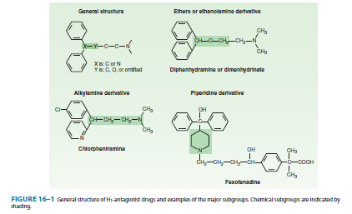

Slide 13
Clinical uses of H1 Antagonists
Allergic reactions:
More effective when given before exposure.
Sedative effect reduces awareness of itching.
Local application may induce allergy by itself.
Motion Sickness and Vestibular Disturbances: Menier’s Syndrome.
Nausea and vomiting of Pregnancy (Morning Sickness):
Teratogenic in rodents.

Slide 14
H2 Antagonists
Breakthrough treatment for peptic ulcer disease(1972).
Do not completely abolish acid secretion(40-60%).
Replaced by proton pump inhibitors(100% inhibition).
Cimetidine.
Ranitidine.
Famotidine.
Naziditine.

Slide 15
Serotonin and 5-Hydroxytryptamine
Serotonin: a vsoconstrictor released from the blood clot.
Enteramine: a smooth muscle stimulant found in intestinal mucosa.
5-Hydroxytryptamine( synthesized in 1951)

Slide 16
Serotonin and 5-Hydroxytryptamine
Widely distributed in nature, found in plant
( (Banana) and animal tissues, venoms, and stings.
Synthesized from L-tryptophan.
Stored or rapidly inactivated by MAO.
90% is found in the enterochromaffin cells of the GIT.
Also found in platelets, enteric nervous system, nerve endings, and brain.
Involved in mood, sleep, appetite, temperature control, and pain perception.
Involved in depression, anxiety, migraine,

Slide 19
Pharmacologic Effects of Serotonin
Nervous System:
Melatonin
Chemoreceptor Reflex( Bezold-Jarish Reflex): activation of 5-HT3 receptors in coronary arteries, leads to hypotension and bradycardia.
Respiratory System:
Bronchoconstriction and hyperventilation.
Cardiovascular System:
Vasoconstriction.
Vasodilation in skeletal muscles and coronary arteries. Intact endothelium is required
Platelets aggregation.

Slide 20
Pharmacologic Effects of Serotonin
GIT:
Stimulation and diarrhea.
Carcinoid Syndrome: due to a tumor of the enterochromaffin cells.
Skeletal Muscle:
Serotonin Syndrome:
Due to excess serotnergic activity.
Potentially fatal .
Skeletal muscle contraction and hyperthermia
Predictable, not idiosyncratic.

Slide 21
Clinical Uses of Serotonin Agonists
Serotonin:
Has no clinical application.
Buspirone:
5HT1A agonist, anxiolytic, nonsedating.
Triptans: e.g. Sumatryptan
5HT1D/1B agonists
First line drugs for migraine headache.
Cisapride:
5HT4 agonist used only in gastroesophageal reflux.
Tagaserod:
5HT4 agonist
Fluoxetine:
SSRI, widely used in depression.

Slide 22
Serotonin Antagonists
Phenoxybenzamine:
An alpha blocker
Cyproheptadine:
5HT2 and H1 blocker.
Useful in carcinoid and serotonin syndrome.
Ketanserine:
5HT2 blocker, antihypertensive agent.
Ritanserine:
5HT2 blocker, prevents platelets sggregation.
Ondansetron:
5HT3 blocker, used to prevent nausea and vomiting of cancer chemotherapy.

Slide 23
Ecosanoids
Prostaglandins.
Thromboxanes.
Leukotrienes.

Slide 24
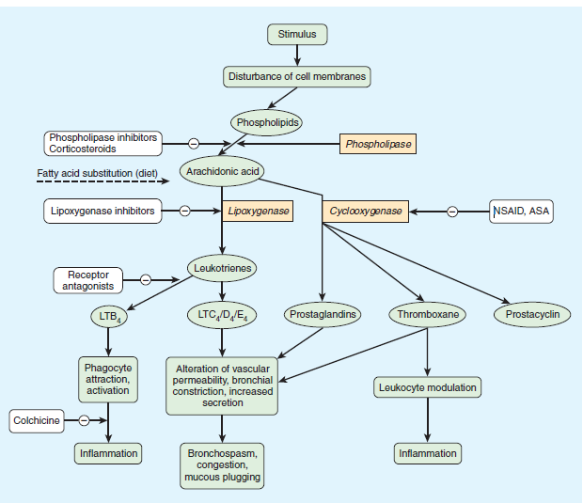

Slide 25
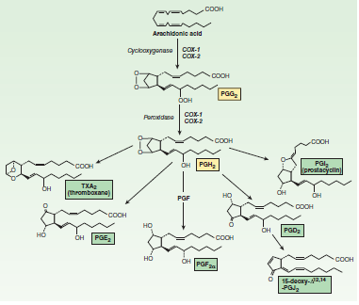

Slide 26
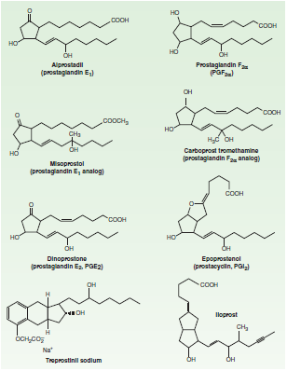

Slide 27
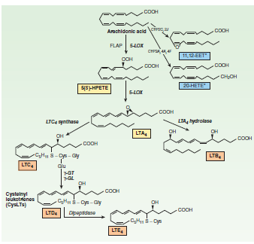

Slide 28
Vasoactive Peptides
Renin-Angiotensin- Aldosterone System(RAAS).
Kinins.
Vasopressin.
Natriuretic Peptides.
Endothelins.
Vasoactive Intestinal Peptide.
Subtance P.
Neurotensin.
Calctonin Gene-Related Peptide.
Adrenomedullin.
Neuropeptide Y
Urotensin.

Slide 29
What is RAAS?
RAAS is a hormonal cascade that functions to control arterial pressure, tissue perfusion, and extracellular volume.
Pathophysiologic processes might occur when components of the RAAS are overexpressed or inhibited, thus disturbing the balance of this regulatory system
Dysregulation of the RAAS plays an important role in the pathogenesis of cardiovascular and renal disorders.

Slide 30
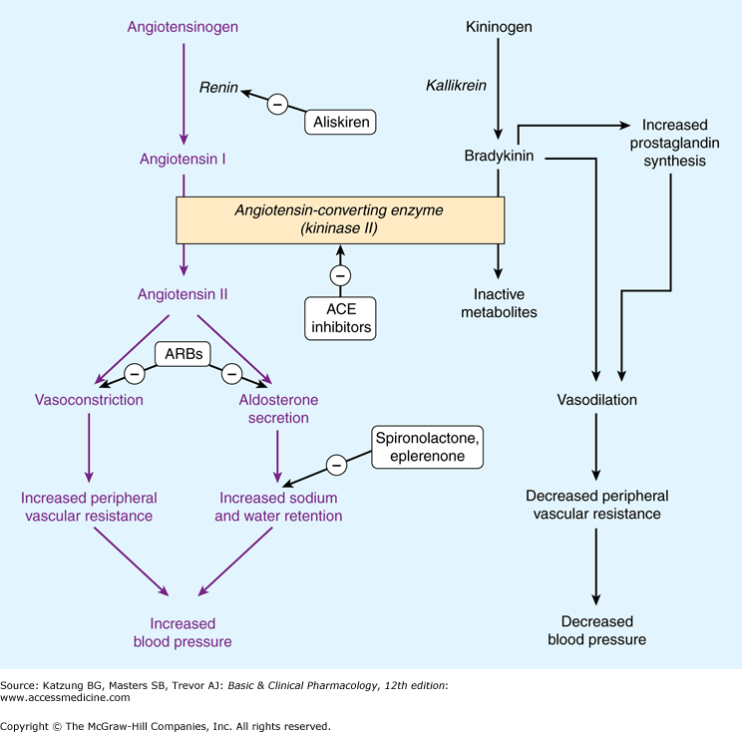
CHYMASE
Aug-15
Munir Gharaibeh, MD, PhD, MHPE
30

Slide 31
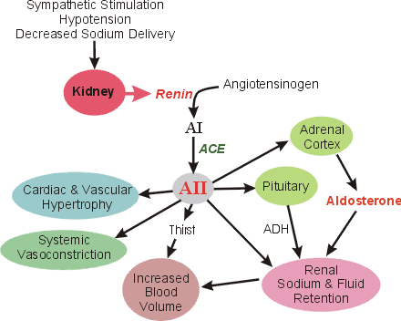

Slide 32
Local Renin-angiotensin Systems
 The renin-angiotensin system is a classic
endocrine system.
 There are complete local renin-angiotensin systems existing entirely within organs and tissues .
e.g. in the vascular endothelium, volume depletion increases angiotensinogen levels in aortic smooth muscle.
-Then either locally produced or systemic renin could initiate the sequential formation of angiotensin I and II.

Slide 33
The Cardiac Renin-Angiotensin System
-Stretch directly increases:
Release of angiotensin II from cardiac myocytes.
Expression of the angiotensinogen gene on the long-term.
-The apparent function of the cardiac RAAS is to maintain cellular balance of inhibition and cellular growth .

Slide 34
Effects of the Angiotensin II on the Heart
1- Inotropy .
2- Hypertrophy.
3- Ventricular remodeling
4- Electrical remodeling.
5- Pathogenesis of atherosclerosis

Slide 35
Angiotensin II
AT₁R
Superoxide
Inflammation
Cell Growth, Fibrosis
Aldosterone, NE
⇧ BP
⇧Glucose
Atherosclerosis
Remodeling of
Heart & Vessels
Plaque
Progression
MI & Stroke
Death

Slide 36
Alternative Pathways Of The Renin
Alternative enzymatic pathways, not involving ACE, contribute to angiotensin II production.
Human heart chymase appears to be the most important of these pathways, particularly in the ventricles .
The physiologic importance of chymase is uncertain because of the presence of natural protease inhibitors in the interstitial fluid which inhibit chymase-induced angiotensin II production.

Slide 37
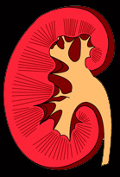
(Pro)renin receptor
RI
Prorenin
Renin
PRA
Angiotensinogen
B-blocker
ACE
ACE-I
Ang I
Non-ACE
pathway
Ang II
Ang III
Ang IV
ARB
Victor , J Clin Hypertens, 2007 in press.
AT₁R
AT₂R
AT₄R

Slide 38
CHYMASE
Aug-15
Munir Gharaibeh, MD, PhD, MHPE
38

Slide 39
Direct Renin Inhibitors
The most recent class of agents that block the RAAS, are the direct renin inhibitors represented by aliskiren,
Recently approved for treatment of hypertension.
This compound differs from the ACEIs and ARBs in that, by blocking the catalytic activity of renin at the point of activation of the RAAS, it blocks the synthesis of all angiotensin peptides and prevents the compensatory increase in renin activity

Slide 40
Angiotensin-converting enzyme inhibitors (ACEI)
ACEI lower systemic vascular resistance and venous pressure, and reduce levels of circulating catecholamines, thus improving myocardial performance.

Slide 41
Angiotensin-converting enzyme inhibitors ACEI
Captopril
Benazepril
Enalapril
Fosinopril
Lisinopril
Moexipril
Quinapril
Ramipril

Slide 42
Cardiorenal Effects of ACE Inhibitors
Vasodilation (arterial & venous): - reduce arterial & venous pressure. - reduce ventricular afterload and preload.
Decrease blood volume: - natriuretic. - diuretic.
Depress sympathetic activity.
Inhibit cardiac and vascular hypertrophy.

Slide 43
Angiotensin - Converting Enzyme Inhibitors (ACEI)
Therapeutic Benefits:
High-rennin hypertension ( present in 20% of cases).
HF and Ischemic Heart Disease.
Do not increase HR.
Diabetic Nephropathy, dilate efferent arterioles which will reduce intraglomerular pressure and consequently protects against progressive glomerulosclerosis.
No need for a diuretic but can be added.
Can be combined with CCBs.
Should not be combined with Beta blockers, except in HF.
No metabolic effects(DM, Lipids, Uric Acid).
Aug-15
43

Slide 44
Angiotensin - Converting Enzyme Inhibitors (ACEI)
Side Effects:
Captopril is SH containing drug, so very toxic( bone marrow suppression, disguesia, proteinuria, allergic skin rash, fever)
Hypotension( First Dose Phenomena) especially with renovascular hypertension.
K+ retention, especially in the presence of renal dysfunction or when combined with K+ sparing diuretics or ARBs.
Cough(10% of patients).
Angioedema.
Aug-15
Munir Gharaibeh, MD, PhD, MHPE
44

Slide 45
Angiotensin Receptor Antagonists(ARBs)
Losartan.
Irbersartan.
Candesartan.
Valsartan
Have similar haemodynamic effects to ACEI
Do not affect bradykinin metabolism.
Do not cause cough.
Block the effects of Angiotensin II generated from both pathways (chymase &ACE)

Slide 47
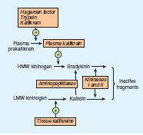

Slide 48
Actions of Kinins
Cardiovascular System:
Arteriolar vasodilation: direct & endothelium-dependent via the release of NO and PGI₂
Venous constriction: direct and via PGF_{2α}
Increased capillary permeability
Response to iv bradykinin:
Transient decrease in BP: direct arteriolar dilation
Restoration of normal BP: reflex sympathetic discharge

Slide 49
Actions of Kinins
Other Effects:
Pro-inflammatory
Algesic: via PGE₂
Constrict visceral smooth muscle
Putative Effects:
Local modulators of blood flow
Modulate tone of salivary and pancreatic ducts
Regulate transport of H₂O, electrolytes, aa in GIT

Slide 50
Kinin Receptors
B₁:
Sensitive to des-Arg metabolites
Kallidin is 10x more potent than BK
limited tissue distribution
VSM contraction, proliferation,
Collagen synthesis, inflammation
Induced by trauma
B₂ (B_{2A}, B_{2B}):
Sensitive to intact peptides
GPCR; wide tissue distribution
Vasodilation, permeability, pain.
Ca⁺⁺ mobilization, Cl⁻ transport, NO, PLC, PLA₂, AC
B₃: Unknown function

Slide 51
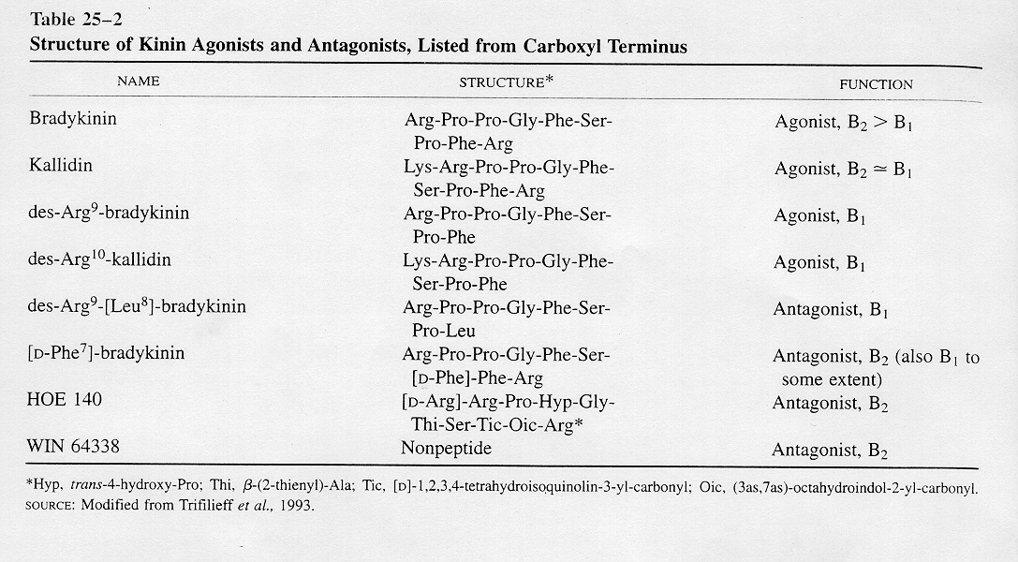
Kinins

Slide 52
Kinins
Potential Clinical Uses of KKS Antagonists:
Allergic conditions
Anti-inflammatory
Anti-nociceptive

