Slide 1
Adrenal gland
Dr Heyam Awad
FRCPath

Slide 2
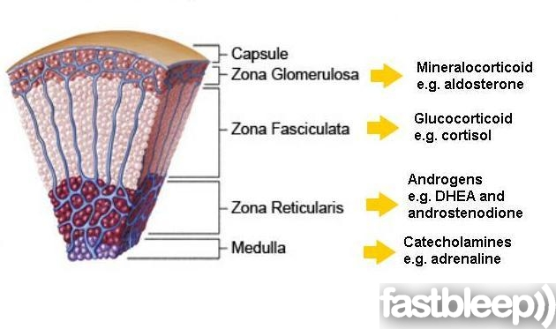
Adrenal gland

Slide 3
Adrenal cortex
Hyperadrenalism :
*Hypercortisolism,
*hyperaldosteronism.
* adrenogenital syndromes (will not be discussed here)
Hypoadrenalism:
*acute adrenal insufficiency
*chronic adrenal insufficiency (Addison disease)
*secondary adrenal insufficiency.
Masses = Neoplasms
* adenoma
*carcinoma

Slide 4
Hypercortisolism (Cushing Syndrome)
- Exogenous glucocorticoids (Iatrogenic) : Most common cause
- Endogenous causes
Primary hypothalamic-pituitary diseases ; hypersecretion of ACTH (Cushing disease)
Primary adrenal hyperplasia and neoplasms
Secretion of ectopic ACTH by nonpituitary tumors

Slide 5
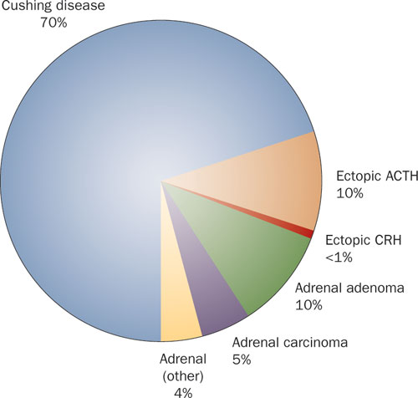

Slide 6
HYPOTHALAMIC- PITUITARY CAUSES CUSHING DISEASE
-70% of cases of spontaneous, endogenous Cushing syndrome are due to Cushing disease.
Occurs most frequently during young adulthood (the 20s and 30s)
mainly affecting women.

Slide 7
CUSHING DISEASE
-majority: pituitary gland contains an ACTH-producing adenoma
- In the remaining patients, the anterior pituitary contains areas of corticotroph cell hyperplasia which may be:
a. Primary
or, less commonly, secondary to CRH producing tumor

Slide 8
MORPHOLOGY
The adrenal glands in Cushing disease show bilateral nodular cortical hyperplasia secondary to the elevated levels of ACTH ("ACTH-dependent" Cushing syndrome).

Slide 9
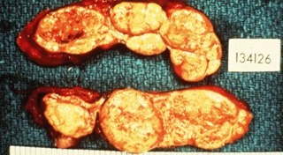
Nodular cortical hyperplasia

Slide 10
PRIMARY ADRENAL HYPERPLASIA AND NEOPLASMS
10% to 20% of cases of endogenous Cushing syndrome
ACTH-independent Cushing syndrome, or adrenal Cushing syndrome ; low serum levels of ACTH
Caused by adrenal adenoma or carcinoma.
primary hyperplasia can cause it but is very rare.

Slide 11
ECTOPIC ACTH BY NONPITUITARY TUMORS
- mostly caused by small cell carcinoma of the lung,
- The adrenal glands undergo bilateral hyperplasia due to elevated ACTH,

Slide 12
Changes in adrenal in cases of Cushing syndrome:
1) Cortical atrophy :If the syndrome results from exogenous glucocorticoids ,suppression of endogenous ACTH results in bilateral cortical atrophy.
- The zona glomerulosa is of normal thickness because it functions independently of ACTH
2) Diffuse and nodular hyperplasia: Is found in 60% to 70% of Cases of endogenous Cushing syndrome.
- Secondary hyperplasia is found in patients with ACTH- dependent Cushing syndrome (due to Cushing disease or ectopic production of ACTH)

Slide 13
Primary adrenocortical neoplasms
- Are more common in women in their 30s to 50s.
a. Adrenocortical adenomas: Are yellow tumors surrounded by thin capsules, and most weigh less than 30 g
Carcinomas tend to be nonencapsulated masses , exceeding 200 to 300 g in weight,

Slide 14
CLINICAL MANIFESTATIONS OF CUSHING SYNDROME
Hypertension and weight gain
truncal obesity, "moon facies,“ accumulation of fat in the posterior neck and back ("buffalo hump") .
Glucocorticoids induce gluconeogenesis with resultant hyperglycemia, glucosuria, and polydipsia,
The catabolic effects on proteins cause loss of collagen and resorption of bone and bone resorption results in osteoporosis and susceptibility to fractures.
The skin is thin, fragile, and easily bruised; cutaneous striae are particularly common in the abdominal area
Patients are at increased risk for a variety of infections.
g. Hirsutism and menstrual abnormalities
h. Mental disturbances ,mood swings, depression, psychosis

Slide 15
Clinical features

Slide 16
Moon face

Slide 17
Buffalo hump

Slide 18
buffalo

Slide 19
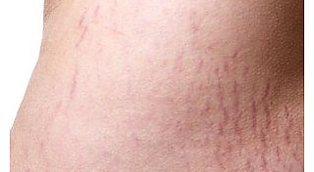
stria

Slide 20
HYPERALDOSTERONISM
Primary hyperaldosteronism:
- autonomous overproduction of aldosterone with secondary suppression of renin- angiotensin system and decreased plasma renin activity
Secondary hyperaldosteronism:
- Secondary to activation of renin-angiotensin system characterized by increased levels of plasma renin

Slide 21
CAUSES OF SECONDARY HYPERALDOSTERONISM
Decreased renal perfusion
b. Arterial hypovolemia and edema e.g heart failure
c. Pregnancy (caused by estrogen-induced increases in plasma renin substrate

Slide 22
PRIMARY HYPERALDOSTERONISM
a. Bilateral idiopathic hyperaldosteronism,
- bilateral nodular hyperplasia of adrenals
- the most common underlying cause (60% of cases)
b. Adrenocortical neoplasm, adenoma (the most common cause) or, rarely, an adrenocortical carcinoma.
- In approximately 35% of cases, the cause is a solitary aldosterone-secreting Aldosterone-producing adrenocortical adenoma referred to as Conn syndrome
c. Rarely, familial hyperaldosteronism may result from a genetic defect that leads to overactivity of the aldosterone synthase gene, CYP11B2.

Slide 23
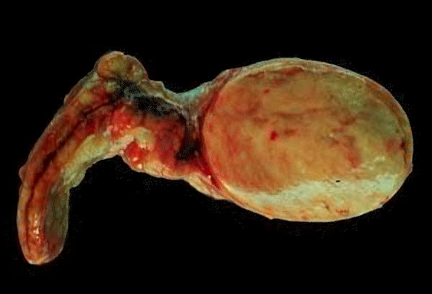
Adrenocortical adenoma

Slide 24
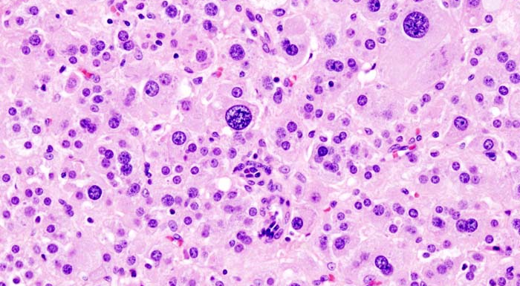
Adrenocortical adenoma

Slide 25
CLINICAL FEATURES OF HYPERALDOSTERONISM
The clinical hallmark is hypertension
- Hyperaldosteronism may be the most common cause of secondary hypertension
Hypokalemia results from renal potassium wasting and, can cause neuromuscular manifestations, including weakness, paresthesias,, and occasionally frank tetany.
Parasthesia = abnormal sensation, typically tingling or pricking (“pins and needles”), caused chiefly by pressure on or damage to peripheral nerves.
Tetany = intermittent muscular spasms.

Slide 26
ADRENAL INSUFFICIENCY
Acute Adrenocortical Insufficiency :
causes
a. Crisis in patients with chronic adrenocortical insufficiency precipitated by stress
b. In patients maintained on exogenous corticosteroids .. Sudden withdrwal, or stress
c. Massive adrenal hemorrhage.

Slide 27
Massive adrenal hemorrhage
may destroy enough of the adrenal cortex to cause acute adrenocortical insufficiency.
- This condition may occur :
1. In patients maintained on anticoagulant therapy
2. Patients suffering from sepsis : a condition known as the Waterhouse-Friderichsen syndrome
Sepsis due to: Neisseria meningitidis ,Pseudomonas spp., , and Haemophilus influenzae
Underlying cause??? unclear but probably involves endotoxin-induced vascular injury .

Slide 28
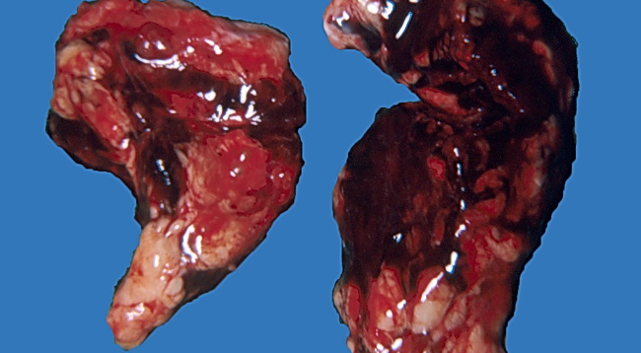
Massive adrenal hemorrhage

Slide 29
primary chronic adrenocortical insufficiency (Addison disease):
-uncommon disorder resulting from progressive destruction of the adrenal cortex.
Causes:
Autoimmune adrenalitis.
Infections
Metastatic tumors

Slide 30
ADDISON DISEASE
1. Autoimmune adrenalitis
- 60% to 70% of Addison disease cases and is the most common cause of primary adrenal insufficiency in developed countries.
There is autoimmune destruction of steroid-producing cells, and autoantibodies to several key steroidogenic enzymes have been detected in affected patients
-

Slide 31
Addison disease
2. Infections,: Tuberculosis and Fungal infections
Tuberculous adrenalitis, which once accounted for as many as 90% of cases of Addison disease, has become less common with the advent of anti-tuberculosis therapy
- Disseminated infections caused by Histoplasma capsulatum and Coccidioides immitis also may result in chronic adrenocortical insufficiency.
- Patients with AIDS are at risk for the development of adrenal insufficiency from several infectious (cytomegalovirus and TB) and noninfectious (Kaposi sarcoma) .

Slide 32
ADDISON DISEASE
3- Metastatic neoplasms involving the adrenals:
Carcinomas of the lung and breast are the most common primary sources.

Slide 33
Secondary adrenocortical insufficiency
Hypothalamic- pituitary diseases including:
Metastasis
Infection.
Infarction
Irradiation
Can be part of panhypopituitarism.

Slide 34
Clinical features of adrenal insufficiency
- Clinical manifestations of adrenocortical insufficiency do not appear until at least 90% of the adrenal cortex has been compromised.
a. progressive weakness and easy fatigability .
b. Gastrointestinal disturbances are common and include anorexia, nausea, vomiting, weight loss, and diarrhea
In patients with primary adrenal disease, increased levels of ACTH precursor hormone stimulate melanocytes, with resultant hyperpigmentation of the skin and mucosal surfaces: The face, axillae, nipples, areolae, and perineum are mainly affected
Note: hyperpigmentation is not seen in patients with secondary adrenocortical insufficiency.

Slide 35
d. Decreased aldosterone in primary hypoadrenalism results in potassium retention and sodium loss , with consequent - hyperkalemia, hyponatremia, volume depletion, and hypotension,
- In secondary hypoadrenalism is characterized by deficient cortisol and androgen output but normal or near-normal aldosterone synthesis. Why?

Slide 36
Adrenal medulla
Chromaffin cells… derived from the neural crest.
Secrete catecholamines.
Most important disease: neoplasms.

Slide 37
TUMORS OF THE ADRENAL MEDULLA
Pheochromocytoma
- give rise to a surgically correctable form of hypertension.
- Pheochromocytomas usually subscribe to "rule of 10s":
10% of pheochromocytomas are extraadrenal, called paragangliomas,
10% of adrenal pheochromocytomas are bilateral; this proportion may rise to 50% in cases that are associated with familial syndromes.
c. 10% of adrenal pheochromocytomas are malignant,
Frank malignancy is somewhat more common in tumors arising in extraadrenal sites.

Slide 38
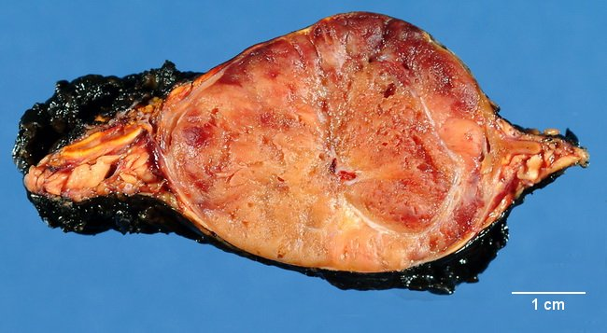
pheochromocytoma

Slide 39
On microscopic examination
- Are composed of polygonal to spindle-shaped chromaffin cells and their supporting cells,compartmentalized into small nests, or Zellballen, by a rich vascular network
- The cytoplasm has a finely granular appearance, because of the presence of granules containing catecholamines.
- The nuclei of the neoplastic cells are often pleomorphic

Slide 40
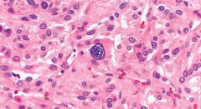
pheochromocytoma

Slide 41
Pheochromocytoma..
- The definitive diagnosis of malignancy in pheochromocytomas is based exclusively on the presence of metastases.
These may involve regional lymph nodes as well as more distant sites, including liver, lung, and bone.

Slide 42
Clinical Features
The predominant clinical manifestation is hypertension
Sudden cardiac death may occur, probably secondary to catecholamine-induced myocardial irritability and ventricular arrhythmias.
- In some cases, pheochromocytomas secrete hormones such as ACTH and somatostatin.
The laboratory diagnosis of pheochromocytoma is based on demonstration of increased urinary excretion of free catecholamines and their metabolites, such as vanillylmandelic acid and metanephrines.

