Slide 1
Joints of the lower limb

Slide 2
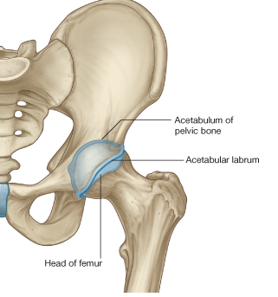
Hip joint
1-Type:
Synovial ball-and-socket joint
2-Articular surfaces:
a- head of femur
b- lunate surface of acetabulum
Which is deepened by the fibrocartilaginous labrum acetabulare
3-Nerve Supply:
Femoral nerve
Obturator nerve
Sciatic nerve
Remember referred pain

Slide 3
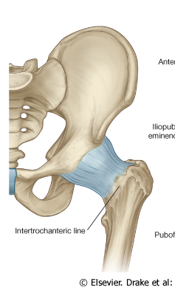
Capsule
4-The capsule of the hip is attached
proximally to the margins of the acetabulum
posteriorly,
to the femoral neck about 0.5 in (12mm) from the trochanteric crest.
From this distal attachment, capsular fibres are reflected on to the femoral
neck as retinacula and provide one pathway for the blood supply to the
femoral head
؟؟؟؟؟
Distally, it is attached along
the trochanteric line, the bases of the greater and lesser trochanters

Slide 4
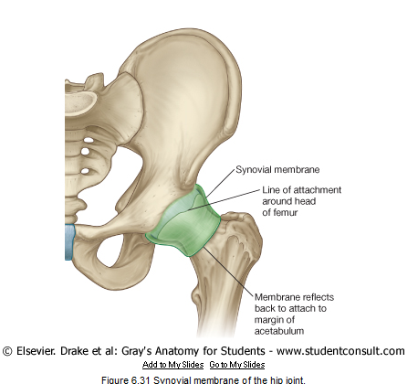
5-The synovial membrane of the hip joint
lines the fibrous layer as well as any intracapsular bony surfaces not lined with articular cartilage
Thus, where the fibrous layer attaches to the femur, the synovial membrane reflects proximally along the femoral neck to the edge of
the femoral head. The synovial folds (retinacula), which reflect superiorly along the femoral neck as longitudinal bands, contain subsynovial
ret inacular arteries (branches of the medial and a few from the lateral femoral circumflex artery), which supply the head and neck of the
femur
important

Slide 5
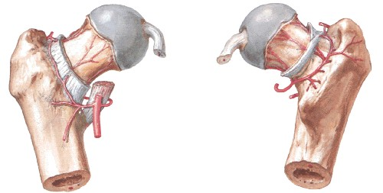
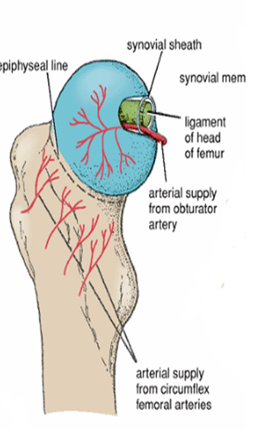
6-Subsynovial retinacular arteries
(branches of the medial and a few from the lateral femoral circumflex artery), which supply the head and neck of the femur
Anterior view
Posterior view

Slide 6
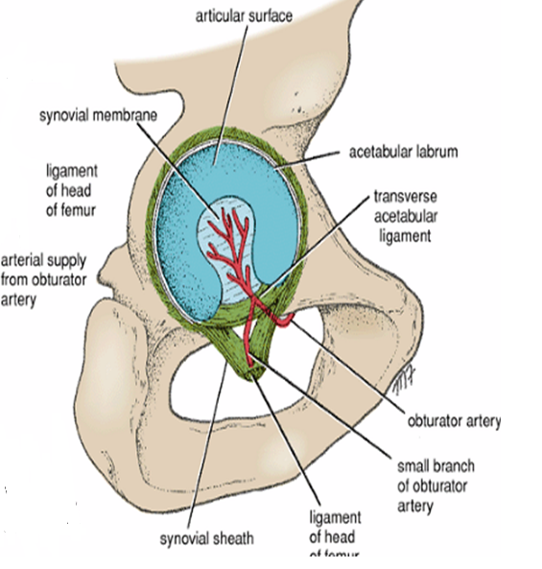
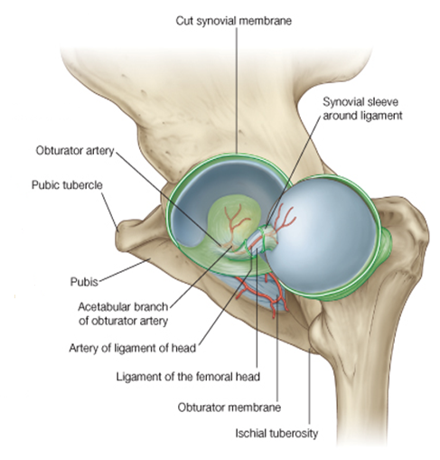
Blood supply of the head of the femur
-Acetabular (foveolar) br. of post division of obturator a. (patent in approx. 30% )

Slide 7
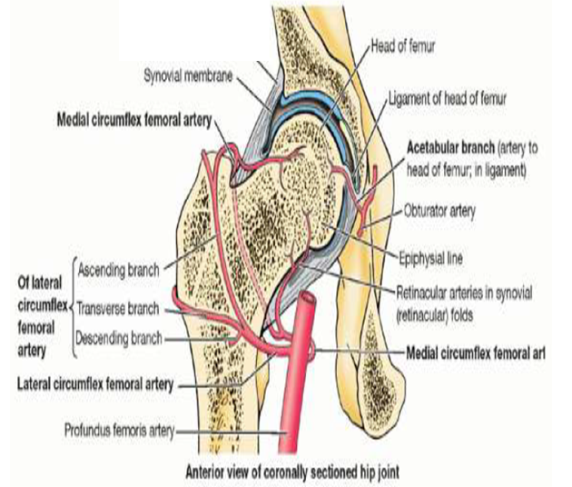
1-Medial and lateral circumflex femoral arteries
The main blood supply is from
the retinacular arteries arising as branches from the circumflex femoral
arteries (especially the medial circumflex femoral artery).
Blood supply to the head of the femur
2-Artery to the head of femur, a branch of the obturator artery that traverses the ligament of the head.

Slide 8
Practice the blood supply of the head of femur

Slide 9
The upper end of the femur is a common site for fracture
in the elderly
The neck may break
1-immediately beneath the head subcapital
2-near its midpoint
cervical
3-adjacent to the trochanters basal
4-the fracture line
may pass between, along or just below the trochanters
pretrochanteic

Slide 10
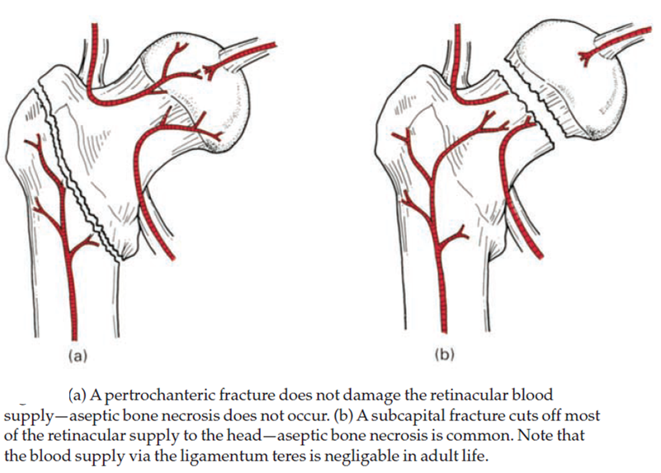
Neck fracture will result in
important

Slide 11
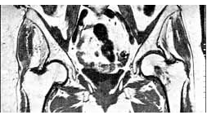
For reading only
MRI revealing Left Femoral neck Fracture

Slide 12
7-MAIN LIGAMENTS OF THE HIP JOINT
a-Iliofemoral: is a strong, inverted
Y-shaped ligament.
Prevents hyperextension of hip joint during
standing
b-Pubofemoral: limits extension and abduction
c-Ischiofemoral:
limits extension

Slide 13
D-The ligament of head of femur ligamentum teres
primarily a synovial fold conducting a blood vessel, is weak and of little importance in strengthening
the hip joint
Its wide end attaches to the margins of the acetabular notch and the transverse acetabular ligament; its narrow end attaches to the femur at the fovea for the ligament of the head of femur. Usually, the ligament contains a small artery to the head of the femur.
The
non-articular lower part of the acetabulum, the acetabular notch, is closed off
below by the
E-transverse acetabular ligament

Slide 14
8-Movements
Flexion is performed by the iliopsoas, rectus femoris, and sartorius
Extension is performed by the gluteus maximus and the hamstring muscles.
Abduction is performed by the gluteus medius and minimus, assisted by the sartorius, tensor fasciae latae, and piriformis.
Adduction is performed by the adductor longus and brevis and the adductor fibers of the adductor magnus. These muscles are assisted by the pectineus and the gracilis.
Lateral rotation is performed by the short lateral rotator muscles and assisted by the gluteus maximus.
Medial rotation is performed by the anterior fibers of the gluteus medius and gluteus minimus and the tensor fasciae latae.
Flexion is limited by the hamstring muscle group. Extension is limited
by the ligamentous thickening of the capsule; abduction, by the adductor
group of muscles; adduction, by the tensor muscle and fascia of the abductor
muscles; and rotation, by the fibrous capsular

Slide 15
9- Angle of Inclination
it is the angle between the neck and shaft of the femur
Approx. 125º
typically ranges from 115 to 140 degrees
is about 160° in the young child and about 125° in the adult

Slide 16
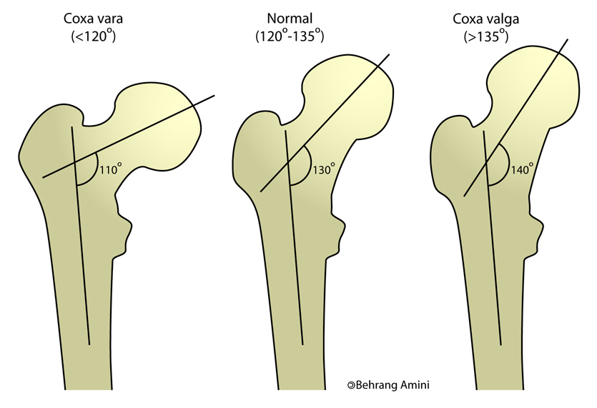
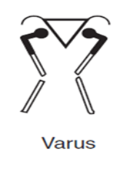
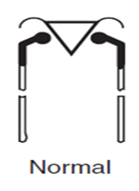
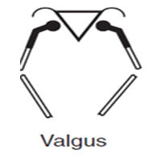
it occurs in fractures of the neck of the femur and in slipping of the femoral epiphysis. In this condition, abduction of the hip joint is limited
for example, in cases of congenital dislocation of the hip. In this condition, adduction of the hip joint is limited

Slide 17
Shenton's line is a useful means of assessing the angle of the femoral neck on a radiograph of the hip region
Note that the inferior margin of the neck of the femur should form a continuous curve with the upper margin of the obturator foramen (Shenton's line)

Slide 18
10-There is a pattern of hip injuries;
In children may sustain
greenstick fractures of the femoral neck
schoolboys may displace the epiphysis
of the femoral head
in adult life the hip dislocates
in old age
fracture of the neck of the femur again becomes the usual lesion

Slide 19
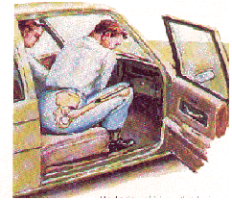
Dislocation of the hip
The hip is usually dislocated backwards and this is produced by a force applied along the femoral shaft with the hip in the flexed position (e.g. the
knee striking against the opposite seat or in car accedent
The sciatic nerve, is in a close posterior relation with the hip joint therefore, it is in a danger of
damage in these injuries

