Slide 1
Liver, Gallbladder, & Spleen

Slide 2
Liver
The liver is the largest gland in the body and has a wide variety of functions
Weight: 1/50 of body weight in adult & 1/20 of body weight in infant
It is exocrine(bile) & endocrine organ(Albumen , prothrombin & fibrinogen)
Function of the liver
Secretion of bile & bile salt
Metabolism of carbohydrate, fat and protein
Formation of heparin & anticoagulant substances
Detoxication
Storage of glycogen and vitamins
Activation of vita .D

Slide 3
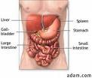
Location …
•Occupies right hypochondrium + epigastrium &extends to left hypochondrium

Slide 4
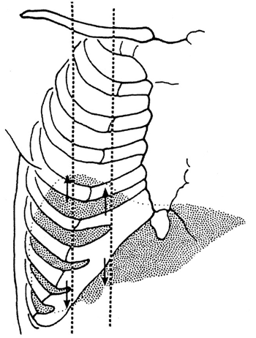
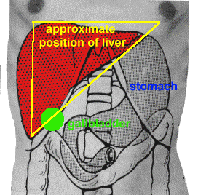
Surface anatomy of the liver
The greater part of the liver is situated under cover of the right costal margin
- Diaphragm separates it from the pleura, lungs, pericardium, and heart.

Slide 5
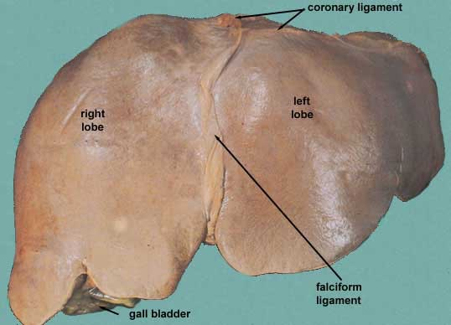
Ant. View of the Liver
Right lobe
Cut edge of the Falciform ligament left lobe
Diverging cut edges of the superior part of the coronary ligament
Fundus of the gall bladder

Slide 6
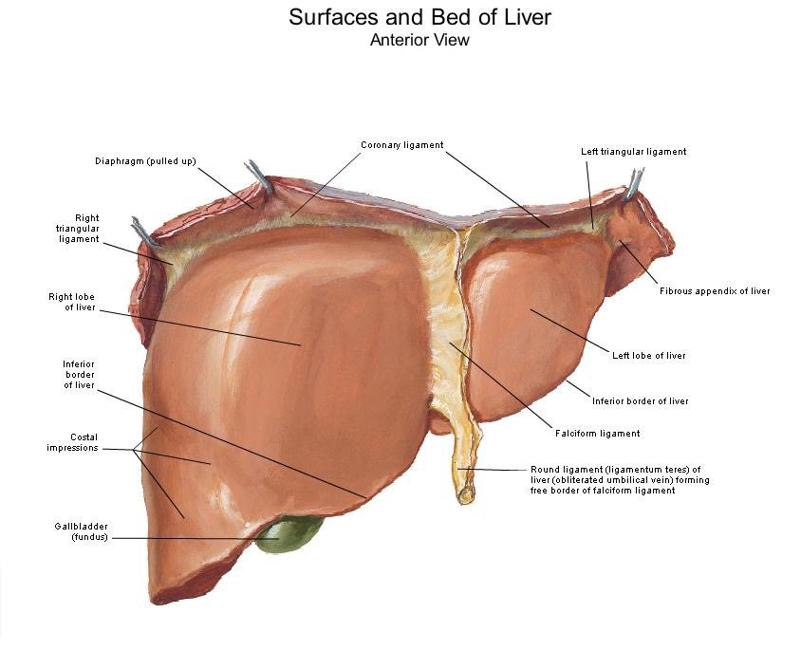
Surfaces of the liver, their relations & impressions
Postero - inferior surface= visceral surface
Superior surface = Diaphragmatic surface
Anterior surface
Posterior surface
Right surface

Slide 7
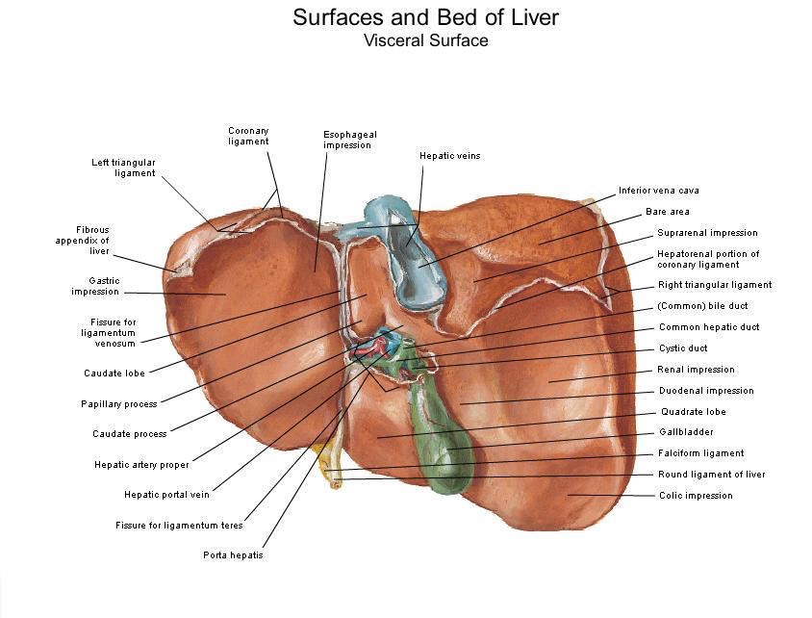
Postero- infero surface= visceral surface
Relations
I.V.C
the esophagus
the stomach
the duodenum
the right colic flexure
the right kidney
Rt. Suprarenal gland
the gallbladder.
Porta hepatic( bile duct,H.a.H.V)
Fissure for lig. Venoosum & lesser omentum
Tubular omentum
Lig.teres

Slide 8
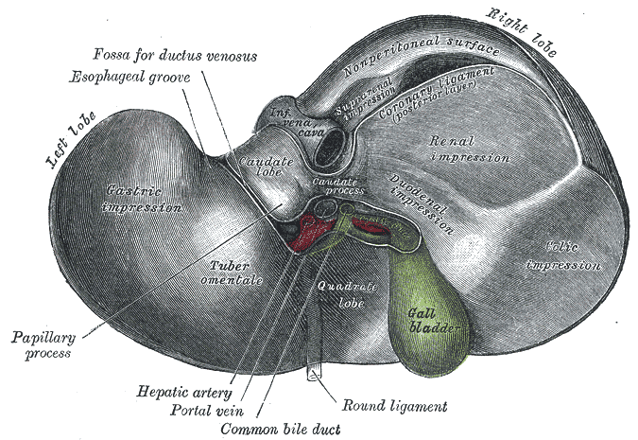
Postero-inferior surface of the liver

Slide 9
Sup. Surface of the liver
Right & left lobes
Cut edge of the Falciform ligament
The cut edges of the superior and inferior parts of the coronary ligament
The left triangular ligament
The right triangular ligament
Bare area of the liver (where there is no peritoneum covering the liver
Groove for the inferior vena cava and the hepatic veins
Caudate lobe of the liver more or less wrapping around the groove of the inferior vena cava
Fundus of gall bladder
Lig.teres

Slide 10
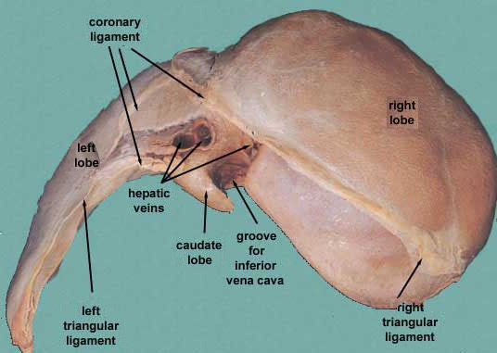

Slide 11
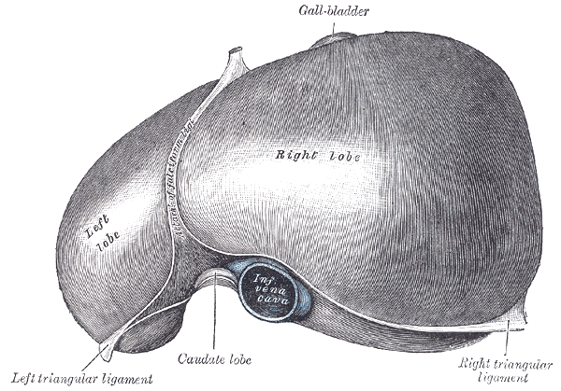
Relations of Sup. Surface of The Liver
Diaphragm
Pleura & lung
Pericardium & heart

Slide 12
Relations of the Liver Anteriorly
Diaphragm
Rt & Lt pleura and lung
Costal cartilage
Xiphoid process
Ant. abdominal wall

Slide 13
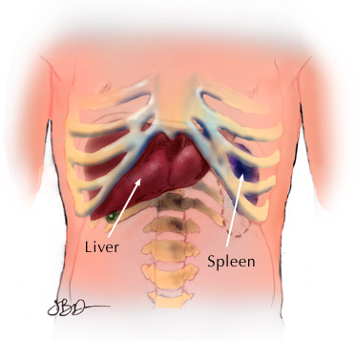
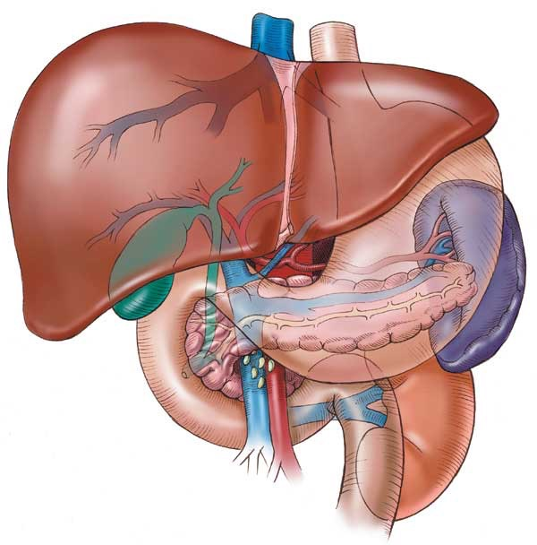

Slide 14
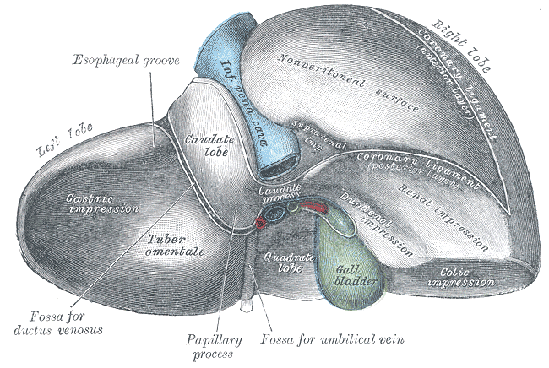
Posterior relation of the liver
Diaphragm
Rt. Kidney
Supra renal gland
T.colon(hepatic flexure
Duodenum
Gall bladder
I.V.C
Esophagus
Fundus of stomach

Slide 15
Lobes of the liver
Rt. Lobe
Lt .lobe
Quadrate lobe
Caudate lobe

Slide 16
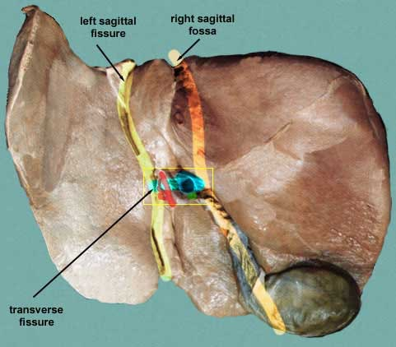
Separation of the four lobes of the liver:
Right sagittal fossa - groove for inferior vena cava and gall bladder
left sagittal fissure - contains the Ligamentum Venoosum and round ligament of liver
Transverse fissure (also porta hepatis) - bile ducts, portal vein, hepatic arteries

Slide 17
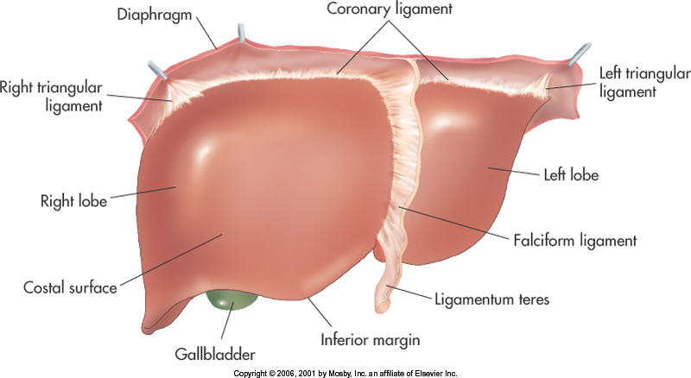
Rt. Lobe
Largest lobe
- Occupies the right hypochondrium
Divided into anterior and posterior sections by the right hepatic vein
Reidel’s Lobe extend as far caudally as the iliac crest

Slide 18
Left Lobe
Varies in size
Lies in the epigastric and left hypochondriac regions
Divided into lateral and medial segments by the left hepatic vein

Slide 19
Lobes of the liver…..cont
Rt. & Lt lobe separated by
Falciform ligament
Ligamentum Venoosum
Ligamentum teres

Slide 20
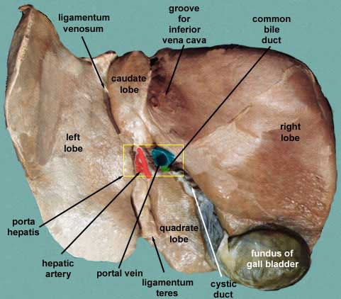
Caudate Lobe
-present in the posterior surface from the Rt. Lobe
Two processes
1- c- process
2- papillary process
Relations of caudate lobe
- Inf. → the porta hepatis
- The right → the fossa for the inferior vena cava
- The left →the fossa for the lig.venosum.

Slide 21
Quadrate lobe
Present on the inferior surface from the Rt. Lobe
Relation
- Ant.→ anterior margin of the liver
- Sup.→ porta hepatis
- Rt. →fossa for the gallbladder
- Lt→ by the fossa for lig.teres

Slide 22
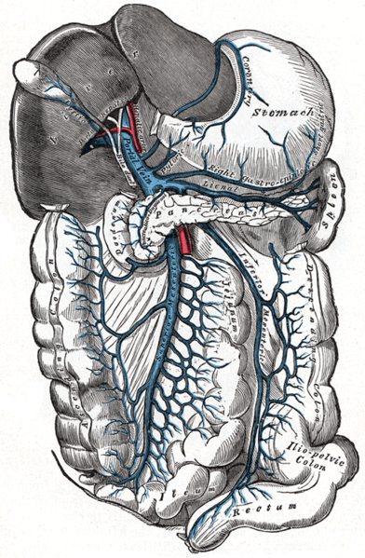
Porta hepatis
It is the hilum of the liver
It is found on the posteroinferior surface
lies between the caudate and quadrate lobes
Lesser omentum attach to its margin
Contents
- Gallbladder → ant.
- Hepatic. Art + nerve+ lymphatic node → middle.
- Portal vein → post.

Slide 23
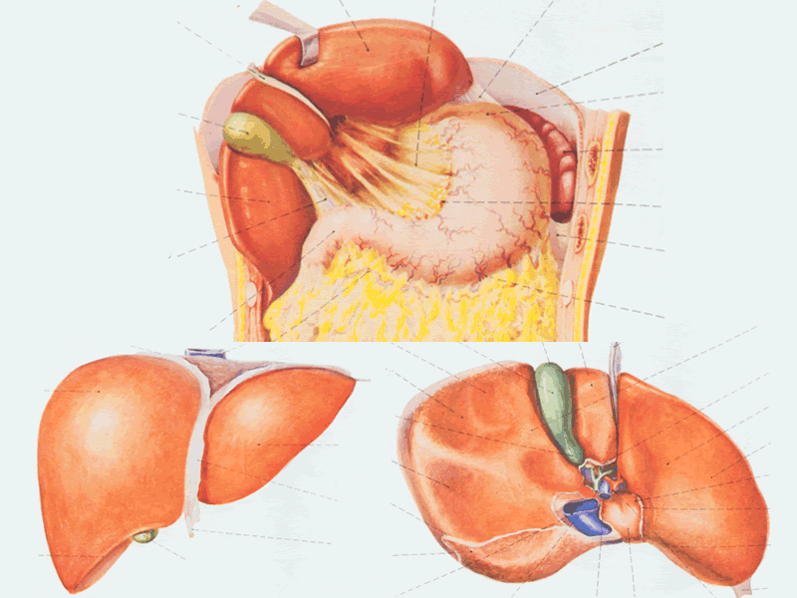
Peritoneum of the liver
The liver is covered by peritoneum (intraperitoneal organ)except at bare area(it is origin from septum transversum)
Inferior surface covered with peritoneum of greater sac except porta hepatis, G.B & Lig.teres fissure
Rt. Lateral surface covered by peritoneum, related to diaphragm which separate it from Rt. Pleura , lung and the Rt Ribs (6-11)

Slide 24
1. The ligaments of the liver
1- The Falciform ligament of liver
2- The Ligamentum teres hepatis
3- The coronary ligament
4- The right triangular ligament
5- The left triangular ligament
6- The Hepatogastric ligament
7- The hepatoduonedenal ligament
8- The Ligamentum Venoosum

Slide 25
Falciform ligament of liver
Consists of double peritoneal layer
Sickle shape
Extends from anterior abdominal wall (umbilicus) to liver
Free border of the ligament contains Ligamentum teres (obliterated umbilical vein)

Slide 27
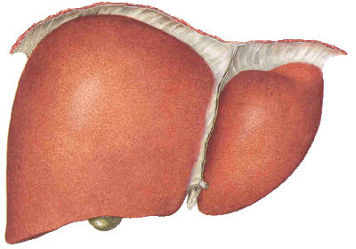
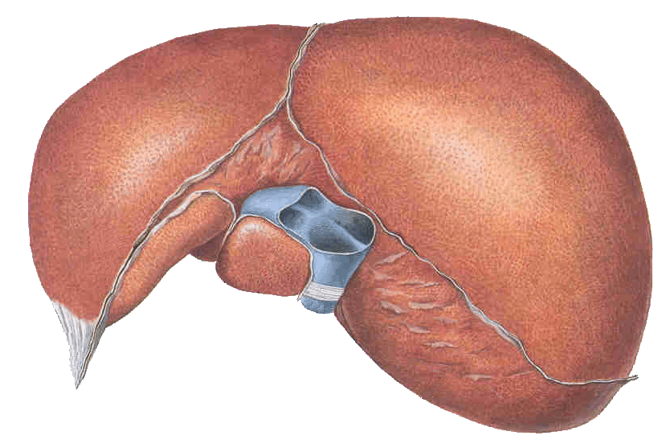
Coronary ligament the area between upper and lower layer of the coronary ligament is the bare area of liver which contract with the diaphragm;
Left and right triangular ligaments formed by left and right extremity of coronary ligament

Slide 28
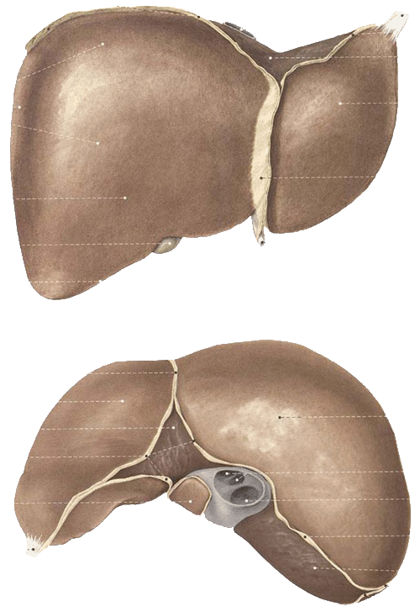
Hepatogastric ligament
Hepatoduodenal ligament

Slide 29
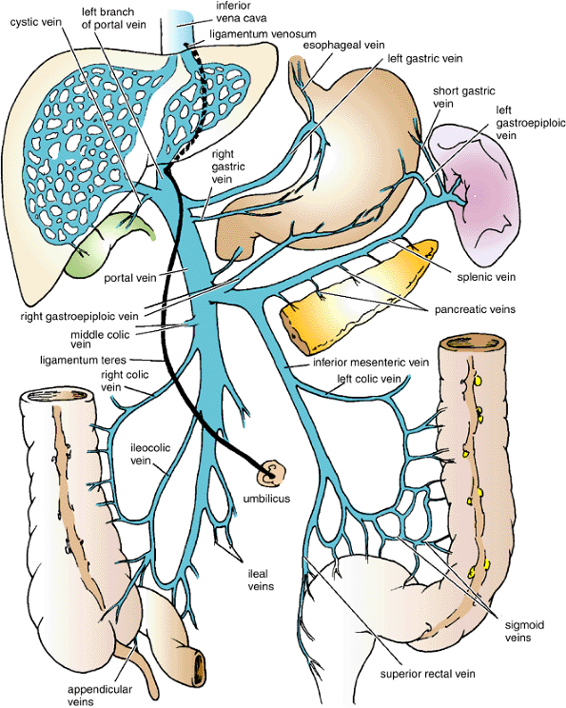
The Ligamentum Venoosum
Fibrous band that is the remains of the ductus venosus
Is attached to the left branch of the portal vein and ascends in a fissure on the visceral surface of the liver to be attached above to the inferior vena cava

Slide 30
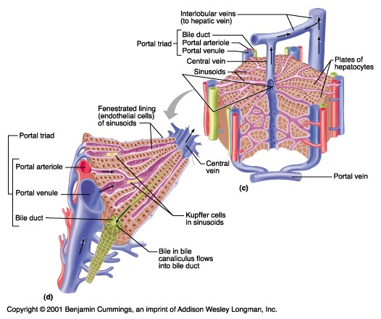
LIVER Histology
lobules >> roughly hexagonal structures consisting of hepatocytes. Radiate outward from a central vein.
At each of the six corners of a lobule is a portal triad ( p.arteriole,p.venule & bile duct)
Between the hepatocytes are the liver sinusoids.

Slide 31
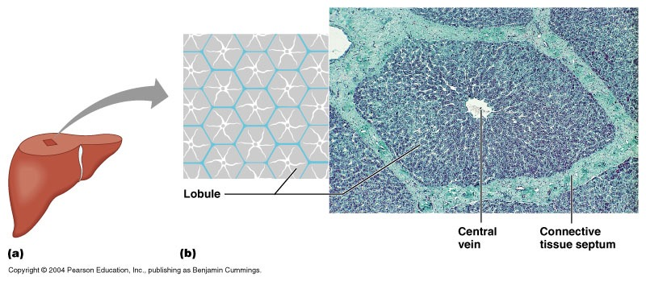
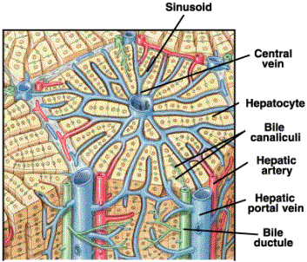
Where do the two blood supplies mix?
Liver surrounded by a thin capsule at portahepatic(it is thick)→Glisson’s capsule invests the liver and send septa into liver subset subdivide the parenchyma into lobules

Slide 32
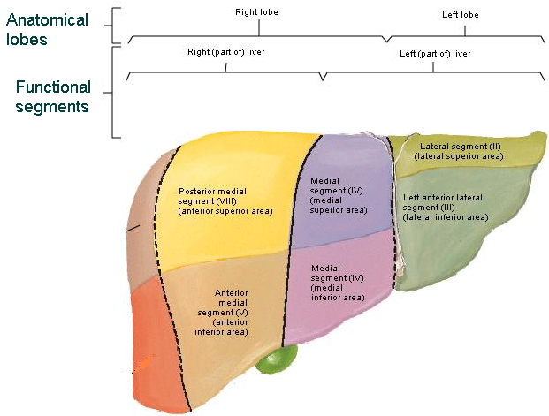
Segmental anatomy of the liver
Rt .& Lt. lobes anatomically no morphological significance. Separation by ligaments (Falciform, lig. Venoosum & Lig.teres)
True morphological and physiological division by a line extend from fossa of GD to fossa of I.V.C each has its own arterial blood supply, venous drainage and biliary drainage
No anastomosis between divisions
3 major hepatic veins → Rt, Lt & central
8 segments based on hepatic and portal venous segments

Slide 33
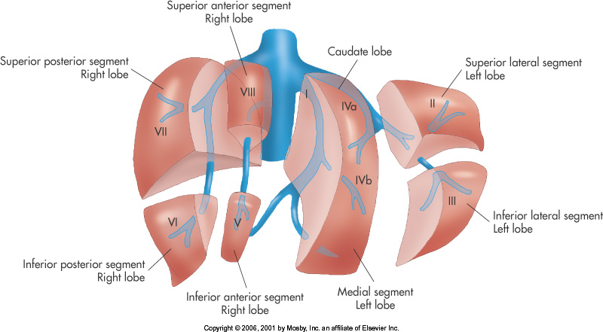
Segmental anatomy of the liver
Liver segments are based on the portal and hepatic venous segments

Slide 34
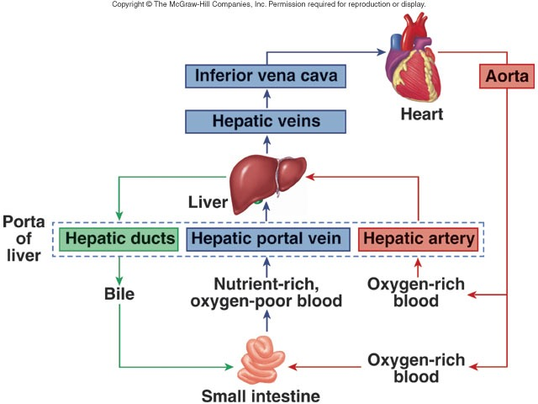
Blood supply of the liver

Slide 35
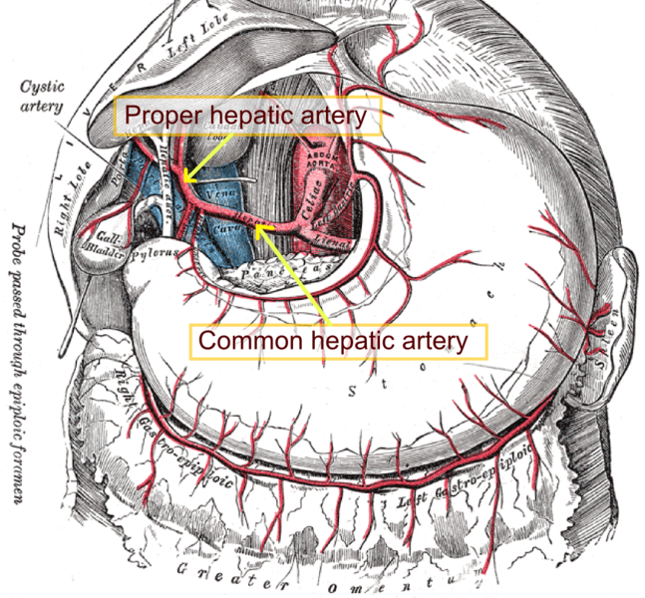
Blood supply of the liver
Proper hepatic artery → The right and left hepatic arteries enter the porta hepatis.
The right hepatic artery usually gives off the cystic artery, which runs to the neck of the gallbladder.

Slide 36
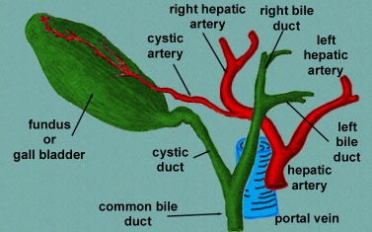
Blood Circulation Through the Liver
The blood vessels conveying blood to the liver are the hepatic artery (30%) and portal vein (70%).
The hepatic artery brings oxygenated blood to the liver, and the portal vein brings venous blood rich in the products of digestion, which have been absorbed from the gastrointestinal tract.
The arterial and venous blood is conducted to the central vein of each liver lobule by the liver sinusoids.
The central veins drain into the right and left hepatic veins, and these leave the posterior surface of the liver and open directly into the inferior vena cava.

Slide 37
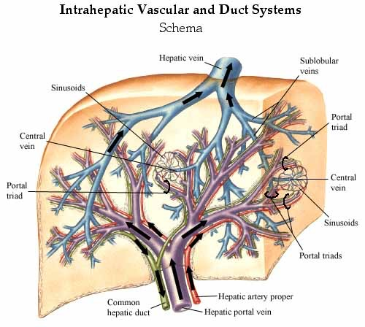
Vein drainage of the liver
The portal vein divides into right and left terminal branches that enter the porta hepatis behind the arteries.
The hepatic veins (three or more) emerge from the posterior surface of the liver and drain into the inferior vena cava.

Slide 38
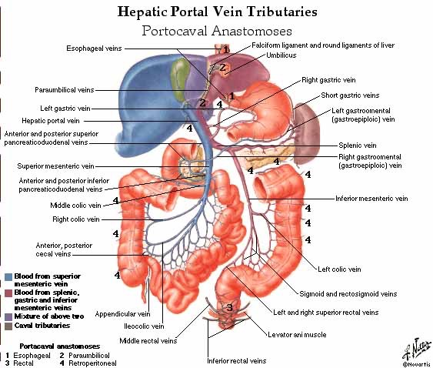

Slide 39
Lymphatic drainage of the liver
Liver produce large amount of lymph~ one third – one half of total body lymph
Lymph leave the liver and enters several lymph nod in porta hepatis→ efferent vessels pass to celiac nods
A few vessels pass from the bare area of the liver through the diaphragm to the posterior Mediastinal lymph nodes.
Nerve supply
Sympathetic → hepatic plexus>>> celiac plexuses → thoracic ganglion chain T1-T12
Parasympathetic → vagous nerve( anterior part)
Sympathetic and parasympathetic nerves form the celiac plexus.
The anterior vagal trunk gives rise to a large hepatic branch, which passes directly to the liver

Slide 40
Endoscopic retrograde cholangiopancreatography (ERCP)
It is a technique that combines the use of endoscopy and fluoroscopy to diagnose and treat certain problems of the biliary or pancreatic ductal systems. Through the endoscope, the physician can see the inside of the stomach and duodenum, and inject dyes into the ducts in the biliary tree and pancreas so they can be seen on X-rays.
ERCP is used primarily to diagnose and treat conditions of the bile ducts, including gallstones, inflammatory strictures (scars), leaks (from trauma and surgery), and cancer.

Slide 41
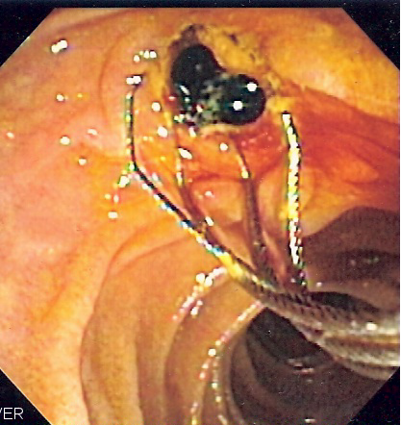
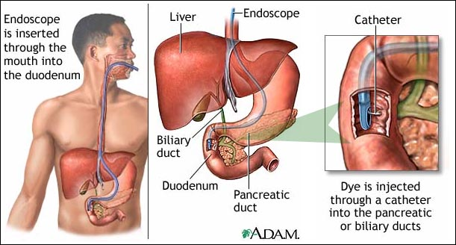
ERCP

Slide 42
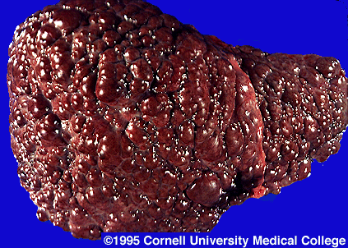
Liver Cirrhosis

Slide 43
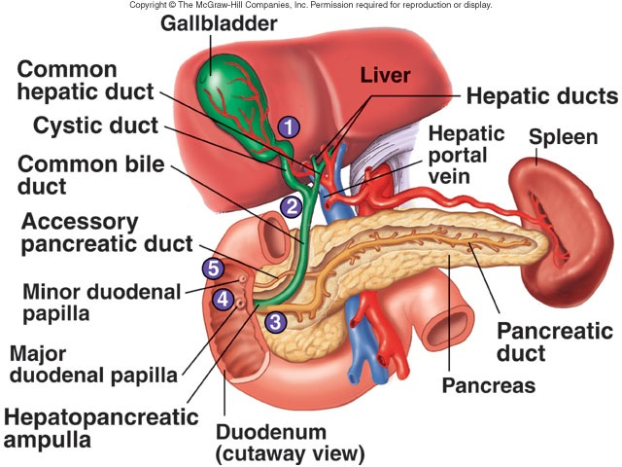
GALLBLADDER

Slide 44
Anatomical position of GB
Epigastric - Right hypochondrium region
At the tip of the 9th RT . C.C
Green muscular organ
Pear-shaped, hollow structure
On inferior surface of liver
Between quadrate and right lobes
Has a short mesentery
Capacity 40- 60 cc
- Body and neck
Directed toward porta hepatis

Slide 45
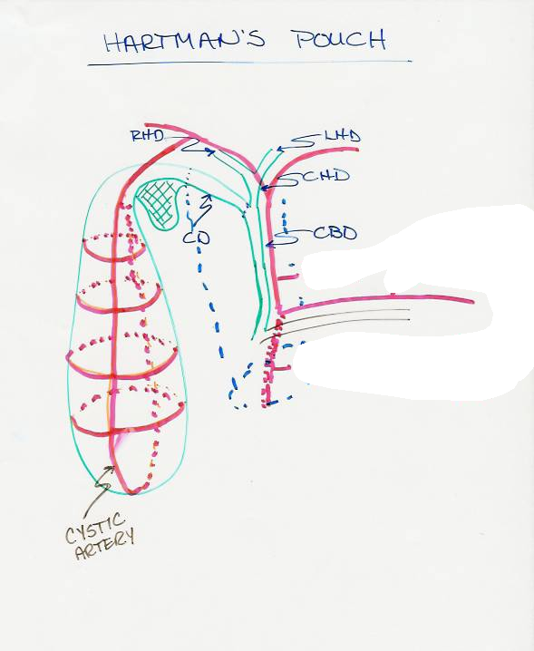
Structure of GB
Fundus -Ant:ant.abdominal wall
- Post.inf: transverscolon
Body sup: liver
post.inf: Tr.colon. End of 1st part of doudenum, begins of 2nd part of doudenum
Neck
- Form the cystic duct, 4cm
Hartmann’s Pouch
1. Lies between body and neck of gallbladder
2. A normal variation
3. May obscure cystic duct
4. If very large, may see cystic duct arising from pouch

Slide 46
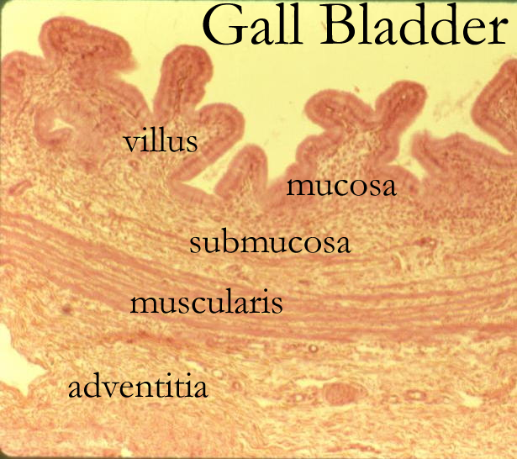

Slide 47
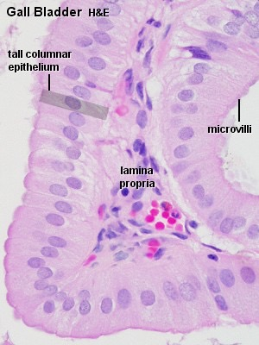

Slide 48
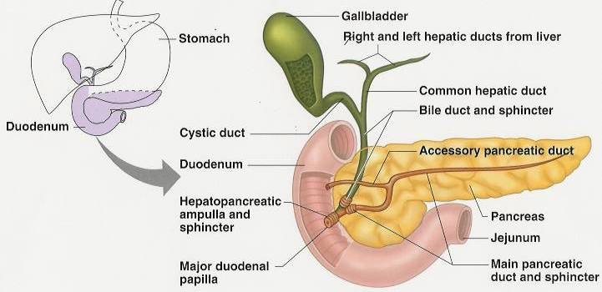
Cystic Duct
- It joins common hepatic duct

Slide 49
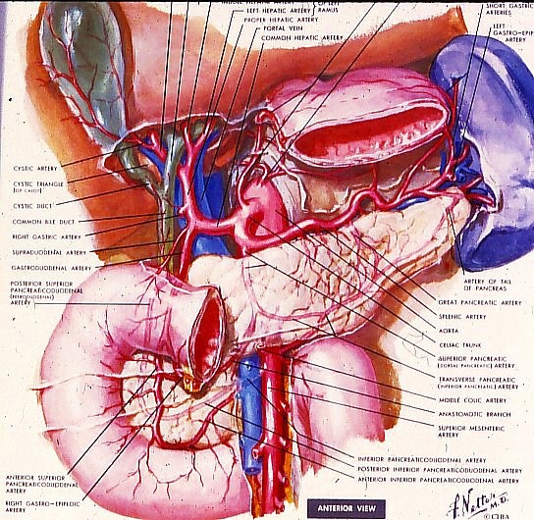
Arterial Supply to the Gallbladder
Cystic artery
Right hepatic artery
Proper hepatic artery
Common hepatic artery
Notes:
1. Portal Cir. (13)

Slide 50
Blood supply of GB: - Cystic artery→ branch of Rt. Hepatic artery
- Cystic vein → end in portal vein
- Small branches ( arteries and veins run between liver and gall bladder
Proper Hepatic Artery
Common Hepatic Artery
Gastroduodenal Artery

Slide 51
Lymphatic drainage of GB
1. Terminate @ celiac nodes
2. Cystic node at neck of GB
a. Actually a hepatic node
b. Lies at junction of cystic & common hepatic ducts
3. Other lymph vessels also drain into hepatic nodes

Slide 52
Nerve supply
Sympathetic and parasympathetic from celiac plexus
Parasympathetic ---- vagous nerve
Hormone →cholecystokini → duodenum

Slide 53
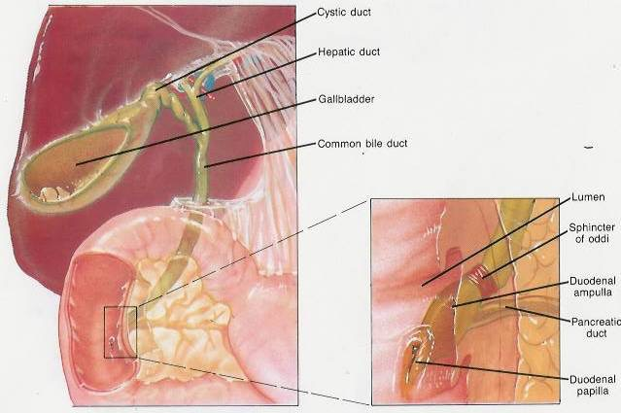
Common bile duct
Extra hepatic biliary system
Rt. hepatic duct
+
Lt hepatic duct
↓
Common hepatic duct
+
Cystic duct
↓
Common bile duct
4cm
Descend in free edge of lesser omentum
Supra duodenal part
Retro duodenal part
Retro pancreatic part

Slide 54
Bile duct……. parts and relations
3 inc long
1st part
Located in right free margin of lesser omentum
in front of the opening into the lesser sac (Epiploic opening)
Rt to hepatic artery and portal vein
2nd part
Behind the 1st part of the duodenum
Rt to the gastroduodenal artery
3 rd part
Posterior surface of the head of the pancreas
Contact with main pancreatic duct
Related with IVC, gastroduodenal artery, portal vein
End in the half second part of duodenum at ampulla of Vater

Slide 55
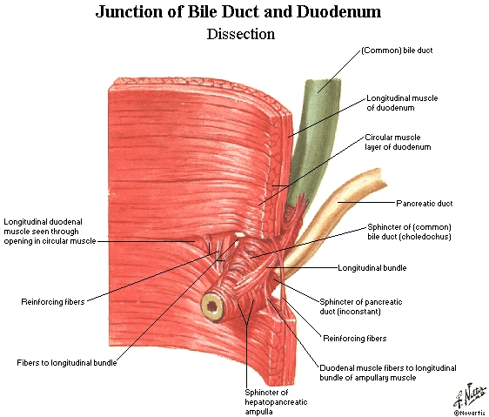
Notes:
Pancreatic duct, the MAIN one from the VENTRAL bud, “usually” empties into the most dstal portion of the CBD (Common Bile Duct)

Slide 56
Ampulla of Vater with CBD and Pancreatic Duct
Ampulla of Vater

Slide 57
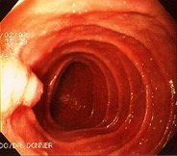
Hepaticopancreatic ampulla (Ampulla of Vater)
Notes:
EGD (Esophago, Gastro, Duodenoscopy)

Slide 58
Blood supply of CBD
Small arteries supplying CBD
a. Arise from cystic artery b. Posterior branch of superior pancreaticoduodenal artery

Slide 59
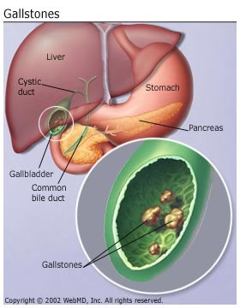
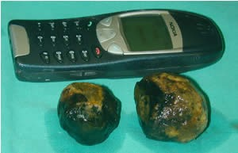
What is bile?
Bile composed of water, ions, bile acids, organic molecules (including cholesterol, phospholipids, bilirubin)
Gallstones are mostly cholesterol
Acids and salts emulsify fats for absorption across wall of small intestines into lacteal lymph capillaries (review)
Contains waste products from RBC breakdown and other metabolic processing (color of feces from bilirubin in bile)(review)
Ions buffer chyme from stomach (review)

Slide 60
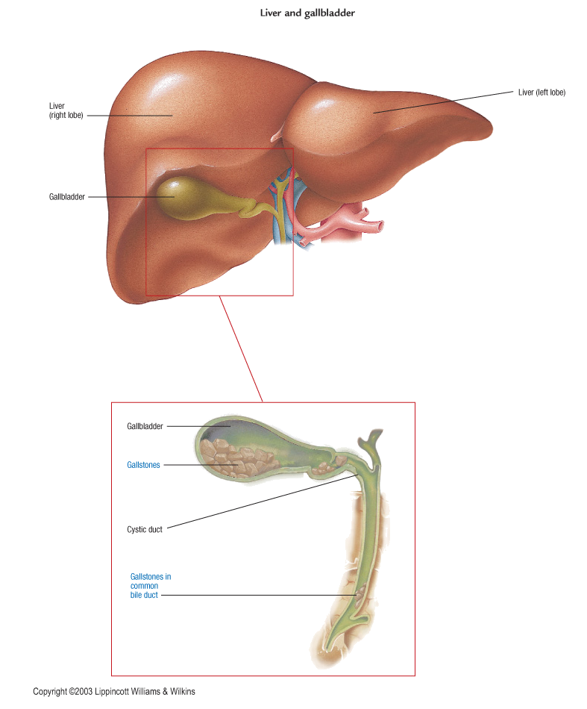
Cholelithiasis
GB shows likely sites of stone formation/deposition
Gangrene of gallbladder is rare
Stone in C.B.D obstruct jaundice & pancreatitis

Slide 61
Gallbladder Diseases
1- Cholelithiasis & Cholecystitis
Cholecystitis = inflammation of GB
Cholelithisi = Stone(s) in GB
2- Obstructive jaundice: liver patterns
3- Gangrene of gall bladder rare
4- Congenital defects

Slide 62
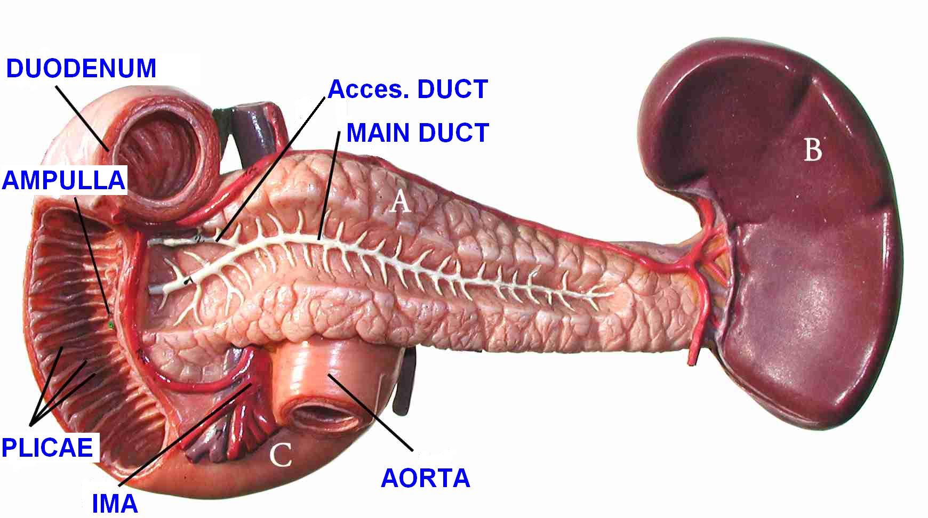
PANCREAS

Slide 63
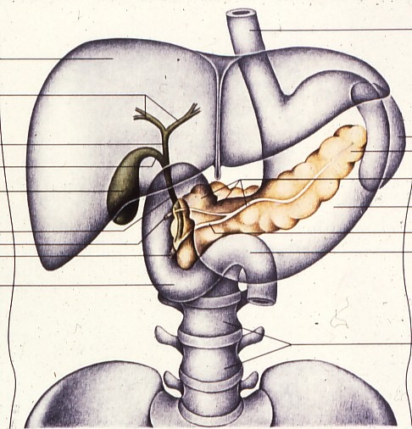
Anatomical position
- Epigastric - left upper hypochondrium region
Right lobe of liver
Falciform ligament
Gallbladder
Pancreas
Duodenum
L-3
Notes:
1. Transparent Pancreas, Ducts, Duodenum (34)

Slide 64
Common Relation
Anterior
Transverse colon
Transvers mesocolon
Lesser sac
Stomach
Posterior
-Bile duct
Portalvein
Splenic vein
IVC
Aorta
origin of Sup.mesentric.a
Lt.Psoas muscle
Lt.Suuprarenal gland
Left kidney
Hilum of the spleen
PANCREAS

Slide 65
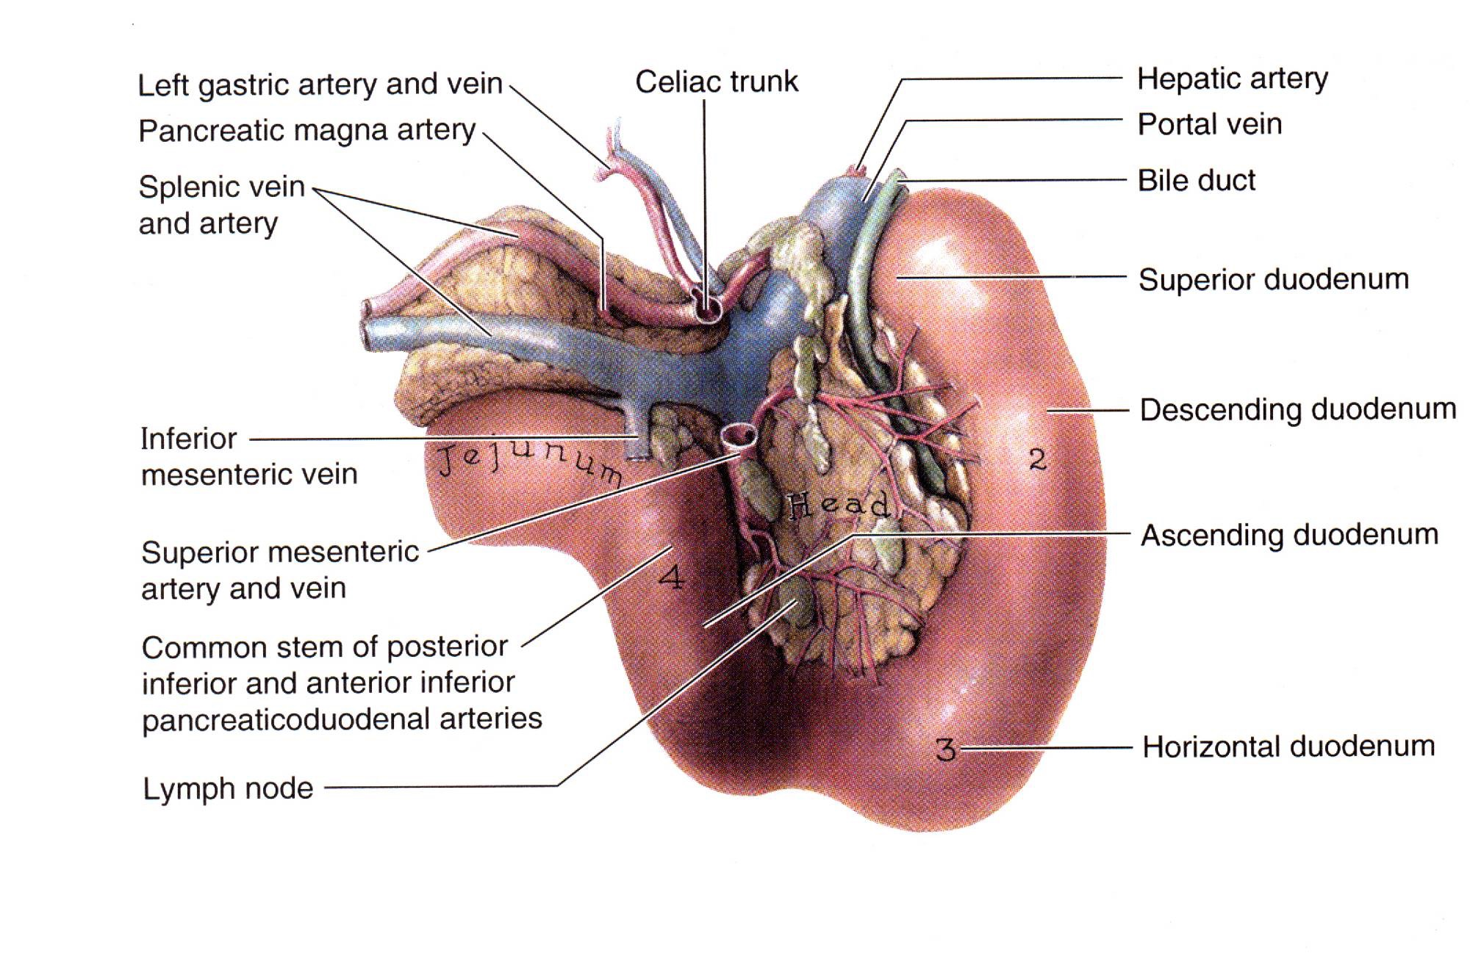
Posterior view of duodenum/pancreas
Notes:
Know main anatomical landmarks and relationships to other organs

Slide 66
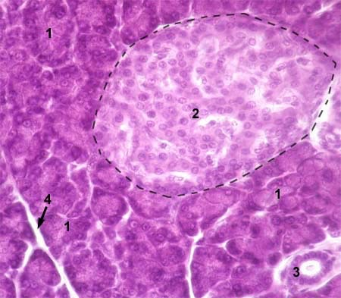
Histology of Pancreas
Exocrine part→Pancreatic juice
Endocrine part →Insulin, glucagon and somatostatin

Slide 67
Parts of the pancreas

Slide 68
Parts:
Head Neck body Tail

Slide 69
The head
It is disc shaped
lies within the concavity of the duodenum
A part of the head extends to the left behind the superior mesenteric vessels and is called the Uncinate process.

Slide 70
The neck
It is the constricted portion of the pancreas
connects the head to the body.
It lies in front of the beginning of the portal vein the origin of the

Slide 71
The body
Runs upward and to the left across the midline
It is somewhat triangular in cross section.

Slide 72
Body of pancreas…cont
Three surfaces: anterior, posterior, and inferior.
Three borders: ant ,post & inf
The anterior surface
1- Covered by peritoneum of post. Wall of lesser sac
2- Tuber omental :
where the ant. surface of pancreas join the neck

Slide 74
Body of pancreas…cont
The inferior surface
- Narrow on the right but broader on the left
Covered by peritoneum of greater omentum
lies upon the duodenojejunal flexure
- Some coils of the jejunum
- its left extremity rests on the left colic flexure
The superior border
Blunt and flat to the right;
Narrow and sharp to the left near the tail
It commences on the right in the omental tuberosity
In relation with
1- The celiac artery
2- Hepatic artery
3- The splenic artery runs toward
the left in a groove along this border.

Slide 75
Body of pancreas…cont
The anterior border
separates the anterior surface from the inferior surface
along this border the two layers of the transverse mesocolon diverge from one another; one passing upward over the anterior surface, the other backward over the inferior surface.

Slide 76
Body of Pancreas
The inferior border
Separates the posterior from the inferior surface
The superior mesenteric vessels emerge under its right extremity.

Slide 77
Body of Pancreas

Slide 78
The Tail
- Passes forward in the splenicorenal ligament and comes in contact with the hilum of the spleen

Slide 79
Pancreatic ducts
The main duct
Begins in the tail and runs the length of the gland
Receiving numerous tributaries on the way .
It opens into the second part of the duodenum at about its middle with the bile duct on the major duodenal papilla
Accessory duct
- When present, drains the upper part of the head
Then opens into the duodenum a short distance above the main duct on the minor duodenal papilla .
The accessory duct frequently communicates with the main duct

