Slide 1
Large Intestine

Slide 2
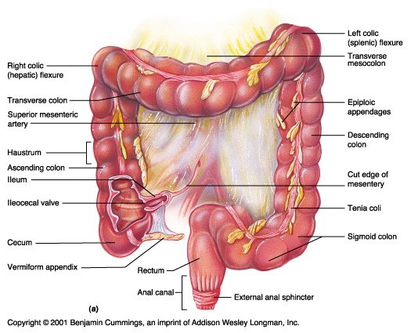
Anatomy of the Large Intestine

Slide 3
Large Intestine
Extends from ileocecal valve to anus
Length = 1.5- 2.5m = 5 feet
Regions
Cecum = 2.5- 3 inch
Appendix= 3-5 inch
Colon
Ascending= 5 inch
Transverse= 15 inch
Descending= 10 inch
Sigmoid colon = 10 – 15 inch
Rectum= 5 inch
Anal canal= 4 cm

Slide 4
General Features of Large Intestine
1- Sacculation= Haustra
2- Teania coli(three separate longitudinal ribbons of smooth muscle)→ except appendex and rectum
3- Appendices epiplolca( adipose structures protruding from the serosal surface of the colon )→ except appendix , Cecum and rectum

Slide 5
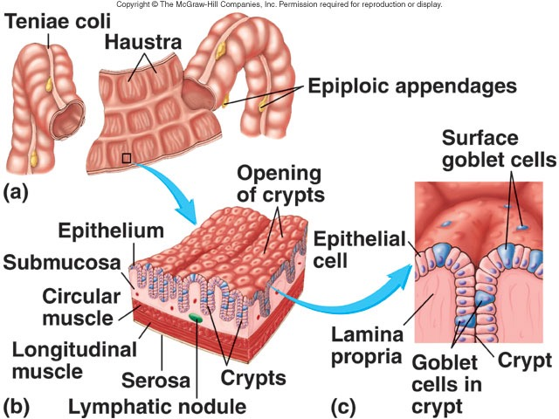
LARGE INTESTINE ANATOMY

Slide 6
Cecum
It is a blind-ended pouch
Site: situated in the right iliac fossa , above the lat ½ of inguinal ligament
Size: It is about 3 inch in diameter
Completely covered with peritoneum.
It possesses a considerable amount of mobility, although it does not have a mesentery.
Attached to :
- Ascending colon
- posteromedially surface is the appendix , 1 inch below ileocoecal valve
- medially→ Ileum
The presence of peritoneal folds in the vicinity of the cecum creates
The superior ileocecal recesses
The inferior ileocecal recesses
- The retrocecal recesses .

Slide 7
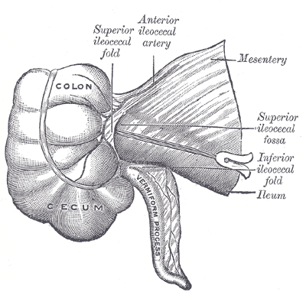
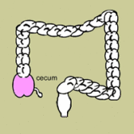

Slide 8
Cecum….cont
The longitudinal muscle is restricted to three flat bands, the taenia coli, which converge on the base of the appendix and provide for it a complete longitudinal muscle coat.

Slide 9
Relations of Cecum
Anteriorly:
Coils of small intestine
- the greater omentum
the anterior abdominal wall in the right iliac region
Posteriorly:
The psoas and the iliacus muscles
the femoral nerve
and the lateral cutaneous nerve of the thigh .
- Postero- medially → The appendix is commonly →retrocecal common.
Medially:
- Small intestine (ileum)

Slide 10
Blood Supply of Cecum
Arteries
Anterior and posterior cecal arteries → a branch of Superior mesenteric artery
The veins correspond to the arteries and drain into the superior mesenteric vein.

Slide 11
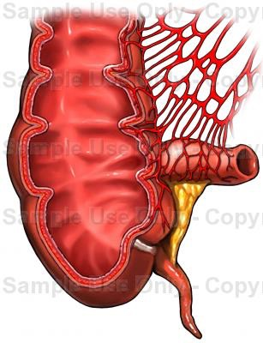
Blood Supply of Cecum

Slide 12
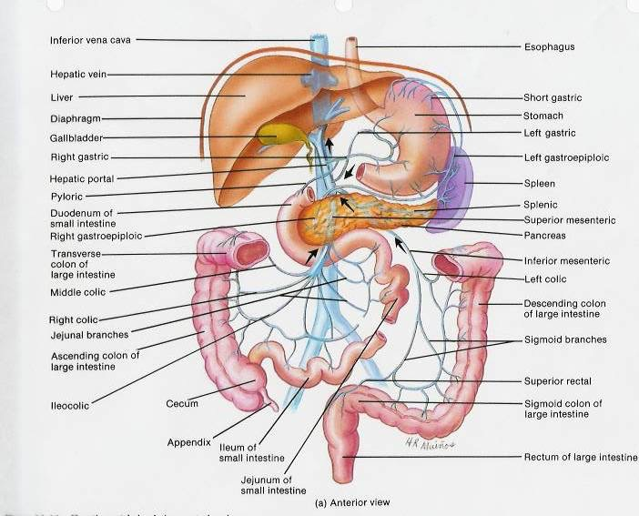
Venous Drainage of Cecum

Slide 13
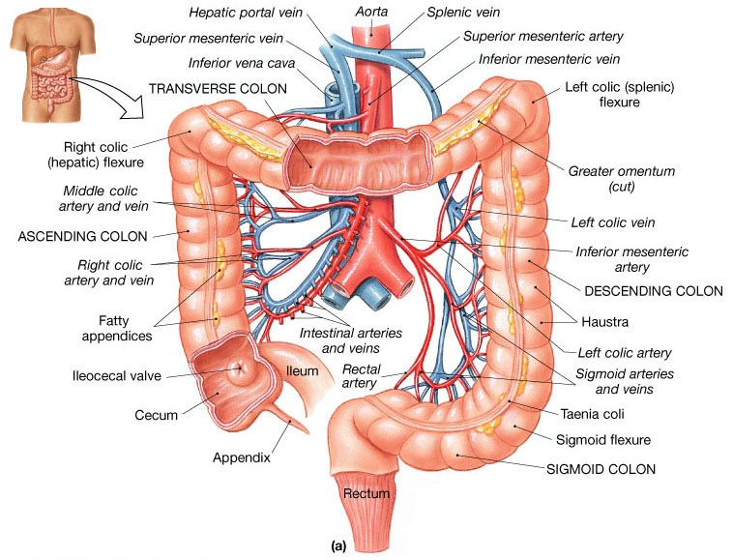

Slide 14
Lymphatic Drainage of Cecum
The lymph vessels pass through several mesenteric nodes → finally reach the superior mesenteric nodes.

Slide 15
Nerve Supply of Cecum
Branches from the sympathetic and parasympathetic (vagus) nerves form the superior mesenteric plexus.

Slide 16
Ileocecal Valve
A rudimentary structure
consists of two horizontal folds of mucous membrane
Project around the orifice of the ileum.
The valve plays little or no part in the prevention of reflux of Cecal contents into the ileum.
The circular muscle of the lower end of the ileum (called the ileocecal sphincter by physiologists) serves as a sphincter and controls the flow of contents from the ileum into the colon.
The smooth muscle tone is reflexly increased when the cecum is distended; the gastrin hormone, which is produced by the stomach, causes relaxation of the muscle tone.

Slide 17
Appendix
Location and Description:
It is a narrow, muscular tube
containing a large amount of lymphoid tissue.
It varies in length from 3 to 5 inch. (2 -22 cm).
The base is attached to the posteromedial surface of the cecum about 1 inch. (2.5 cm) below the ileocecal junction .
The remainder of the appendix is free.
Peritoneum:
- It has a complete peritoneal covering, which is attached to the mesentery of the small intestine by a short mesentery of its own, the mesoappendix.
- The mesoappendix contains the appendicular vessels and nerves.

Slide 18
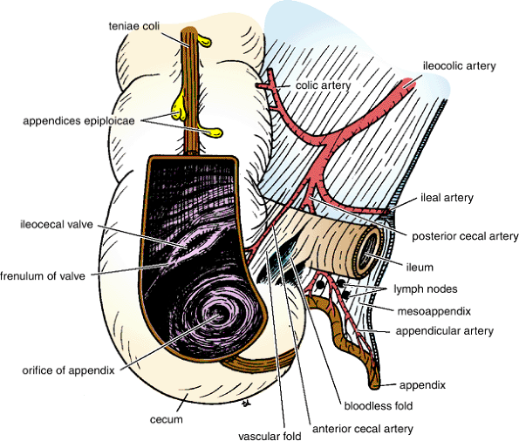
APPENDIX

Slide 19
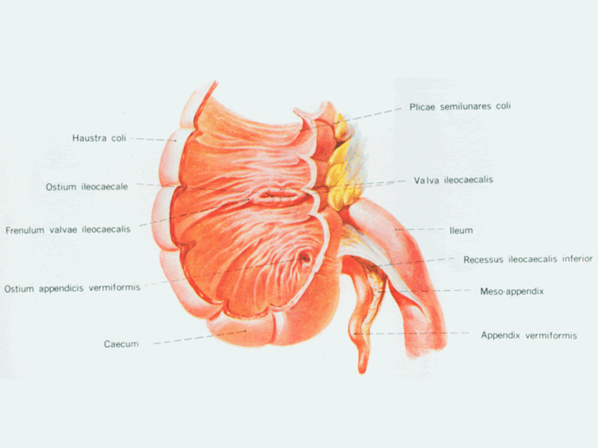

Slide 20
Appendix….cont
Position
The appendix lies in the right iliac fossa, and in relation to the anterior abdominal wall
1- Retrocecal in retrocaecal recess behind cecum→ in 74% of people
2- pelvic: in pelvis related to Rt. Ovary and uterine tube→ in 21% of people
3- Subcaecal: below cecum→ in 3.5%
4- Preileal: infront of ileum → 1%
5- Postileal: behind the ileum→0.5%
Surface anatomy of appendix= McBurney's point
Its base is situated one third of the way up the line joining the right anterior superior iliac spine to the umbilicus
To reach the appendix during operation follow the taenia coli which converge toward the appendix

Slide 21
Blood Supply of Appendix
Arteries
The appendicular artery is a branch of the posterior cecal artery(ilio-cecal.a)which descends behind the ileum.
Veins
The appendicular vein drains into the posterior cecal vein.

Slide 22
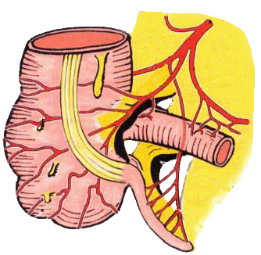
Appendicular artery runs in free margin of the mesoappendix

Slide 23
Lymphatic Drainage of Appendix
The lymph vessels drain into one or two nodes lying in the mesoappendix → eventually into the superior mesenteric nodes.

Slide 24
Nerve Supply of Appendix
The appendix is supplied by the sympathetic and parasympathetic (vagus) nerves from the superior mesenteric plexus.
Afferent nerve fibers concerned with the conduction of visceral pain from the appendix accompany the sympathetic nerves and enter the spinal cord at the level of the 10th thoracic segment.
The peritoneum over the appendix is innervated by the 10th intercostal nerve= skin of umbilicus

Slide 25
Clinical Notes
Acute appendetitis→ uncommon in the two extremes of life
Thrombosis of appendicular .a→ gangrene(just one artery for appendix) →perforation →Lt.paracolic gutter while in Acute cholecystitis→ no gangrene( more than one artery supply the gallbladder)
Appendiectomy

Slide 26
Ascending Colon
Location and Description:
The ascending colon is about 5 inch. (13 cm) long
lies in the right lower quadrant.
It extends upward from the cecum to the inferior surface of the right lobe of the liver, where it turns to the left, forming the right colic flexure
Then becomes continuous with the transverse colon.
Taenia coli, sacculation & appendeces epiplolca are present
The peritoneum
Covers the front and the sides of the ascending colon
Binding it to the posterior abdominal wall.

Slide 27
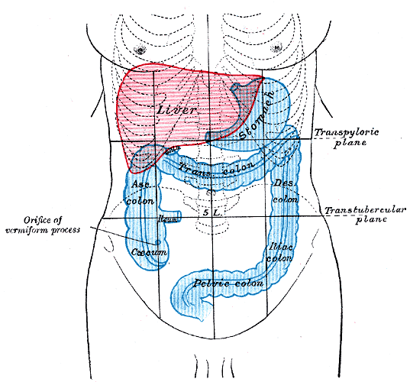

Slide 28
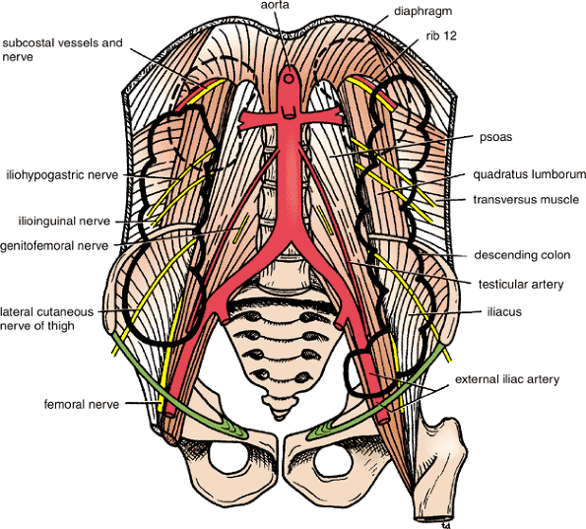
Relations of Ascending Colon
Anteriorly:
Coils of small intestine
The greater omentum
The anterior abdominal wall
Posteriorly:
The iliacus
The iliac crest
The quadratus lumborum
The origin of the transversus abdominis muscle,
The lower pole of the right kidney.
The iliohypogastric .n
The ilioinguinal nerves cross behind it

Slide 29
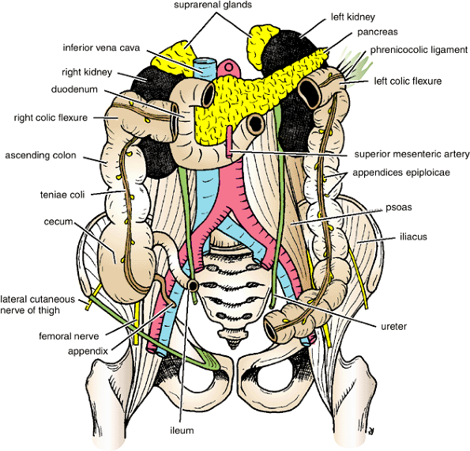
Relations of Ascending Colon

Slide 30
Blood Supply of Ascending Colon
Arteries
The ileocolic & right colic branches of the superior mesenteric artery supply this area.
Veins
The veins correspond to the arteries and drain into the superior mesenteric vein.

Slide 31
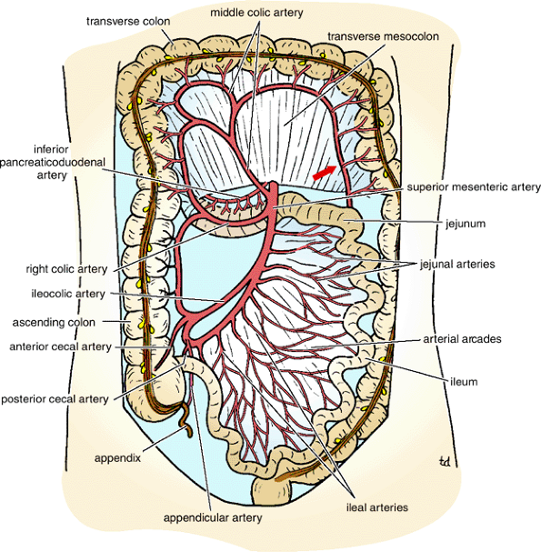

Slide 32
Lymphatic Drainage of Ascending Colon
The lymphatic vessels → lymph nodes lying along the course of the colic blood vessels → the superior mesenteric nodes.

Slide 33
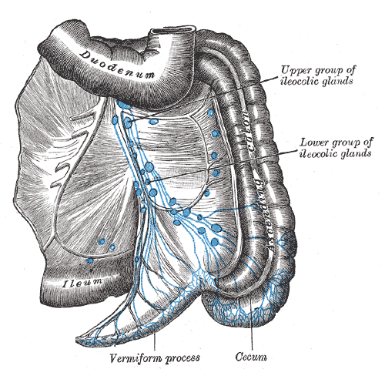
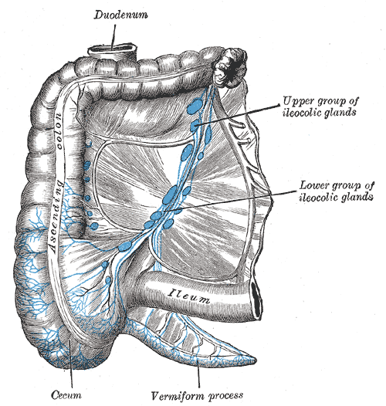
Lymphatic Drainage

Slide 34
Nerve Supply of ascending colon
Sympathetic and parasympathetic (vagus) nerves from the superior mesenteric plexus.

Slide 35
Transverse Colon

Slide 36
Transverse Colon
Location and Description
The transverse colon is about 15 in. (38 cm) long
extends across the abdomen
occupying the umbilical region.
It begins at the right colic flexure below the right lobe of the liver
Hangs downward
Suspended by the transverse mesocolon from the pancreas
It then ascends to the left colic flexure below the spleen.
The left colic flexure is higher than the right colic flexure and is suspended from the diaphragm by the phrenicocolic ligament .
Taenia coli, sacculation & appendeces epiplolca are present

Slide 37
The transverse mesocolon= mesentery of the transverse colon
suspends the transverse colon from the anterior border of the pancreas
The mesentery is attached to the superior border of the transverse colon
The posterior layers of the greater omentum are attached to the inferior border
The position of the transverse colon is extremely variable and may sometimes reach down as far as the pelvis.

Slide 38
Relations of Transverse Colon
Anteriorly:
The greater omentum
The anterior abdominal wall (umbilical and hypogastric regions)
Posteriorly:
The second part of the duodenum
The head of the pancreas
The coils of the jejunum and ileum

Slide 39
Blood Supply of Transverse Colon
Arteries:
The proximal two thirds are supplied by the middle colic artery→ a branch of the superior mesenteric artery.
The distal third is supplied by the left colic artery→ a branch of the inferior mesenteric artery.
Veins
- The veins correspond to the arteries and drain into the superior & inferior mesenteric veins.

Slide 41
Lymphatic Drainage of Transverse Colon
The proximal two thirds drain→ the colic nodes and then into the superior mesenteric nodes
The distal third drains → the colic nodes → the inferior mesenteric nodes.

Slide 42
Nerve Supply of Transverse Colon
The proximal two thirds are innervated by sympathetic and vagal nerves through the superior mesenteric plexus
The distal third is innervated by sympathetic and parasympathetic pelvic splanchnic nerves through the inferior mesenteric plexus.

Slide 43
Descending Colon
Location and Description:
The descending colon is about 10 in. (25 cm) long
It extends downward from the left colic flexure, to the pelvic brim, where it becomes continuous with the sigmoid colon.
Taenia coli, sacculation & appendeces epiplolca are present
The peritoneum
- Covers the front and the sides and binds it to the posterior abdominal wall.

Slide 44
Relations of Descending Colon
Anteriorly:
Coils of small intestine
the greater omentum
the anterior abdominal wall
Posteriorly:
The lateral border of the left kidney
the origin of the transversus abdominis muscle
the quadratus lumborum
the iliac crest
the iliacus
the left psoas
The iliohypogastric and the ilioinguinal nerves
the lateral cutaneous nerve of the thigh
the femoral nerve

Slide 45
Relations of Descending Colon

Slide 46
Blood Supply of Descending Colon
Arteries
- The left colic and the sigmoid branches of the inferior mesenteric artery.
Veins
- The veins correspond to the arteries →drain into the inferior mesenteric vein.

Slide 47
Lymphatic Drainage of Descending Colon
Lymphatic drains →the colic lymphatic nodes & the inferior mesenteric nodes around the origin of the inferior mesenteric artery.

Slide 48
Nerve Supply of descending colon
The nerve supply is the sympathetic and parasympathetic pelvic
Splanchnic nerves through the inferior mesenteric plexus

