Slide 1
Vasculitis
Inflammation of the vessel wall.
Signs and symptoms:
1- local:according to the involved tissue
2- systemic:(fever, myalgia, arthralgias, and malaise)

Slide 2
Pathogenesis
1- immune-mediated inflammation
2- infectious pathogens.
It is critical to distinguish between infectious and immunologic mechanisms due to the huge difference in management.
3- Physical injury (radiation, mechanical trauma)
4- chemical injury (toxins)

Slide 3
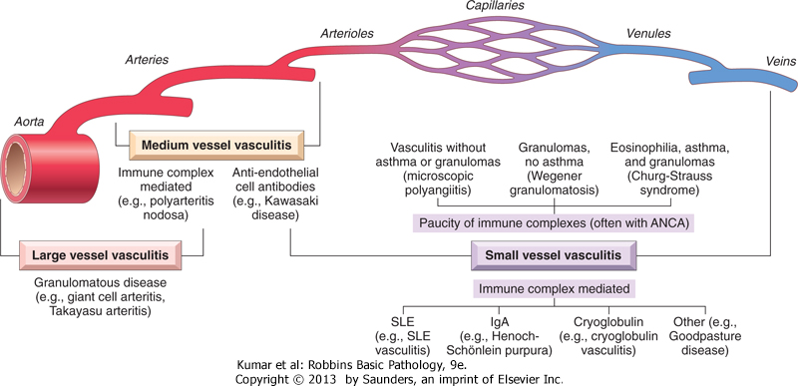

Slide 4
The main immunologic mechanisms underlying vasculitis are:
1- Immune complex deposition
2- Antineutrophil cytoplasmic antibodies (ANCA)
3- Anti-endothelial cell antibodies
4- Auto-reactive T cells

Slide 5
Immune complex deposition
Example:
Drug hypersensitivity vasculitis.
e.g., penicillin
vary from mild and self-limiting, to severe and even fatal
skin lesions are most common.
Treatment: discontinuation of the offending drug.

Slide 6
Anti-Neutrophil Cytoplasmic Antibodies
ANCAs = circulating antibodies that react with neutrophil cytoplasmic antigens (mainly enzymes)
ANCAs blood levels are very useful markers for diagnosis, clinical severity, and as predictive of disease recurrence.

Slide 7
two types are most important:
1- Antiproteinase-3 (PR3-ANCA)= c-ANCA.
proteinase-3 is a neutrophil azurophilic granule constituent;
e.g. Wegener granulomatosis.
2-Anti-myeloperoxidase (MPO-ANCA)= p-ANCA.
MPO is a lysosomal granule constituent;
e.g. Churg-Strauss syndrome

Slide 8
Anti-Endothelial Cell Antibodies
Antibodies against endothelial cells
Associated with certain vasculitides, such as Kawasaki disease (discussed later).

Slide 9
Giant Cell (Temporal) Arteritis
is the most common form of vasculitis among the elderly in developed countries.
chronic, granulomatous, inflammation of large arteries
mainly the temporal arteries, vertebral and ophthalmic arteries, as well as the aorta also can be involved.
ophthalmic artery involvement→ sudden and permanent blindness (rapid diagnosis and treatment are mandatory)

Slide 10
Giant Cell (Temporal) Arteritis
Pathogenesis: T cell-mediated immune response to unknown vessel wall antigen.
Morphology:
granulomatous inflammation (75%) within the inner media centered on the internal elastic membrane (( lymphocytes and macrophages, with multinucleate giant cells ))
fragmentation of the internal elastic lamina.
lesions at different stages of development are seen within the same artery

Slide 11
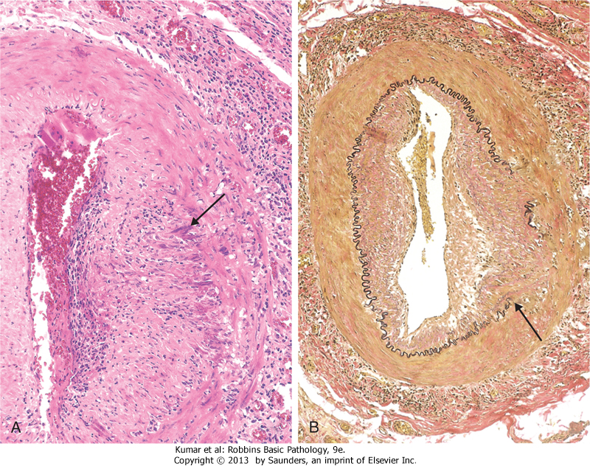
Giant Cell (Temporal) Arteritis:
A> granuloma; B> fragmented internal elastic lamina

Slide 12
Giant Cell Arteritis- clinical picture
rare before the age of 50.
Signs and symptoms:
fever, fatigue, weight loss
facial pain or headache (superficial temporal artery).
Ocular symptoms (ophthalmic artery) in 50% of patients; range from diplopia → → complete vision loss.
Diagnosis:
- Vessel biopsy and histology
Treatment:
- Corticosteroid or anti-TNF therapies

Slide 13
Takayasu Arteritis
vasculitis of medium-sized and large arteries
scarring and thickening of the aorta- especially the aortic arch with severe luminal narrowing of the major branch vessels.
marked weakening of the pulses in the upper extremities (= the pulseless disease).

Slide 14
Takayasu arteritis
Pathogenesis: An autoimmune etiology is likely
affects the aortic arch and arch vessels (2/3)
the distinction from giant cell aortitis is made largely on the basis of a patient's age: >50 years →giant cell aortitis <50 years→Takayasu aortitis.
Treatment: immunosuppressives

Slide 15
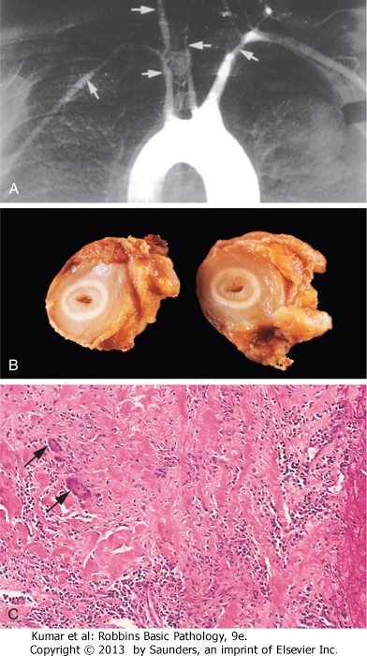
Takayasu arteritis -MORPHOLOGY

Slide 16
Polyarteritis nodosa (PAN)
a systemic vasculitis of small or medium-sized muscular arteries
typically involves the renal and visceral vessels and spares the pulmonary circulation.
There is no association with ANCAs
- (1/3) chronic hepatitis B infection→ immune complexes containing hepatitis B antigens deposit in affected vessels.
- (2/3) →The cause is unknown

Slide 17
PAN- The clinical course
episodic, with long symptom-free intervals.
malaise, fever, and weight loss
the vascular involvement is widely scattered.
Usually present as a combination of:
- malignant hypertension → a major cause of death
abdominal pain and bloody stools (GIT lesions)
muscular aches and pains
peripheral neuritis.
Treatment: if untreated → fatal
- immunosuppression →remission or cure in 90% of the cases

Slide 18
Kawasaki disease
acute, febrile illness of infancy and childhood (80% of cases < 4 years)
arteritis of mainly large to medium-sized vessels.
Its clinical significance: involvement of coronary arteries➔ aneurysms → rupture or thrombosis→ myocardial infarction.
Originally in Japan, the disease is now recognized worldwide

Slide 19
Also called mucocutaneous lymph node syndrome:
conjunctival and oral erythema and blistering
erythema of the palms and soles
a desquamative rash
cervical lymph node enlargement
Pathogenesis: anti-endothelial cell antibodies
Treatment:
intravenous immunoglobulin therapy and aspirin

Slide 20
Wegener granulomatosis
a necrotizing vasculitis with a specific triad of:
1- Granulomas of the lung and/or the upper respiratory tract (ear, nose, sinuses, throat)
2- Vasculitis of small to medium-sized vessels (capillaries, venules, arterioles, and arteries) mostly in lungs and upper respiratory tract
3- renal vasculitis (Glomerulonephritis):

Slide 21
Wegener granulomatosis- pathogenesis
PR3-ANCAs (c-ANCA) is detected > 95% of cases
- useful markers of disease activity (After immunosuppressive therapy, ANCA levels fall dramatically, while rising titers are predictive of relapse)
The typical patient is >40 year old and male, although women and all ages can be affected.
If untreated, the mortality rate at 1 year is 80%.

Slide 22
Wegener granulomatosis- clinical picture
Rash, myalgias, articular involvement, neuritis, and fever
bilateral pneumonitis, nodules and cavitary lesions (95%)
chronic sinusitis (90%)
mucosal ulcerations of nasopharynx (75%)
renal disease (80%)➔→→ rapidly progressive renal failure.
Treatment: steroids, cyclophosphamide, TNF inhibitors...
Most patients with Wegener granulomatosis now survive, but remain at high risk for relapses that can ultimately lead to renal failure.

Slide 23
Churg-Strauss syndrome
is a small vessel necrotizing vasculitis
classically associated with asthma, allergic rhinitis, lung infiltrates, peripheral eosinophilia, necrotizing granulomas, infiltration by eosinophils.
extremely rare disorder.
purpura, GIT bleeding, and renal disease are the major associations.
Cardiomyopathy (60% of patients)→ a major cause of morbidity and death.
Pathogenesis: p-ANCA associated

Slide 24
Thromboangiitis obliterans (Buerger disease)
a disorder of severe vascular insufficiency and gangrene of the extremities.
focal acute and chronic inflammation of medium-sized and small arteries, especially the tibial and radial arteries, associated with thrombosis
secondary extension into adjacent veins and nerves may be seen.
Pathogenesis: almost exclusively in heavy tobacco smokers and usually < age 35.
The etiology is unknown:- components of tobacco- ? Direct endothelial cell toxicity ? -an immune response.
-? A genetic predilection

Slide 25
Thromboangiitis obliterans/clinical manifestations
Early : Raynaud phenomenon, foot pain induced by exercise, superficial nodular phlebitis (venous inflammation).
severe pain-even at rest→ neural involvement.
Chronic ulcerations
Gangrene of fingers and toes
Treatment: Smoking abstinence in the early stages of the disease

