Slide 1
The Small Intestine

Slide 2
DOUDENUM

Slide 3
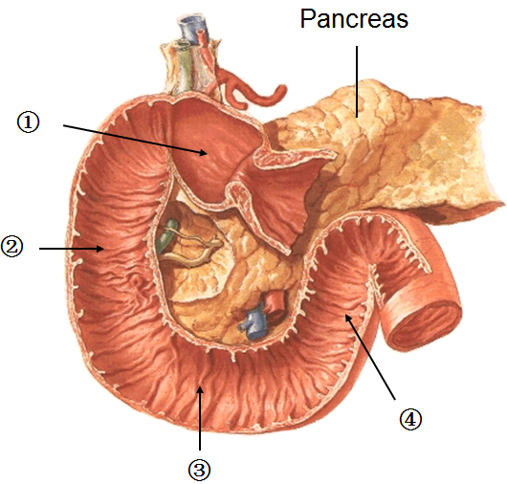
Duodenum
The duodenum is a c-shaped
Concave tube
About 10” in length.
It joins the stomach to the jejunum.
It curves around the head of the pancreas to the left and backwards.
It is important because it receives the opening of the bile and pancreatic ducts.

Slide 4
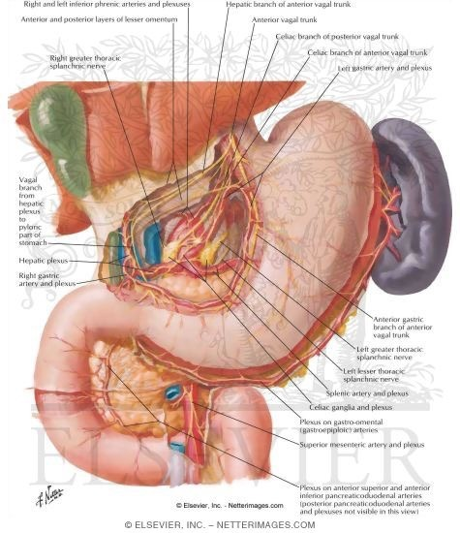
Duodenum….cont
Most of the duodenum is retroperitoneal except the 1st inch & last inch
This short segment( 1st inch) has the lesser omentum on its upper border, the greater omentum on its lower border, and the lesser sac posterior to it
The duodenum extends from the pylorus to the jejunum
It is divided into 4 parts.

Slide 5
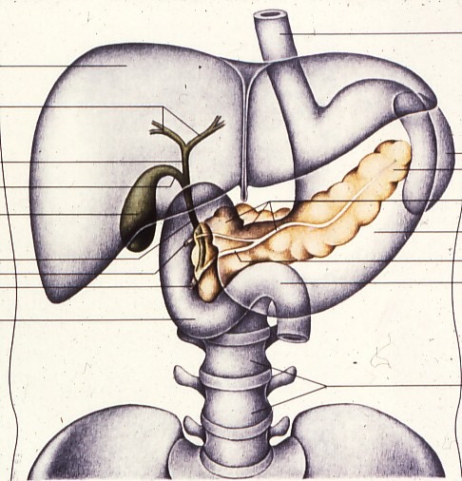
Site of duodenum - The duodenum is situated in the epigastric and umbilical regions - for purposes of description, is divided into four parts
Right lobe of liver
Falciform ligament
Gallbladder
Pancreas
Duodenum
L-3
Notes:
1. Transparent Pancreas, Ducts, Duodenum (34)

Slide 6
Parts of the duodenum & Their relations

Slide 7
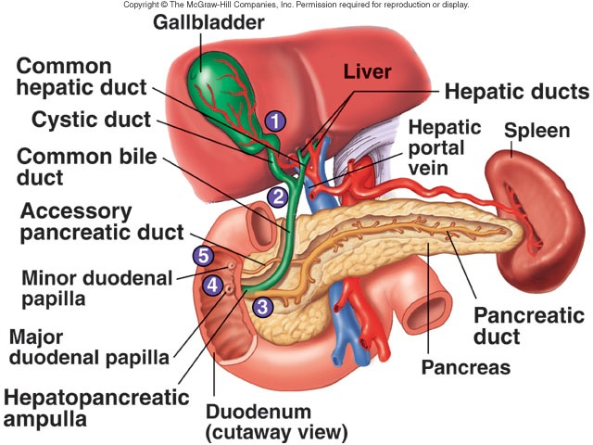
Parts of the duodenum &Their relations

Slide 8
1st part of Duodenum
- The first part is 2 inches long.
It begins from the pyloduodenal junction
At the level of the transpyloric line
Runs upward and backward at the level of the 1st lumbar vertebra 1 inch to the right.

Slide 9
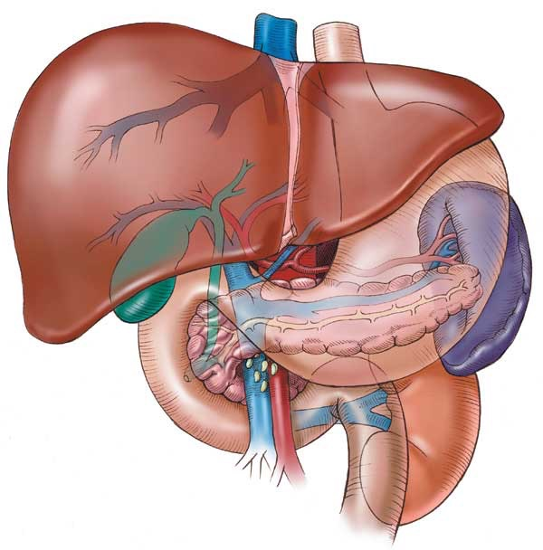
Relations of 1st part of doudenum
Ant.
The liver (quadratus lobe)
gall bladder

Slide 10
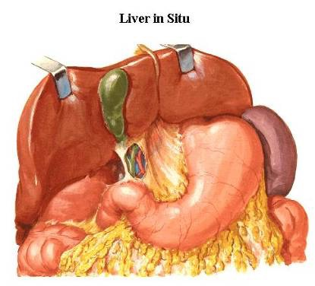
Relations of 1st part of duodenum……cont
Sup.
- the epiploic foramen

Slide 11
Relations of 1st part duodenum……cont
Post.
- The lesser sac
- gastroduodenal Artery
- the Bile duct
portal vein
I.V.C
Inf.
The head of the pancreas.

Slide 12
2nd^{d} part of duodenum
It is 3”(3 inch) long
runs downward vertically on the right side
In front of the Rt.kidney
next to the 3rd and 4th lumbar vertebrae.
halfway of it, The bile duct and the main pancreatic duct pierce the medial wall, and then form the ampulla that opens in the major duodenal papilla.
The accessory pancreatic duct (if present) opens in the minor duodenal papilla more superiorly.

Slide 13
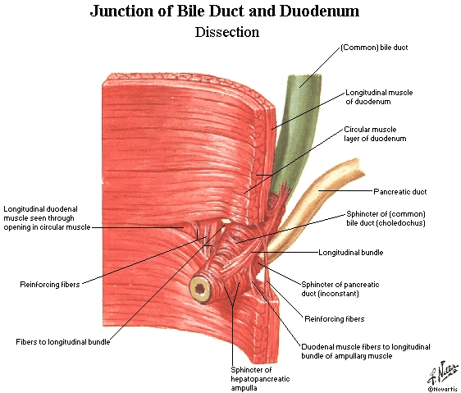

Slide 14
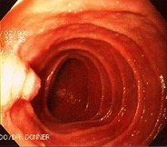
Hepaticopancreatic ampulla (Ampulla of Vater)
Notes:
EGD (Esophago, Gastro, Duodenoscopy)

Slide 15
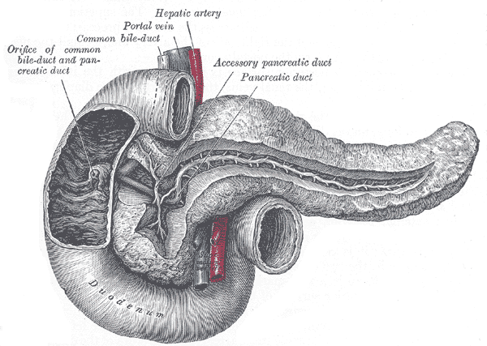

Slide 16
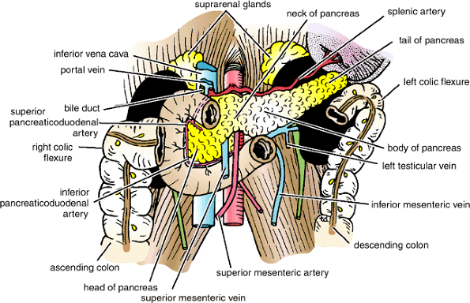
Relations of 2nd part of duodenum
Ant.
The gallbladder (fundus)
Right lobe of the liver
Transverse colon
coiled of small intestine.
Post.
Hilum of Rt. Kidney
Rt. Ureter.
Lateral.
Right colic flexure
Ascending colon
Right lobe of the liver.
Medial.
- Head of pancreas
- Bile and pancreatic ducts.

Slide 17
3rd part of duodenum
4” long
Runs horizontally to the left
On the subcostal plane.
Runs in front of the vertebral column
Under the lower margin of the head of pancreas
Above the coils of the jejunum.

Slide 18
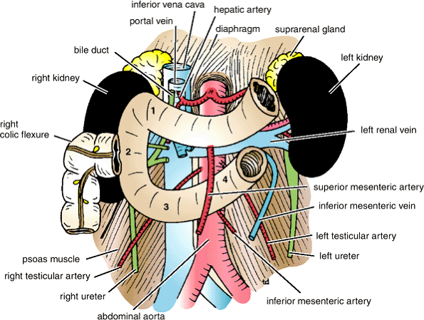
Relations of 3rd part of duodenum
Anteriorly:
- The root of the mesentery of the small intestine
- The superior mesenteric vessels contained within the mesentry
coils of jejunum
Posteriorly:
The right ureter
the right psoas muscle
the inferior vena cava
the aorta
Superiorly:
The head of the pancreas
Inferiorly:
Coils of jejunum

Slide 19
4th part of duodenum…..cont
1” long
Runs upward to the left
End in the duodejejunal junction at the level of the 2nd lumbar vertebrae 1” to the left.
The junction (flexure) is held in position by the ligament of Treitz, which is attached to the right crus of the diaphragm (duodenal recess).

Slide 20
Relation of 4th part of duodenum
Ant.
- The beginning of the root of the mesentery
- coils of the jejunum.
Post.
- Lt. psoas major
- the sympathetic chain
left margin of the aorta.
Sup.
- Uncinate process of the pancreas.

Slide 21
Blood Supply of Duodenum
Arteries
1- The Upper half (1st part + upper1/2 of 2nd part) is supplied by the superior pancreaticoduodenal artery, a branch of the gastroduodenal artery.
2- The lower half (lower ½of 2nd part +3rd+4th part) is supplied by the inferior pancreaticoduodenal artery, a branch of the superior mesenteric artery

Slide 22
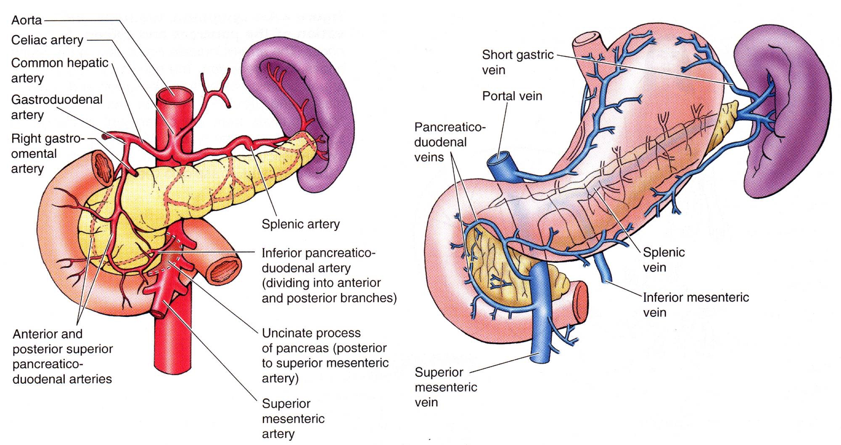
Arterial supply and venous drainage of the duodenum
Notes:
Recall blood flow, arterial, venous.

Slide 23
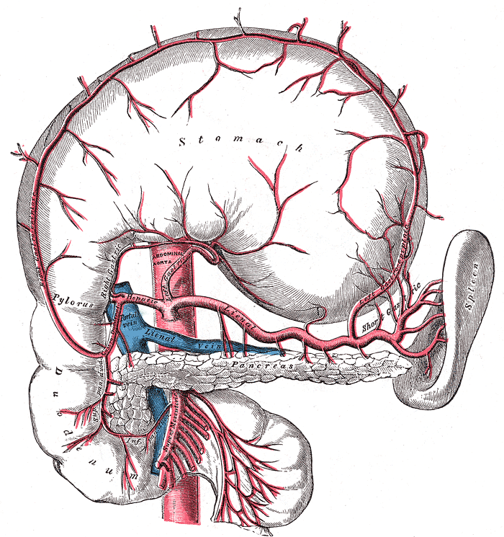
Blood Supply of the Duodenum

Slide 24
Veins of Duodenum
The superior pancreaticoduodenal vein drains into the portal vein
The inferior vein joins the superior mesenteric vein .

Slide 25
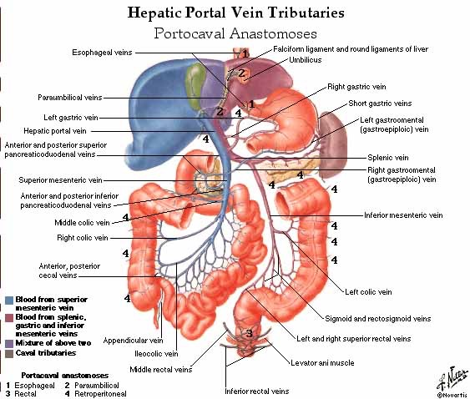

Slide 26
Lymphatic Drainage
The lymph vessels follow the arteries
drain upward→ via pancreaticoduodenal nodes → the gastroduodenal nodes → the celiac nodes
drain downward →via pancreaticoduodenal nodes→ the superior mesenteric nodes around the origin of the superior mesenteric artery.

Slide 27
Nerve supply
Sympathetic nerve
Parasympathetic nerves from:
1- The celiac plexus
2- Superior mesenteric plexus.

Slide 28
Jejunum and Ileum Location and Description
The jejunum and ileum measure about 20 ft (6 m) long
The upper two fifths is the jejunum & the lower 3/5 is the ileum
Each has distinctive features
There is a gradual change from one to the other
The jejunum begins at the duodenojejunal flexure
The ileum ends at the ileocecal junction.
The coils of jejunum and ileum are freely mobile and are attached to the posterior abdominal wall by a fan-shaped fold of peritoneum known as the mesentery of the small intestine

Slide 29
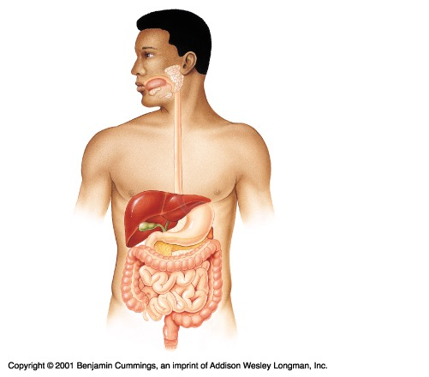
SMALL INTESTINES ANATOMY
Jejunum
Ileum

Slide 30
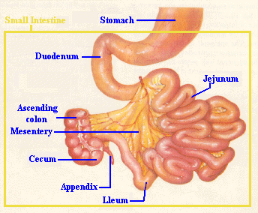

Slide 31
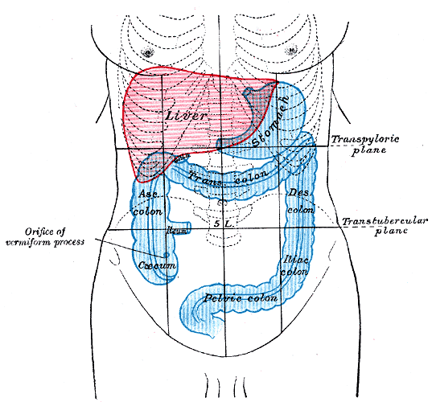
Anatomical Position of Small Intestine

Slide 32
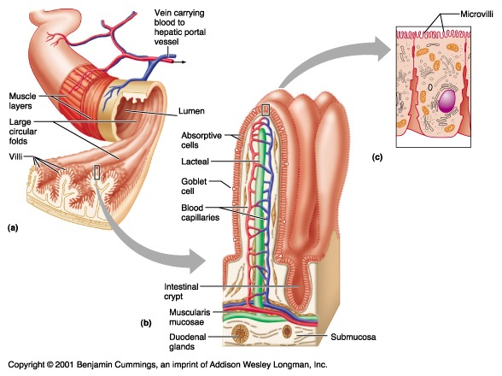
Structure of the Villi in the Small Intestine
32

Slide 33
Mesentery of the Small Intestine
Fan-shaped fold of peritoneum
The long free edge of the fold encloses the mobile intestine.
The short root of the fold is continuous with the parietal peritoneum on the posterior abdominal wall
Along a line that extends downward and to the right from the left side of the second lumbar vertebra to the region of the right sacroiliac joint

Slide 34
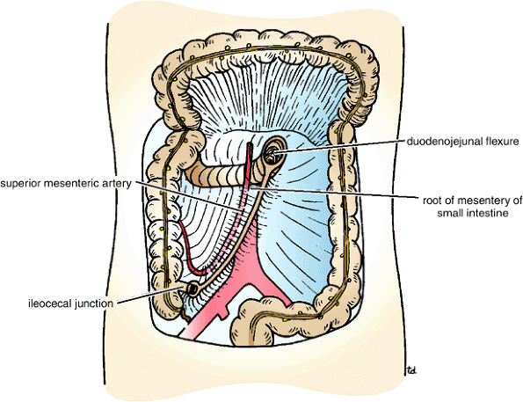
Root of the mesentery

Slide 35
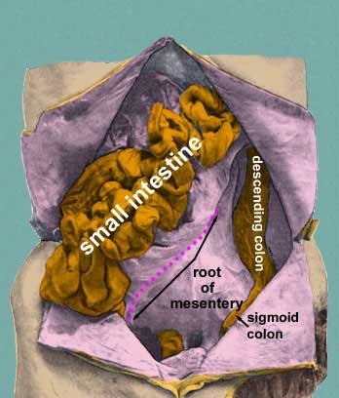

Slide 36
Contents of the Mesentery
The branches of the superior mesenteric artery and vein
Lymphatic vessels & lymphatic nodes
Nerves

Slide 37
Difference between Jejunum & Ileum
 | Jejunum | Ileum
Length | Proximal 2/5 | Distal 3/5
Site | in the upper part of the peritoneal cavity below the left side of the transverse mesocolon | in the lower part of the cavity and in the pelvis
Wall | thicker wall & redder | Thinner & less redder
Arcades in mesentery | simple ,only one or two arcades with long infrequent branches Long vase recta | numerous short terminal vessels arise from a series of three or four or even more Arcade - Short vase recta
Fat in mesentery | - the fat is deposited near the root - it is scanty near the intestinal wall - Less in amount →appear window | - the fat is deposited throughout mesentery - Big amount - No window appear

Slide 38
Difference between Jejunum & Ileum
 | jejunum | Ileum
Diameter | wider | smaller
Villi | numerous | Less numerous
Plicae circularis(the permanent enfolding of the mucous membrane& submucosa | They are: 1- larger 2- more numerous 3- closely set | they are: 1- smaller 2- more widely separated 3- in the lower part they are absent .
Lymphatic follicles | No or few | Aggregations of lymphoid tissue (Peyer's patches) are present in the mucous membrane

Slide 39
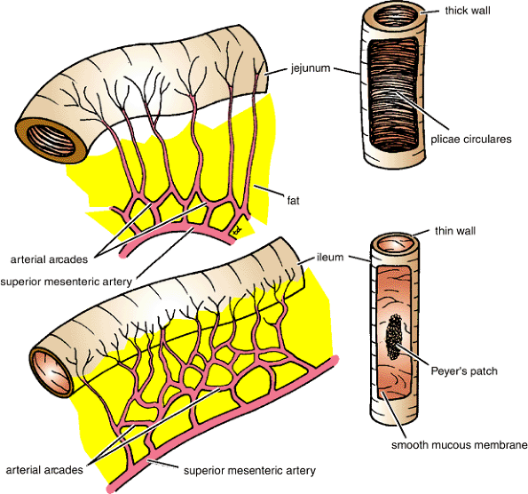

Slide 40
Blood supply of Jejunum & Ileum
Arteries:
The arterial supply is from branches of the superior mesenteric artery .
The intestinal branches arise from the left side of the artery and run in the mesentery to reach the gut.
They anastomosis with one another to form a series of arcades.
The lowest part of the ileum is also supplied by the ileocolic artery.

Slide 41
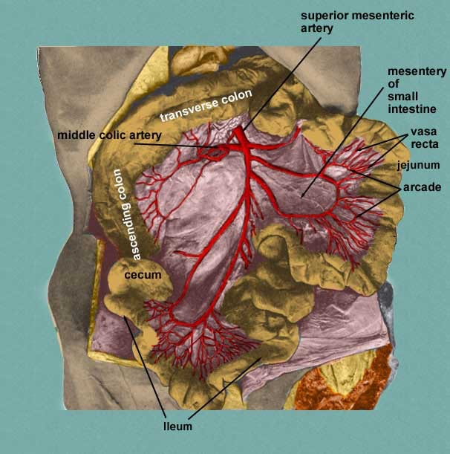
Blood Supply for Jejunum & Ileum

Slide 42
Veins:
The veins correspond to the branches of the superior mesenteric artery
Drain into the superior mesenteric vein.

Slide 43
Lymphatic Drainage of Jejunum & Ileum
The lymph vessels pass through many intermediate mesenteric nodes
Finally reach the superior mesenteric nodes→ around the origin of the superior mesenteric artery.

Slide 44
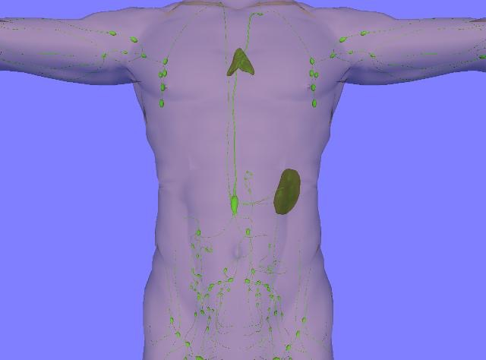
Lymph Drainage of Jejunum & Ileum

Slide 45
Nerve Supply of Jejunum & Ileum
The nerves are derived from the sympathetic and parasympathetic (vagus)
Nerves from the superior mesenteric plexus.

Slide 46
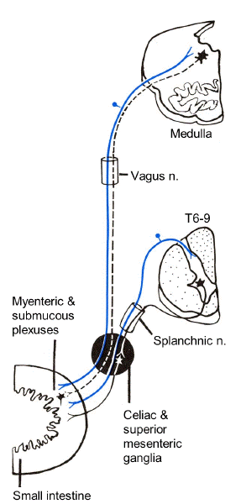
Nerve Supply of the Small Intestine

Slide 47
Congenital Anomaly of Small Intestine
Meckel's Diverticulum:
A congenital anomaly of the ileum
Present in 2% of people
2 feet from iliocecal junction
2 inch long
contains gastric or pancreatic tissue
Remains of vitelline duct of embryo

Slide 48
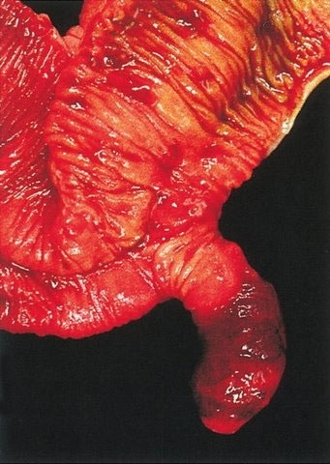
Meckel's Diverticulum

