Slide 1
HYPERTENSIVE VASCULAR DISEASE

Slide 2
Hypertension(HTN)
Cutoffs in diagnosing hypertension in clinical practice➔ sustained diastolic pressures >90 mm Hg, and/or sustained systolic pressures >140 mm Hg

Slide 3
Malignant hypertension
→ A small percentage of HTN patients (5%) present with a rapidly rising blood pressure that, if untreated, leads to death within 1 to 2 years.
➔ systolic pressures > 200 mm Hg or diastolic pressures > 120 mm Hg
→ associated with renal failure and retinal hemorrhages
→ most commonly is superimposed on preexisting benign hypertension

Slide 4
Hypertension (HTN) has the following complications:
stroke (CVD)
multi-infarct dementia
atherosclerotic coronary heart disease
cardiac hypertrophy and heart failure (hypertensive heart disease)
aortic dissection
renal failure

Slide 5
Types of hypertension
1- essential hypertension: most cases (95%) are idiopathic.
2- secondary hypertension: Most of the remaining cases (are due to renal disease, or renal artery narrowing ( called renovascular hypertension), and to a lesser degree many other conditions….

Slide 6
Essential HTN Accounts for 90% to 95% of all cases
Secondary HTN
Renal Acute glomerulonephritis Chronic renal disease Polycystic disease Renal artery stenosis Renal vasculitis Renin-producing tumors
Endocrine Adrenocortical hyperfunction (Cushing syndrome, primary aldosteronism, CAH licorice ingestion) Exogenous hormones (glucocorticoids, estrogen sympathomimetics monoamine oxidase inhibitors) Pheochromocytoma Acromegaly Hypothyroidism (myxedema) Hyperthyroidism (thyrotoxicosis) Pregnancy-induced (pre-eclampsia)
Cardiovascular Coarctation of aorta Polyarteritis nodosa Increased intravascular volume Increased cardiac output Rigidity of the aorta
Neurologic Psychogenic Increased intracranial pressure Sleep apnea Acute stress, including surgery

Slide 7
Pathogenesis of essential HTN
Genetic factors
familial clustering of hypertension
HTN has been linked to specific angiotensinogen polymorphisms and angiotensin II receptor variants; polymorphisms of the renin-angiotensin system.
Susceptibility genes for essential hypertension are currently unknown but probably include those that control renal sodium absorption, etc.

Slide 8
Pathogenesis of essential HTN
Environmental factors
such as stress, obesity, smoking, physical inactivity, and high levels of salt consumption, modify the impact of genetic determinants.
Evidence linking dietary sodium intake with the prevalence of hypertension in different population groups is particularly strong.

Slide 9
Morphology
HTN is associated with arteriolosclerosis (small arterial disease)
Two forms of small blood vessel disease are hypertension-related:
1- hyaline arteriolosclerosis
2- hyperplastic arteriolosclerosis

Slide 10
Hyaline arteriolosclerosis
associated with benign hypertension.
marked by homogeneous, pink hyaline thickening of the arteriolar walls, and luminal narrowing.
Results from leakage of plasma components across injured endothelial cells, into vessel walls and increased ECM production by smooth muscle cells in response to chronic hemodynamic stress.

Slide 11
Complications:
Most significant in the kidneys➔ nephrosclerosis (glomerular scarring).
Other causes of hyaline arteriolosclerosis (in absence of HTN):
1- elderly patients (normo-tensive)
2- diabetis mellitus

Slide 12
Hyperplastic arteriolosclerosis
is more typical of severe (malignant) hypertension.
"onionskin," concentric, laminated thickening of arteriolar walls and luminal narrowing.
The laminations consist of smooth muscle cells and thickened, reduplicated basement membrane.
In malignant hypertension these changes are accompanied by fibrinoid deposits and vessel wall necrosis (necrotizing arteriolitis), which are particularly prominent in the kidney

Slide 13
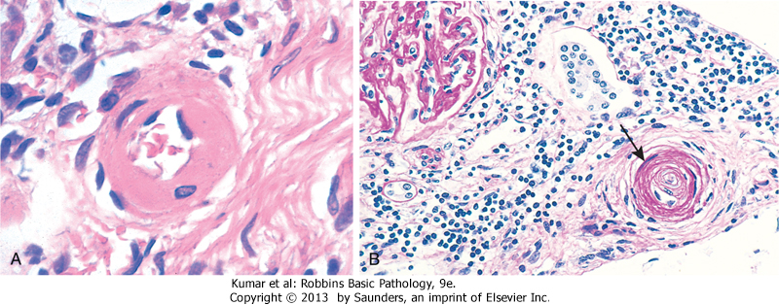
A, Hyaline arteriolosclerosis. The arteriolar wall is thickened with the deposition of amorphous proteinaceous material, and the lumen is markedly narrowed. B, Hyperplastic arteriolosclerosis ("onion-skinning") (arrow) causing luminal obliteration

Slide 14
DISORDERS OF BLOOD VESSEL HYPERREACTIVITY
Several disorders are characterized by inappropriate or exaggerated vasoconstriction of blood vessels:
1- Raynaud Phenomenon
2- Myocardial Vessel Vasospasm

Slide 15
1- Raynaud Phenomenon
- results from exaggerated vasoconstriction of arteries and arterioles in the extremities (the fingers and toes, but also sometimes the nose, earlobes, or lips).
-restricted blood flow induces paroxysmal pallor or cyanosis
involved digits characteristically show "red-white-and-blue" color changes from most proximal to most distal (reflecting proximal vasodilation, central vasoconstriction, and more distal cyanosis, respectively).
- Raynaud phenomenon can be a primary entity or may be secondary to other disorders

Slide 16
Primary Raynaud phenomenon
caused by exaggerated vasomotor responses to cold or emotion (intrinsic hyperreactivity of medial smooth muscle cells)
affects 3% to 5% of the general population and has a predilection for young women.
Structural changes in the arterial walls are absent except late in the course, when intimal thickening may appear.
The course is usually benign
chronic cases may show atrophy of the skin, subcutaneous tissues, and muscles.
Ulceration and ischemic gangrene are rare.

Slide 17
Secondary Raynaud phenomenon
refers to vascular insufficiency due to arterial disease caused by other entities
these include SLE, scleroderma, Buerger disease, or atherosclerosis.
every patient with Raynaud phenomenon should be evaluated for these secondary causes

