Slide 2
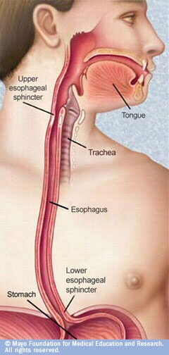
The esophagus is a tubular structure (muscular, collapsible tube ) about 10 in. (25 cm) long that is continuous above with the laryngeal part of the pharynx opposite the sixth cervical vertebra
The esophagus conducts food from the pharynx into the stomach. Wavelike contractions of the muscular coat, called peristalsis, propel the food onward.
It passes through the diaphragm at the level of the 10th thoracic vertebra to join the stomach
In the neck, the esophagus lies in front of the vertebral column; laterally, it is related to the lobes of the thyroid gland; and anteriorly, it is in contact with the trachea and the recurrent laryngeal nerves
In the thorax, it passes downward and to the left through the superior and then the posterior mediastinum
At the level of the sternal angle, the aortic arch pushes the esophagus over to the midline

Slide 3
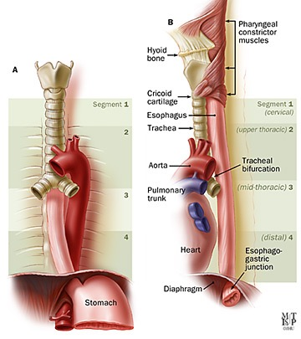
The relations of the thoracic part of the esophagus :
Anteriorly: The trachea and the left recurrent laryngeal nerve; the left principal bronchus, which constricts it; and the pericardium, which separates the esophagus from the left atrium
Posteriorly: The bodies of the thoracic vertebrae; the thoracic duct; the azygos veins; the right posterior intercostal arteries; and, at its lower end, the descending thoracic aorta
Right side: The mediastinal pleura and the terminal part of the azygos vein
Left side: The left subclavian artery, the aortic arch, the thoracic duct, and the mediastinal pleura

Slide 4
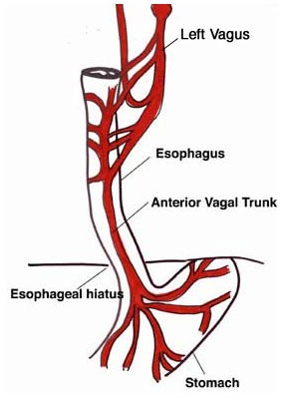
Inferiorly to the level of the roots of the lungs, the vagus nerves leave the pulmonary plexus and join with sympathetic nerves to form the esophageal plexus
The left vagus lies anterior to the esophagus and the right vagus lies posterior
At the opening in the diaphragm, the esophagus is accompanied by the two vagi, branches of the left gastric blood vessels, and lymphatic vessels
Fibers from the right crus of the diaphragm pass around the esophagus in the form of a sling.
In the abdomen, the esophagus descends for about 0.5 in. (1.3 cm) and then enters the stomach
It is related to the left lobe of the liver anteriorly and to the left crus of the diaphragm posteriorly.

Slide 5
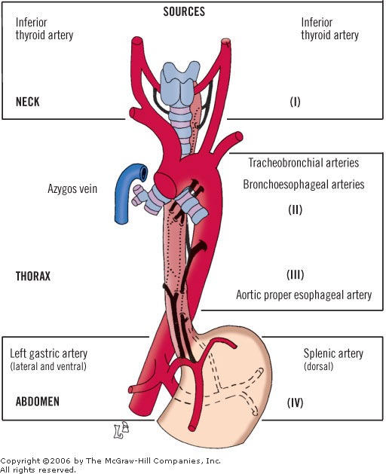
The upper third of the esophagus is supplied by the inferior thyroid artery,
the middle third by branches from the descending thoracic aorta,
and the lower third by branches from the left gastric artery
The veins from the upper third drain into the inferior thyroid veins, from the middle third into the azygos veins, and from the lower third into the left gastric vein, a tributary of the portal vein.

Slide 6
Lymph vessels from the upper third of the esophagus drain into the deep cervical nodes,
from the middle third into the superior and posterior mediastinal nodes,
and from the lower third into nodes along the left gastric blood vessels and the celiac nodes
The esophagus is supplied by parasympathetic and sympathetic efferent and afferent fibers via the vagi and sympathetic trunks
In the lower part of its thoracic course, the esophagus is surrounded by the esophageal nerve plexus.

Slide 7
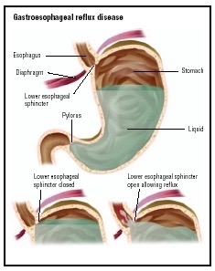
No anatomic sphincter exists at the lower end of the esophagus
However, the circular layer of smooth muscle in this region serves as a physiologic sphincter
As the food descends through the esophagus, relaxation of the muscle at the lower end occurs ahead of the peristaltic wave so that the food enters the stomach
The tonic contraction of this sphincter prevents the stomach contents from regurgitating into the esophagus.
The closure of the sphincter is under vagal control, and this can be augmented by the hormone gastrin and reduced in response to secretin, cholecystokinin, and glucagon.

Slide 8
The Stomach

Slide 9
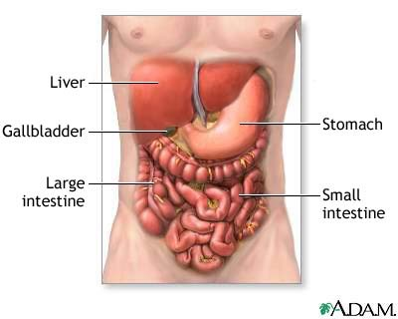
- The stomach is a dilated part of the alimentary canal
- Between the esophagus and the small intestine

Slide 10
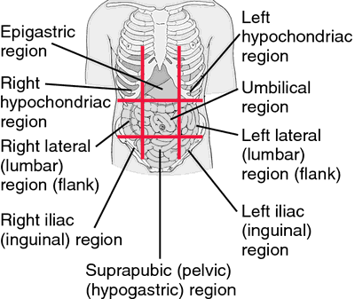
It occupies the left upper quadrant mainly in the epigastric region

Slide 11
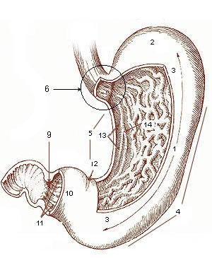
It is roughly J-shaped
Steer horn in obese person
has two openings, the cardiac and pyloric orifices
Two curvatures, the greater and lesser curvatures
Two surfaces, an anterior and a posterior surface

Slide 12
Its shape undergoes considerable variation in the same person and depends on
- The volume of its contents
- The position of the body
- The phase of respiration.

Slide 13
Has three main functions:
It stores food (in the adult it has a capacity of about 1500 mL )
It mixes the food with gastric secretions to form a semifluid chyme
It controls the rate of delivery of the chyme to the small intestine so that efficient digestion and absorption can take place.

Slide 15
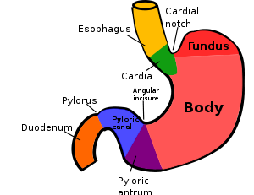
The stomach is divided into the following parts :
1- Fundus:
Dome-shaped
Projects upward and to the left of the cardiac orifice
It is usually full of gas.

Slide 16
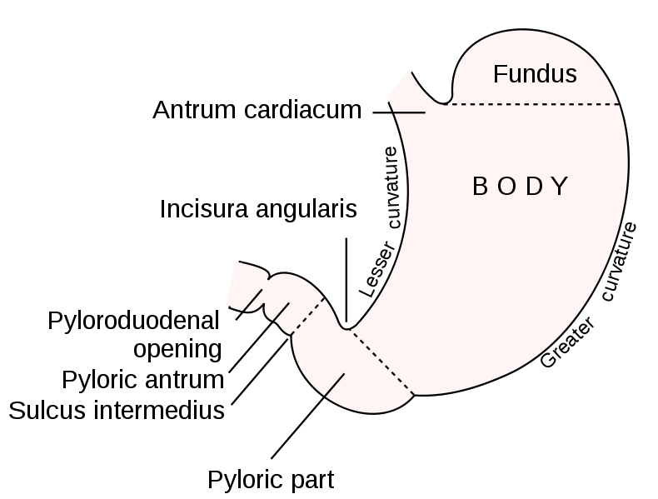
2- Body:
Extends from the level of the cardiac orifice to the level of the incisura angularis (a constant notch in the lower part of the lesser curvature )
3- Pyloric region
divided into:
a- Pyloric antrum:
- This extends from the incisura angularis to the pylorus

Slide 17
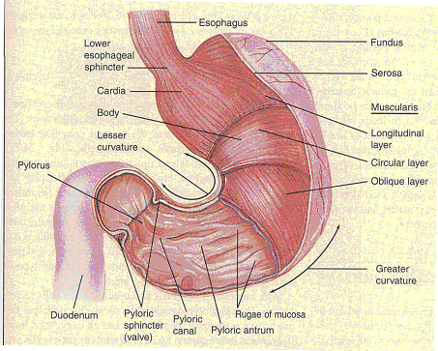
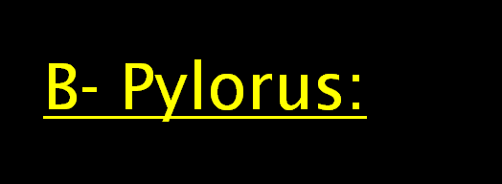
- The most tubular part of the stomach
- The thick muscular wall is called the pyloric sphincter

Slide 18
Orifices of the stomach
- Cardiac orifice
- pyloric orifice

Slide 19
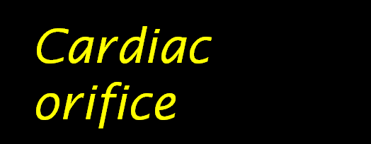
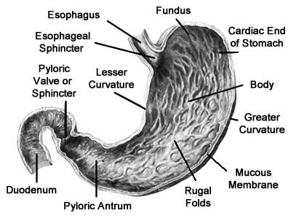
The cardiac orifice is where the esophagus enters the stomach
No anatomic sphincter can be demonstrated here
A physiological sphincter→ physiological mechanism exists that prevents regurgitation of stomach contents into the esophagus

Slide 20
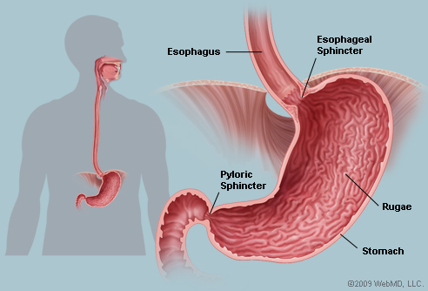
7th Lt. costal cartilage
1 inch to Lt. of midline
45 cm from incisors in the oral cavity.
10 cm from ant. abdominal wall

Slide 21
Present at end of the pyloric canal
On the level of L1
1” to the Rt. of the midline.
The circular muscle coat of the stomach is much thicker here and forms the anatomic and physiologic pyloric sphincter
Its position can be recognized by a slight constriction on the surface of the stomach (The pylorus lies on the transpyloric plane).

Slide 22
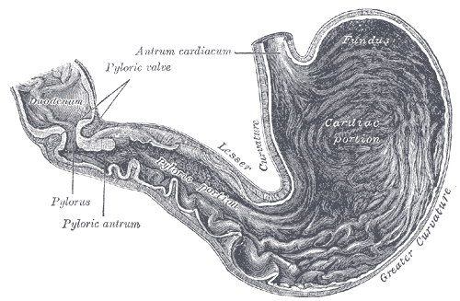

Slide 23
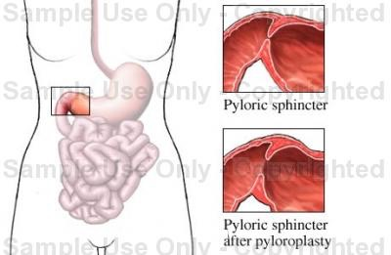
The pyloric sphincter controls the outflow of gastric contents into the duodenum.
The sphincter receives motor fibers from the sympathetic system and inhibitory fibers from the vagus nerve

Slide 24
Function of pyloric opening control by:
1- Hormonal influences from stomach & duodenum
2- Nerve fibers
Filling stomach → Myenteric fibers → relaxation of sphincter

Slide 25
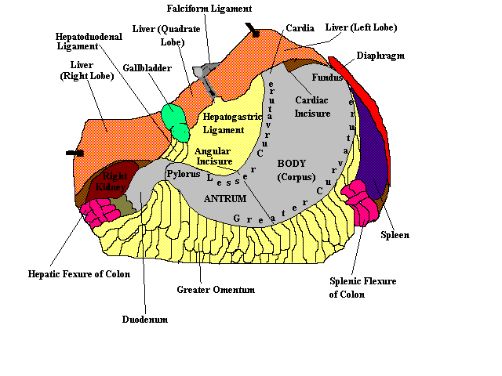
1- The lesser curvature
Forms the right border of the stomach
Extends from the cardiac orifice to the pylorus

Slide 26
2- The greater curvature
Much longer than the lesser curvature
Extends from the left of the cardiac orifice, over the dome of the fundus, and along the left border of the stomach to the pylorus

Slide 28
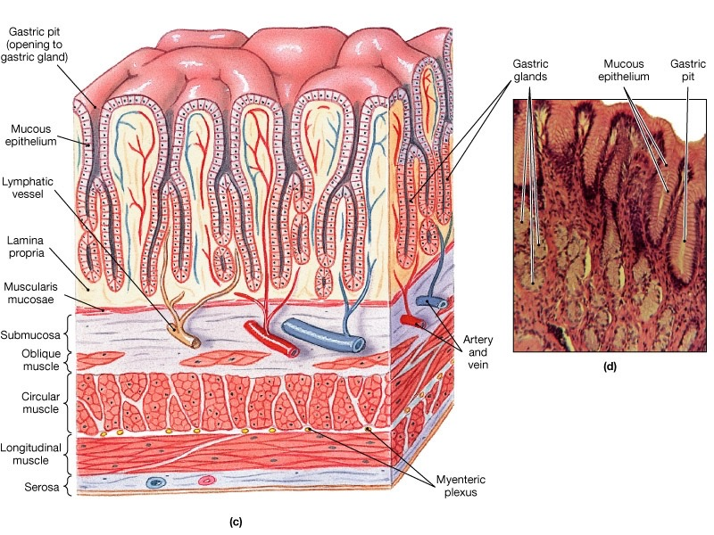

Slide 29
The mucous membrane of the stomach is thick and vascular and is thrown into numerous folds, or rugae mainly longitudinal in direction
The folds flatten out when the stomach is distended.

Slide 30
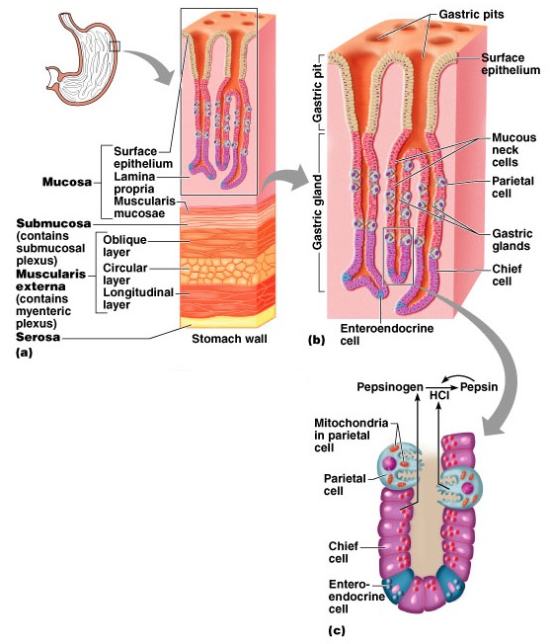

Slide 31
The muscular wall of the stomach contains longitudinal fibers (outer surface), circular fibers( inner surface), and oblique fibers

Slide 32
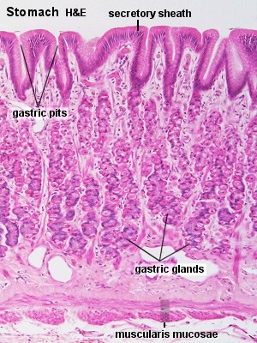

Slide 33
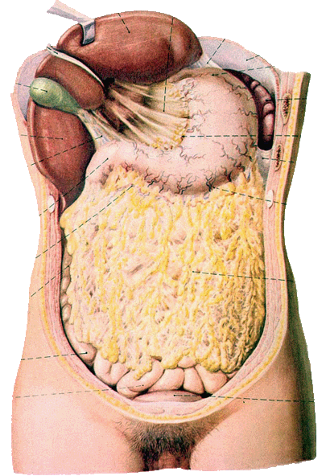
The peritoneum (visceral peritoneum) completely surrounds the stomach.
It leaves the lesser curvature as the lesser omentum
It leaves the greater curvature as the gastrosplenic ligament and the greater omentum
The gastrosplenic ligament extends from the upper part of the greater curvature to the spleen, and the greater omentum extends from the lower part of the greater curvature to the transverse colon

Slide 34
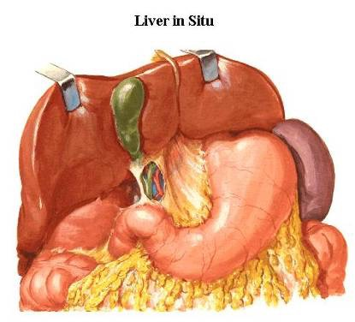
The lesser curvature is suspended from the liver by the lesser omentum
Gastrophrenic ligament between the fundus and the diaphragm.

Slide 35
Anterior- superior
The anterior abdominal wall
the left costal margin
the left pleura and lung
the diaphragm
the left lobe of the liver

Slide 36
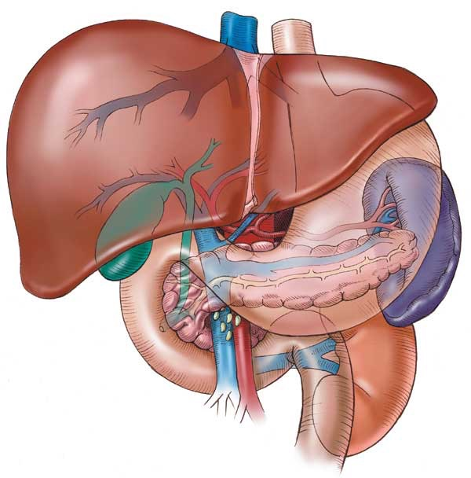
Posteriorly = stomach bed
The lesser sac
the Lt. crus of diaphragm
the spleen
the left suprarenal gland
the upper part of the left kidney
the splenic artery
the body of pancreas
the transverse mesocolon
the transverse colon

Slide 37
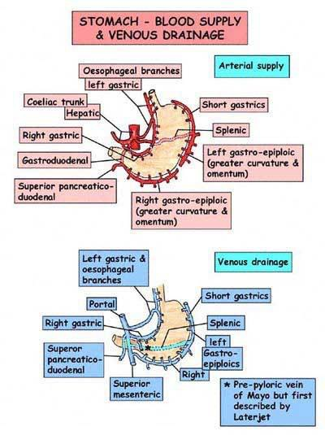

Slide 38
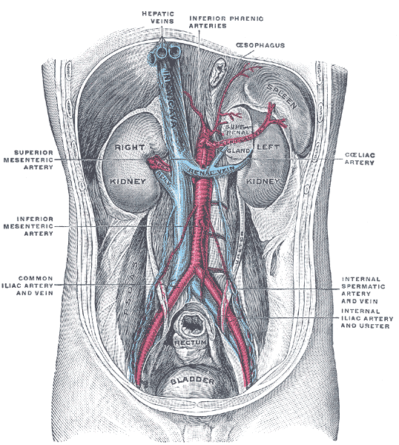
- The arteries are derived from the branches of the celiac artery
The celiac trunk arise from the front of the abdominal aorta and its located at the level of T12 to L1 above the pancreas
Its 1 cm long

Slide 39
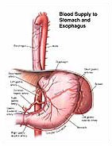
Relations of celiac artery
On each side : celiac ganglia+ lymphatic nodes
Crus of diaphragm and lumbar nerves
Its Branches for foregut
Main distribution
Lt.gastric.a
Splenic.a
Hepatic.a

Slide 41
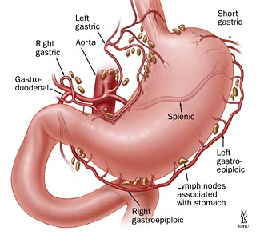
1- The left gastric artery
Arises from the celiac artery
It passes upward and to the left to reach the esophagus
Then descends along the lesser curvature of the stomach
It supplies the lower third of the esophagus and the upper right part of the stomach

Slide 42
2- The right gastric artery
arises from the hepatic artery at the upper border of the pylorus
runs to the left along the lesser curvature.
It supplies the lower right part of the stomach.

Slide 43
3- The short gastric arteries
Arise from the splenic artery (5-7 arteries)
Arises from splenic artery in the gastrosplenic ligament
- pass upward in the gastrosplenic to supply the fundus

Slide 44
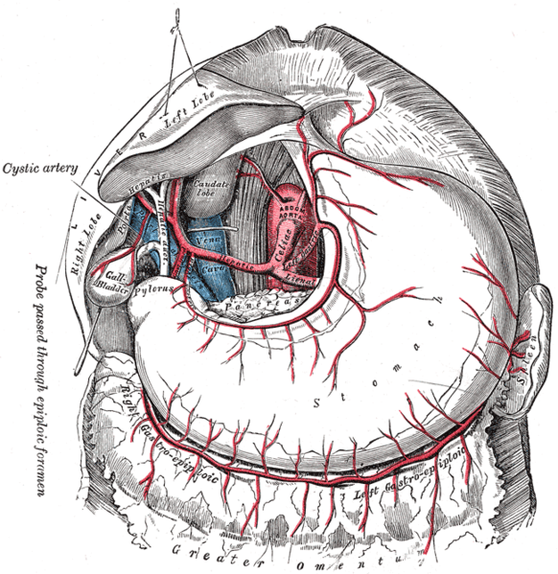

Slide 45
4- The left gastroepiploic artery
- Arises from the splenic artery before the hilum of the spleen
Passes forward in the gastrosplenic (ligament)
Supply the stomach along the upper part of the greater curvature in the greater omentum
5- The right gastroepiploic artery
arises from the gastroduodenal branch of the hepatic artery
It passes to the left and supplies the stomach along the lower part of the greater curvature in the greater omentum.

Slide 46
The veins drain into the portal circulation
The left and right gastric veins drain directly into the portal vein
The short gastric veins and the left gastroepiploic veins join the splenic vein
The right gastroepiploic vein joins the superior mesenteric vein(which meet the splenic vein behind the neck of pancreas to form the portal vein

Slide 47
Follow the arteries of stomach
The left and right gastric nodes
The left and right gastroepiploic nodes
The short gastric nodes
All lymph from the stomach eventually passes to the celiac nodes located around the root of the celiac artery on the posterior abdominal wall.

Slide 48
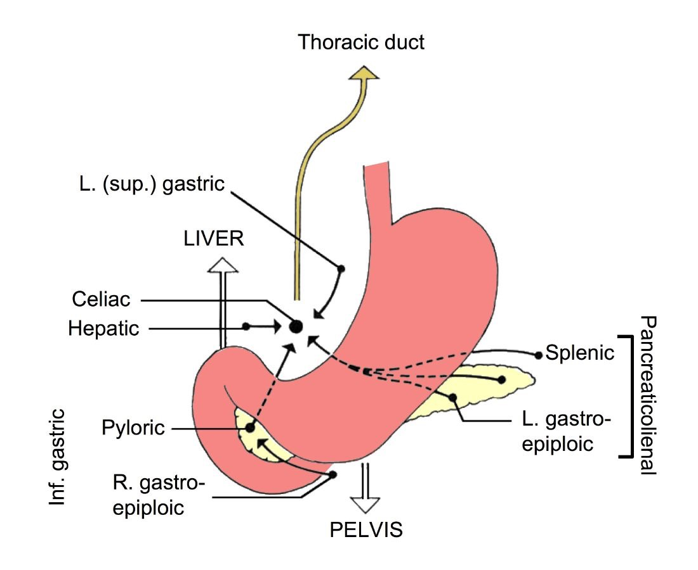

Slide 49
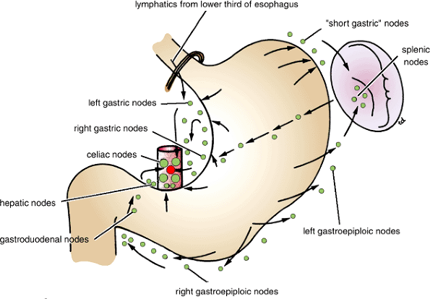

Slide 50
The nerve supply includes sympathetic fibers derived from the celiac plexus
parasympathetic fibers from the right and left vagus nerves .
The sympathetic innervation of the stomach carries a proportion of pain sensation
The parasympathetic vagal fibers are secreto-motor to the gastric glands and motor to the muscular wall of the stomach( peristaltic movement)
The pyloric sphincter receives motor fibers from the sympathetic system and inhibitory fibers from the vagus.n.

Slide 51
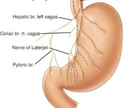

Slide 52
The anterior vagal trunk
mainly from the left vagus nerve
Distribution
1- The anterior surface of the stomach.
2- A large hepatic branch passes up to the liver
3-Ant. Nerve Laterjet→ pylorus

Slide 53
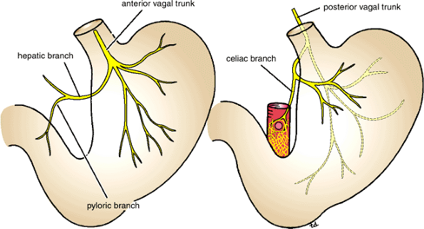

Slide 54
The posterior vagal trunk
mainly from the right vagus nerve
Distribution
1- mainly the posterior wall of the stomach.
2- Ant. Wall of body of stomach
3- Celiac branch→ small intestine+ as far as to splenic flexure+ pancreas
4- post. Nerve latarjet→ pylorus

Slide 55
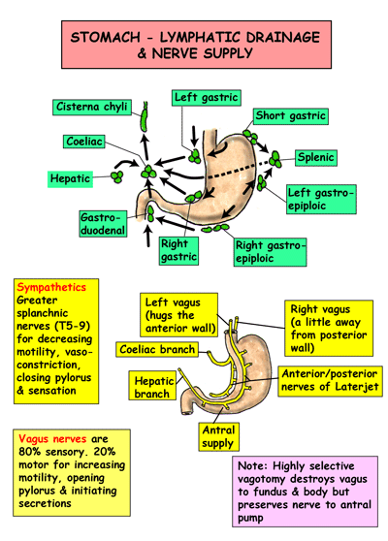

Slide 56
Gastric Ulcer
Trunkal vagotomy →Sectioning the vagus nerves below the diaphragm around the esophagus.
Highly selective vagotomy( cut all branches of the vagi except latarjet.n)
Peptic ulcer(D.U)
Gastroscopy
Pyloroplasty(drainage)= gastro- jejunostomy

Slide 57
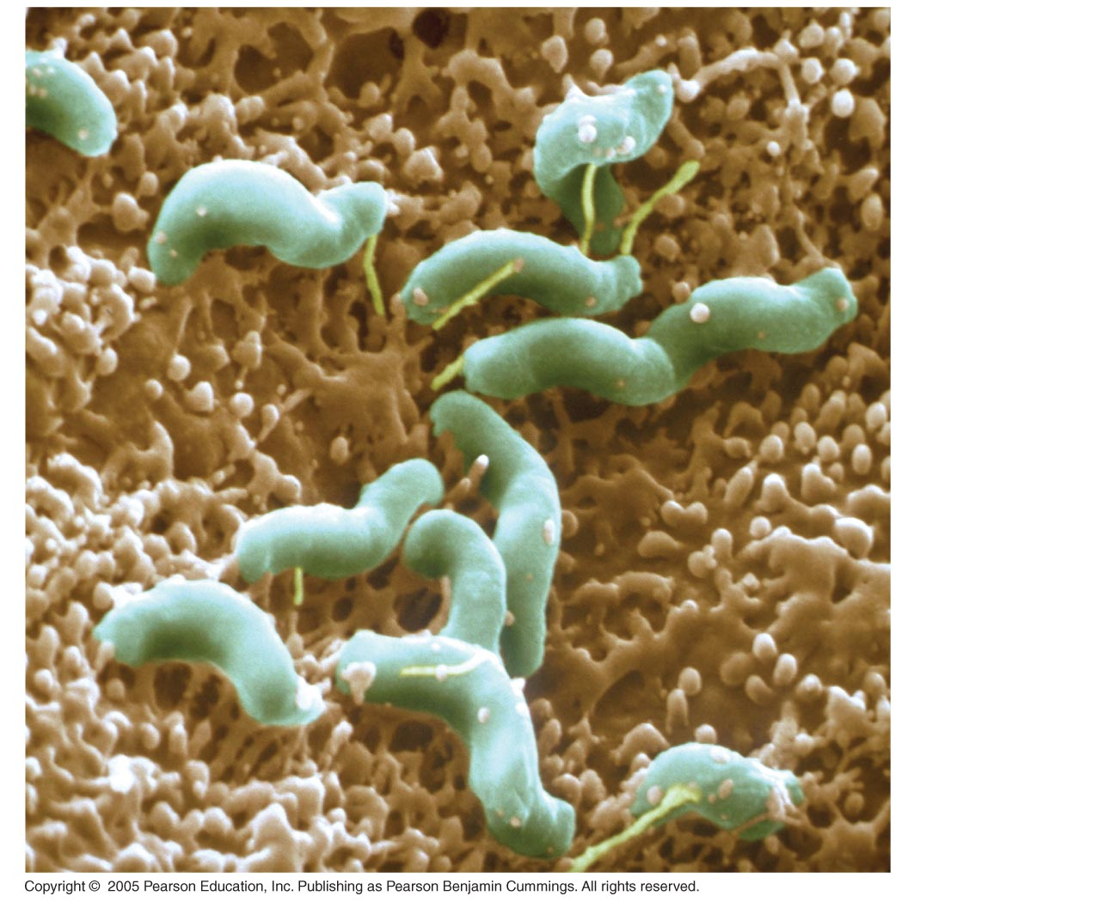
Helicobacter pylori

