Slide 1
ANEURYSMS AND DISSECTIONS

Slide 2
Aneurysm
An aneurysm is a localized abnormal dilation of a blood vessel or the heart
Types:
1-"true" aneurysm
→it involves all three layers of the arterial wall (intima, media, and adventitia) or the attenuated wall of the heart.
e.g. Atherosclerotic, syphilitic, and congenital aneurysms, and ventricular aneurysms that follow transmural myocardial infarctions.
2- “false” aneurysm
→(also called pseudo-aneurysm)
is a breach in the vascular wall leading to an extravascular hematoma that freely communicates with the intravascular space ("pulsating hematoma").
E.g. ventricular ruptures after MI that are contained by a pericardial adhesion
E.g. a leak at the junction of a vascular graft with a natural artery.

Slide 3
aneurysms are classified by macroscopic shape and size (aspects of shape and size are not specific for any disease or clinical manifestations) :
Saccular aneurysms
spherical outpouchings (involving only a portion of the vessel wall, and often contain thrombi.
Fusiform aneurysms
diffuse, circumferential dilation of a long vascular segment;
they vary in diameter and length and can involve extensive portions of the aortic arch, abdominal aorta, or even the iliacs.

Slide 5
Aortic aneurysms
The two most important causes are:
1- atherosclerosis : the most common cause
→ causes thinning and weakening of the media. The intimal plaques compress the underlying media and also compromise nutrient and waste diffusion from the vascular lumen into the arterial wall. The media consequently undergoes degeneration and necrosis, thus allowing the dilation of the vessel
2- cystic medial degeneration of the arterial media.
Other causes include trauma, congenital defects (e.g., berry aneurysms), infections (mycotic aneurysms), systemic diseases, such as vasculitis.

Slide 6
Mycotic aneurysms
Infection of a major artery that weakens its wall is called a mycotic aneurysm
possible complications: thrombosis and rupture.
can originate from:
embolization of a septic thrombus, usually as a complication of infective endocarditis
extension of an adjacent suppurative process;
circulating organisms directly infecting the arterial wall
Mycotic AAAs are atherosclerotic lesions infected by lodging of circulating microorganisms in the wall, e.g. bacteremia from a primary Salmonella gastroenteritis. suppuration further destroys the media, potentiating rapid dilation and rupture

Slide 7
Abdominal Aortic Aneurysm
Atherosclerotic aneurysms occur most frequently in the abdominal aorta (abdominal aortic aneurysm, often abbreviated AAA)
the common iliac arteries, the arch, and descending parts of the thoracic aorta can also be involved
Pathogenesis
AAA occurs more frequently in men and rarely develops before age 50.
Atherosclerosis is a major cause of AAA
other contributors include: hereditary defects in structural components of the aorta (e.g., defective fibrillin production in Marfan disease affects elastic tissue synthesis)
an altered balance of collagen degradation and synthesis mediated by local inflammatory infiltrates and the destructive proteolytic enzymes

Slide 8
Morphology
Usually positioned below the renal arteries and above the bifurcation of the aorta
AAA can be saccular or fusiform
as large as 15 cm in diameter, and as long as 25 cm.
Microscopically: atherosclerosis with destruction and thinning of the underlying aortic media
the aneurysm frequently contains a laminated mural thrombus

Slide 9
Syphilitic Aneurysm
Caused by The spirochetes T. pallidum
A vanishingly rare complication in the U.S. and West thanks to early recognition and treatment of syphilis
Tertiary stage of syphilis can cause obliterative endarteritis of the involve small vessels in any part of the body, including the vasa vasorum of the aorta
this results in ischemic medial injury, leading to aneurysmal dilation of the aorta and aortic annulus, and eventually valvular insufficiency.

Slide 10
Morphology of Syphilitic Aneurysm
Obliterative endarteritis:
luminal narrowing and obliteration, scarring of the vessel wall, and a dense surrounding rim of lymphocytes and plasma cells that may extend into the media
With destruction of the media, the aorta loses its elastic recoil and may become dilated, producing an aneurysm.
valvular insufficiency and massive volume overload lead to hypertrophy of the left ventricle.
The greatly enlarged hearts are sometimes called "cor bovinum" (cow's heart).

Slide 11
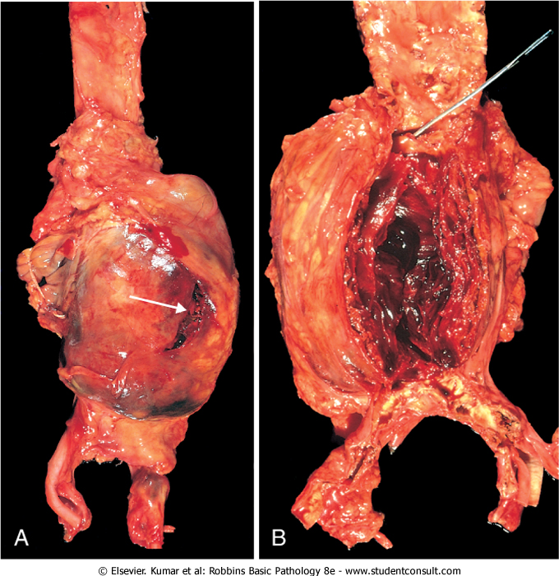
Abdominal aortic aneurysm

Slide 12
The clinical consequences of AAA include:
Rupture →massive potentially fatal hemorrhage
- risk of rupture is directly related to the size of the aneurysm (of 5 cm or more)
- operative mortality for unruptured aneurysms 5%, emergency surgery after rupture the mortality rate is more than 50%
Obstruction of downstream vessel→ tissue ischemic injury((e.g. iliac (leg), renal (kidney), mesenteric (gastrointestinal [GI] tract), or vertebral (spinal cord) arteries))
Embolism →from atheroma or mural thrombus
Impingement and compression on an adjacent structure (e.g.ureter or vertebrae)
Presentation as an abdominal mass (often palpably pulsating) that simulates a tumor

Slide 13
Arterial dissection
arises when blood enters the wall of the artery, as a hematoma dissecting between its layers.
Dissections are often but not always aneurysmal.
Both true and false aneurysms as well as dissections can rupture, often with catastrophic consequences

Slide 14
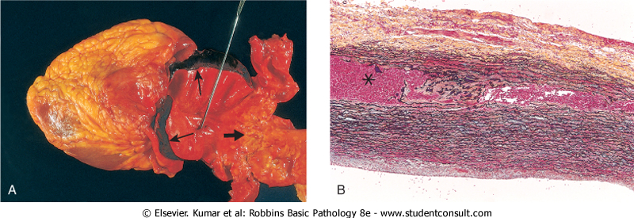
Aortic dissection

Slide 15
Aortic dissection
is a catastrophic event whereby blood dissects apart the media to form a blood-filled channel within the aortic wall
Complications are :
- massive hemorrhage
- cardiac tamponade (hemorrhage into the pericardial sac).

Slide 16
Pathogenesis of Aortic dissection
1- Hypertension is the major risk factor
pressure-related mechanical injury and/or ischemic injury.
2- inherited or acquired connective tissue disorders causing abnormal vascular ECM
(e.g., Marfan syndrome, Ehlers-Danlos syndrome, vitamin C deficiency, copper metabolic defects)

Slide 17
Marfan syndrome
The most common cause among the inherited or acquired connective tissue disorders assosiated with Aortic dissection
it is an autosomal dominant disease of fibrillin, an ECM scaffolding protein required for normal elastic tissue synthesis.
Patients have skeletal abnormalities (elongated axial bones) and ocular findings (lens subluxation) in addition to the cardiovascular manifestations

Slide 18
Aortic dissections are generally classified into two types:
1- The more common (and dangerous) proximal lesions (called type A dissections), involving either the ascending aorta only or both the ascending and descending aorta (types I and II of the DeBakey classification)
2- Distal lesions not involving the ascending part and usually beginning distal to the subclavian artery (called type B dissections or DeBakey type III

Slide 19
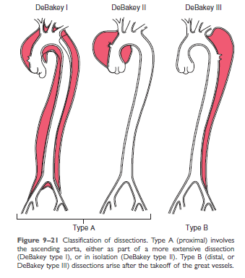

Slide 20
Clinical course
Previously, aortic dissection was typically fatal, but the prognosis has markedly improved.
Rapid diagnosis and institution of intensive antihypertensive therapy, coupled with surgical procedures involving plication of the aorta permits survival of 65% to 75% of patients

