Slide 1
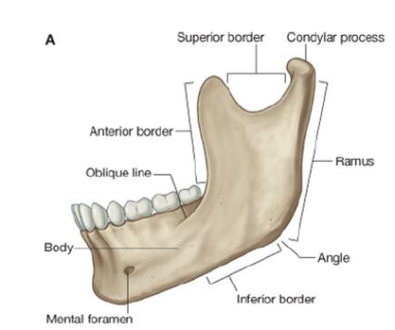
Condylar and coronoid processes
Most of the lateral surface provides attachment for the masseter muscle.
The ramus of mandible is quadrangular in shape and
has
medial and lateral surfaces
The superior border is notched to form the mandibular notch
The coronoid process extends superiorly from the junction of the anterior and superior borders of
the ramus.
The posterior and inferior borders of the ramus intersect to form the angle of mandible
provides attachment for temporalis muscle

Slide 2
The condylar process is made of:
1-the head of mandible, participates in forming the
temporomandibular joint;
and
2-the neck of mandible, which bears a shallow depression (the pterygoid fovea) on its anterior
surface for attachment of the lateral pterygoid muscle.

Slide 3
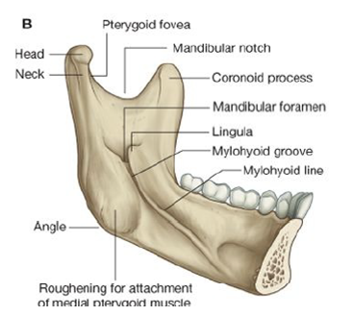
The medial surface of the ramus shows the following features:
1-Mandibular foramen, which is the superior opening ofthe mandibular canal. The inferior alveolar nerve and vessels pass through this foramen.
2-A triangular elevation (the lingula) for
attachment of the mandibular end of the sphenomandibular ligament
4-An elongate groove (the mylohyoid groove) extends anteroinferiorly from the mandibular foramen.
The nerve to mylohyoid is in this groove
3-Roughened for attachment of the medial pterygoid muscle

Slide 4
Masseter muscle
The masseter muscle is quadrangular in shape
Origin: inferior border and inner surface of the zygomatic arch.
insertion: into the lateral surface of the ramus of the mandible and its coronoid process.
Note: the mandible is the only movable bone in the skull !!! Therefore , it receives the insertion of all the muscles of mastication.
The masseter is innervated by the masseteric nerve from the mandibular nerve [V₃]

Slide 5
Temporalis muscle
The temporalis muscle is a large fan-shaped muscle that fills much of the temporal fossa
It originates from the bony surfaces of the temporal fossa
superiorly to the inferior temporal line
Tip and medial surface of the coronoid process
And anterior border of the ramus of the mandible
Temporalis is a powerful elevator of the mandible, closes the mandible
Temporalis is innervated by deep temporal nerves that originate from the mandibular nerve

Slide 6
Medial pterygoid
The medial pterygoid muscle is quadrangular in shape and has deep and superficial heads
Origin: medial surface of the lateral plate of the pterygoid process and the pyramidal process of the palatine bone
Insertion: medial surface of the ramus of mandible inferior to mandibular foramen
The medial pterygoid is innervated by the nerve to medial pterygoid from the mandibular nerve [V₃].
The medial pterygoid mainly elevates the mandible, closing jaws

Slide 7
Lateral pterygoid
The lateral pterygoid is a thick triangular muscle
The upper head originates from the roof of the infratemporal fossa (inferior surface of the greater wing of the sphenoid and the infratemporal crest
The lower head is larger and originates from the lateral surface of the lateral plate of the pterygoid process
Insertion:
into the neck of mandible
into the capsule of the Temporomandibular joint
Into the articular disc.
The lateral pterygoid is innervated by the nerve to lateral pterygoid from the mandibular nerve [V₃].

