Slide 1
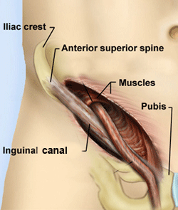
Inguinal canal

Slide 2
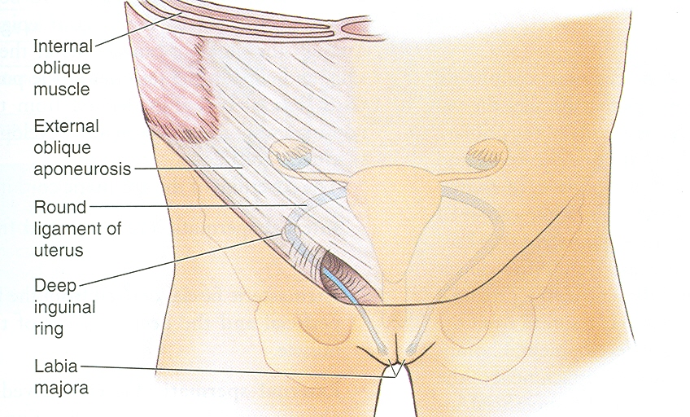
Inguinal Canal
It is an oblique passage through the lower part of the anterior abdominal wall
Present in both sexes
It allows structures to pass to and from the testis to the abdomen in males
In females it permits the passage of the round ligament of the uterus from the uterus to the labium majus
Transmits ilioinguinal nerve in both sexes

Slide 3
Inguinal Canal
It is about 1 ½ inches or 4cm long in the adults
Extends from the deep inguinal ring downward and medially to the superficial inguinal ring
Lies parallel to and immediately above the inguinal ligament
In the newborn child, the deep ring lies almost directly posterior to the superficial ring

Slide 4
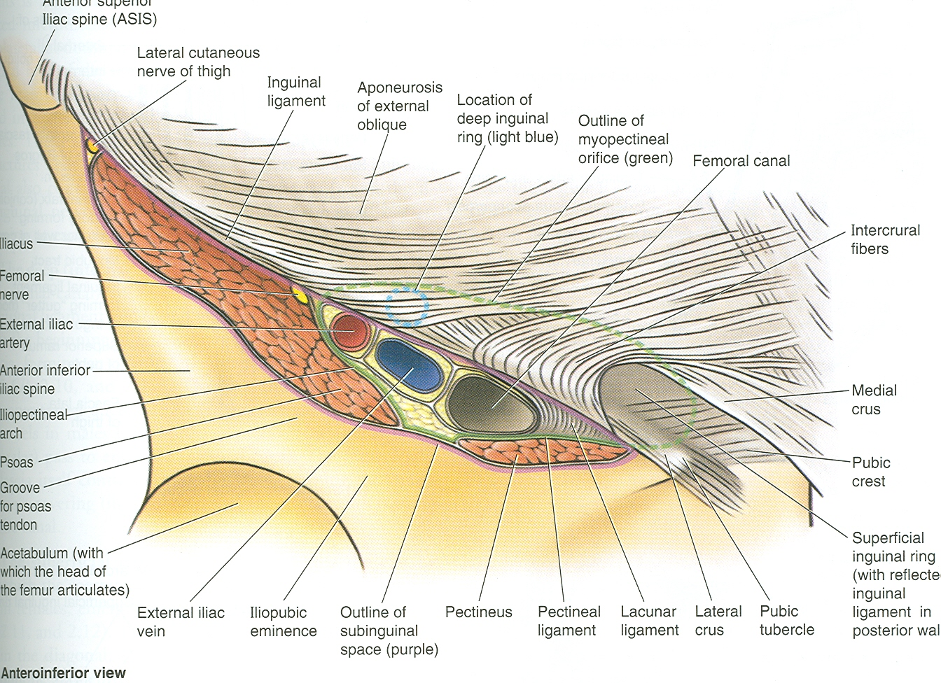
Deep Inguinal Ring
Is an oval opening in the fascia transversalis
Lies about ½ inch (1.3cm) above the inguinal ligament midway between the anterosuperior iliac spine and the symphysis pubis
Margins of the ring give attachment to the internal spermatic fascia

Slide 5
Superficial Inguinal Ring
Triangular in shape
Defect in the aponeurosis of the external oblique muscle
Lies immediately above and medial to the pubic tubercle
Its margins some times called crura(Med & lat crus), give attachment to the external spermatic fascia

Slide 6
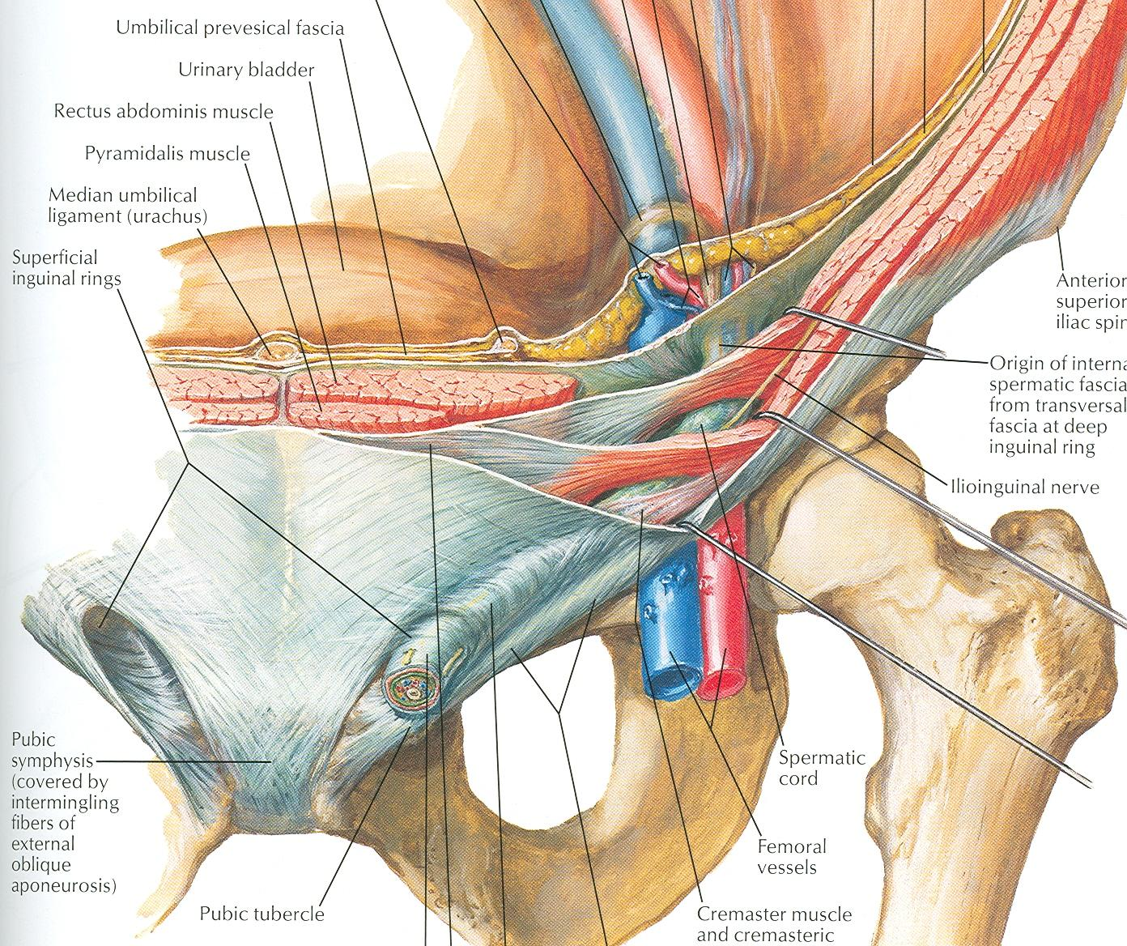
Anterior Wall of Inguinal Canal
It is formed along its entire length by aponeurosis of the external oblique muscle
It is reinforced in its lateral third by the origin of the internal oblique from the inguinal ligament
This wall is strongest where it lies opposite the weakest part of posterior wall, that is deep inguinal ring

Slide 7
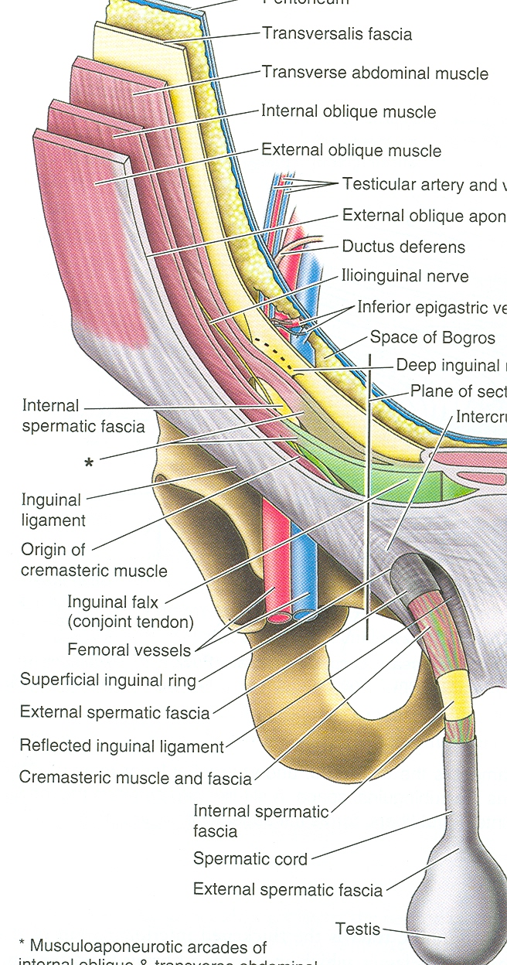
Posterior Wall of Inguinal Canal
It is formed along its entire length by the fascia transversalis
It is reinforced in its medial third by conjoint tendon, the common tendon of insertion of internal oblique and transversus, attached to the pubic crest and pectineal line
This wall is strongest where it lies opposite the weakest part of the anterior wall, that is superficial inguinal ring

Slide 8
Inferior Wall of Inguinal Canal = floor
It is formed by the rolled-under inferior edge of the aponeurosis of the external oblique muscle called inguinal ligament and at its medial end, the lacunar ligament
Superior Wall of Inguinal Canal = Roof
It is formed by the arching lowest fibers of the internal oblique and transversus abdominis muscles

Slide 9
Functions of Inguinal Canal
It allows structures of spermatic cord to pass to and from the testis to the abdomen in male
Permits the passage of round ligament of uterus from the uterus to the labium majus in female

Slide 10
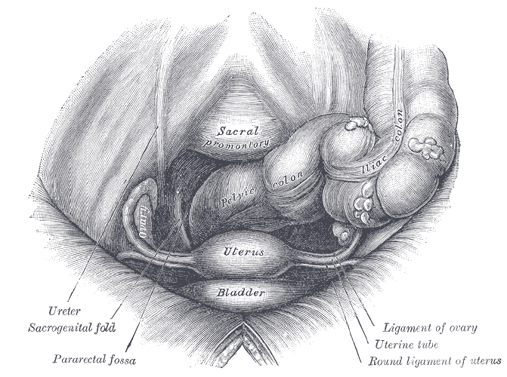
Contents of inguinal canal
Spermatic cord & its contents in male
Round ligament in female
Genital branch of genitofemoral nerve
Ilioinguinal nerve: Enter the canal through the posterior wall

Slide 11
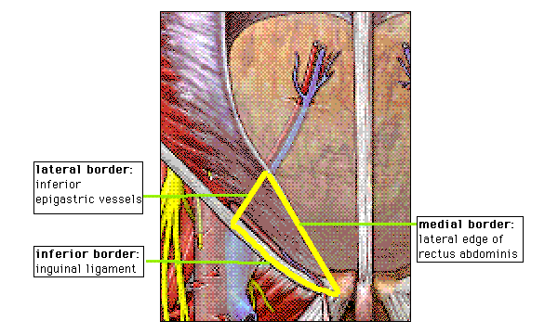
Inguinal triangle
- Region of abdominal wall
Borders
Medial border: Lateral margin of the rectus sheath, also called linea semilunaris
Superolateral border: Inferior epigastric vessels
Inferior border: Inguinal ligament

Slide 12
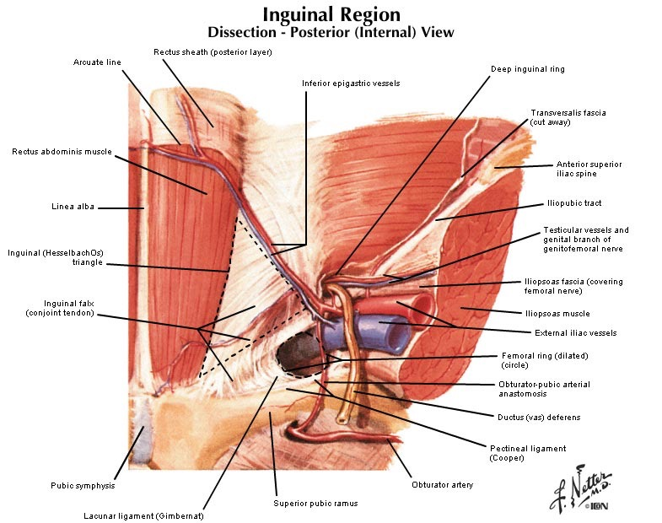

Slide 13
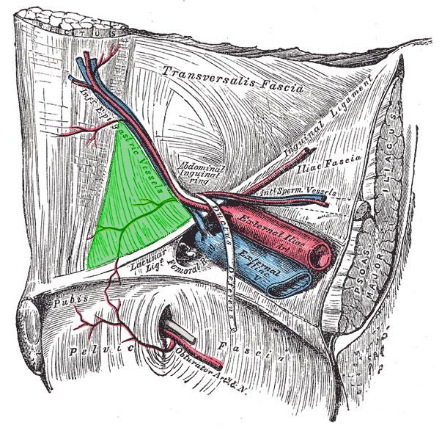

Slide 14
Spermatic Cord
It is a collection of structures that pass through the inguinal canal to and from the testis
It is covered with three concentric layers of fascia derived from the layers of anterior abdominal wall
It begins at the deep inguinal ring lateral to the inferior epigastric artery and ends at the testis

Slide 15
Structures of Spermatic Cord
Vas deferens
Testicular artery and vein
Testicular lymph vessels
Autonomic nerves
Processus vaginalis
Cremastric artery
Artery of the vas deference
Genital branch of genitofemoral nerve

Slide 16
Covering of the Spermatic Cord
The covering of the spermatic cord are three concentric layers of fascia derived from the layers of the anterior abdominal wall
Each covering is acquired as the processus vaginalis descends into the scrotum through the layers of the abdominal wall
External Spermatic fascia: Is derived from the external oblique aponeurosis and attached to the margins of the superficial inguinal ring
Cremasteric Fascia: Is derived from the internal oblique muscle
Internal Spermatic Fascia: Is derived from the fascia transversalis and attached to the margins of deep inguinal ring

Slide 17
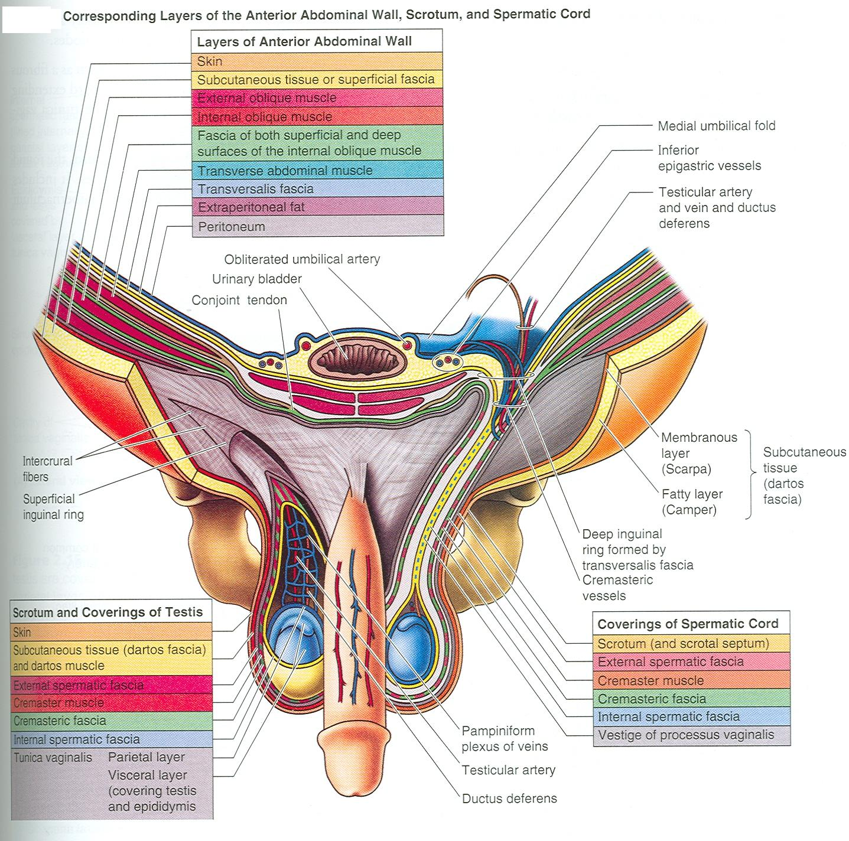

Slide 18
Vas Deferens
It is a cord like structure
Can be palpated between finger and thumb in the upper part of the scrotum
It is a thick walled muscular duct that transport spermatozoa from the epididymis to the prostatic urethra

Slide 19
Testicular Artery
It is a branch of abdominal aorta at level of L2
It is long and slender
Descends on the posterior abdominal wall
It traverses the inguinal canal and supplies the testis and the epididymis

Slide 20
Testicular Veins
These are the extensive venous plexus, the pampiniform plexus
Leaves the posterior border of the testis
As the plexus ascends, it becomes reduced in size so that at about the level of deep inguinal ring, a single testicular vein is formed
Drains into left renal vein on left side and inferior vena cava on right side

Slide 21
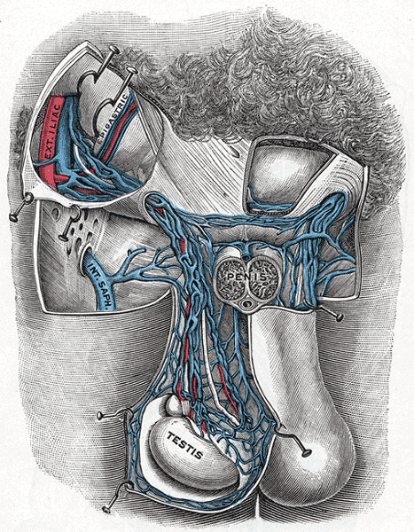
Testicular artery & vein

Slide 22
Autonomic nerve & Genitofemoral nerve
Autonomic nerves
Sympathetic fibers run with testicular artery from renal or aortic sympathetic plexuses
Afferent sensory nerve
Genital branch of the genitofemoral nerve
- Its root L1& L2
- Supply the cremastric muscle

Slide 23
Testicular lymphatic vessels
Ascend through the inguinal canal
Passes up over the post. Abdominal wall
Reach the lumbar (Para-aortic) lymph nodes on each side of the aorta at level L1

Slide 24
Processus vaginalis
An out pouching of peritoneum that in the fetus is responsible for the formation of the inguinal canal
The remains of the processus vaginalis causes the indirect hernia

Slide 25
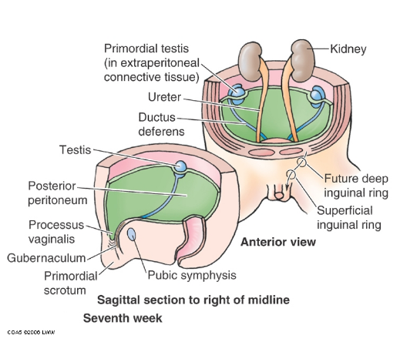
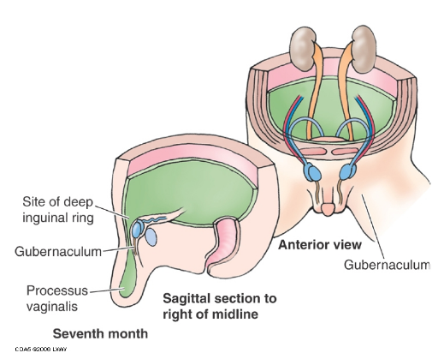
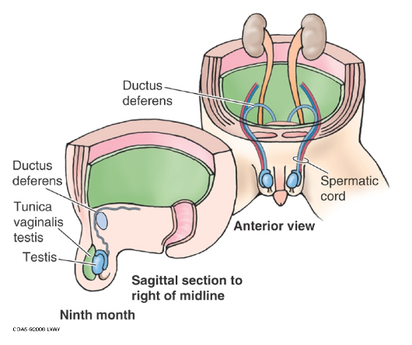
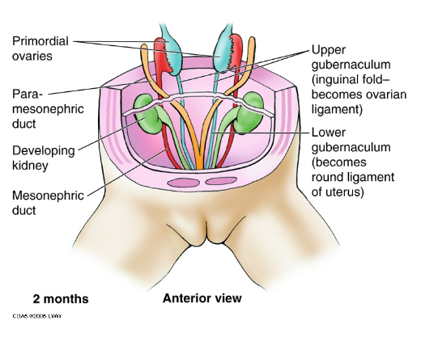
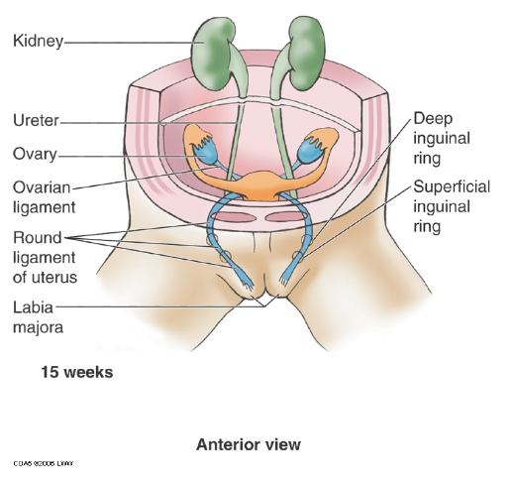
Developing of process vaginalis

Slide 26
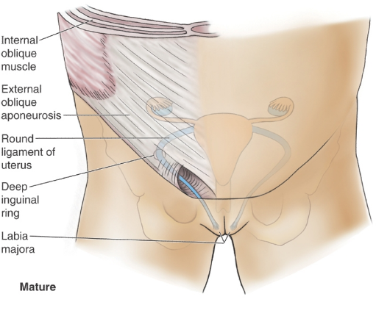
Developing of process vaginalis……..cont

Slide 27
Inguinal Hernia
A hernia is the protrusion of part of the abdominal contents beyond the normal confines of the abdominal wall
Consists of three parts: the sac, contents of the sac, covering of the sac
Hernial coverings are formed from the layers of the abdominal wall through which the hernial sac passes

Slide 28
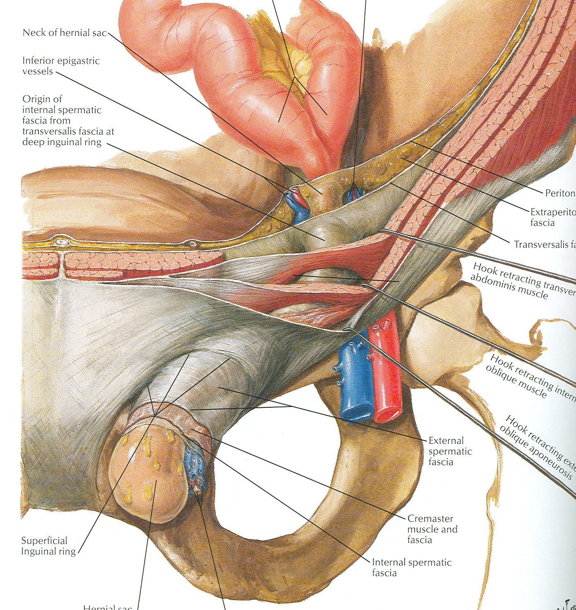

Slide 29
Indirect Inguinal Hernia
It is the most common form of hernia
Is believed to be congenital in origin
The hernial sac is remains of processus vaginalis
Enters the inguinal canal through the deep inguinal ring lateral to the inferior epigastric vessels
It may extend part of the way along the canal or as far as the superficial inguinal ring

Slide 30
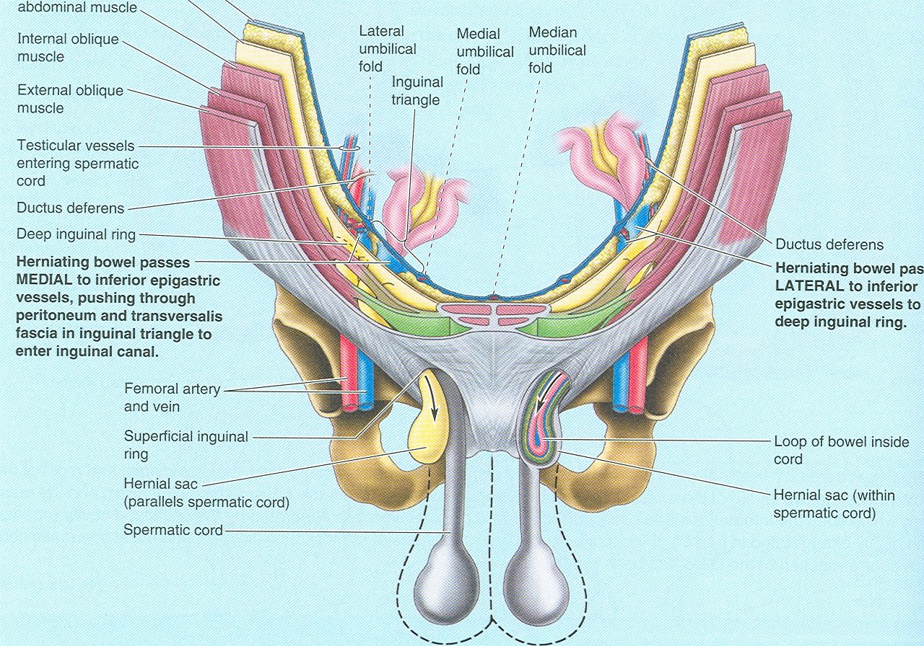

Slide 31
Indirect Inguinal Hernia
If the processus vaginalis has undergone no obliteration, the hernia is complete and extends through the superficial inguinal ring down into the scrotum or labium majus
Under these circumstances the neck of the hernial sac lies at the deep inguinal ring
It is 20 times more common in young males than females
Is more common on the right side(the Rt. testis descends later than the Lt. testis)

Slide 32
Direct Inguinal Hernia
It composes about 15% of all inguinal hernias
Common in old men with weak abdominal muscles and rare in women
Hernial sac bulges forward through the posterior wall of the inguinal canal medial to the inferior epigastric artery
The neck of the hernial sac is wide

Slide 33
Inguinal Hernia
 | Direct | Indirect
Age | Common on old | young
Bilaterally | Usually bilateral | unilateral
Shape | Hemispherical | Oval
Reaches scrotum | never | Can reach the scrotum
Direction of descent | Forwards | Downwards , forwards medially
Reduction | backward | Upward, backward laterally
Relation to inf. epigastric art. | Medially | Laterally
Superficial inguinal ring test | Feel impulse on the side finger | Feel an impulse on the tip of the finger
Deep ring test Reduction of hernia, put thumb over deep ring, ask patient to cough | Hernia appears | Hernia does not appear
Coverings | 1- Lat. To lat. Umbilical lig Same as indirection 2- Med. To lat. Umbilical lig Same but instead of cremastric muscle & fascia we have conjoint tendon | Skin, superfacial fascia, Ex.sp.fascia, cremastric muscle & fascia, Int.spermatic fascia, extra peritoneum fat

Slide 34
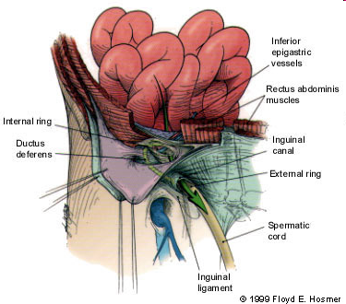
Direct Hernia Route
Note:
The hernia sac passes directly through inguinal triangle and may disrupt the floor of the inguinal canal.

Slide 35
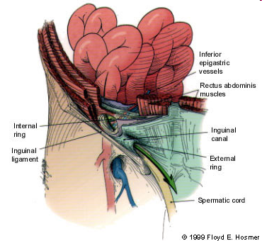
Indirect Hernia Route
Note:
The hernia sac passes outside the boundaries of Hesselbach's triangle(inguinal triangle) and follows the course of the spermatic cord.

Slide 37
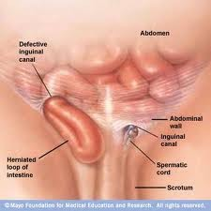

Slide 38
Scrotum
It is an outpouching of the lower part of the anterior abdominal wall
It contains testes, epididymis, and the lower ends of the spermatic cord
Its wall has following layers: skin, superficial fascia, external spermatic fascia derived from external oblique, cremastric fascia derived from internal oblique internal spermatic fascia derived from transversalis, and tunica virginals( parietal & visceral layer)

Slide 39
Skin of the Scrotum
Skin of the scrotum is thin, wrinkled, and pigmented and forms a single pouch
A ridge in the midline indicates the line of fusion of the two lateral labioscrotal swellings
Superficial fascia is continuous with the fatty and membranous layers of the anterior abdominal wall

Slide 40
Superficial Fascia
Superficial fascia is continuous with the fatty and membranous layers of the anterior abdominal wall
The fat is replaced by smooth muscle called dartos muscle
It is responsible for wrinkles of the skin
Membranous layer referred to as Colle’s fascia
Innervated by sympathetic nerve fibers
Both layers of sup. Fascia contribute to a median partition that crosses the scrotum and separates the testes from each other

Slide 41
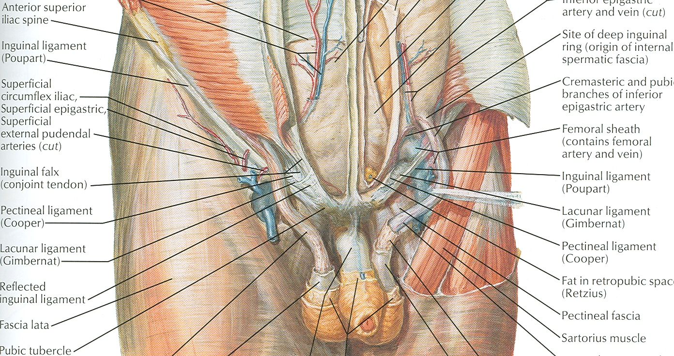

Slide 42
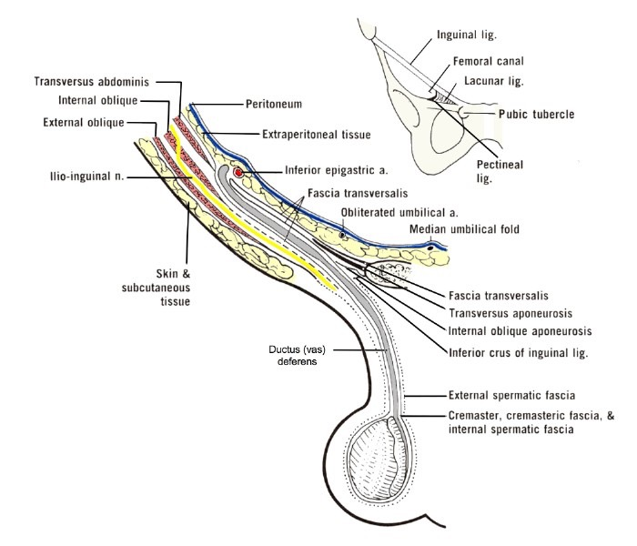
Spermatic Fasciae
Lies beneath the superficial fascia
Derived from three layers of anterior abdominal wall on each side
The external spermatic fascia is derived from external oblique
The cremastric fascia is derived from internal oblique
The internal spermatic fascia is derived from the fascia transversalis

Slide 43
Tunica Vaginalis
Lies within the spermatic fasciae
Covers the anterior, medial and lateral surfaces of each testis
It is the lower expanded part of the processus vaginalis
Normally shut off just before birth from the upper part of the processus and the peritoneal cavity

Slide 45
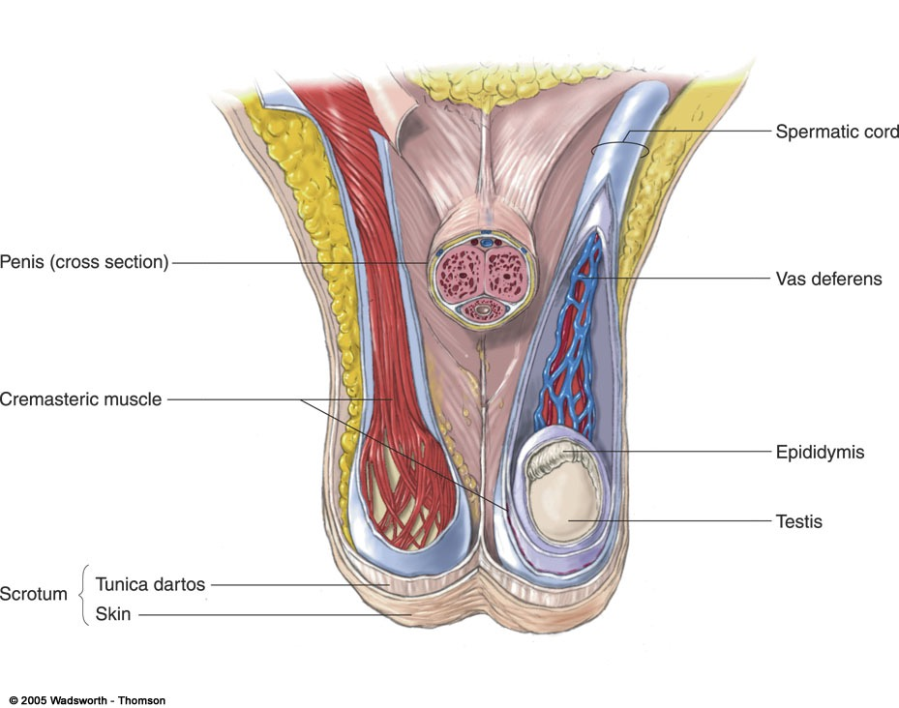
Internal structures of the scrotum
(contains vas deferens,
blood vessels, nerves,
and cremasteric muscle)
(sperm-carrying tube)
(muscle fibers that control
the position of the testis
in the scrotal sac)
(where sperm mature and
are stored temporarily)
Fig :Internal structures of the scrotum. This illustration shows portions of the scrotum cut away to reveal the cremasteric muscle, spermatic cord, vas deferens, and a testis within the scrotal sac.

Slide 46
Testis
They are a firm, mobile organ, within the scrotum
Left testis usually lies at a lower level than the right
Upper end of the gland is tilted forward
Surrounded by a tough fibrous capsule, the tunica albuginea
A series of fibrous septa divide the interior of the organ into lobules
Lying in each lobule are one to three coiled seminiferous tubules
The tubules open into the network of channels called the rete testis
Small efferent ductules connect the rete testis to the upper end of the epididymis

Slide 47
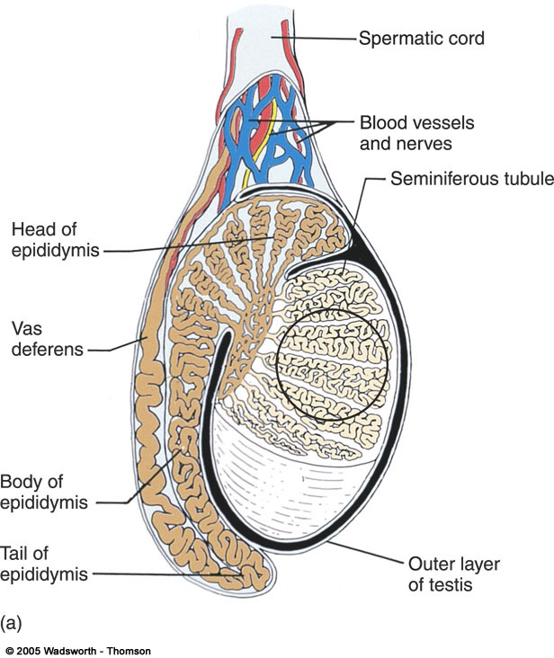
Structures inside the testis
Seminiferous tubules
Thin, highly coiled structures where sperm production occurs.
Interstitial cells
Major source of androgens
Located between seminiferous tubules
Epididymis
Site of sperm maturation
Runs along back of testis
Vas deferens
Sperm-carrying tube
Begins at the testis and ends at the urethra.

Slide 48
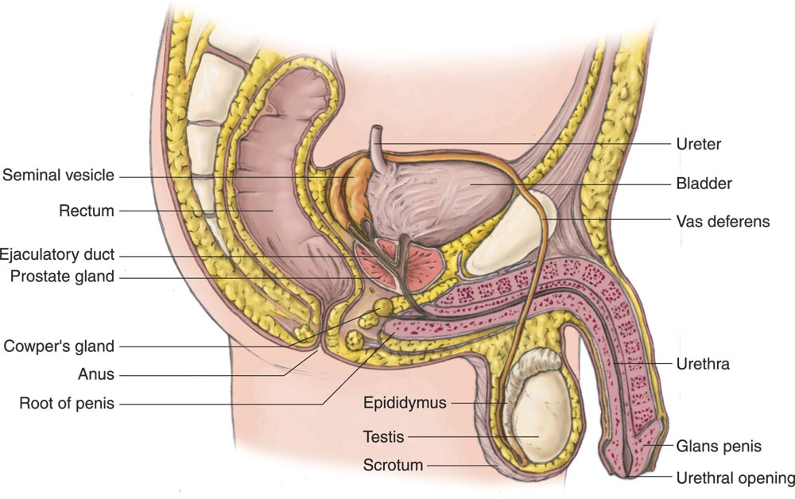
Overview: male sexual anatomy
Fig :Male sexual anatomy: A cross-section side view of male reproductive organs.

Slide 49
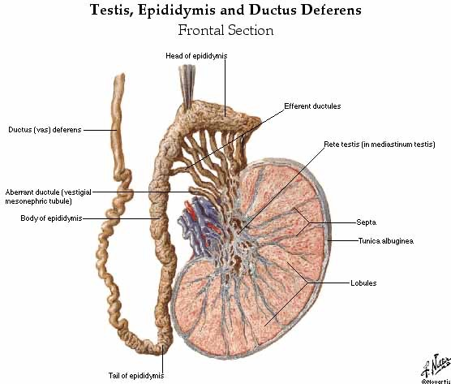

Slide 50
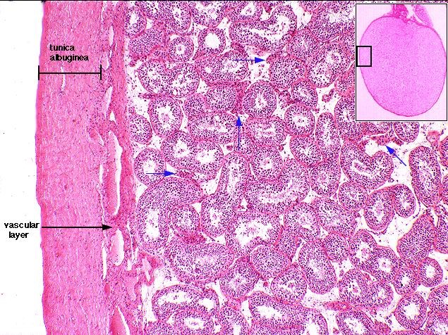

Slide 51
Blood supply of testes
Artery
- Testicular arteries→ Abdominal aorta at level L2
Vein
- Pampiniform plexus → reduced to a single vein → ascend through inguinal canal → Rt. testicular vein drains into I.V.C & Lt. testicular vein drains into Lt.renal vein

Slide 52
Lymphatic drainage of testes
Ascend in the spermatic cord
End in the lymph nodes on the side of aorta(Lumber or Para- aortic) nodes at level L1
Scrotum+ skin→ inguinal canal lymphatic nodes

Slide 53
Nerve supply to testes
Autonomic nerves
Sympathetic fibers run with testicular artery from renal or aortic sympathetic plexuses
Afferent sensory nerve
Genital branch of the genitofemoral nerve
Supply the cremastric muscle
Scrotum→ By the above nerves + ilioinguinal nerve

Slide 54
Clinical Notes
Clinical conditions involving the scrotum and testes

Slide 55
Varicocele:
-The veins of the pampiniform plexus elongated & dilated
- Lt side more common → venous pressure is higher
Common in young & adult
Vasectomy→ Infertility
Processus vaginalis
Upper part → obliterated just before birth
Lower part → Tunica vaginalis
Congenital anomalies of processus vaginalis
1- persist→ indirect inguinal hernia
2- Narrowed →congenital hydrocele
3- Obliterated upper & lower part → encysted hydrocele of the cord

Slide 56
Abnormality in testis & scrotum……..cont
Hydrocele
Accumulation of fluid within the tunica vaginalis of the testis
Causes
1- Inflammatory
2- idiopathic
Tapping ahydrocele → structures (all layers covering the testis, skin→ tunica vaginalis)traversed by the cannula

Slide 57
Congenital anomalies of the testes
Cryptorchidism
Incomplete descent of testis although traveling down normal pathway
It may be found in
1- Abdominal cavity
2- In inguinal canal
3- At superficial inguinal ring
4- In upper part of scrotum
Maldescent
- Testes travel down an abnormal pathway
1- Superfacial fascia
2- Root of penis
3- Perineum
4- In the thigh

Slide 58
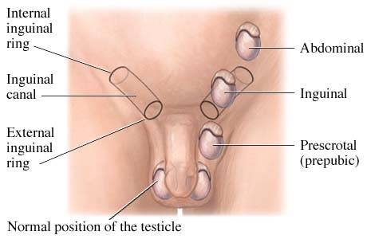
Cryptorchidism

