Slide 1
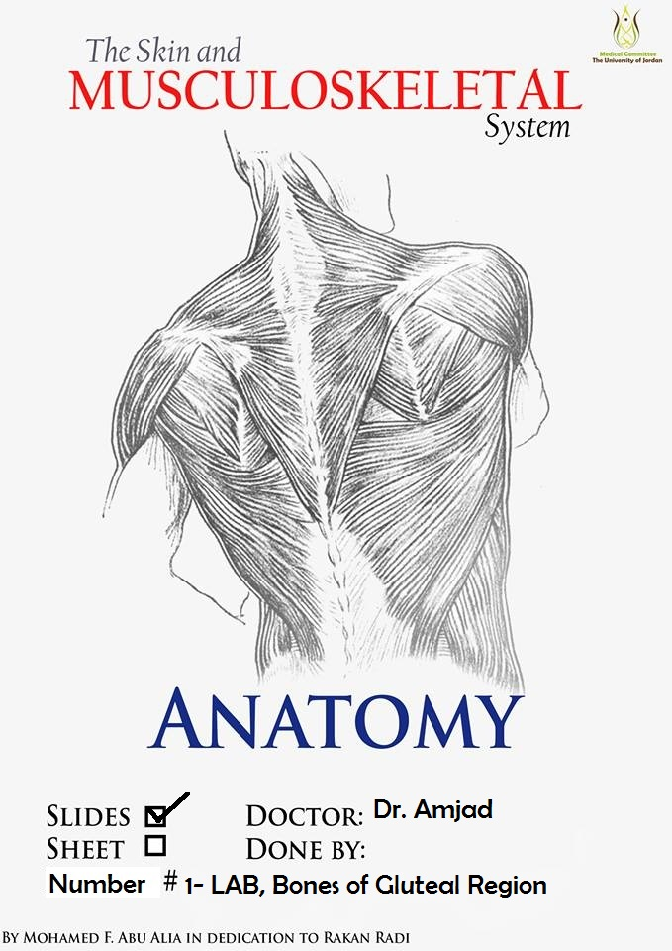

Slide 2
Bones of the gluteal region

Slide 3
The Hip bone
The hip bone is made of:
1-The ilium: superior in position
2-The ischium:postero-inferior in position
3-The pubis: antero-inferior in position
Anatomical position of the hip bone
It is very important to understand the anatomical position of the hip bone,
in anatomical position:
1-The Anterior superior iliac spine and the pubic tubercle lie in the same vertical plane.
2- The ischial spine and the upper border of the
symphysis pubis lie in the same horizontal plane.
What does this mean?

Slide 4
The ilium , ischium and pubis meet one another by means of triradiate (Y-shaped)
cartilage at the Acetabulum.
While the inferior ramus of the pubis meets with the ramus
of the ischium by
cartilaginous union
Ossifies near the age of 7 years
Remember that
at puberty the triradiate cartilage starts to ossify and near the age of 17 the triradiate cartilage will be replaced by bony union
X-ray?
What is the idea here?

Slide 5
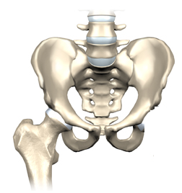
The hip bones articulate with the sacrum at the sacroiliac joints posteriorly while anteriorly they articulate with one another at the symphysis pubis.
Thus the two hip bones form the pelvic girdle where the ilium corresponds to the scapula in the upper limb, the pubis corresponds to the clavicle while the ischium corresponds to the coracoid process
sacroiliac joints
hip bone
sacrum
symphysis pubis
femur

Slide 6
Two parts:
1- Ala
2- Body
1-The Ilium
Superior border
Is made by the iliac crest
Four borders:
1- superior
2-anteroir
3-posterior
4-medial
Anterior border
Begins at the anterior superior iliac spine
(A.S.I.S)
and
ends at the
anterior Inferior iliac spine
(A.I.I.S)
Three surfaces
1- gluteal surface
2- iliac fossa
3- sacropelvic surface
Posterior border
Begins at the posterior superior iliac spine
(P.S.I.S)
And ends at the posterior inferior iliac spine
(P.I.I.S)
the anterior superior spine of the ilium is easily felt and may be visible in the thin subject

Slide 7
The sacropelvic surface presents:
1- Iliac tuberosity: rough area that gives attachment to the interosseous and dorsal sacroiliac ligaments
2- auricular surface:
Smooth area
articulates with the sacrum to form the sacroiliac joint
3- pelvic surface
Smooth area
Iliac fossa
Medial border
Forms the arcuate line
Which extends to the
ilio-pubic eminence

Slide 8
The gluteal surface is divided into 4 parts
by three lines:
1- Posterior gluteal line
2- Middle gluteal line
Or anterior
3- Inferior gluteal line
MAKE SURE you know the names of the muscles
that are attached to the areas between these lines
Which muscle is attached to the area between
The inferior and middle gluteal lines?

Slide 9
Pubic bone
Formed of a body and two rami:
superior and inferior
The body is flattened and has:
1- an upper border called pubic crest
that ends laterally by the pubic tubercle
2- symphyseal surface which articulates with
the opposite pubis to form the pubic symphysis
The inferior ramus of the pubic bone joins the ischial ramus
to form the conjoined tendon.
The superior pubic ramus has a pectineal line on
its medial surface
Pectineal line

Slide 10
The ischium
Body
Ischial ramus
Greater sciatic notch
Ischial spine
lesser sciatic notch
Ischial tuberosity

Slide 11
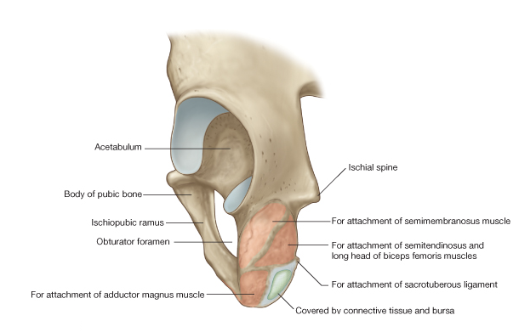
The ischial tuberosity is covered by gluteus maximus when one stands.
In the sitting position the muscle slips away laterally .To palpate this bony point, therefore, feel for it uncovered by gluteus maximus in the flexed position of the hip.
Ischial tuberosity
Divided by a transverse ridge into:
An upper quadrangular and a lower triangular parts
The upper quadrangular part is divided by an oblique ridge into:
1-Upper lateral part for the attachment of semimembranousus
2- lower Medial for the attachment of semitendinosus and long head of biceps
The lower triangular part is divided by a longitudinal ridge into:
1-lateral part that gives attachment to the adductor part of the adductor magnus muscle 2-medial part ( subcutaneous part)

Slide 12
The Acetabulum
Ilium forms the superior 2/5
of the lunate surface
anterior
It is a C-shaped cavity located on the lateral
aspect of the hip bone
directed laterally, downwards and forwards
It is notched inferiorly by the acetabular notch which is bridged by the transverse acetabular ligament
( part of the acetabular labrum)
The pubis forms the anterior 1/5
of the lunate surface
The ischium forms the posterior 2/5
Of the lunate surface
The acetabular ligament converts the
acetabular notch into foramen
Its cavity presents a horse-shoe shaped articular
surface called Lunate surface
The Lunate surface surrounds a non articular depression
called acetabular fossa which is occupied by fat tissue in living

Slide 13
Medial surface of the
right hip bone
OBTURATOR foramen
Covered by a membrane in living subjects

Slide 14
Important
origin of glutei
muscles
Important
Muscles and ligaments attached to the external surface of the right hip bone

Slide 15
IMPORTANT
IMPORTANT
IMPORTANT
IMPORTANT
IMPORTANT

Slide 16
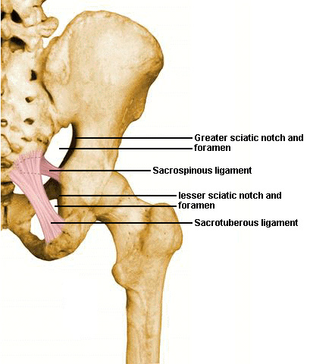
ligaments in the gluteal region
1- SACROTUBEROUS LIGAMENT
2- SACROSPINOUS LIGAMENT

Slide 17
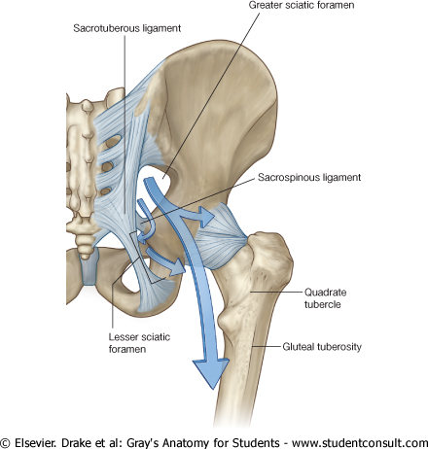
A) The greater sciatic foramen
is formed by the greater sciatic notch of the hip bone and the sacrotuberous and the sacrospinous ligament
Provides an exit from the pelvis into the gluteal region
sacrotuberous ligament
B) The lesser sciatic foramen
is formed by
The lesser sciatic notch of the hip bone and
the sacrotuberous and the sacrospinous ligament
Provides an entrance into
the perineum from the gluteal region
sacrospinous ligament

Slide 18
Bones the thigh

Slide 19
Left femur (anterior view)
head of femur
fovea capitis
Long bone ?
greater trochanter
neck
intertrochanteric line
Upper end
Lower end
And a shaft
Lesser trochanter
The upper end or proximal end
Shaft or body
The lower end or distal end
Adductor tubercle
lateral epicondyle
Medial epicondyle
lateral condyle
Medial condyle
Pattelar surface

Slide 20
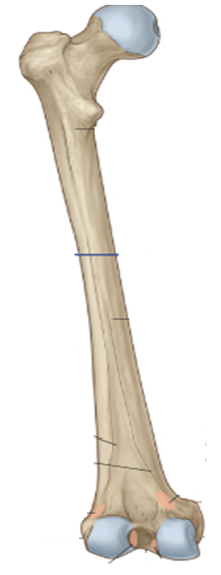
Left femur (posterior view)
greater trochanter
intertrochanteric creast
Lesser trochanter
Gluteal tuberosity
Spiral line
lateral lip of linea aspera
Medial lip of linea aspera
linea aspera
lateral surface
medial surface
medial supracondylar line
lateral supracondylar line
Adductor tubercle
lateral condyle
medial condyle
Intercondylar notch

Slide 21
The greater trochanter of the femur lies a hand’s breadth below the iliac crest; it is best palpated with the hip adducted so that the overlying hip abductors (tensor fasciae latae and gluteus medius and minimus) are relaxed.

Slide 22
important

Slide 23
important
important

Slide 24
important

Slide 25
important

