Slide 1
Veins and lymphatics

Slide 2
Normal vein physiology

Slide 3
Veins and lymphatics
Varicose Veins
are abnormally dilated, tortuous veins produced by prolonged increase in intra-luminal pressure and loss of vessel wall support.
The superficial veins of the leg are typically involved

Slide 4
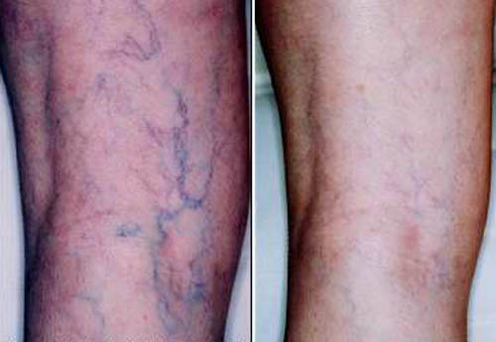
Varicose Veins

Slide 5
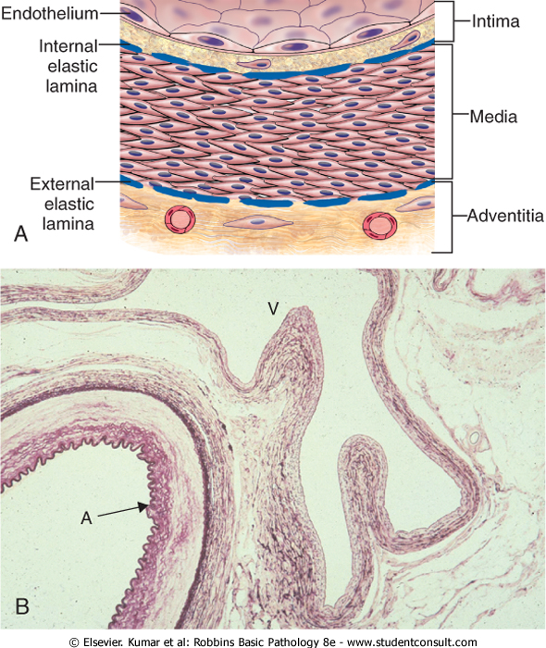

Slide 6
venous pressures in legs can be markedly elevated → venous stasis and pedal edema (simple orthostatic edema).
Some 10% to 20% of adult males and 25% to 33% of adult females develop lower extremity varicose veins

Slide 7
Risk factors
Obesity
Female gender
Pregnancy.
Familial tendency (premature varicosities results from imperfect venous wall development)

Slide 8
Morphology (microscopic)
wall thinning
intimal fibrosis in adjacent segments
spotty medial calcifications (phlebosclerosis)
Focal intraluminal thrombosis
venous valve deformities (rolling and shortening)

Slide 9
complications
stasis, congestion, edema, pain, and thrombosis
chronic varicose ulcers
embolism is very rare.

Slide 10
Thrombophlebitis And Phlebothrombosis
interchangeable terms
= Inflammation + thrombosis of veins
The deep leg veins account for more than 90% of cases
the most important clinical predispositions are: congestive heart failure, neoplasia, pregnancy, obesity, the postoperative state, and prolonged bed rest or immobilization

Slide 11
Thrombophlebitis of upper limb veins are usually associated with local risk factors like: catheter or canula site; or in some cases can be associated with systemic hypercoagulabilities.
local manifestations: distal edema, cyanosis, superficial vein dilation, heat, tenderness, redness, swelling, and pain
Distant manifestations: emboli

Slide 12
Clinical syndromes associated with venous thrmobosis:
1- Migratory thrombophlebitis (Trousseau sign):
hypercoagulability occurs as a paraneoplastic syndrome related to tumor elaboration of pro-coagulant factors
- Most often related to GI carcinomas

Slide 13
2- The superior vena caval syndrome
caused by neoplasms that compress or invade the superior vena cava.
A characteristic clinical complex including marked dilation of the veins of the head, neck, and arms with cyanosis.

Slide 14
3- The inferior vena caval syndrome
can be caused by neoplasms that compress or invade the inferior vena cava (IVC)- particularly hepatocellular carcinoma and renal cell carcinoma, which show a striking tendency to grow within veins-
induces marked lower extremity edema, distention of the superficial collateral veins of the lower abdomen, and-with renal vein involvement-massive proteinuria.

Slide 15
Lymphangitis
is the acute inflammation due to bacterial infections spread into the lymphatics
most common are group A β-hemolytic streptococci.
lymphatics are dilated and filled with an exudate of neutrophils and monocytes.
red, painful subcutaneous streaks (the inflamed lymphatics), with painful enlargement of the draining lymph nodes (acute lymphadenitis).
Sometimes, subsequent passage into the venous circulation can result in bacteremia or sepsis.

Slide 16
lymphedema
can occur as:
1- Primary (A congenital defect), resulting from lymphatic agenesis or hypoplasia.
2- Secondary or obstructive lymphedema
blockage of a previously normal lymphatic; e.g. Malignant tumors
Surgical procedures that remove lymph nodes
Post-irradiation (e.g. breast cancer)
Fibrosis
Filariasis
Post-inflammatory thrombosis and scarring

Slide 17
chylous
Milky accumulations of lymph in various body cavities
caused by rupture of dilated lymphatics, typically obstructed secondary to an infiltrating tumor mass
- chylous ascites (abdomen)
Chylothorax (chest)
Chylopericardium (pericardium)

