Slide 1
The Face
1-Skin of the Face
The skin of the face is:
Elastic
Vascular (bleed profusely however heal rapidly)
Rich in sweat and sebaceous glands
(can cause acne in adults)
It is connected to the underlying bones by loose connective tissue, in which are embedded
the muscles of facial expression
2-Superficial fascia of the face
Contains:
a-facial muscles
b-vessels & nerves
c-fat tissue (absent in the eye lids but it is well developed in the cheeks)
3-Deep fascia: is absent (except over the parotid gland & buccopharngeal fascia covering the buccinator muscle)

Slide 2
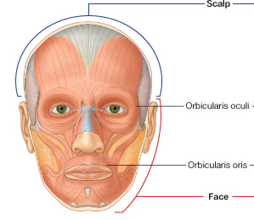
Muscles of the face: muscles of the facial expression
General features
1-They lie within the superficial fascia
2-They take their origin from the facial bones
3-They are inserted into the skin
4- They are arranged around the three openings of the face namely, the orbit, nose, and mouth either as sphincters or dilators
5- They are supplied by the facial nerve
6- Embryologically, they are originating from the mesoderm of the second branchial arch and therefore are supplied by the facial nerve
7- Can be divided into two groups
1- Three large muscles
2- Many small muscles

Slide 3
1- Three large muscles
1-Buccinator muscle
2- Orbicularis oris muscle
3- Orbicularis occuli muscle
2-Many small muscles such as:
Levator labii superioris alaeque nasi
Levator labii superioris
Zygomaticus minor
Zygomaticus major
Levator anguli oris
Risorius
Depressor anguli oris
Depressor labii inferioris
Mentalis
Platysma

Slide 4
Muscle of the Cheek
Buccinator
Origin:
Upper fibers: from the maxilla opposite the molar teeth
Lower fibers:from the mandible opposite the molar teeth
Middle fibers: from the pterygomandibular ligament
Insertion: At the angle of the mouth.
the central (middle) fibers decussate, those from below entering the upper lip and those from above entering the lower lip
the highest (upper) and lowest (lower)fibers continue into the upper and lower lips, respectively, without intersecting.
The buccinator muscle thus blends and forms part of the orbicularis oris muscle
Read only
The muscle is pierced by the parotid duct.
Nerve supply: Buccal branch of the facial nerve
Action: Compresses the cheeks and lips against the teeth
(prevents accumulation of food in the vestibule)
Important

Slide 6
Orbicularis Oris
Origin : The fibers encircle the oral orifice within the substance of the lips
Some of the fibers arise near the midline from the maxilla above and the mandible below.
Other fibers arise from the deep surface of the skin and pass obliquely to the mucous membrane lining the inner surface of the lips.
Many of the fibers are derived from the buccinator muscle.
Read only
Insertion: angles of the mouth and lips
Nerve supply: Buccal and mandibular branches of the facial nerve
Action: Compresses the lips together (closes the vestibule of the mouth)?!
How you should test it?

Slide 7
Orbicularis oculi
How should you test it ?
The orbicularis oculi is a large muscle that completely surrounds each orbital orifice
and extends into each eyelid
It has two major parts:
1-The outer orbital part is a broad ring that encircles the orbital orifice and extends beyond the orbital rim;
2-The inner palpebral part is in the eyelids and consists of muscle fibers originating in the medial corner of the eye that arch across each lid to attach laterally.
Action:
The orbital and palpebral parts have specific roles to play during eyelid closure.
The palpebral part closes the eye gently whereas
The orbital part closes the eye more forcefully and produces some wrinkling on the forehead

Slide 8
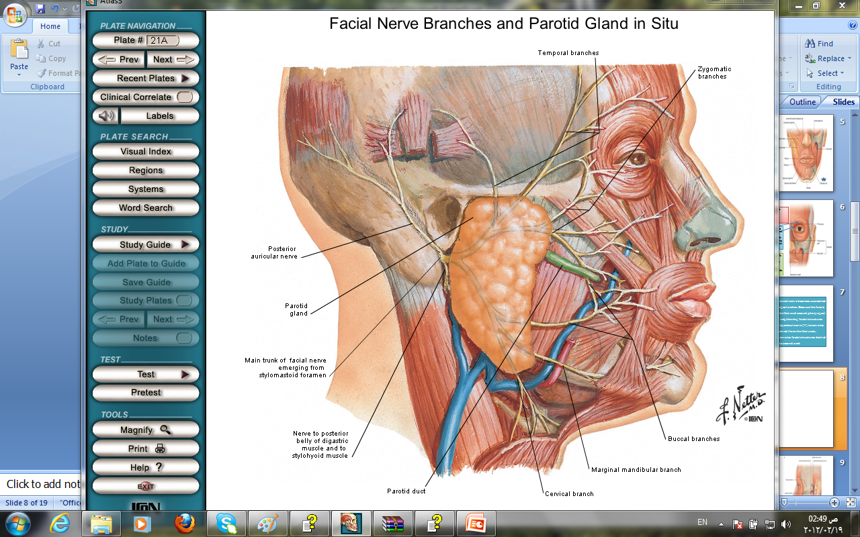
Facial Nerve
As the facial nerve runs forward within the substance of the parotid salivary gland it divides into its five terminal branches
1-The temporal
2-The zygomatic
3-The buccal
4-The mandibular
5-The cervical

Slide 9
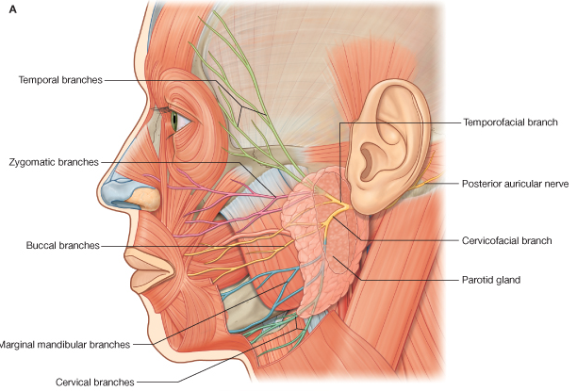
Facial Nerve

Slide 10
Facial Muscle Paralysis
A-a lower motor neuron lesion
Damage to the facial nerve in
1- The internal acoustic meatus (by a tumor)
2-The middle ear (by infection or operation),
3-The facial nerve canal (perineuritis,
4- The parotid gland (by a tumor)
5- Lacerations of the face
will cause distortion of the face
drooping of the lower eyelid,
and the angle of the mouth will sag on the affected side.
Bell's palsy
B-An upper motor neuron lesion
(involvement of the pyramidal tracts) will leave the
upper part of the face normal
because the neurons supplying this part
of the face receive
corticobulbar fibers from both cerebral cortices.
Read only

Slide 11
Sensory Nerves of the Face
The skin of the face is supplied by branches of:
the three divisions of
the trigeminal nerve
except for the small area over the angle of the mandible and the parotid gland which is supplied by the great auricular nerve
(C2 and 3).

Slide 12
Ophthalmic Nerve
A-Frontal nerve:
1-The supratrochlear nerve
supplies the skin and conjunctiva on the medial part of the upper eyelid and the skin over the lower part of the forehead, close to the median plane.
2-The supraorbital nerve
supplies the skin and conjunctiva on the central part of the upper eyelid; it also supplies the skin of the forehead

Slide 13
B-The lacrimal nerve supplies the skin and conjunctiva of the lateral part of the upper eyelid
C- Nasociliary nerve
1-The infratrochlear nerve
It supplies the skin and conjunctiva on the medial part of the upper eyelid and the adjoining part of the side of the nose
2-The external nasal nerve It supplies the skin on the side of the nose down as far as the tip

Slide 14
Maxillary Nerve
Three branches of the nerve pass to the skin.
1-The infraorbital nerve
is a direct continuation of the maxillary nerve. It enters the orbit and appears on the face through the infraorbital foramen.
It immediately divides into numerous small branches, which radiate out from the foramen and supply the skin of the lower eyelid and
cheek, the side of the nose, and the upper lip

Slide 15
2-The zygomaticofacial nerve
passes onto the face through a small foramen on the lateral side of the zygomatic bone.
It supplies the skin over the prominence of the cheek
3-The zygomaticotemporal nerve
emerges in the temporal fossa through a small foramen on the posterior surface of the zygomatic bone. It esupplies the skin over the templ

Slide 16
Mandibular Nerve
The mandibular nerve supplies the skin of the lower lip, the lower part of the face, the temporal region, and part of the auricle
1-The mental nerve emerges from the mental foramen of the mandible
2-The buccal nerve
3-The auriculotemporal nerve
It supplies the skin of the auricle, the external auditory meatus, the outer surface of the tympanic membrane, and the skin of the scalp above the auricle

Slide 17
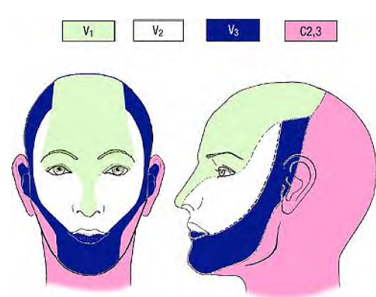

Slide 18
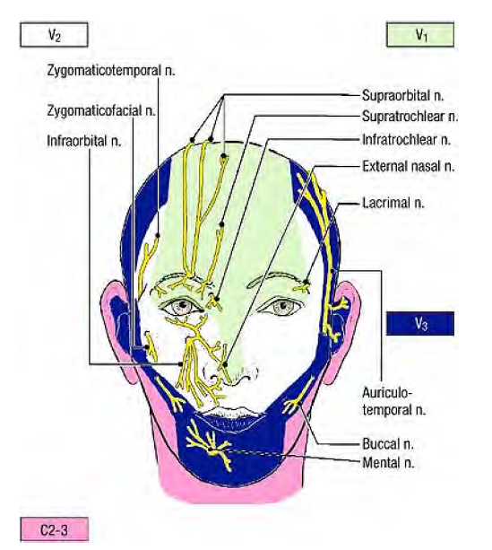

Slide 19
Arterial Supply of the Face
The face receives a rich blood supply from two main vessels:
1-The facial artery
2-Superficial temporal artery

Slide 20
The facial artery
Arises from the external carotid artery
Ascends over the submandibular salivary gland
It curves around the inferior margin of the body of the mandible
Passes on and in front of the anterior border of the masseter muscle (pulse)|

Slide 21
It runs upward in a tortuous course toward the angle of the mouth
It then ascends deep to the zygomaticus muscles and runs along the side of the nose to the medial angle of the eye, where it anastomoses with the terminal branches of the ophthalmic artery
Branches (Read Only)
Anterior branches which are large and named while the posterior are small and unnamed
The inferior labial artery supplies the lower lip.
The superior labial artery supplies the upper lip
The lateral nasal artery supplies the skin on the side and dorsum of the nose.

Slide 22
2-The superficial temporal artery
ascends over the zygomatic arch, where it may be palpated just in front of the auricle,
supplies the scalp

Slide 23
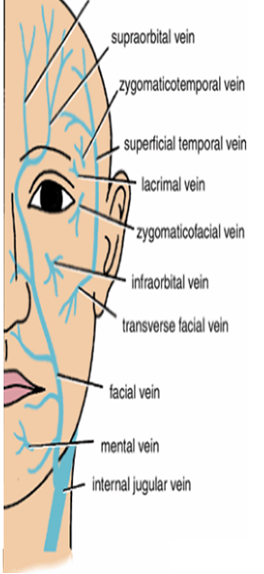
Supratrochlear
Venous Drainage of the Face
The facial vein is formed at the medial angle of the eye by the union of
The Supraorbital and Supratrochlear veins
The facial vein descends behind the facial artery to the lower margin of the body of the mandible
It crosses superficial to the submandibular gland and
is joined by the anterior division of
The retromandibular vein.
The facial vein ends by draining into
The internal jugular vein.
Important communications
It communicates with the pterygoid venous plexus by the deep facial vein
It communicates with the cavernous sinus by the superior ophthalmic vein

Slide 24
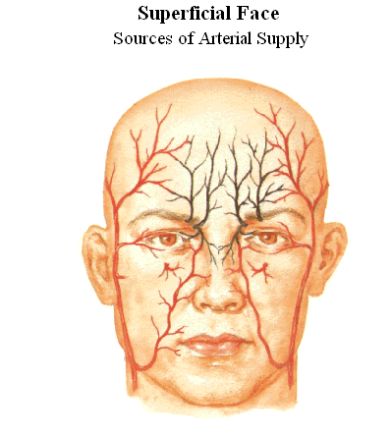
It is connected to the superior ophthalmic vein directly through the supraorbital vein.
By means of the superior ophthalmic vein,
the facial vein is connected to
The cavernous sinus
this connection is of a great clinical importance because it provides
a pathway for the spread of infection from
DANGEROUS AREA OF THE FACE
(THE LOWER PART OF THE NOSE AND THE UPPER LIP)
to the cavernous sinus
Infection from the triangular area can cause Thrombosis of the cavernous sinus

Slide 25
Arterial Supply of the Scalp
The arteries lie in the superficial fascia.
A-Branches of the ophthalmic artery
1-The supratrochlear
2-The supraorbital
B-Branch of the external carotid artery
The superficial temporal artery
The posterior auricular artery
The occipital artery

Slide 26
Anatomically, it is useful to remember in an emergency
that
all the superficial arteries supplying the scalp
ascend from the face and the neck.
Thus, in an emergency situation,
encircle the head just above
the ears and eyebrows
with a tie, shoelaces, or even a piece of string and tie it tight.
Then insert a pen, pencil,
or stick into the loop and rotate it so that the tourniquet exerts pressure on the arteries

