Slide 1
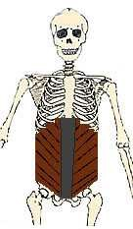
Abdominal Wall

Slide 2
Borders of the Abdomen
Abdomen is the region of the trunk that lies between the diaphragm above and the inlet of the pelvis below
Borders
Superior:
Costal cartilages 7-12.
Xiphoid process:
Inferior:
Pubic bone and iliac crest:
Level of L4.
Umbilicus:
Level of IV disc L3-L4

Slide 3
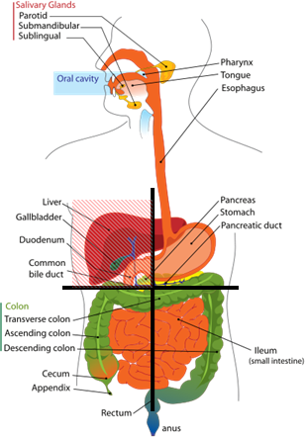
Abdominal Quadrants
Formed by two intersecting lines:
Vertical & Horizontal
Intersect at umbilicus.
Quadrants:
Upper left.
Upper right.
Lower left.
Lower right

Slide 4
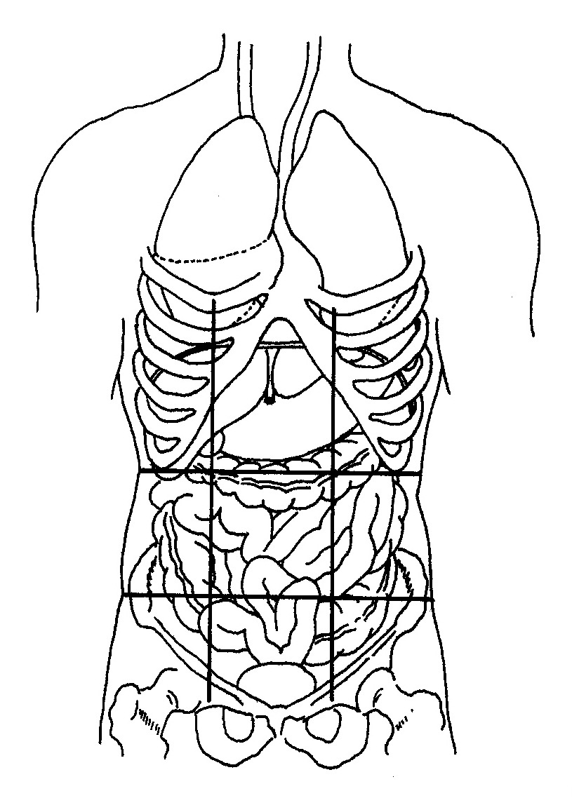
Abdominal Regions
Divided into 9 regions by two pairs of planes:
1- Vertical Planes:
Left and right lateral planes
Midclavicular planes
passes through the midpoint between the ant.sup.iliac spine and symphysis pupis
2- Horizontal Planes:
Subcostal plane
at level of L3 vertebra
Joins the lower end of costal cartilage on each side
Intertubercular plane:
- At the level of L5 vertebra
- Through tubercles of iliac crests.

Slide 5
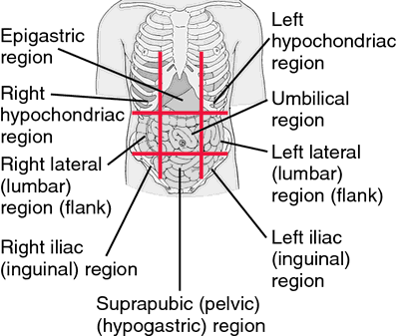

Slide 6
Abdominal wall divided into:-
- Anterior abdominal wall
- Posterior abdominal wall

Slide 7
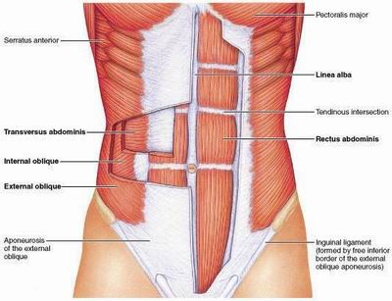
The Layers of Anterior Abdominal Wall
Skin
Superficial Fascia
Above the umbilicus one layer
Below the umbilicus two layers
Camper's fascia - fatty superficial layer.
Scarp's fascia - deep membranous layer.
Deep fascia :
Thin layer of C.T covering
the muscle may absent
Muscular layer
External oblique muscle
Internal oblique muscle
Transverse abdominal muscle
Rectus abdominis
Transversalis fascia
Extraperitoneal fascia
Parietal Peritoneum

Slide 8
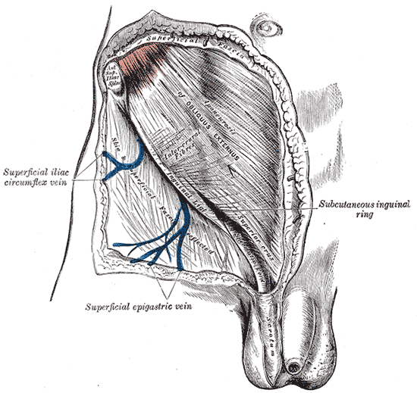
Superficial Fascia
Camper's fascia - fatty layer= dartos muscle in male
Scarpa's fascia - membranous layer.
Attachment of scarpa’s fascia= membranous fascia
INF: Fascia lata
Sides: Pubic arch
Post: Perineal body
- Membranous layer in scrotum referred to as colle’s fascia
- Rupture of penile urethra lead to extravasations of urine into(scrotum, perineum, penis &abdomen)

Slide 9
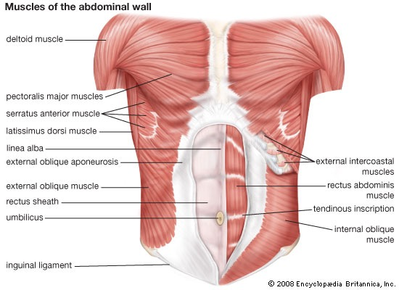
Muscles
Rectus abdominis
External oblique muscle
Internal oblique muscle
Transverse abdominal muscle

Slide 10
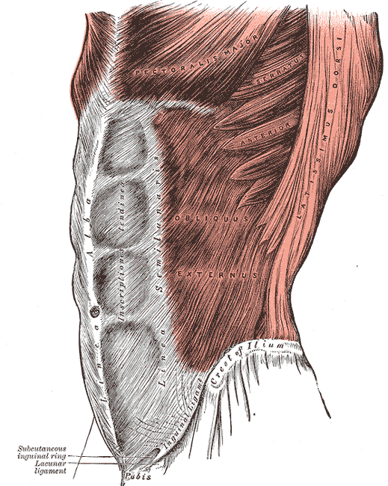
External oblique muscle
Broad
Thin
Direction:
Downward forward medially
Origin
outer surface of lower 8 ribs.
Insertion
Xiphoid process, Linea alba,
pubic crest, pubic tubercle,
iliac crest(ant. Half).
Nerve Supply
1- Lower 6th thoracic nerves
2- L1( iliohypogastric n., ilioinguinal n.)

Slide 11
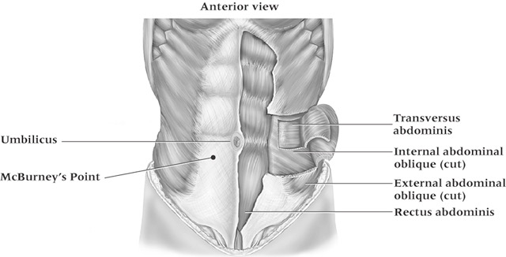
Muscles of the anterior abdominal wall

Slide 12
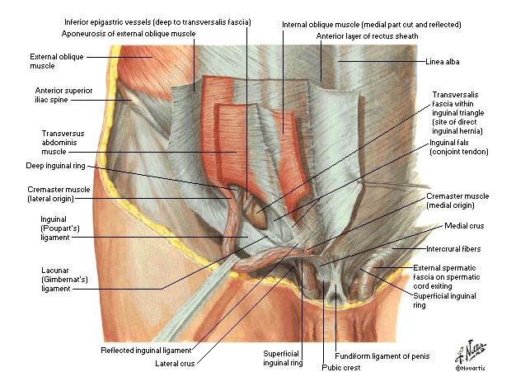
Aponeurosis of external oblique muscle
Boundaries of inguinal canal
Formation of rectus sheath
Superficial inguinal ring.
Inguinal ligament
Lacunar ligament
Pectineal ligament

Slide 13
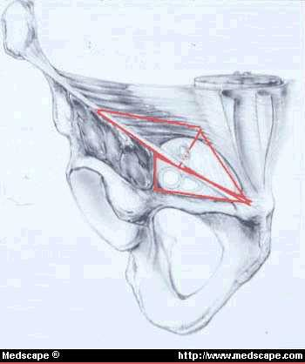
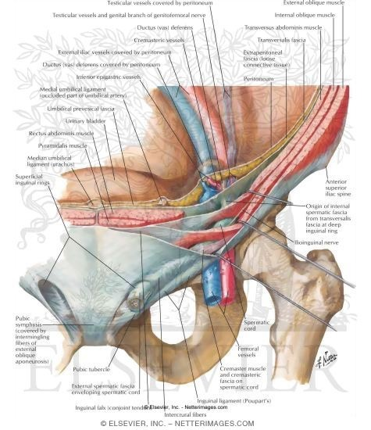
Inguinal ligament
1- folded back ward the lower border of aponeurosis of external muscle on it self
2- between ant.sup.iliac spine and the pupic tubercle

Slide 14
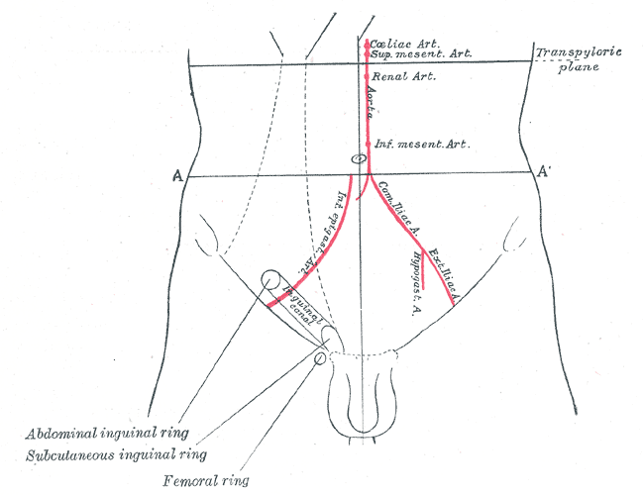
Superficial inguinal ring.
1- triangular shape
2- Defect in external oblique aponeurosis
3- lies immediately above and medial to the pupic tubercle
4- Opening for passing the spermatic cord or ligament of uterus

Slide 16
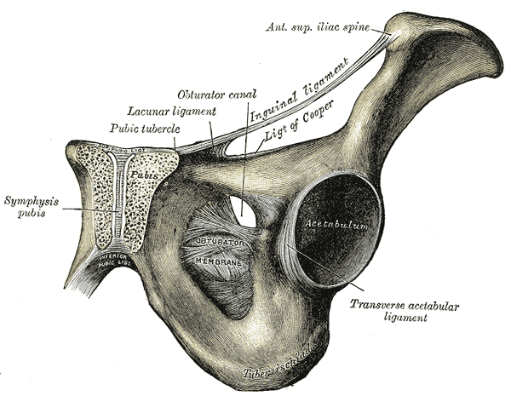
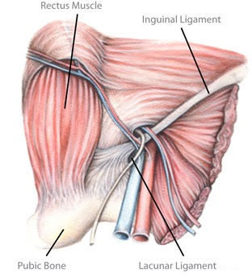
Lacunar ligament
1- extension of aponeurosis of external muscle backward and upward to the pectineal line
2- on the superior ramus of the pupis
3- its sharp, free crecentric edge forms the medial margin of the femoral ring
Pectineal ligament
1- Continuation of the lacunar ligment at pectineal line
2- Continuation with a thickeing of the periosteum

Slide 17
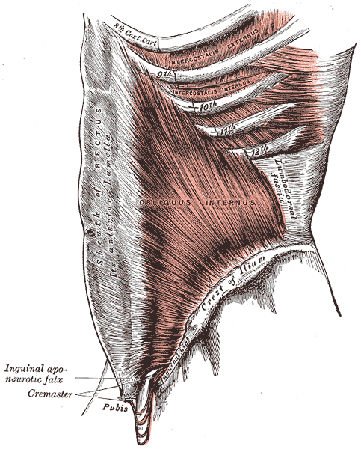
Internal Oblique
Direction:
upward forward medially
Origin
Lumbar Fascia, Ant 2/3 iliac crest,
lateral two thirds of inguinal ligament.
Insertion
- Lower three ribs& costal cartilage, Xiphoid process, Linea alba, symphesis pubis.
-
Nerve Supply
Lower 6th thoracic nerves, iliohypogastric n & ilioinguinal n→L1.

Slide 18
Internal oblique muscle……..cont
Conjoint tendon
The lowest tendinous fibers of internal oblique which joint with transversus abdominis
Attach medially to linea alba
Support the inguinal canal
Has lateral free border
Cremastric fascia
Internal oblique has free lower border arches over the spermatic cord or ligament of uterus
Cremastric muscle
Fascia
- Int. abd.muscle assist in the formation of the Roof of the inguinal canal

Slide 19
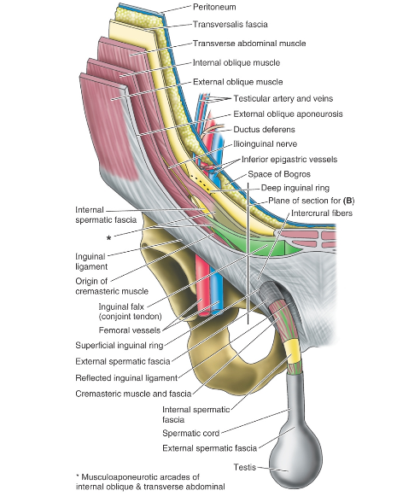

Slide 20
Conjoint tendon & Cremastric fascia

Slide 21
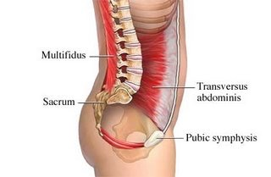
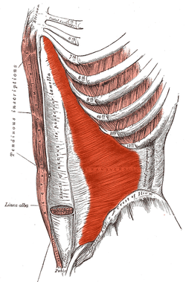
Transversus Abdominis
Direction
Its fibers run horizontally forward under the internal oblique
Origin
- Inner surface of lower six costal cartilage,
lumbar fascia, anterior two thirds of iliac crest, lateral third of inguinal ligament.
Insertion
Xiphoid process, Linea alba, symphysis pubis.
The lower part fuses with internal oblique to form conjoint tendon which attach to pupic crest and pectineal line
Nerve Supply
Lower six thoracic nerves, L1( iliohypogastric n.& ilioinguinal n.)

Slide 22
Transversus Abdominis………cont
Assist in the formation of
Conjoint tendon
Rectus sheath

Slide 23
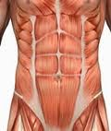
RECTUS ABDOMINIS
Long strap muscle
Extends along the whole length of the anterior abdominal wall
In the rectus sheath
Origin
Symphsis pubis, pubic crest
Insertion
5^{th,} 6th and 7th costal cartilage & xiphoid process.
Nerve Supply
Lower 6th thoracic nerves

Slide 24
Rectus abdominis muscle……cont
Linea semilunaris
Tendinous intersection:

Slide 25
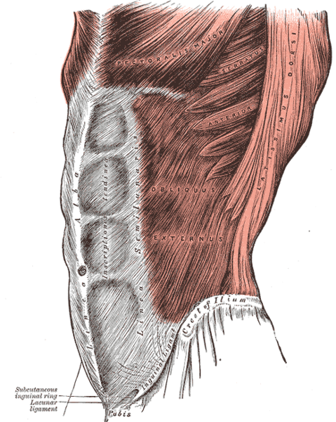
Lines & Land marks of the Anterior Abdominal Wall
Linea alba:
- Located along the midline.
Between the xiphoid process & symphysis pupis
Formed by the fusion of aponeurosises of three abdominal wall( Ex.In,Tran. Abd.muscle)
Linea semilunaris
Lateral margins of rectus abd. .muscle
Can be palpated
Extend from 9th c.c to pupic tubercle

Slide 26
Tendinous intersection: = Linea transverses
- 3 transverse fibrous bands
- divide the rectus abdominis muscle into distinct segments
1- one at level of xiphoid process
2- one at level of umbilicus and
3- one half way between these two
- They can be palpated as a transverse depressions

Slide 27
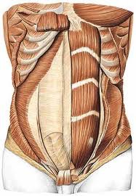
Pyramidalis muscle
Origin
Ant. Surface of the pupis
Insertion:
Linea alba
It lies in front of the lower part of the rectus abdominis muscle
Nerve supply
12th subcostal nerve

Slide 28
Rectus sheath

Slide 29
Rectus sheath…….cont
The rectus sheath is a long fibrous sheath
Formed mainly by the aponeuroses of the three lateral abdominal muscles.
Contents
- Rectus abdominis muscle
- Pyramidalis muscle (if present)
- The anterior rami of the lower six thoracic nerves
- The superior and inferior epigastric vessels
- Lymphatic vessels.

Slide 30
Rectus sheath…….cont
Description the rectus sheath is considered at three levels.
1- Above the costal margin
2- Between the costal margin and the level of the anterior superior iliac spine
3- Between the level of the anterosuperior iliac spine and the pubis the anterior wall

Slide 32
ABOVE THE COSTAL MARGIN, - ANTERIOR WALL # APONEUROSIS OF THE EXTERNAL OBLIQUE. - POSTERIOR WALL # THORACIC WALL THAT IS, THE FIFTH, SIXTH, AND SEVENTH COSTAL CARTILAGES AND THE INTERCOSTAL SPACES.

Slide 33
Between the costal margin and the level of the anterior superior iliac spine
- The aponeurosis of the internal oblique splits to enclose the rectus muscle
the external oblique aponeurosis is directed in front of the muscle
the transversus aponeurosis is directed behind the muscle.

Slide 34
Between the level of the anterosuperior iliac spine and the pubis the anterior wall : the aponeurosis of all three muscles form. The posterior wall is absent, and the rectus muscle lies in contact with the fascia transversalis.

Slide 35
Rectus sheath……cont
The posterior wall of the rectus sheath is not attached to the rectus abdominis muscle. The anterior wall is firmly attached to it by the muscle's tendinous intersections
Linea semicircularis (arcuate line)
Is a crescent-shaped line marking the inferior limit of the posterior layer of the rectus sheath just below the level of the iliac crest.

Slide 37
.
Others fascia in the ant. abd.ominal wall
Transversalis fascia
- a thin layer of fascia that lines the Transversus Abdominis muscle
- continue to diaphragm , iliac muscle & pelvis fascia
- contribute to femoral sheath
Extraperitoneal Fascia
The thin layer of C.T and adipose tissue between the peritoneum and fascia transversalis.
Parietal peritoneum
It is a thin serous membrane
Continuous below with the parietal peritoneum lining the pelvis.
.

Slide 39
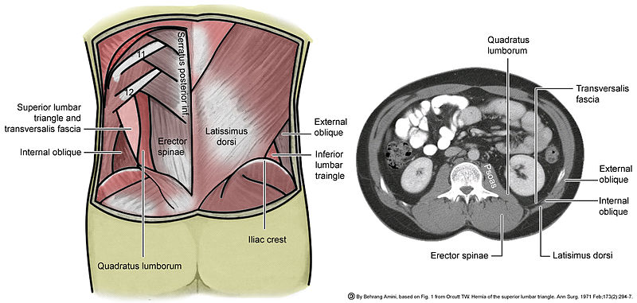
Lumbar triangle

Slide 40
lumbar triangle
1- the inferior lumbar (Petit) triangle, which lies superficially
2- the superior lumbar (Grynfeltt) triangle, which is deep and superior to the inferior triangle.
Of the two, the superior triangle is the more consistently found in cadavers,and is more commonly the site of herniation
however, the inferior lumbar triangle is often simply called the lumbar triangle, perhaps owing to its more superficial location and ease in demonstration.

Slide 41
Lumber triangle(petitis)
The inferior lumbar (Petit) triangle is formed
- Medially by the latissimus dorsi muscle
- laterally by the external abdominal oblique muscle
- Inferiorly by the iliac crest
- The floor internal abdominal oblique muscle.
- The fact that herniation occasionally occur here is of clinical importance.

Slide 42
Superior lumbar (Grynfeltt-Lesshaft) triangle
Medially: by the quadratus lumborum muscle
laterally :by the internal abdominal oblique muscle
Superiorly: by the 12th rib.
The floor : transversalis fascia
Roof: is the external abdominal oblique muscle

Slide 43
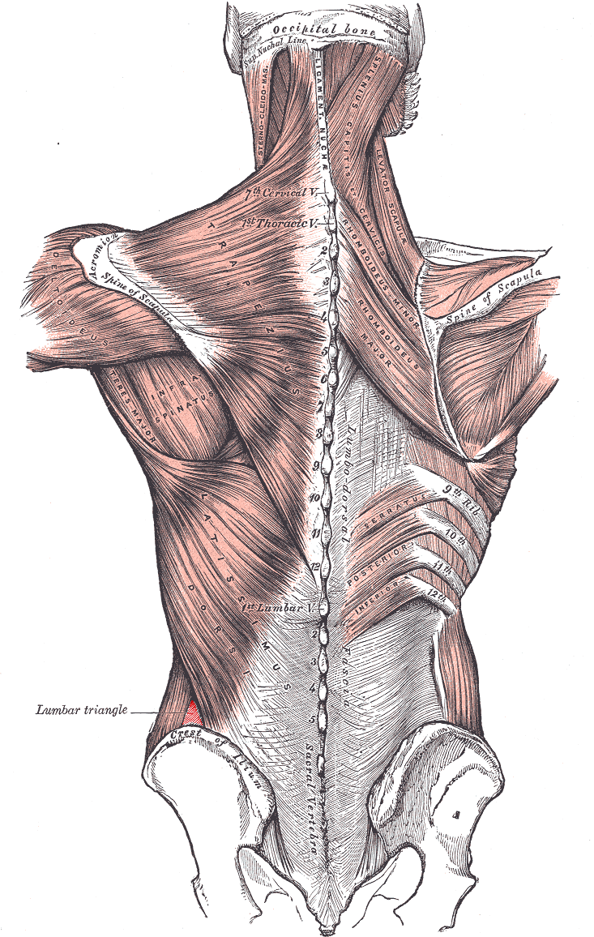

Slide 44
Action of the Ant. Abdominal muscle
Deep expiration
Increase the intra abdominal pressure in
- Vomiting
- Cough
- Defecation
- Labour
Protect viscera
keep viscera in position
Rectus abdominis → bends trunk forward

Slide 45
Blood supply of the ant. Abdominal wall
Arteries
Sup. Epigastric artery
Inf. Epigastric artery
Intercostal arteries
Lumbar arteries
Deep circumflex artery

Slide 46
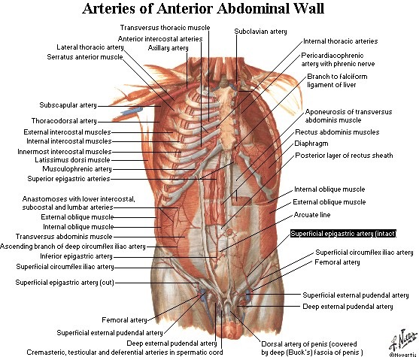

Slide 47
Blood supply……cont
Veins
1- Above the umbilicus
- Lat. Thoracic. vein.→ Axillary vein
2- Below the umbilicus
- Inf. Epigastric → Femoral vein
3- Paraumbilica veins
- Ligamentum teres → portal vein( Porto- systemic anastomosis)

Slide 48
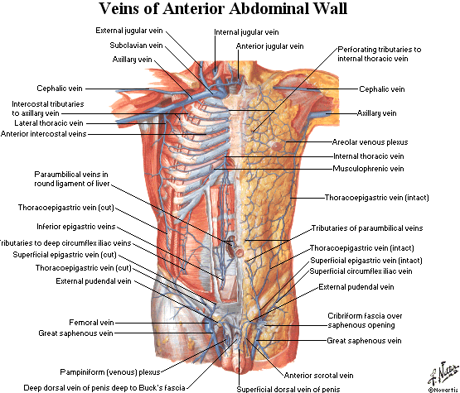

Slide 49
Nerve supply of the ant. Abdominal wall
Thoracoabdominal nerve: Lower 6th thoracic nerves & 12th subcostal nerve
Dermatomes (Anterior, lateral cutaneous nerve terminal branches of Thoracoabdominal nerve
T7 to skin superior to umbilicus below xiphoid process
T10 to skin surrounding umbilicus
L1 to skin inferior to umbilicus above sym.pubis
LI nerve
- Iliohypogastric nerve
- Ilioinguinal nerve

Slide 50
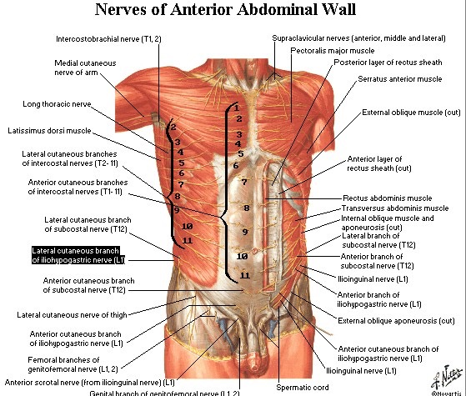

Slide 51
Lymphatic drainage of ant. Abdominal wall
Above the umbilicus→ Ant.axillary L.N
Below the umbilicus → Sup. Inguinal L.N
Above the iliac crest→ Post.axillary.L.N
Below the iliac crest→ Sup.inguinal L.N

Slide 52
Clinical notes
Abdominal stab wounds
Surgical incision

Slide 53
Abdominal stab wounds
Lateral to rectus sheath
Ant. To rectus sheath
In the midline= Linea alba
- Structures in the various layers through which an abdominal stab wound depend on the anatomical location

Slide 54
Surgical incision
- The length and direction of surgical incision through the ant. Abdominal wall to expose the underlying viscera are largely controlled by
1- position & direction of nerves
2- direction of muscle fibers
3- arrangement of the apponeurosis forming the rectus sheath
- The incision should be mad In the direction of the line of cleavage in the skin so that the hairline scare is produced

Slide 55
Incision through the rectus sheath
Widely used
The rectus abdominis muscle and its nerve supply are kept intact
On closure the ant & post wall of the sheath are sutured separately and the rectus muscle back into position between the suture lines

Slide 56
Common types of incisions
Paramedian incision
Pararectus incsion
Midline incision
Transrectus incision
Transverse incision
Muscle splitting
Abdominothoracic incision

