Slide 1
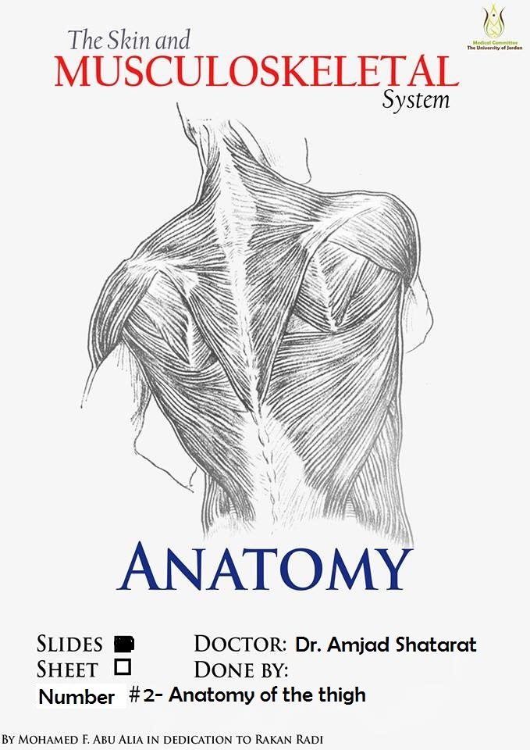

Slide 2
ANATYOMY OF The thigh

Slide 3
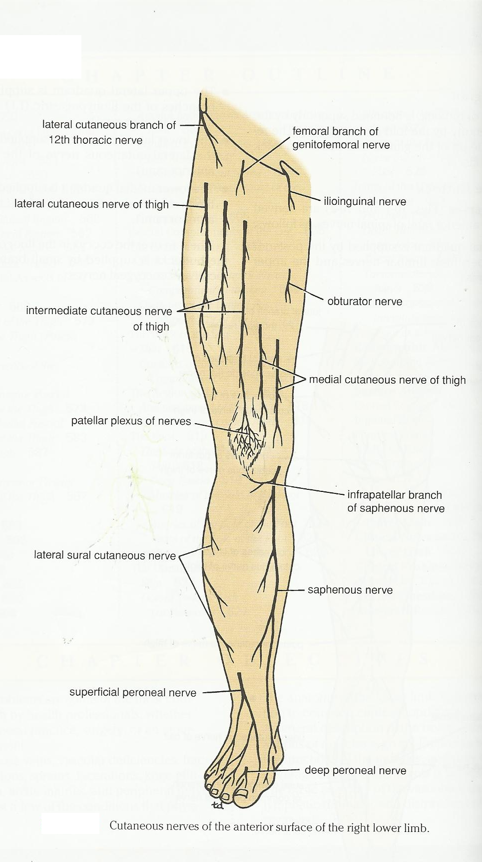
1- Lateral cutaneous nerve of the thigh
Ι) Skin of the thigh
2- Femoral branch of the genitofemoral nerve
Anterior view
1, 2 and 3 are
From the lumber plexus
3- Ilioinguinal nerve
5- Intermediate cutaneous nerve of the thigh
6- Branches from the obturator nerve
4- Medial cutaneous nerve of the thigh
7- Posterior cutaneous nerve of the thigh
from the Sacral plexus
4 and 5 are branches from
the femoral nerve

Slide 4
The Lateral cutaneous nerve of the thigh
Posterior cutaneous nerve of the thigh
Intermediate cutaneous nerve of the thigh
Branches from the obturator nerve

Slide 5
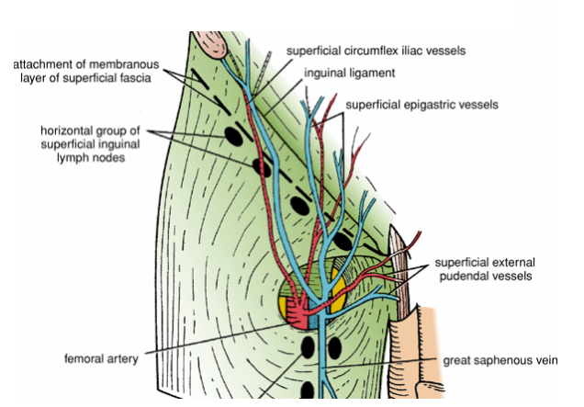
ΙΙ) Fascia
A- Superficial fascia of the thigh
B- Deep fascia of the thigh (fascia lata)
A-The superficial fascia of the thigh
1- Cutaneous nerves
all nerves that have been mentioned above.
2- Superficial arteries (branches from the femoral artery)
that emerge through the Saphenous opining

Slide 6
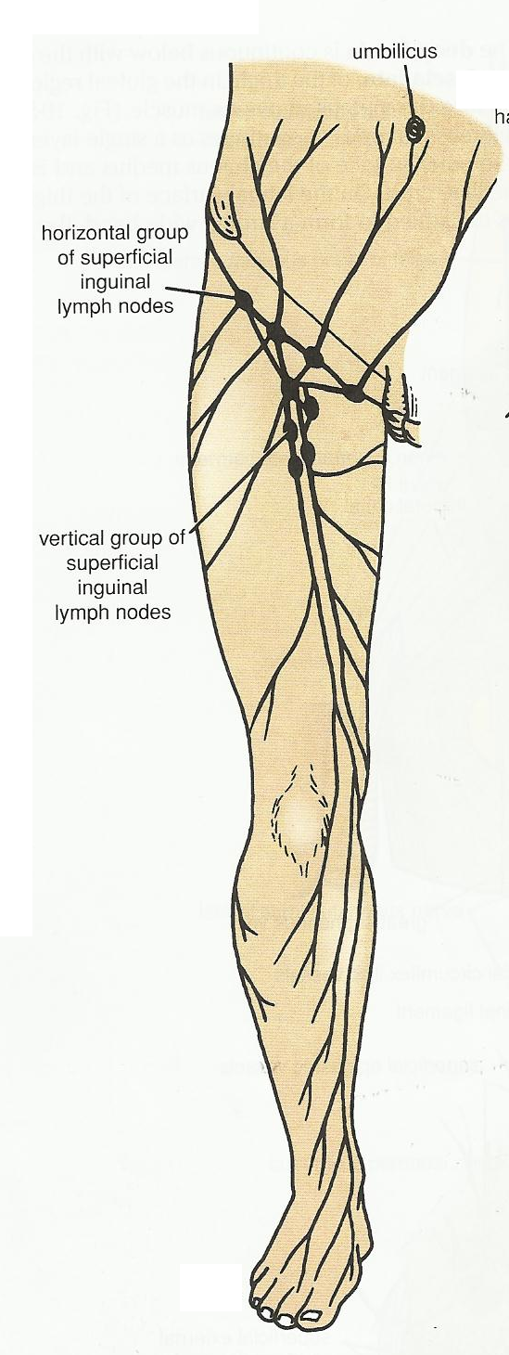
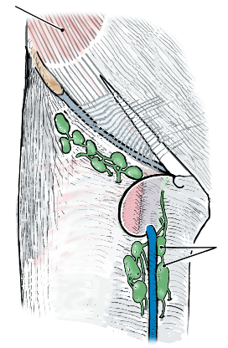
3- Superficial inguinal lymph nods
Lies below the inguinal ligament
Divided into two groups; horizontal and vertical.
A-The horizontal group lies below and parallel to the inguinal ligament.
It divides into medial and lateral groups
B-The vertical group lies along the terminal part of Saphenous vein.
Anterior view of the thigh
Showing the lymphatic drainage of the
Right Lower limb
Note:
Lymph nodes cannot bee palpated or seen unless they are enlarged

Slide 7
The medial members of the horizontal group receive superficial lymph vessels from:
1-The anterior abdominal wall below the level of the umbilicus
2-The perineum
3-The urethra
4-The external genitalia of both sexes (EXCEPT the testes)?!!!!!
5-The lower half of the anal canal
6- The lower third of the vagina
The lateral members of the horizontal group receive superficial lymph vessels from the back below the level of the iliac crests
The vertical group receives most of the superficial lymph vessels of the lower limbs
The efferent lymph vessels from the superficial inguinal nodes pass through the saphenous opening in the deep fascia and
join the deep inguinal nodes.
Remember that if the patient
presented to you with an
enlarged superficial inguinal
lymph nods you should ask about and check the above mentioned areas

Slide 8
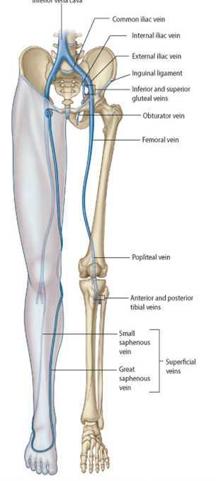
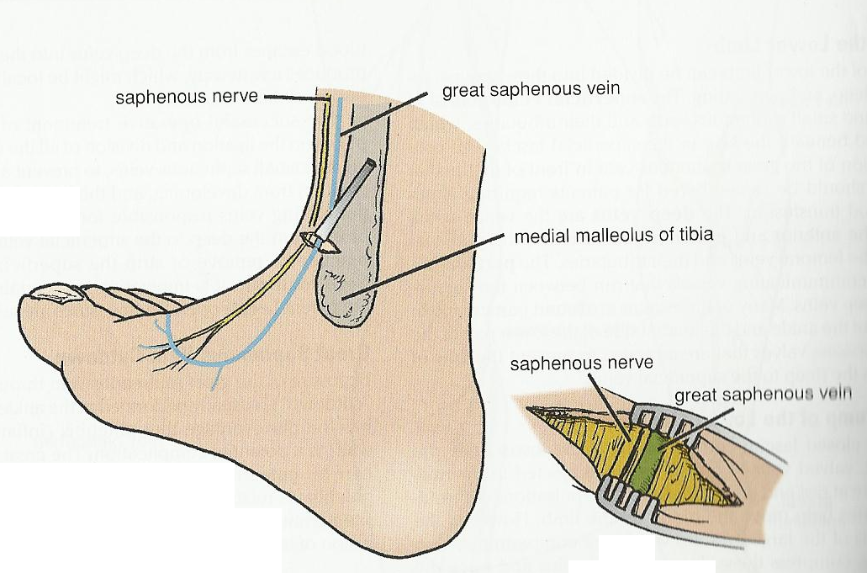
4- Superficial veins
The most important superficial vein is the
important
Great Saphenous vein.
The great Saphenous vein
drains the medial end of the dorsal venous arch.
passes directly in front of the medial malleolus of the tibia.
ascends in a company with the Saphenous nerve.
in the superficial fascia over the medial side of the leg.
passes behind the knee and then curves around the medial
side of the thigh.
pierces the Saphenous opining and then joins
the femoral vein about 4cm below and lateral to the
pubic tubercle.
Great Saphenous vein cutdown at the ankle? When we need this procedure

Slide 9
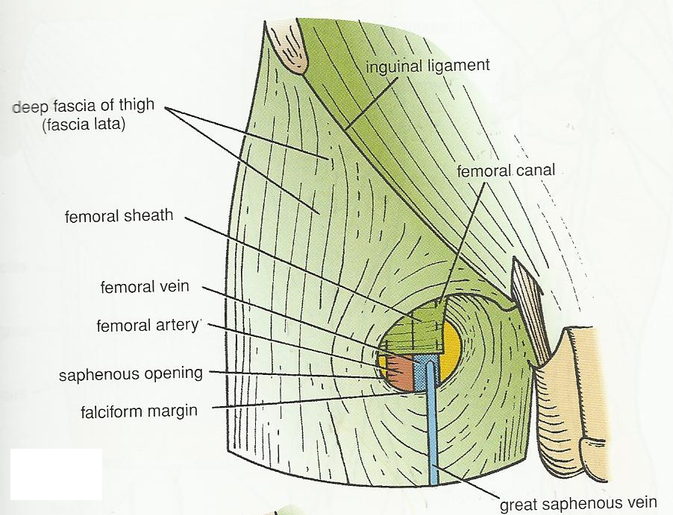
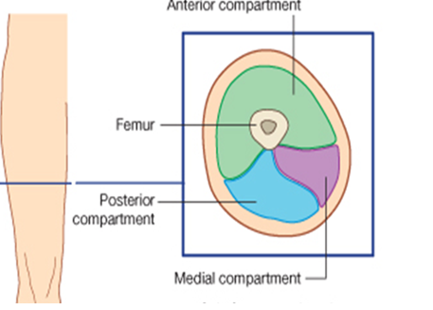
B- Deep fascia of the thigh (fascia lata)
Forms on the anterio-medial side of the thigh the Saphenous opening (fossa ovalis).
Saphenous opening (fossa ovalis) is a gap in the fascia lata which is covered by loose connective tissue called cribriform fascia.
The cribriform fascia is pierced by:
1- Great Saphenous vein
2- superficial branches of the femoral artery
3- Lymphatics.
Fascia lata is connected to the linea aspera by
three intermuscular septa;
1- Medial intermuscular septum
2- Lateral intermuscular septum
3- Posterior intermuscular septum
Thus the deep fascia and septa divide the thigh into three compartment; Anterior, Posterior and Medial.

Slide 10
Fascial compartments of the thigh

Slide 11
Fascial Compartments of the Thigh
Fascia lata is connected to the linea aspera by
three intermuscular septa;
1- Medial intermuscular septum
2- Lateral intermuscular septum
3- Posterior intermuscular septum
Thus the deep fascia and septa divide the thigh into three compartment;
Anterior
Posterior
Medial.

Slide 12
Contents of the Anterior Fascial Compartment of the Thigh
1-Muscles: Sartorius, iliacus, psoas, pectineus, and quadriceps femoris
2-Blood supply: Femoral artery
3-Nerve supply: Femoral nerve
Note: that not all the contents of the anterior compartment have the Same function. For example psoas is the main flexor of the thigh at the hip joint while quadriceps femoris is the main extensor of the leg at the knee joint.

Slide 13
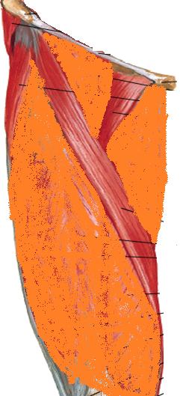
Sartorius
Origin: Anterior superior iliac spine
Insertion: Upper medial surface of shaft of tibia
Nerve supply: Femoral nerve
Actions: Flexes, abducts, laterally rotates thigh at hip joint
Flexes and medially rotates leg
at knee joint
Pectineus
Origin: Superior ramus of pubis
Insertion: Upper end of linea aspera of shaft of femur
Nerve supply: Femoral nerve?
Actions: Flexes and adducts thigh at hip joint

Slide 14
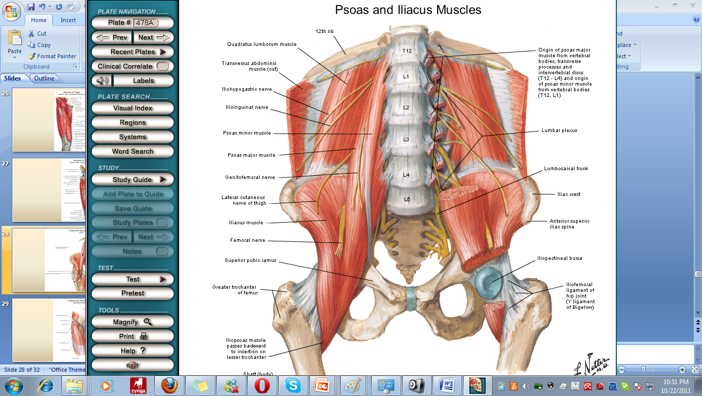
Psoas
Origin: Transverse processes, bodies, and intervertebral discs of the 12th thoracic and five lumbar vertebrae
Insertion: With iliacus into lesser trochanter of femur
Nerve supply: Lumbar plexus
Actions: Flexes thigh on trunk; if thigh is fixed, it flexes the trunk on thigh as in sitting up from lying down.
Iliacus
Origin: Iliac fossa of hip bone
Insertion: With psoas into lesser trochanter of femur
Nerve supply: Femoral nerve
Actions: Flexes thigh on trunk; if thigh is fixed, it flexes the trunk on the thigh as in sitting up from lying down(the same as psoas).

Slide 15
Consisting of:
1- The rectus femoris
2- The vastus intermedius
3- The vastus lateralis
4- The vastus medialis
The quadriceps femoris muscle
Rectus femoris
Originates by two heads
Straight head from anterior inferior iliac spine Reflected head from ilium above acetabulum
Vastus lateralis
Origin : Upper end and shaft of femur
(linear origin)
Vastus medialis
Origin : Upper end and shaft of femur (linear origin)

