Slide 1
Where should you palpate the pulse of
different arteries in the lower limb?

Slide 2
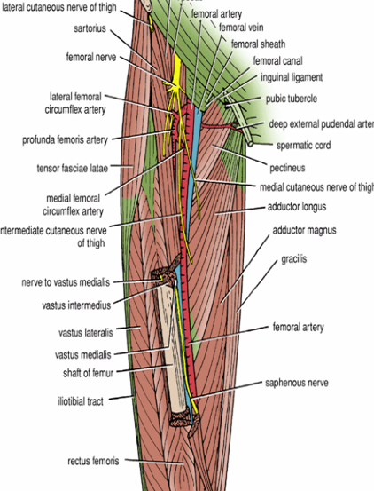
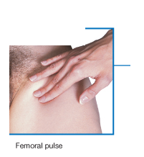
The femoral artery
In the femoral triangle, its pulse is easily felt just inferior to the inguinal ligament midway between the pubic symphysis and the anterior superior iliac spine.

Slide 3
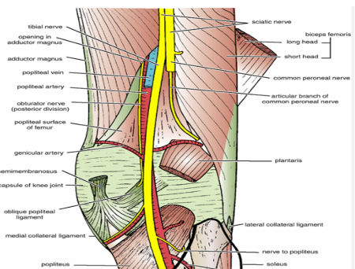
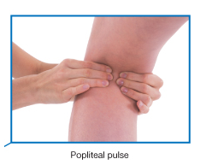
The popliteal artery
The popliteal artery pulse is difficult to find, but usually can be detected on deep palpation just medial to the midline of the popliteal fossa.

Slide 4
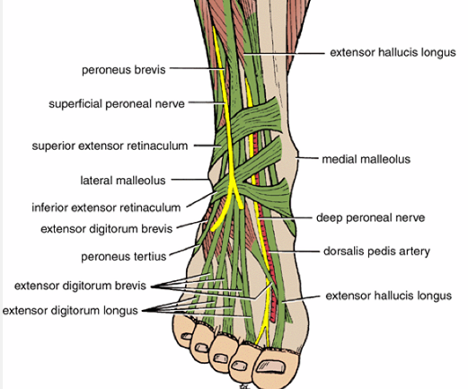
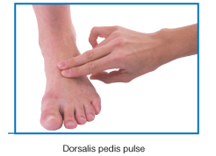
The dorsalis pedis artery
Passes onto the dorsal aspect of the foot and anteriorly over the tarsal bones where it lies between and is parallel to the tendon of extensor hallucis longus and the tendon of extensor digitorum longus to the second toe.
The artery may be absent in around 15% of people

Slide 5
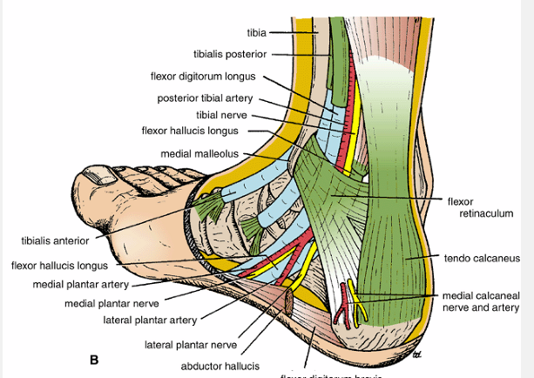
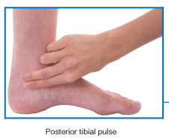
The posterior tibial artery
Is palpable just posteroinferior to the medial malleolus between the heel and medial malleolus.

Slide 6
Nerve injuries
of
lower limbs

Slide 7
Femoral Nerve Injury
The femoral nerve can be injured in:
Stab or gunshot wounds
a complete damage of the nerve is rare.
Clinical manifestations:
If The nerve is completely injured
Motor: The quadriceps femoris muscle is paralyzed, and the knee cannot be extended.
Sensory: Skin sensation is lost over
1-The anterior and medial sides of the thigh,
2-Over the medial side of the lower part of the leg
3- The medial border of the foot as far as the ball of the big toe; this area is normally supplied by the saphenous nerve

Slide 8
Sciatic Nerve Injury
The nerve is sometimes injured by:
1- penetrating wounds
2-fractures of the pelvis
3-dislocations of the hip joint. (posterior)
4-badly placed intramuscular injections in the gluteal region. (common).
The following clinical features are present:
Motor: 1-The hamstring muscles are paralyzed, but weak flexion of the knee is possible because of the action of the sartorius (femoral nerve) and gracilis (obturator nerve)
2-All the muscles below the knee are paralyzed,
the foot assume the plantar-flexed position, or Foot drop
Sensory: Sensation is lost below the knee,
except for a narrow area down the medial side
of the lower part of the leg and along the medial
border of the foot as far as the ball of the big toewhich is supplied by the saphenous nerve (femoral nerve).

Slide 9
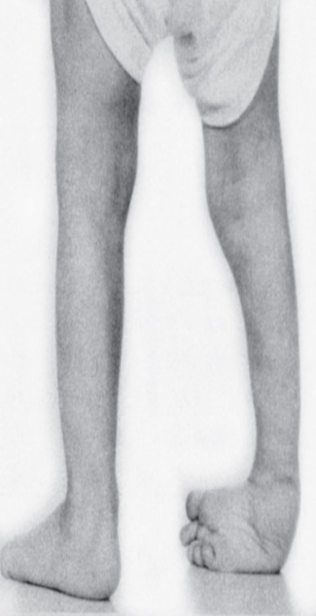
common peroneal nerve is in an exposed position as it leaves the popliteal fossa and winds around the neck of the fibula to enter the peroneus longus muscle
Injury to common peroneal nerve
Paralysis of extensor muscles (supplied by deep peroneal nerve) this means loss of dorsiflexion of the foot
Paralysis of peronei muscles (supplied by the superficial peroneal nerve) this means
loss of Eversion of the foot
The antagonistic muscles (planter flexors and invertors) will take over
this leads to
Foot drop and inversion
Equino varus

Slide 10
Tibial Nerve Injury
Because of its deep and protected position, it is rarely injured.
Complete damage results in the following clinical features:
Motor: All the muscles in the back of the leg and the sole of the foot are paralyzed. The opposing muscles dorsiflex the foot at the ankle joint and evert the foot at the subtalar and transverse tarsal joints, an attitude referred to as Calcaneovalgus
Sensory: Sensation is lost on the sole of the foot; later, trophic ulcers develop.
Read only

Slide 11
Obturator Nerve Injury
It is rarely injured in :
penetrating wounds,
in anterior dislocations of the hip joint,
or in abdominal herniae through the obturator foramen.
It may be pressed on by the fetal head during
parturition.
The following clinical features occur:
Motor: All the adductor muscles are paralyzed except the hamstring part of the adductor magnus, which is supplied by the sciatic nerve.
Sensory: The cutaneous sensory loss is minimal on the medial aspect of the thigh.
important

Slide 12
Veins of the Lower Limb
The veins of the lower limb can be divided into three groups:
1-superficial, 2- deep , 3-perforating.
The superficial veins consist of the great and small saphenous veins, which are situated beneath the skin in the superficial fascia.
The deep veins are the venae comitantes to the anterior and posterior tibial arteries, the popliteal vein, and the femoral veins and their tributaries.
The perforating veins are communicating vessels that run between the superficial and deep veins. Many of these veins are found particularly in the region of the ankle and the medial side of the lower part of the leg. They possess valves that are arranged to prevent the flow of blood from the deep to the superficial veins.

Slide 13
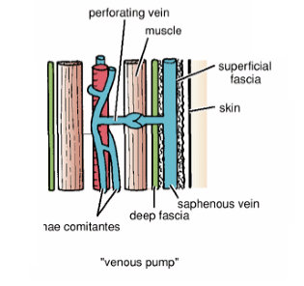
The valves in the perforating veins prevent the high-pressure venous blood from being forced outward into the low-pressure superficial veins.
Low pressure
High pressure
The superficial saphenous veins
lie within the superficial fascia and are not subject to compression forces
venae comitantes
are subjected to intermittent pressure at rest and during exercise

Slide 14
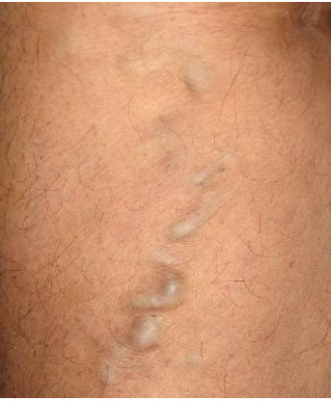
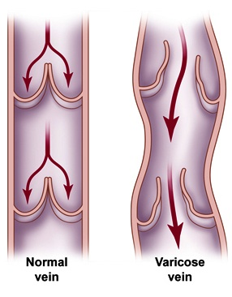
Varicose Veins
A varicosed vein is one that has a larger diameter than normal and is elongated and tortuous.
This condition commonly occurs in the superficial veins of the lower limb
CAUSES
hereditary weakness of the vein walls and incompetent valves;
elevated intra-abdominal pressure as a result of multiple pregnancies or abdominal tumors;
incompetence of a valve in a perforating vein.`

Slide 15
Dermatomes in the lower limb
Regions that can be tested for sensation and are reasonably autonomous (have minimal overlap) are:
over
1-The inguinal ligament-L1
2-Lateral side of the thigh-L2;
3-Lower medial side of the thigh-L3
4-Meidal side of the great toe (digit 1)-L4
5-Meidal side of digit 2-L5
6-Little toe (digit 5)-S1
7-Back of the thigh-S2
8-Skin over the gluteal fold-S3

Slide 17
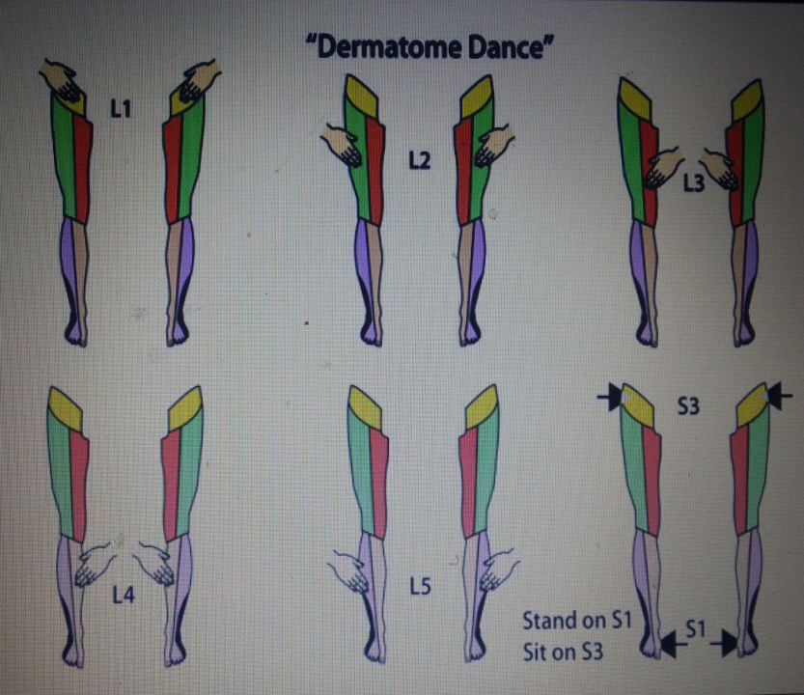

Slide 19
In an unconscious patient, both somatic sensory and somatic motor functions of spinal cord levels can be tested using tendon reflexes:
1- a 'tap' on the patellar ligament at the knee tests Patellar tendon reflex (knee jerk) L3, and 4 (extension of the knee joint on tapping the patellar tendon)
2-Achilles tendon reflex (ankle jerk) S1 and S2 (plantar flexion of the ankle joint on tapping the Achilles tendon)

Slide 20
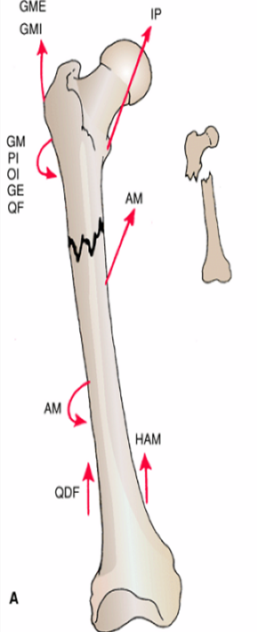
Read only
In fractures of the upper third of the shaft of the femur
The proximal fragment is
flexed by the iliopsoas
abducted by the gluteus medius and minimus
laterally rotated by the gluteus maximus, the piriformis, the obturator internus, the gemelli, and the quadratus femoris
The lower fragment is adducted by the adductor muscles,
pulled upward by the hamstrings and quadriceps, and laterally rotated by the adductors and the weight of the foot

Slide 21
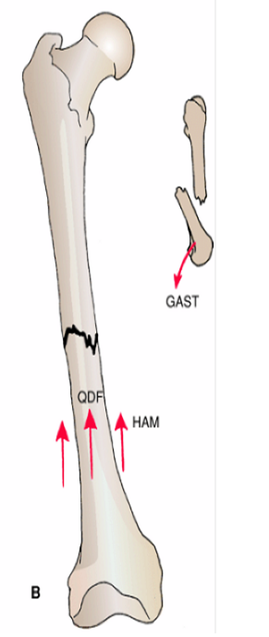
Read only
In fractures of the middle third of the shaft of the femur gastrocnemius
The distal fragment is pulled upward by the hamstrings and the quadriceps resulting in considerable shortening.
The distal fragment is also rotated backward
by the pull of the two heads of the
GASTROCNEMIUS

Slide 22
In fractures of the distal third of the shaft of the femur, the same displacement of the distal fragment occurs as seen in fractures of the middle third of the shaft..
However, the distal fragment is smaller and is rotated backward by the gastrocnemius muscle to a greater degree and may exert pressure on the popliteal artery
and interfere with the blood flow through the leg and foot

Slide 23
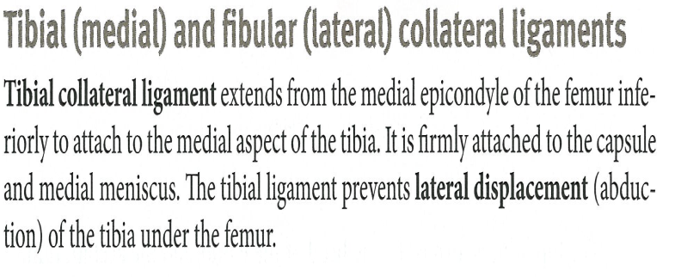

Slide 24
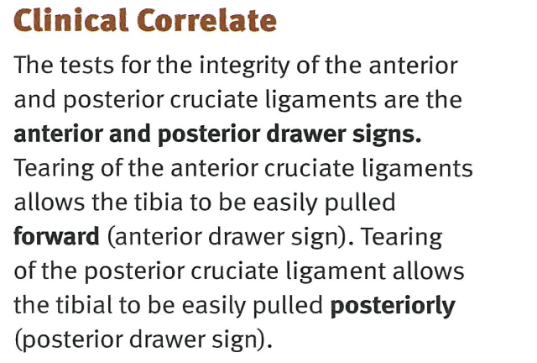

Slide 26
Ankle Sprains
The ankle is the most frequently injured major joint in the body. Ankle sprains (torn fibers of ligaments) are most common. A
sprained ankle is nearly always an inversion injury, involving twisting of the weight-bearing plantarflexed foot. The anterior
talofibular ligament (part of the lateral ligament) is most commonly torn during ankle sprains, either partially or completely,
resulting in instability of the ankle joint. The calcaneofibular ligament may also be torn.

Slide 27
Genu Varum and Genu Valgum
The femur is placed diagonally within the thigh, whereas the tibia is almost vertical within the leg, creating an angle,
the Qangle,
at the knee between the long axes of the bones. The Q-angle is assessed by drawing a line from the ASIS to the
middle of the patella and extrapolating a second (vertical) line through the middle of the patella and tibial tuberosity .
The Q-angle is typically greater in adult females, owing to their wider pelves.
A medial angulation of the leg in relation
to the thigh, in which the femur is abnormally vertical and the Q-angle is small, is a deformity called genu varum (bowleg) that
causes unequal weight distribution. Excess pressure is placed on the medial aspect of the knee joint, which
results in arthrosis (destruction of knee cartilage).

Slide 28
A lateral angulation of the leg in relation to the thigh
(exaggeration of knee angle) is genu valgum (knock-knee). Consequently, in genu valgum, excess stress is placed on the lateral
structures of the knee. The patella, normally pulled laterally by the tendon of the vastus lateralis, is pulled even farther laterally
when the leg is extended in the presence of genu varum so that its articulation with the femur is abnormal.

Slide 29
Patellofemoral Syndrome
Pain deep to the patella often results from excessive running, especially downhill; hence, this type of pain is often called
“runner's knee.”
The pain results from repetitive microtrauma caused by abnormal tracking of the patella relative to the patellar
surface of the femur, a condition known as the patellofemoral syndrome.
This syndrome may also result from a direct blow
to the patella and from osteoarthrit is of the patellofemoral compartment (degenerative wear and tear of articular
cartilages).
In some cases, strengthening of the vastus medialis corrects patellofemoral dysfunction.
This muscle tends to
prevent lateral dislocation of the patella resulting from the Q-angle because the vastus medialis attaches to and pulls on the
medial border of the patella. Hence, weakness of the vastus medialis predisposes the individual to patellofemoral dysfunction
and patellar dislocation.

Slide 30
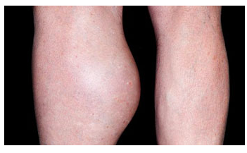
Popliteal Cysts
Popliteal cysts (Baker cysts) are abnormal fluid-filled sacs of synovial membrane in the region of the popliteal fossa.. Popliteal cysts are
common in children but seldom cause symptoms. In adults, popliteal cysts can be large, extending as far as the midcalf, and
may interfere with knee movements.
A popliteal
cyst is almost always a complication of chronic knee joint effusion. The cyst may be a herniation of the gastrocnemius or
semimembranosus bursa through the fibrous layer of the joint capsule into the popliteal fossa, communicating with the synovial
cavity of the knee joint by a narrow stalk. Synovial fluid may also escape from the knee joint (synovial effusion) or a bursa
around the knee and collect in the popliteal fossa. Here it forms a new synovial-lined sac, or popliteal cyst
Read only

Slide 31
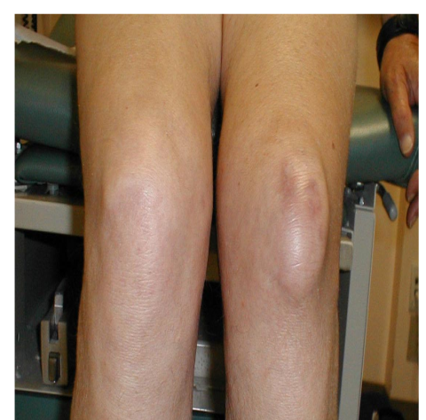
Bursit is in Knee Region
Prepatellar bursitis (“housemaid's knee”) is usually a friction bursitis caused by friction between the skin and the patella.
Subcutaneous infrapatellar bursitis results from excessive friction between the skin and the tibial tuberosity
Deep infrapatellar bursitis results in edema between the patellar ligament and the tibia,
superior to the tibial tuberosity.
The suprapatellar bursa communicates with the articular cavity of the knee joint;
consequently, abrasions or penetrating wounds
(e.g., a stab wound) superior to the patella may result in suprapatellar bursitis caused by bacteria entering the bursa from the
torn skin.
The infection may spread to the knee joint.

Slide 32
Intraosseous Infusion of the Tibia in the Infant
The technique may be used for the infusion of fluids and blood when it has been found impossible to obtain an intravenous line. The procedure is easy and rapid to perform, as follows:
With the distal leg adequately supported, the anterior subcutaneous surface of the tibia is palpated.
The skin is anesthetized about 1 in. (2.5 cm) distal to the tibial tuberosity, thus blocking the infrapatellar branch of the saphenous nerve.
The bone marrow needle is directed at right angles through the skin, superficial fascia, deep fascia, and tibial periosteum and the cortex of the tibia. Once the needle tip reaches the medulla and bone marrow, the operator senses a feeling of â€œgive.â€‌ The position of the needle in the marrow can be confirmed by aspiration. The needle should be directed slightly caudad to avoid injury to the epiphyseal plate of the proximal end of the tibia. The transfusion may then commence
Read only

Slide 33
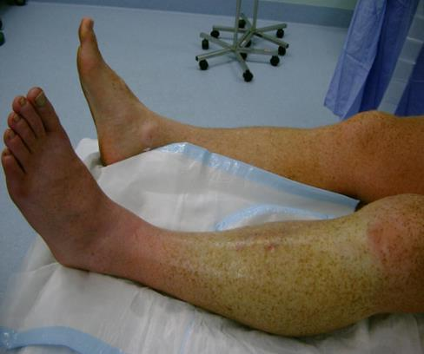
Anterior Compartment of the Leg Syndrome.
is produced by an increase in the intracompartmental pressure that results from an increased production of tissue fluid.
Soft tissue injury associated with bone fractures is a common cause, and early diagnosis is critical.
The deep, aching pain in the anterior compartment of the leg that is characteristic of this syndrome can become severe.
Dorsiflexion of the foot at the ankle joint increases the severity of the pain.
As the pressure rises, the venous return is diminished, thus producing a further rise in pressure.
In severe cases, the arterial supply is eventually cut off by compression
the dorsalis pedis arterial pulse disappears.
The tibialis anterior, the extensor digitorum longus, and the extensor hallucis longus muscles are paralyzed.
Loss of sensation is limited to the area supplied by the deep peroneal nerve
that is, the skin cleft between the first and second toes.
The surgeon can open the anterior compartment of the leg by making a longitudinal incision through the deep fascia and thus decompress the area and prevent anoxic necrosis of the muscles
Read only

Slide 34
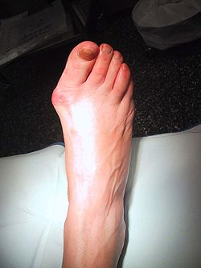
Hallux Valgus
Hallux valgus is a foot deformity caused by degenerative joint disease; it is characterized by lateral deviation of the hallux). In some people, the deviation is so great that the first toe overlaps the second toe. These individuals are unable to move
their first digit away from their second digit because the sesamoid bones under the head of the first metatarsal are displaced and
lie in the space between the heads of the first and second metatarsals. In addition, a subcutaneous bursa may form owing to
pressure and friction against the shoe. When tender and inflamed, the bursa is called a bunion great toe (L.

Slide 35
Patellar Dislocations
The patella is a sesamoid bone lying within the quadriceps tendon. The importance of the lower horizontal fibers of the vastus medialis and the large size of the lateral condyle of the femur in preventing lateral displacement of the patella has been emphasized. Congenital recurrent dislocations of the patella are caused by underdevelopment of the lateral femoral condyle. Traumatic dislocation of the patella results from direct trauma to the quadriceps attachments of the patella (especially the vastus medialis), with or without fracture of the patella

