Slide 1
EDEMA
60% of lean body weight = water
(2/3) intracellular.
(1/3)extracellular (interstitial fluid)
5% blood plasma.
edema = an accumulation of interstitial fluid within tissues.
Extravascular fluid collection in body cavities:
pleural cavity (hydrothorax)
the pericardial cavity (hydropericardium)
peritoneal cavity (hydroperitoneum, or ascites).
Anasarca is severe, generalized edema marked by profound swelling of subcutaneous tissues and accumulation of fluid in body cavities.

Slide 2
Increased Hydrostatic Pressure
Impaired Venous Return
Congestive heart failure; Constrictive pericarditis; Ascites (liver cirrhosis); Venous obstruction or compression; Thrombosis; External pressure (e.g., mass); Lower extremity inactivity with prolonged dependency
Arteriolar Dilation
Heat; Neurohumoral dysregulation
Reduced Plasma Osmotic Pressure (Hypoproteinemia)
Protein-losing glomerulopathies (nephrotic syndrome) Liver cirrhosis (ascites); Malnutrition; Protein-losing gastroenteropathy
Lymphatic Obstruction
Inflammatory; Neoplastic; Postsurgical; Postirradiation
Sodium Retention
Excessive salt intake with renal insufficiency Increased tubular reabsorption of sodium Renal hypoperfusion Increased renin-angiotensin-aldosterone secretion
Inflammation
Acute inflammation; Chronic inflammation; Angiogenesis

Slide 3
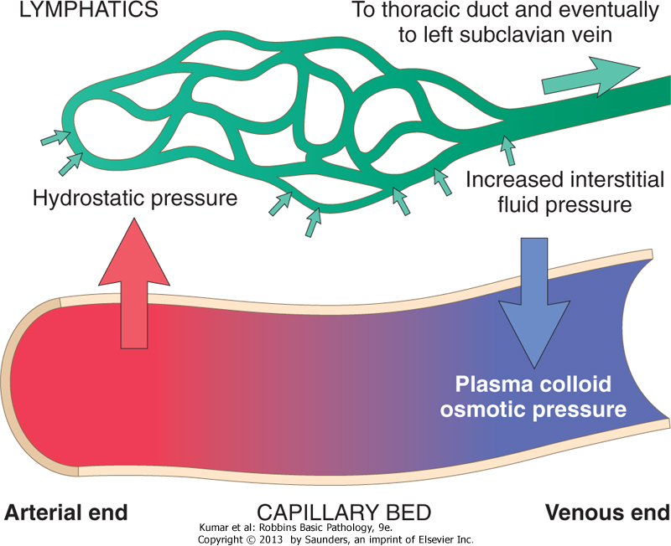

Slide 4
Increased Hydrostatic Pressure
Local : -impaired venous return- e.g. DVT
Generalized: -congestive heart failure (most common):
reduced cardiac output leads →hypoperfusion of the kidneys→renin-angiotensin-aldosterone axis → sodium and water retention (secondary hyperaldosteronism).
(vicious circle): fluid retention→ increased venous hydrostatic pressures→worsening edema.
Treatment of generalized edema:
salt restriction
diuretics
aldosterone antagonists

Slide 5
Reduced Plasma Osmotic Pressure
common causes:
1- albumin is lost from the circulation
e.g. nephrotic syndrome → loss of albumin (and other plasma proteins) in the urine .
2- albumin synthesized in inadequate amounts
e.g. severe liver disease (e.g., cirrhosis)
e.g. protein malnutrition
Unfortunately, increased salt and water retention by the kidney not only fails to correct the plasma volume deficit but also exacerbates the edema, since the primary defect (low serum protein) persists

Slide 6
Lymphatic Obstruction = lymphedema
Causes:
1- localized obstruction caused by an inflammation.e.g. filariasis (so-called elephantiasis)
2- neoplastic conditions. E.g. breast cancer: Infiltration and obstruction of superficial lymphatics cause edema of the breast’s overlying skin →peau d'orange (orange peel).
3- post surgical. e.g. breast cancer who undergo axillary lymph node resection and/or irradiation→ upper limb lymphedema
4- irradiation

Slide 7
Sodium and Water Retention
leads to edema by increasing hydrostatic pressure (due to expansion of the intravascular volume) and reducing plasma osmotic pressure.
causes: diseases that compromise renal function, including poststreptococcal glomerulonephritis and acute renal failure

Slide 8
Clinical Correlation
Subcutaneous edema: the most common, is important to recognize primarily because it signals potential underlying cardiac or renal disease
Can impair wound healing or the clearance of infections.
Pulmonary edema
Common causes:
left ventricular failure - renal failure - ARDS
inflammatory and infectious disorders of the lung.
can cause death by interfering with normal ventilatory function & impeding oxygen diffusion
creates a favorable environment for infections.
Brain edema
is life-threatening→ → brain herniation (extrude) through the foramen magnum.

