Slide 1
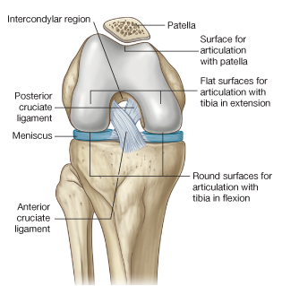
Knee Joint
Is the most complicated joint in the body
Consists of two condylar joints between:
The medial and lateral condyles of the femur and The condyles of the tibia
and a gliding joint
between the patella and the patellar surface of the femur
Note that the fibula is not directly involved in the joint.
Type
The joint between the femur and tibia is a synovial joint of the hinge variety, but some degree of rotatory movement is possible.
The joint between the patella and femur is a synovial joint of the plane gliding variety.

Slide 2
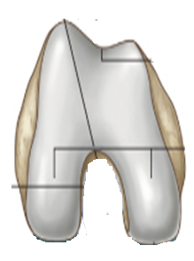
Notice that the lateral condyle of femur is a bit longer than the medial why?!
Lateral condyle of femur
(OUTR)
Medial condyle of femur
(INNER)
THE OUTER IS STOUTER
THE INNER IS THINER
prevents lateral dislocation
of the patella
Longer than the medial

Slide 3
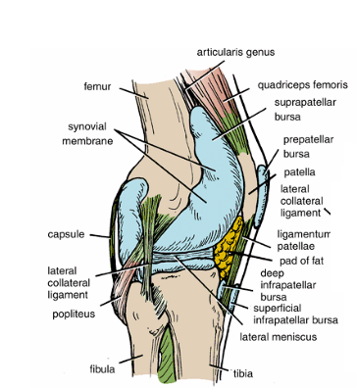
Capsule
1-The capsule is attached to the margins of the articular surfaces
2- surrounds the sides and posterior aspect of the joint.
3-On the front of the joint, the capsule is absent permitting the synovial membrane to pouch upward beneath the quadriceps tendon, forming
the suprapatellar bursa

Slide 4
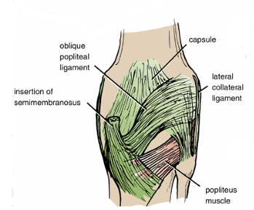
4-On each side of the patella, the capsule is strengthened by expansions from the tendons of vastus lateralis and medialis.
5- Behind the joint, the capsule is strengthened by an expansion of the semimembranous muscle called the oblique popliteal ligament
6-An opening in the capsule behind the lateral tibial condyle permits the tendon of the popliteus to emerge

Slide 5
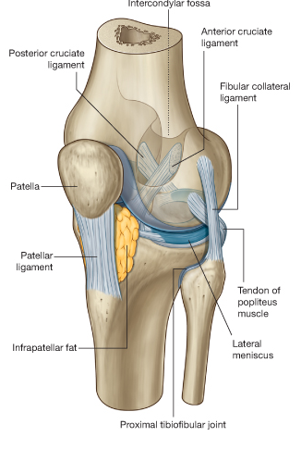
The lateral collateral ligament
is cordlike and is attached above to the lateral condyle of the femur and below to the head of the fibula. The tendon of the popliteus muscle intervenes between the ligament and the lateral Meniscus (thus, the ligament is not attached to the lateral meniscus)
Ligaments of the knee joint
The ligaments may be divided into
1-Extracapsular Ligaments
The ligamentum patellae is attached
above to the lower border of the patella and below to the tuberosity of the tibia.

Slide 6
The medial collateral ligament
is a flat band and is attached above to the medial condyle of the femur and below to the medial surface of the shaft of the tibia.
It is firmly attached to the edge of the medial meniscus ?!
The oblique popliteal ligament
Is a tendinous expansion derived from the semimembranosus muscle.
It strengthens the posterior aspect of the capsule

Slide 7
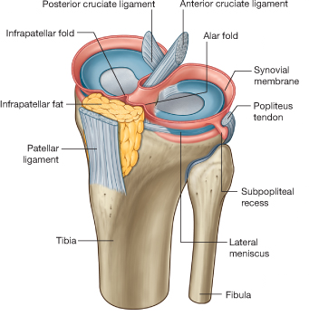
2-Intracapsular Ligaments
The cruciate ligaments
They are named anterior and posterior, according to their tibial attachments
The cruciate ligaments are the main bond between the femur and the tibia during the joint's range of movement.

Slide 8
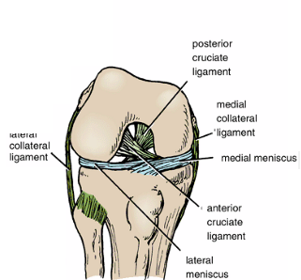
Anterior Cruciate Ligament
Is attached to the anterior intercondylar area of the tibia and passes upward, backward, and laterally, to be attached to the posterior part of the medial surface of the lateral femoral condyle
Prevents posterior displacement of the femur on the tibia. With the knee joint flexed, the anterior cruciate ligament prevents the tibia from being pulled anteriorly.
Anterior Cruciate Ligament

Slide 9
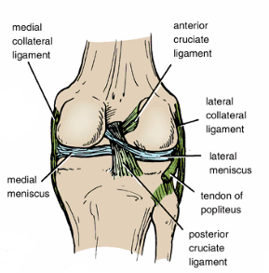
Posterior Cruciate Ligament
Is attached to the posterior intercondylar area of the tibia and passes upward, forward, and medially to be attached to the anterior part of the lateral surface of the medial femoral condyle
Prevents anterior displacement of the femur on the tibia. With the knee joint flexed, the posterior cruciate ligament prevents the tibia from being pulled posteriorly.

Slide 10
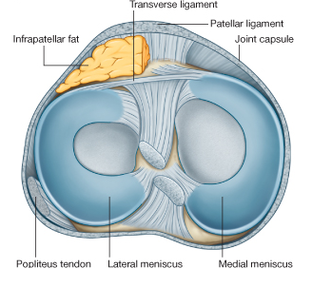
Anterior
Menisci
Medial and lateral menisci are C-shaped sheets of fibrocartilage.
Their function is to deepen the articular surfaces of the tibial condyles to receive the convex femoral condyles;
They also serve as cushions between the two bones
Each meniscus is attached to the upper surface of the tibia by anterior and posterior horns.
Posterior

Slide 11
Locking mechanism
When standing, the knee joint is 'locked' which reduces the amount of muscle work needed to maintain the standing position
The locking mechanism is achieved by medial rotation of the femur on the tibia during extension. Medial rotation and full extension tighten all the associated ligaments
Another feature that keeps the knee extended when standing is that the body's center of gravity is positioned along a vertical line that passes anterior to the knee joint.
The extended knee is said to be in the locked position
Before flexion of the knee joint can occur, it is essential that the major ligaments be untwisted to permit movements between the joint surfaces.
This unlocking or untwisting process is accomplished by the popliteus muscle, which laterally rotates the femur on the tibia

Slide 12
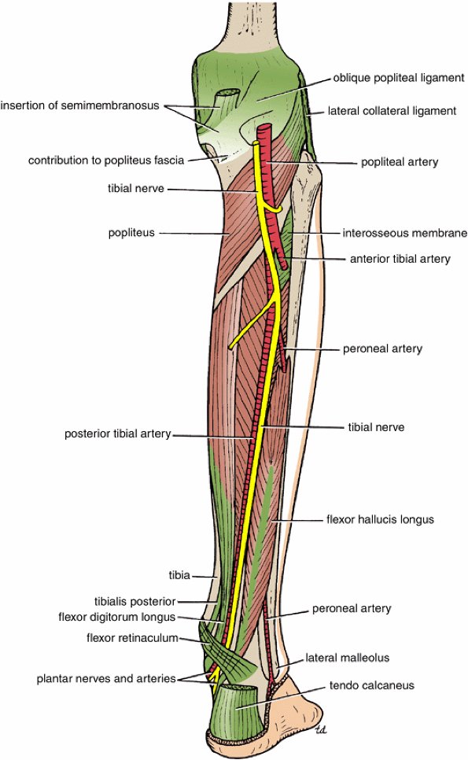
Popliteus Muscle
plays a key role in the movements of the knee joint
Origin: From the lateral surface of the lateral condyle of the femur by a rounded tendon and by a few fibers from the lateral semilunar cartilage
Insertion: The fibers pass downward and medially and are attached to the posterior surface of the tibia, above the soleal line.
The muscle arises within the capsule of the knee joint
its tendon separates the lateral meniscus from the lateral ligament of the joint.
It emerges through the lower part of the posterior surface of the capsule of the joint to pass to its insertion.
Action: Medial rotation of the tibia on the femur or, if the foot is on the ground,
lateral rotation of the femur on the tibia
The latter action occurs at the commencement of flexion of the extended knee, and its rotatory action slackens the ligaments of the knee joint; this action is sometimes referred to as unlocking the knee joint.‌

Slide 13
movements of the knee joint
Flexion
The biceps femoris, semitendinosus, and semimembranosus muscles, assisted by the gracilis, and sartorius, produce flexion.
Flexion is limited by the contact of the back of the leg with the thigh.
Extension
The quadriceps femoris.
Extension is limited by the tension of all the major ligaments of the joint.
Medial Rotation
The sartorius, gracilis, and semitendinosus
Lateral Rotation
The biceps femoris
Note:
The stability of the knee joint depends on the tone of the strong muscles acting on the joint and the strength of the ligaments.

Slide 14
Ankle Joint
Type
The ankle is a synovial hinge joint.
Articulation
the lower end of the tibia, the two malleoli, and the body of the talus
Ligaments
The medial, or deltoid, ligament
The lateral ligament
Movements
Dorsiflextion is performed by the tibialis anterior, extensor hallucis longus, extensor digitorum longus, and peroneus tertius. (muscles of the anterior compartment of the leg)

Slide 15
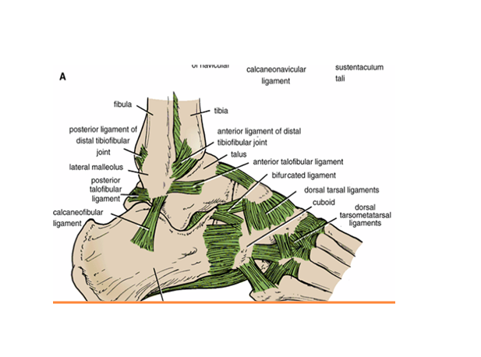
Plantar flexion is performed by the gastrocnemius, soleus, plantaris, peroneus longus, peroneus brevis, tibialis posterior, flexor digitorum longus, and flexor hallucis longus. (all the muscles of lateral and posterior compartment except popliteus muscle)

Slide 16
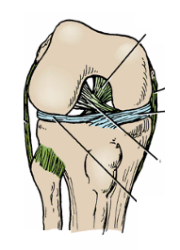
Proximal Tibiofibular Joint
Articulation
Articulation is between the lateral condyle of the tibia and the head of the fibula).
The articular surfaces are flattened and covered by hyaline cartilage.
Type
This is a synovial, plane, gliding joint.
Capsule
The capsule surrounds the joint and is attached to the margins of the articular surfaces.
Ligaments
Anterior and posterior ligaments strengthen the capsule.
Synovial Membrane
The synovial membrane lines the capsule and is attached to the margins of the articular surfaces.
Nerve Supply
The common peroneal nerve supplies the joint.
Movements
A small amount of gliding movement takes place during movements at the ankle joint.
Read only

Slide 17
Distal Tibiofibular Joint
Articulation
Articulation is between the fibular notch at the lower end of the tibia and the lower end of the fibula
Type
The distal tibiofibular joint is
a fibrous joint
Capsule
There is no capsule.
Ligaments
1-The interosseous ligament is a strong, thick band of fibrous tissue that binds the two bones together.
2-The anterior and posterior ligaments are flat bands of fibrous tissue connecting the two bones together in front and behind the interosseous ligament
Read only
3-The inferior transverse ligament

Slide 18
Tarsal Joints
1-Subtalar Joint
The subtalar joint is the posterior joint between the talus and the calcaneum.
Articulation
is between the inferior surface of the body of the talus and the facet on the middle of the upper surface of the calcaneum
Type
These joints are synovial, of the plane variety
Ligaments
Medial and lateral (talocalcaneal) ligaments strengthen the capsule.
The interosseous (talocalcaneal) ligament is strong and is the main bond of union between the two bones. It is attached above to the sulcus tali and below to the sulcus calcanei..
Movements
Gliding and rotatory movements are possible

Slide 19
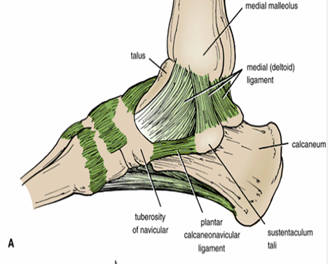
2-Talocalcaneonavicular Joint
is the anterior joint between the talus and the calcaneum and also involves the navicular bone
Articulation
Articulation is between the rounded head of the talus, the upper surface of the sustentaculum tali, and the posterior concave surface of the navicular bone.
Type
The joint is a synovial joint..
Ligaments.
The plantar calcaneonavicular ligament is strong and runs from the anterior margin of the sustentaculum tali to the inferior surface and tuberosity of the navicular bone. The superior surface of the ligament is covered with fibrocartilage and supports the head of the talus..
Movements
Gliding and rotatory movements are possible

Slide 20
The talocalcaneonavicular and the calcaneocuboid joints are together referred to as the midtarsal or transverse tarsal joints
3-Calcaneocuboid Joint
Articulation
Articulation is between the anterior end of the calcaneum and the posterior surface of the cuboid
The calcaneocuboid joint is synovial, of the plane variety.
Ligaments
The bifurcated ligament

Slide 21
؟؟؟؟؟Tarsal Tunnel Syndrome

