Slide 1
The Digestive System in the Head and Neck

Slide 2
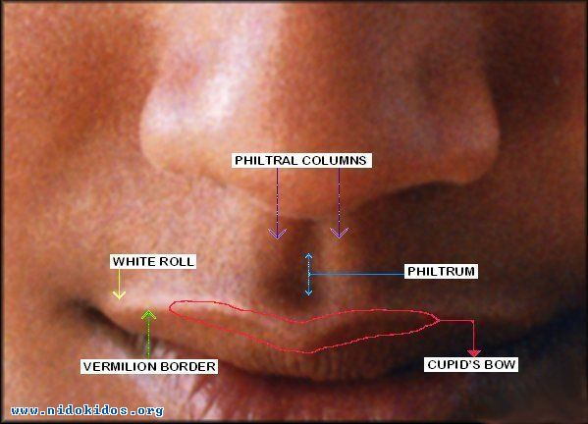
The Mouth
The Lips
The lips are two fleshy folds that surround the oral orifice
They are covered on the outside by skin and are lined on the inside by mucous membrane
the substance of the lips is made up by the orbicularis oris muscle and the muscles that radiate from the lips into the face
Also included are the labial blood vessels and nerves, connective tissue, and many small salivary glands.
The philtrum is the shallow vertical groove seen in the midline on the outer surface of the upper lip. Median folds of mucous membraneâ€”the labial frenulaeâ€”connect the inner surface of the lips to the gums.

Slide 3
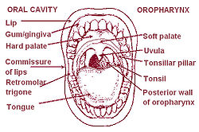
The Mouth Cavity
The mouth extends from the lips to the pharynx
The entrance into the pharynx, the oropharyngeal isthmus, is formed on each side by the palatoglossal fold
The mouth is divided into the vestibule and the mouth cavity proper.

Slide 4
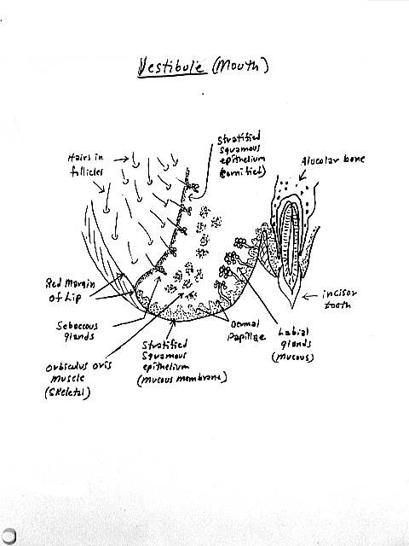
Vestibule
The vestibule lies between the lips and the cheeks externally and the gums and the teeth internally
This slitlike space communicates with the exterior through the oral fissure between the lips
when the jaws are closed, it communicates with the mouth proper behind the third molar tooth on each side.
The vestibule is limited above and below by the reflection of the mucous membrane from the lips and cheeks to the gums.
The lateral wall of the vestibule is formed by the cheek, which is made up by the buccinator muscle and is lined with mucous membrane.
The tone of the buccinator muscle and that of the muscles of the lips keeps the walls of the vestibule in contact with one another
The duct of the parotid salivary gland opens on a small papilla into the vestibule opposite the upper second molar tooth

Slide 5
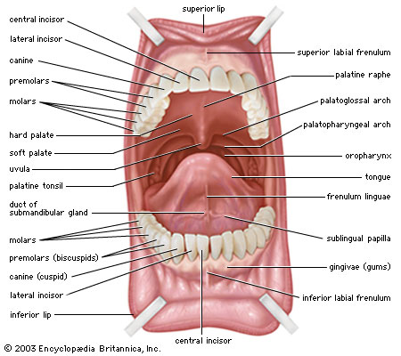
Mouth Proper
The mouth proper has a roof and a floor.
The roof of the mouth is formed by the hard palate in front and the soft palate behind
The floor is formed largely by the anterior two thirds of the tongue and by the reflection of the mucous membrane from the sides of the tongue to the gum of the mandible
fold of mucous membrane called the frenulum of the tongue connects the undersurface of the tongue in the midline to the floor of the mouth
Lateral to the frenulum, the mucous membrane forms a fringed fold, the plica fimbriata
The submandibular duct of the submandibular gland opens onto the floor of the mouth on the summit of a small papilla on either side of the frenulum of the tongue
The sublingual gland projects up into the mouth, producing a low fold of mucous membrane, the sublingual fold
Numerous ducts of the gland open on the summit of the fold.

Slide 6
Mucous Membrane of the Mouth
In the vestibule the mucous membrane is tethered to the buccinator muscle by elastic fibers in the submucosa
prevent redundant folds of mucous membrane from being bitten between the teeth when the jaws are closed
The mucous membrane of the gingiva, or gum, is strongly attached to the alveolar periosteum.

Slide 7
Sensory Innervation of the Mouth
Roof: The greater palatine and nasopalatine nerves from the maxillary division of the trigeminal nerve
Floor: The lingual nerve (common sensation), a branch of the mandibular division of the trigeminal nerve.
The taste fibers travel in the chorda tympani nerve, a branch of the facial nerve.
Cheek: The buccal nerve, a branch of the mandibular division of the trigeminal nerve (the buccinator muscle is innervated by the buccal branch of the facial nerve)

Slide 8
The Teeth
The gingivae (gums) are specialized regions of the oral mucosa that surround the teeth and cover adjacent regions of the alveolar bone.
Deciduous Teeth
There are 20 deciduous teeth: four incisors, two canines, and four molars in each jaw
They begin to erupt about 6 months after birth and have all erupted by the end of 2 years.
The teeth of the lower jaw usually appear before those of the upper jaw.

Slide 9
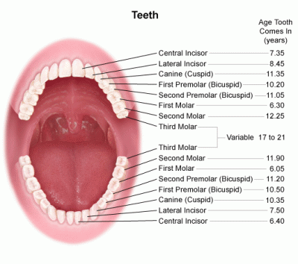
Permanent Teeth
There are 32 permanent teeth: four incisors, two canines, four premolars, and six molars in each jaw
They begin to erupt at 6 years of age
The last tooth to erupt is the third molar, which may happen between the ages of 17 and 30
The teeth of the lower jaw appear before those of the upper jaw.

Slide 10
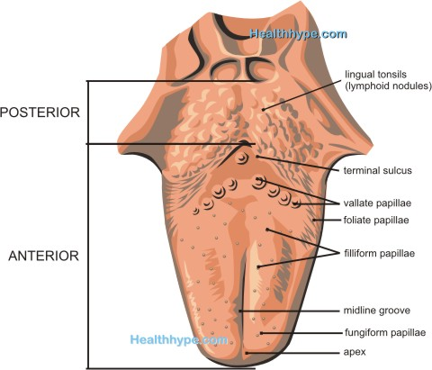
The Tongue
The tongue is a mass of striated muscle covered with mucous membrane
The muscles attach the tongue to the styloid process and the soft palate above and to the mandible and the hyoid bone below
The tongue is divided into right and left halves by a median fibrous septum.

Slide 11
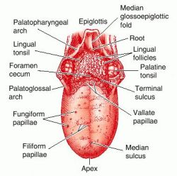
Mucous Membrane of the Tongue
The mucous membrane of the upper surface of the tongue can be divided into anterior and posterior parts by a V-shaped sulcus, the sulcus terminalis
The apex of the sulcus projects backward and is marked by a small pit, the foramen cecum
The apex of the sulcus projects backward and is marked by a small pit, the foramen cecum
the foramen cecum is an embryologic remnant and marks the site of the upper end of the thyroglossal duct

Slide 12
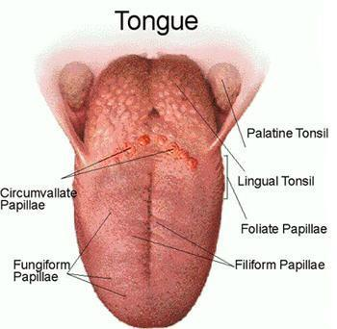
Three types of papillae are present on the upper surface of the anterior two thirds of the tongue: the filiform papillae, the fungiform papillae, and the vallate papillae.
The mucous membrane covering the posterior third of the tongue is devoid of papillae but has an irregular surface caused by the presence of underlying lymph nodules, the lingual tonsil.
The mucous membrane on the inferior surface of the tongue is reflected from the tongue to the floor of the mouth
In the midline anteriorly, the undersurface of the tongue is connected to the floor of the mouth by a fold of mucous membrane, the frenulum of the tongue
On the lateral side of the frenulum, the deep lingual vein can be seen through the mucous membrane
Lateral to the lingual vein, the mucous membrane forms a fringed fold called the plica fimbriata

Slide 13
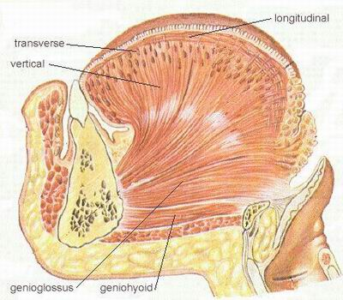
Muscles of the Tongue
The muscles of the tongue are divided into two types: intrinsic and extrinsic
Intrinsic Muscles
These muscles are confined to the tongue and are not attached to bone.
They consist of longitudinal, transverse, and vertical fibers.
Nerve supply: Hypoglossal nerve
Action: Alter the shape of the tongue

Slide 14
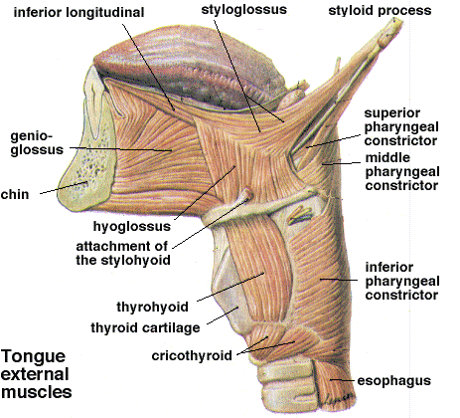
Extrinsic Muscles
These muscles are attached to bones and the soft palate
They are the genioglossus (Superior genial spine of mandible), Protrudes apex of tongue through mouth
the hyoglossus (Body and greater cornu of hyoid bone), Depresses tongue
the styloglossus (Styloid process of temporal bone), Draws tongue upward and backward
and the palatoglossus (Palatine aponeurosis), Pulls roots of tongue upward and backward, narrows oropharyngeal isthmus
Insertion : Blends with eachother, the palatoglossus inserts at Side of tongue
Nerve supply: Hypoglossal nerve

Slide 15
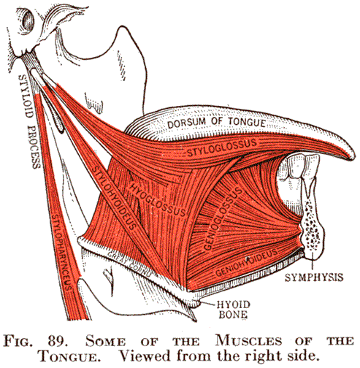
Movements of the Tongue
Protrusion: The genioglossus muscles on both sides acting together
Retraction: Styloglossus and hyoglossus muscles on both sides acting together
Depression: Hyoglossus muscles on both sides acting together
Retraction and elevation of the posterior third: Styloglossus and palatoglossus muscles on both sides acting together
Shape changes: Intrinsic muscles

Slide 16
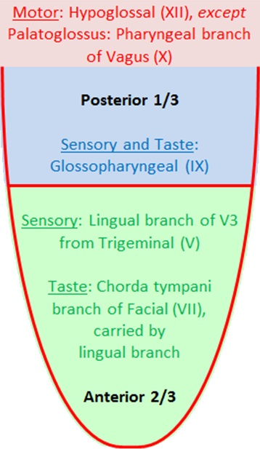
Sensory Innervation
Anterior two thirds: Lingual nerve branch of mandibular division of trigeminal nerve (general sensation) and chorda tympani branch of the facial nerve (taste)
Posterior third: Glossopharyngeal nerve (general sensation and taste)
Blood Supply
The lingual artery, the tonsillar branch of the facial artery, and the ascending pharyngeal artery supply the tongue
The veins drain into the internal jugular vein.
Lymph Drainage
Tip: Submental lymph nodes
Sides of the anterior two thirds: Submandibular and deep cervical lymph nodes
Posterior third: Deep cervical lymph nodes

Slide 17
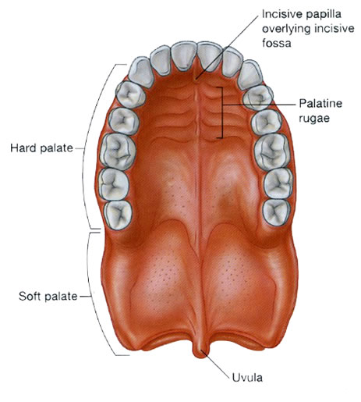
The Palate
The palate forms the roof of the mouth and the floor of the nasal cavity.
It is divided into two parts: the hard palate in front and the soft palate behind.
Hard Palate
The hard palate is formed by the palatine processes of the maxillae and the horizontal plates of the palatine bones
It is continuous behind with the soft palate.
Soft Palate
The soft palate is a mobile fold attached to the posterior border of the hard palate
Its free posterior border presents in the midline a conical projection called the uvula.
The soft palate is continuous at the sides with the lateral wall of the pharynx
The soft palate is composed of mucous membrane, palatine aponeurosis, and muscles.

Slide 18
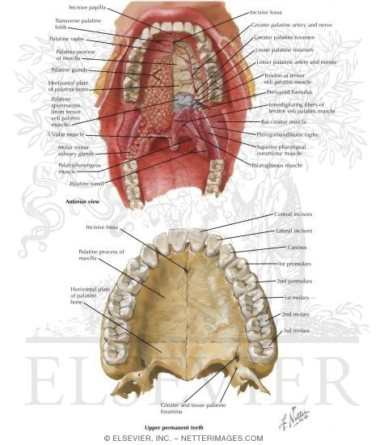
The mucous membrane covers the upper and lower surfaces of the soft palate.
The palatine aponeurosis is a fibrous sheet attached to the posterior border of the hard palate
It is the expanded tendon of the tensor veli palatini muscle.

Slide 19
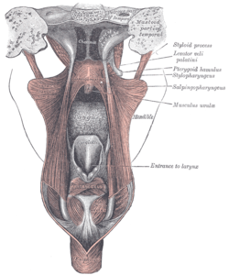
Muscles of the Soft Palate
The muscles of the soft palate are the tensor veli palatini, the levator veli palatini, the palatoglossus, the palatopharyngeus, and the musculus uvulae
The muscle fibers of the tensor veli palatini converge as they descend from their origin to form a narrow tendon, which turns medially around the pterygoid hamulus
The tendon, together with the tendon of the opposite side, expands to form the palatine aponeurosis
When the muscles of the two sides contract, the soft palate is tightened so that the soft palate may be moved upward or downward as a tense sheet.

Slide 20
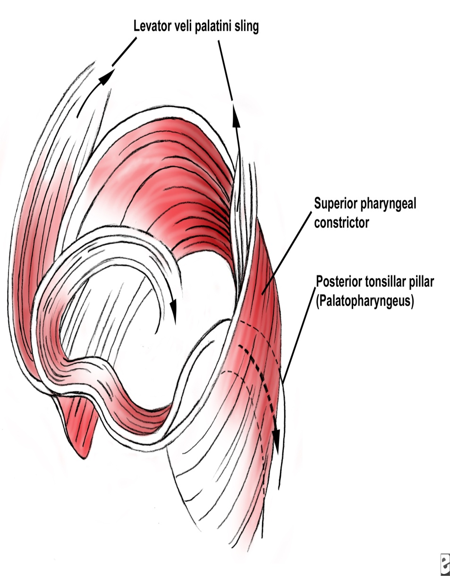
Levator veli palatini :
O: Petrous part of temporal bone, auditory tube
I: Palatine aponeurosis
Innerv.: Pharyngeal plexus
Action: Raises soft palate
Tensor veli palatini
Spine of sphenoid, auditory tube
With muscle of other side, forms palatine aponeurosis
Nerve to medial pterygoid from mandibular nerve
Tenses soft palate

Slide 21
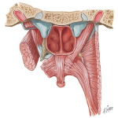
Palatopharyngeus
Palatine aponeurosis
Posterior border of thyroid cartilage
Pharyngeal plexus
Elevates wall of pharynx, pulls palatopharyngeal folds medially
Musculus uvulae
Posterior border of hard palate
Mucous membrane of uvula
Pharyngeal plexus
Elevates uvula

Slide 22
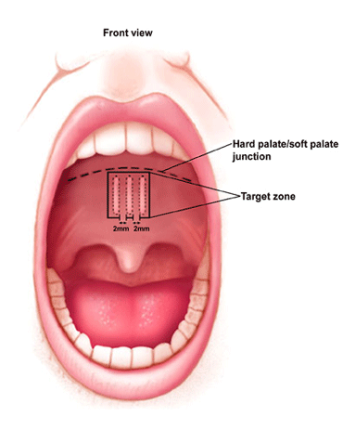
Movements of the Soft Palate
The pharyngeal isthmus (the communicating channel between the nasal and oral parts of the pharynx) is closed by raising the soft palate.
Closure occurs during the production of explosive consonants in speech.
The soft palate is raised by the contraction of the levator veli palatini on each side.
At the same time, the upper fibers of the superior constrictor muscle contract and pull the posterior pharyngeal wall forward
The palatopharyngeus muscles on both sides also contract so that the palatopharyngeal arches are pulled medially, like side curtains
By this means the nasal part of the pharynx is closed off from the oral part.

Slide 23
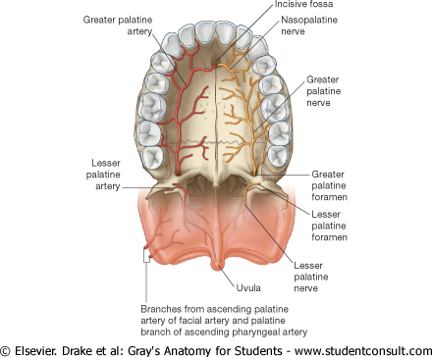
Nerve Supply of the Palate
The greater and lesser palatine nerves from the maxillary division of the trigeminal nerve enter the palate through the greater and lesser palatine foramina
The nasopalatine nerve, also a branch of the maxillary nerve, enters the front of the hard palate through the incisive foramen.
The glossopharyngeal nerve also supplies the soft palate
Blood Supply of the Palate
The greater palatine branch of the maxillary artery, the ascending palatine branch of the facial artery, and the ascending pharyngeal artery
Lymph Drainage of the Palate
Deep Cervical Lymph Nodes

Slide 24
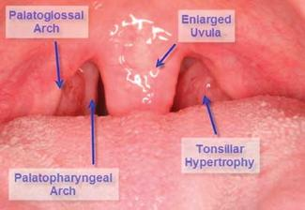
The palatoglossal arch is a fold of mucous membrane containing the palatoglossus muscle, which extends from the soft palate to the side of the tongue
The palatoglossal arch marks where the mouth becomes the pharynx.
The palatopharyngeal arch is a fold of mucous membrane behind the palatoglossal arch
runs downward and laterally to join the pharyngeal wall.
The muscle contained within the fold is the palatopharyngeus muscle.
The palatine tonsils, which are masses of lymphoid tissue, are located between the palatoglossal and palatopharyngeal arches

Slide 25
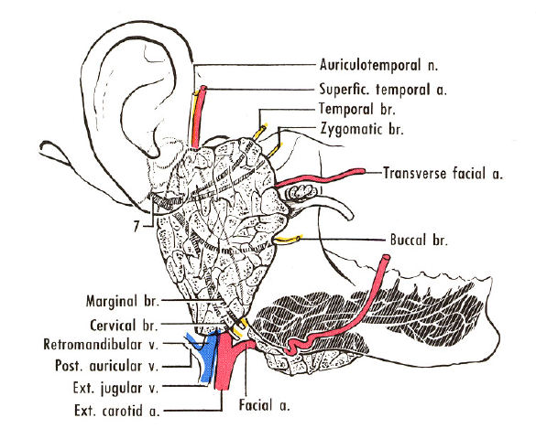
The Salivary Glands
Parotid Gland
The parotid gland is the largest salivary gland and is composed mostly of serous acini
lies in a deep hollow below the external auditory meatus, behind the ramus of the mandible and in front of the sternocleidomastoid muscle
The facial nerve divides the gland into superficial and deep lobes
The parotid duct emerges from the anterior border of the gland and passes forward over the lateral surface of the masseter.
It enters the vestibule of the mouth upon a small papilla opposite the upper second molar tooth
Parasympathetic secretomotor supply arises from the glossopharyngeal nerve
The nerves reach the gland via the tympanic branch, the lesser petrosal nerve, the otic ganglion, and the auriculotemporal nerve.

Slide 26
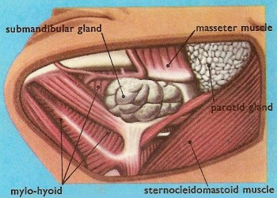
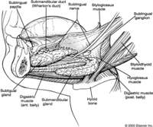
Submandibular Gland
The submandibular gland consists of a mixture of serous and mucous acini
It lies beneath the lower border of the body of the mandible
divided into superficial and deep parts by the mylohyoid muscle
The deep part of the gland lies beneath the mucous membrane of the mouth on the side of the tongue.
The submandibular duct emerges from the anterior end of the deep part of the gland and runs forward beneath the mucous membrane of the mouth.
It opens into the mouth on a small papilla, which is situated at the side of the frenulum of the tongue
Parasympathetic secretomotor supply is from the facial nerve via the chorda tympani, and the submandibular ganglion
The postganglionic fibers pass directly to the gland.

Slide 27
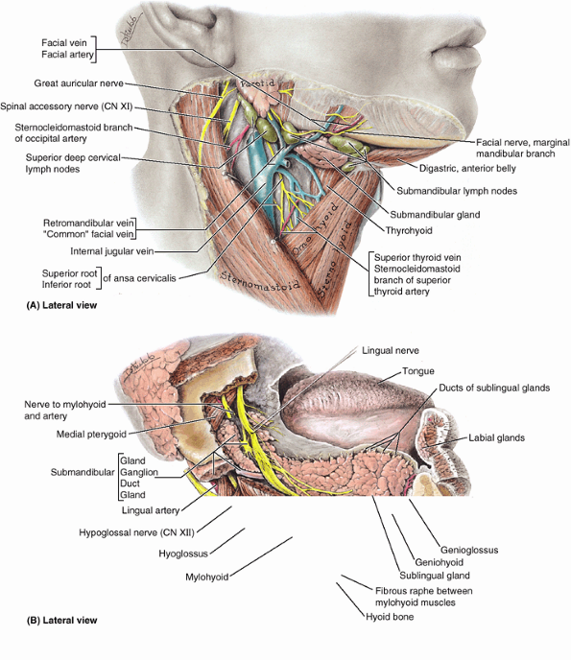
Anatomical relations
Parotid
Lies in the parotid bed that is formed by:
the sternocleidomastoid muscle behind;
the ramus of mandible in front;
superiorly, the base of the trench is formed by the external acoustic meatus and the posterior aspect of the zygomatic arch.
The parotid duct passes anteriorly across the external surface of the masseter muscle and then turns medially to penetrate the buccinator muscle of the cheek and open into the oral cavity adjacent to the crown of the second upper molar tooth
The parotid gland encloses the external carotid artery, the retromandibular vein, and the origin of the extracranial part of the facial nerve [VII].

Slide 28
Submandibular gland
the larger arm of the hook is directed forward in the horizontal plane below the mylohyoid muscle and is therefore outside the boundaries of the oral cavity-this larger superficial part of the gland is directly against a shallow impression on the medial side of the mandible (submandibular fossa) inferior to the mylohyoid line;
the smaller arm of the hook (or deep part) of the gland loops around the posterior margin of the mylohyoid muscle to enter and lie within the floor of the oral cavity where it is lateral to the root of the tongue on the lateral surface of the hyoglossus muscle.
The lingual nerve loops under the submandibular duct, crossing first the lateral side and then the medial side of the duct, as the nerve descends anteromedially through the floor of the oral cavity and then ascends into the tongue.

Slide 29
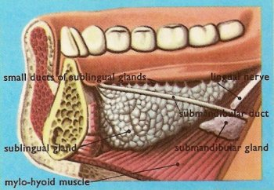
Sublingual Gland
The sublingual gland lies beneath the mucous membrane (sublingual fold) of the floor of the mouth, close to the frenulum of the tongue
It has both serous and mucous acini, with the latter predominating.
The sublingual ducts (8 to 20 in number) open into the mouth on the summit of the sublingual fold
Parasympathetic secretomotor supply is from the facial nerve via the chorda tympani, and the submandibular ganglion. Postganglionic fibers pass directly to the gland.

Slide 30
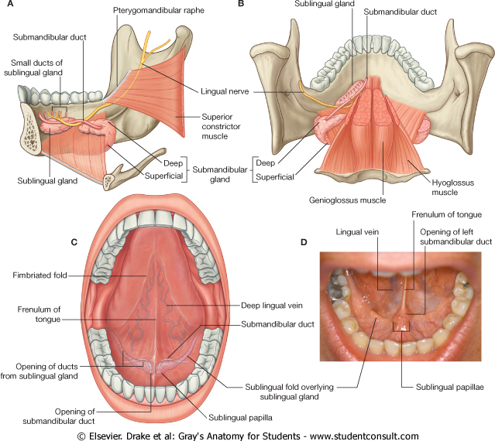
Sublingual and submandibular gland

Slide 31
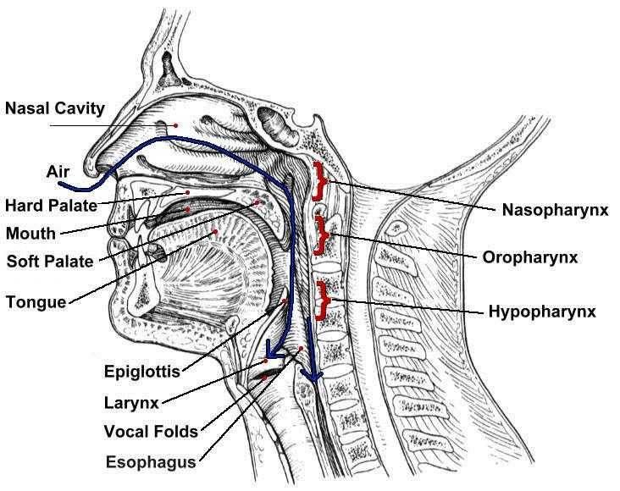
The Pharynx
The pharynx is situated behind the nasal cavities, the mouth, and the larynx
and may be divided into nasal, oral, and laryngeal parts
The pharynx is funnel shaped, its upper, wider end lying under the skull and its lower, narrow end becoming continuous with the esophagus opposite the sixth cervical vertebra
The pharynx has a musculomembranous wall, which is deficient anteriorly.
Here, it is replaced by the posterior openings into the nose (choanae), the opening into the mouth, and the inlet of the larynx.
By means of the auditory tube, the mucous membrane is also continuous with that of the tympanic cavity.

Slide 32
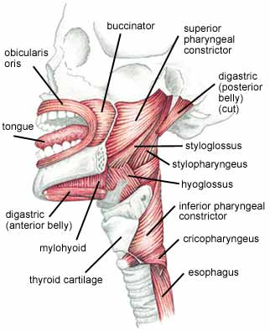
Muscles of the Pharynx
The muscles in the wall of the pharynx consist of the superior, middle, and inferior constrictor muscles
whose fibers run in a somewhat circular direction, and the stylopharyngeus and salpingopharyngeus muscles, whose fibers run in a somewhat longitudinal direction.
The three constrictor muscles extend around the pharyngeal wall to be inserted into a fibrous band or raphe that extends from the pharyngeal tubercle on the basilar part of the occipital bone of the skull down to the esophagus
The three constrictor muscles overlap each other so that the middle constrictor lies on the outside of the lower part of the superior constrictor and the inferior constrictor lies outside the lower part of the middle constrictor

Slide 33
The lower part of the inferior constrictor, which arises from the cricoid cartilage, is called the cricopharyngeus muscle
The fibers of the cricopharyngeus pass horizontally around the lowest and narrowest part of the pharynx and act as a sphincter
Killian's dehiscence is the area on the posterior pharyngeal wall between the upper propulsive part of the inferior constrictor and the lower sphincteric part, the cricopharyngeus.

Slide 34
Muscles of the Pharynx
Superior constrictor
O: Medial pterygoid plate, pterygoid hamulus, pterygomandibular ligament, mylohyoid line of mandible
Ins: Pharyngeal tubercle of occipital bone, raphe in midline posteriorly
Inerrv: Pharyngeal plexus
Aids soft palate in closing off nasal pharynx, propels bolus downward

Slide 35
Middle constrictor
Lower part of stylohyoid ligament, lesser and greater cornu of hyoid bone
Pharyngeal raphe
Pharyngeal plexus
Propels bolus downward

Slide 36
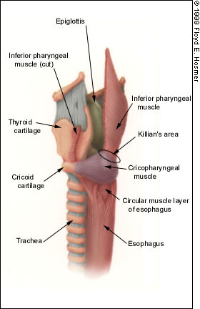
Inferior constrictor
Lamina of thyroid cartilage, cricoid cartilage
Pharyngeal raphe
Pharyngeal plexus
Propels bolus downward
Cricopharyngeus
Lowest fibers of inferior constrictor muscle
Sphincter at lower end of pharynx
Stylopharyngeus
Styloid process of temporal bone
Posterior border of thyroid cartilage
Glossopharyngeal nerve
Elevates larynx during swallowing

Slide 37
Salpingopharyngeus
Auditory tube
Blends with palatopharyngeus
Pharyngeal plexus
Elevates pharynx
Palatopharyngeus
Palatine aponeurosis
Posterior border of thyroid cartilage
Pharyngeal plexus
Elevates wall of pharynx, pulls palatopharyngeal arch medially

Slide 38
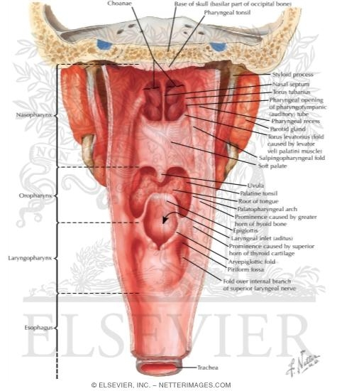
Interior of the Pharynx
The pharynx is divided into three parts: the nasal pharynx, the oral pharynx, and the laryngeal pharynx.
Nasal Pharynx
This lies above the soft palate and behind the nasal cavities
In the submucosa of the roof is a collection of lymphoid tissue called the pharyngeal tonsil
The pharyngeal isthmus is the opening in the floor between the soft palate and the posterior pharyngeal wall
On the lateral wall is the opening of the auditory tube, the elevated ridge of which is called the tubal elevation
The pharyngeal recess is a depression in the pharyngeal wall behind the tubal elevation
The salpingopharyngeal fold is a vertical fold of mucous membrane covering the salpingopharyngeus muscle.

Slide 39
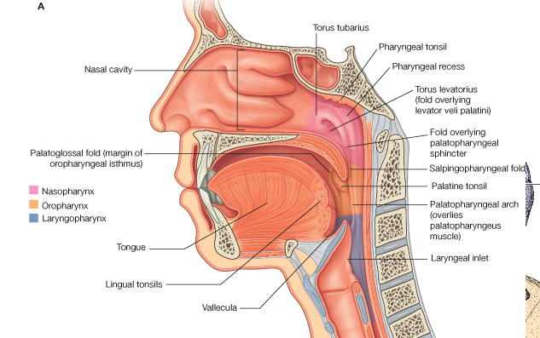
Oral Pharynx
This lies behind the oral cavity
The floor is formed by the posterior one third of the tongue and the interval between the tongue and epiglottis
In the midline is the median glossoepiglottic fold
and on each side the lateral glossoepiglottic fold.
The depression on each side of the median glossoepiglottic fold is called the vallecula
On the lateral wall on each side are the palatoglossal and the palatopharyngeal arches or folds and the palatine tonsils between them
interval between the two palatoglossal arches is called the oropharyngeal isthmus and marks the boundary between the mouth and pharynx.

Slide 40
Laryngeal Pharynx
This lies behind the opening into the larynx
The lateral wall is formed by the thyroid cartilage and the thyrohyoid membrane
The piriform fossa is a depression in the mucous membrane on each side of the laryngeal inlet

Slide 41
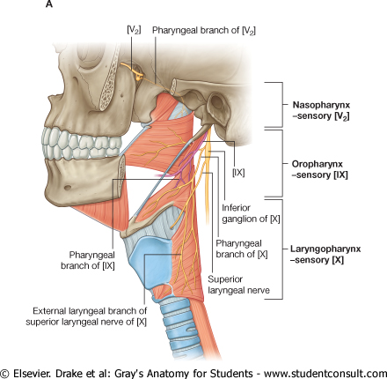
Sensory Nerve Supply of the Pharyngeal Mucous Membrane
Nasal pharynx: The maxillary nerve (V2)
Oral pharynx: The glossopharyngeal nerve
Laryngeal pharynx (around the entrance into the larynx): The internal laryngeal branch of the vagus nerve
Blood Supply of the Pharynx
Ascending pharyngeal, tonsillar branches of facial arteries, and branches of maxillary and lingual arteries
Lymph Drainage of the Pharynx
Directly into the deep cervical lymph nodes or indirectly via the retropharyngeal or paratracheal nodes into the deep cervical nodes

Slide 42
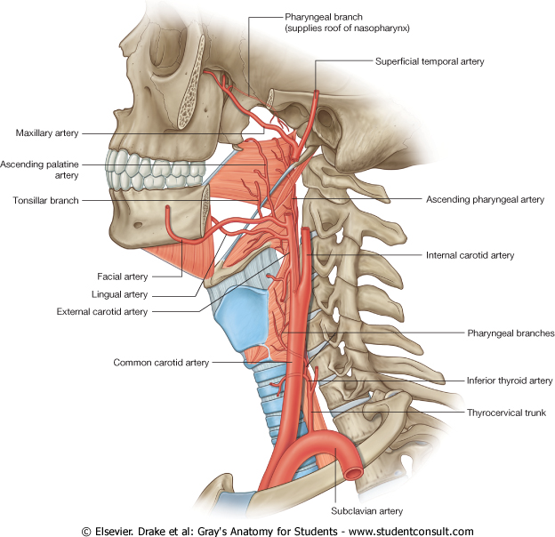

Slide 43
The Process of Swallowing (Deglutition)
Masticated food is formed into a ball or bolus on the dorsum of the tongue and voluntarily pushed upward and backward against the undersurface of the hard palate
This is brought about by the contraction of the styloglossus muscles on both sides, which pull the root of the tongue upward and backward
The palatoglossus muscles then squeeze the bolus backward into the pharynx.
From this point onward the process of swallowing becomes an involuntary act.
The nasal part of the pharynx is now shut off from the oral part of the pharynx by the elevation of the soft palate
the pulling forward of the posterior wall of the pharynx by the upper fibers of the superior constrictor muscle, and the contraction of the palatopharyngeus muscles. This prevents the passage of food and drink into the nasal cavities.

Slide 44
The larynx and the laryngeal part of the pharynx are pulled upward by the contraction of the stylopharyngeus, salpingopharyngeus, thyrohyoid, and palatopharyngeus muscles
The main part of the larynx is thus elevated to the posterior surface of the epiglottis, and the entrance into the larynx is closed
The laryngeal entrance is made smaller by the approximation of the aryepiglottic folds, and the arytenoid cartilages are pulled forward by the contraction of the aryepiglottic, oblique arytenoid, and thyroarytenoid muscles.
The bolus moves downward over the epiglottis, the closed entrance into the larynx, and reaches the lower part of the pharynx as the result of the successive contraction of the superior, middle, and inferior constrictor muscles
Some of the food slides down the groove on either side of the entrance into the larynx, that is, down through the piriform fossae
Finally, the lower part of the pharyngeal wall (the cricopharyngeus muscle) relaxes and the bolus enters the esophagus.

Slide 45
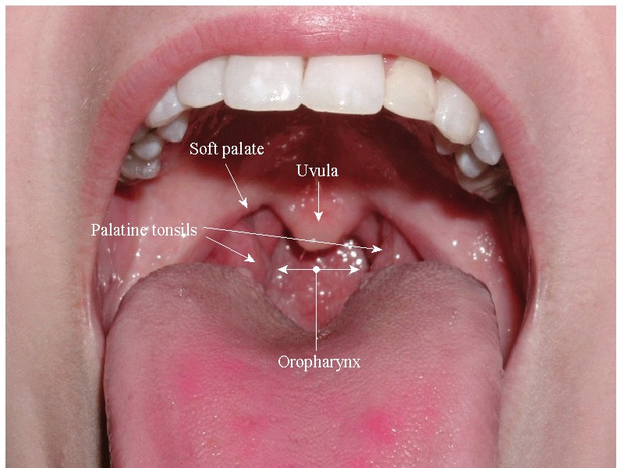
Palatine Tonsils
The palatine tonsils are two masses of lymphoid tissue, each located in the depression on the lateral wall of the oral part of the pharynx between the palatoglossal and palatopharyngeal arches
Each tonsil is covered by mucous membrane, and its free medial surface projects into the pharynx
The surface is pitted by numerous small openings that lead into the tonsillar crypts.
The tonsil is covered on its lateral surface by a fibrous capsule
The capsule is separated from the superior constrictor muscle by loose areolar tissue
and the external palatine vein descends from the soft palate in this tissue to join the pharyngeal venous plexus
Lateral to the superior constrictor muscle lie the styloglossus muscle, the loop of the facial artery, and the internal carotid artery.
The tonsil reaches its maximum size during early childhood, but after puberty it diminishes considerably in size.

Slide 46
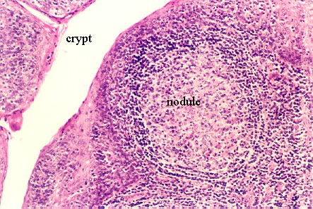
Blood Supply
The tonsillar branch of the facial artery. The veins pierce the superior constrictor muscle and join the external palatine, the pharyngeal, or the facial veins.
Lymph Drainage of the Tonsil
The upper deep cervical lymph nodes, just below and behind the angle of the mandible

Slide 47
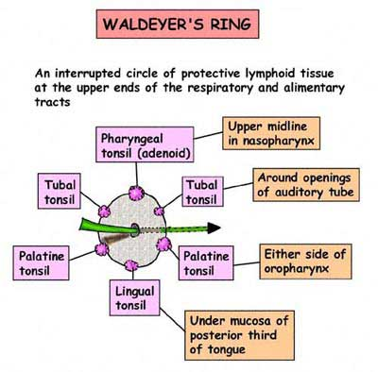
Waldeyer's Ring of Lymphoid Tissue
The lymphoid tissue that surrounds the opening into the respiratory and digestive systems forms a ring
The lateral part of the ring is formed by the palatine tonsils and tubal tonsils (lymphoid tissue around the opening of the auditory tube in the lateral wall of the nasopharynx)
The pharyngeal tonsil in the roof of the nasopharynx forms the upper part, and the lingual tonsil on the posterior third of the tongue forms the lower part.

