Slide 2
Anatomy of the lower limbs
a.shatarat@ju.edu.jo
By
Dr. Amjad Shatarat
د.امجد الشطرات

Slide 3
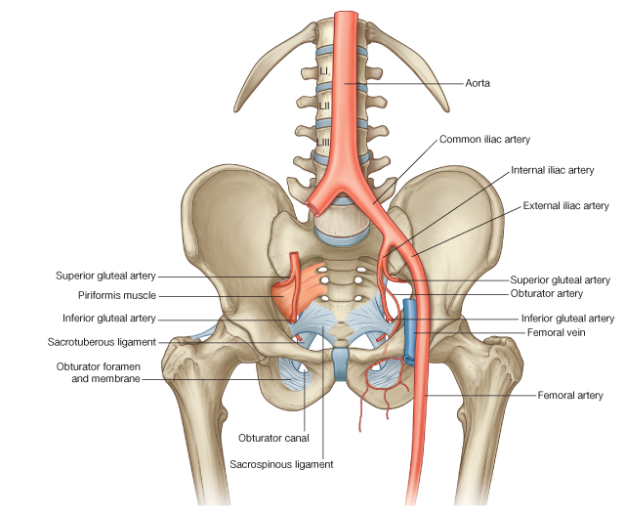
Blood supply of the lower limbs
1-The abdominal aorta divides at the level of L4 into Right and left common iliac arteries
2- Each common iliac artery divides into external and internal iliac arteries
3- The external iliac artery becomes the femoral artery
( as it passes behind the inguinal ligament) which will be
the main blood supply to the whole lower limb
4- The internal iliac artery shares in the blood supply of the lower limb through its branches, for example, the superior and inferior gluteal arteries and obturator artery (to be discussed later)

Slide 4
5- THE FEMORAL ARTERY (to be discussed later)
begins midinguinal point and ends
at the opining in the adductor magnus where it becomes
THE POPLITEAL ARTERY
6- The popliteal artery
Ends at the lower border of the popliteus muscle
by dividing into
ANTERIOR AND POSTERIOR TIBIAL ARTERIES
7- The anterior tibial artery supplies
the anterior compartment of the leg and terminates
in front of the ankle joint by becoming
THE DORSALIS PEDIS ARTERY
8-The posterior tibial artery supplies the posterior
and the lateral compartments of the leg
ends deep to the flexor retinaculum by dividing
Into
MEDIAL AND LATERAL PLANTER ARTERIES
which supply the sole

Slide 5
Nerves of the lower limb
Lumber plexus

Slide 6
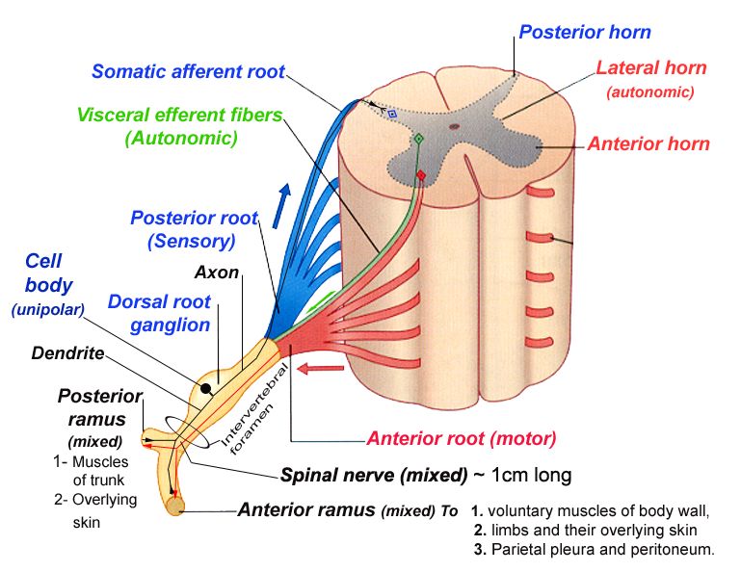
The structure of the spinal nerves
Quick reminder

Slide 7
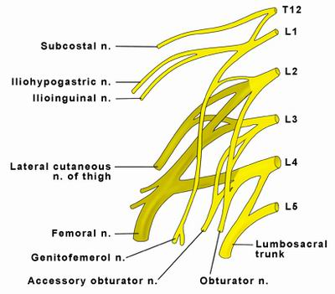
The lumber plexus
Is formed by
the anterior primary rami of the upper four lumber nerves
in the substance of psoas major muscle
what about the posterior?
It also receives a contribution from T12 (subcostal) nerve
4 small nerves ?+2 main nerves ?
Ilio-hypogastric
Ilio-inguinal
Genitofemoral
Lateral cutaneous nerve of the thigh
Femoral
Obturator

Slide 8
L1 gives
1- Ilio-hypogastric nerve
2- Ilio-inguinal
3- The first root of the genito-femoral
What is the key to memorize the lumber plexus?
L2 gives (four branches)
1- The second root of the genito-femoral
2-The first root of the lateral cutaneous nerve of the thigh
3- The first root of the femoral nerve
4- The first root of the obturator nerve
L3 gives
1-The second root of the lateral cutaneous nerve
of the thigh
1-The second root of the femoral nerve
2-The second root of the obturator nerve
L4 gives
1- The third root of the femoral nerve
2- The third root of the obturator nerve
3- The upper root of the lumbo-sacral trunk

Slide 9
Each nerve of the lumber plexus emerges ( exits) from the substance of the psoas major muscle as flows:
Genitofemoral nerve from the anterior surface.
Obturator nerve and lumbosacral trunk from the medial side.
The Iliohypogastric
The Ilioinguinal
The Lateral cutaneous nerve of the thigh
Femoral nerve
exit from the lateral side of the psoas major muscle
lumbosacral trunk
Obturator nerve

Slide 10
The ilio-hypogastric and ilio-inguinal nerves arise as a single trunk from the anterior ramus of L1
Pay attention to this during practicals
Either before or soon after emerging from the lateral border of the psoas major muscle, this single trunk divides into:
the ilio-hypogastric and the ilio-inguinal nerves
:Note
1- The iliohypogastric nerve is larger than the ilio-inguinal nerve
2-The iliohypogastric nerve runs superior to the ilio-inguinal nerve

Slide 11
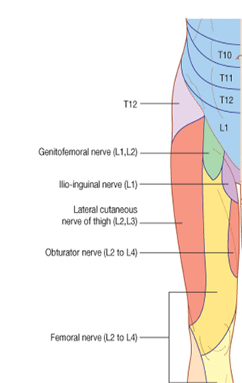
Iliohypogastric nerve
Iliohypogastric nerve
supplies the posterolateral gluteal skin and
just above the superficial inguinal ring, after piercing the aponeurosis of the external oblique, it distributes to the skin in the pubic region

Slide 12
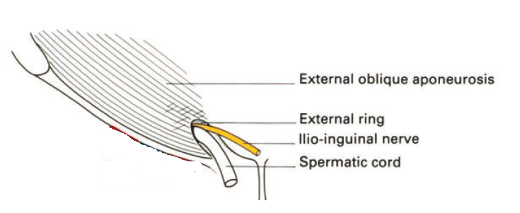
The surgeon should be very careful to the Ilio-inguinal nerve while giving incision and hernia repair as it could be injured during these procedures
Ilio-inguinal nerve
Ilio-inguinal nerve
enters the inguinal canal
Then emerges through the superficial inguinal ring, along with the spermatic cord, and provides cutaneous innervation to the upper medial thigh, the root of the penis, and the anterior surface of the scrotum in men, or the mons pubis and labium majus in women

Slide 13
The distance between L1 spinal segment of the spinal cord
and the pubic region that is supplied by its branches is too long.
How you explain this?

Slide 14
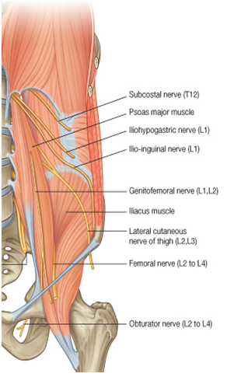
Genitofemoral nerve
Genitofemoral nerve
(L1 and L2)
The genitofemoral nerve arises from the anterior rami of the nerves of L1 and L2
emerges on the anterior surface of psoas major.
It eventually divides into
genital and femoral branches.

Slide 15
The femoral branch descends on the lateral side of the external iliac artery and passes posterior to the inguinal ligament, entering the femoral sheath lateral to the femoral artery. It pierces the anterior layer of the femoral sheath and the fascia lata to supply the skin of the upper anterior thigh
The genital branch continues downward and enters the inguinal canal through the deep inguinal ring.
It continues through the canal and:
in men, innervates the cremasteric muscle and terminates on the skin in the upper anterior part of the scrotum;
in women, accompanies the round ligament of the uterus and terminates on the skin of the mons pubis and labium majus.

Slide 16
Lateral cutaneous nerve of thigh (L2 and L3)
The lateral cutaneous nerve of thigh arises from the anterior rami of nerves L2 and L3
It emerges from the lateral border of the psoas major muscle
It passes posterior to the inguinal ligament and enters the thigh.
The lateral cutaneous nerve of thigh supplies the skin on the anterior and lateral thigh to the level of the knee
Clinical application
Intrapelvic: causes include pregnancy, abdominal tumors
extrapelvic: causes include trauma to the region of the ASIS (eg, from a seatbelt in a motor vehicle accident), tight garments, belts, girdles, or stretch from obesity
Mechanical :factors include prolonged sitting or standing.
Diabetes can also cause this neuropathy in isolation or in the clinical setting of a polyneuropathy
Injury of this nerve
Graft for bone marrow

Slide 17
Now you should be
able to name the nerves
and the areas that they supply

Slide 18
Sacral plexus

Slide 19
The sacral plexus is formed by the union of lumbosacral trunk and anterior primary rami of the S1, S2, S3 and the upper part of S4 in the pelvis in front of sacrum
The lumbosacral trunk is a thick nerve formed by the union of lower part of anterior primary ramus of L4 ( nervus furcalis ?) with the anterior primary ramus of L5
3-
4-
7- Sciatic nerve
6-Pudendal nerve
1-
2-
5-

Slide 20
Thank you

